Slide 1
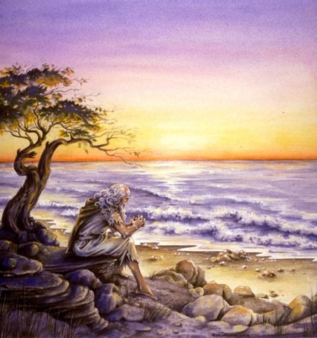
The Book of 1 John
To Download this lesson go to:
http://www.purifiedbyfaith.com/1John/1John.htm
https://revelationillustrated.com/

Slide 2
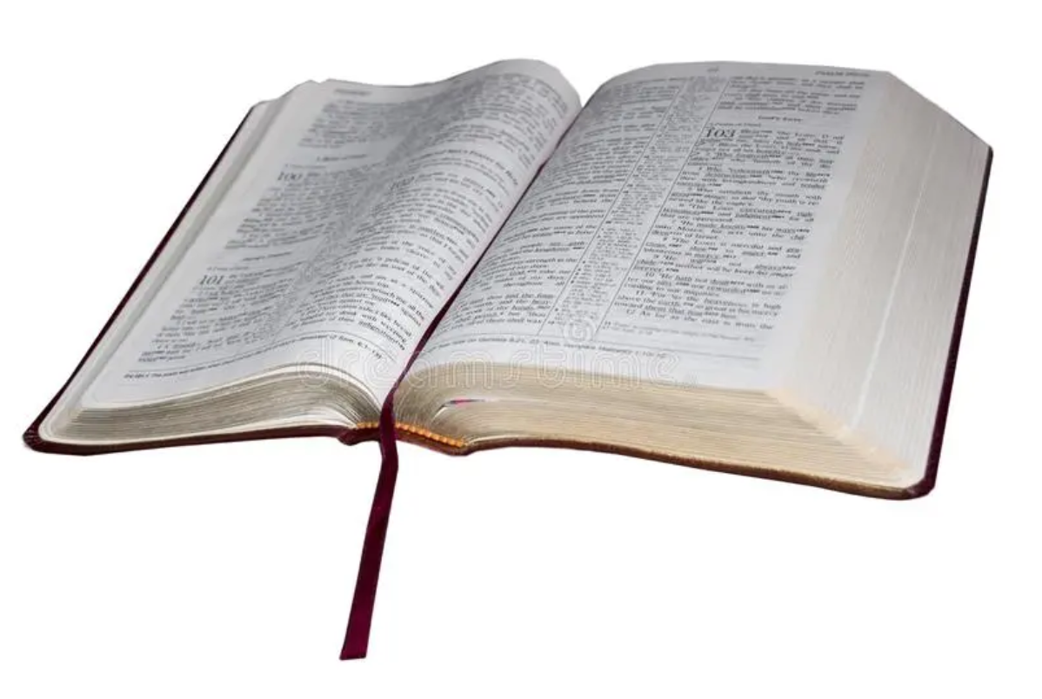
1 John 1:5 – 2:28
The First Presentation of the Three Themes of RIGHTEOUSNESS, LOVE and BELIEF in Jesus
To Download this lesson go to:
http://www.purifiedbyfaith.com/1John/1John.htm
http://ullesthorpe.org/bible-owner/

Slide 3

Outline of 1 John
1:1-4 - Prologue: John Introduces the Major Theme of the Letter - FELLOWSHIP WITH GOD
1:5-2:28 - The First Presentation of the Three Themes of RIGHTEOUSNESS, LOVE and BELIEF in Jesus
2:29-4:6 -The Second Presentation of the Three Themes of RIGHTEOUSNESS, LOVE and BELIEF in Jesus
4:7-5:21 - The Third Presentation of the Three Themes of RIGHTEOUSNESS, LOVE and BELIEF in Jesus
Robert Law, The Tests of Life, Third Edition, 1914, p.21-24

Slide 4
Outline of 1 John
1:1-4 - Prologue: John Introduces the Major Theme of the Letter - FELLOWSHIP WITH GOD
1:5-2:28 - The First Presentation of the Three Themes of RIGHTEOUSNESS, LOVE and BELIEF in Jesus
2:29-4:6 -The Second Presentation of the Three Themes of RIGHTEOUSNESS, LOVE and BELIEF in Jesus
4:7-5:21 - The Third Presentation of the Three Themes of RIGHTEOUSNESS, LOVE and BELIEF in Jesus
Robert Law, The Tests of Life, Third Edition, 1914, p.21-24

Slide 5
1 John 1:5-7
Walking in the Light
⁵ This is the message we have heard from him and proclaim to you, that God is light, and in him is no darkness at all. ⁶ If we say we have fellowship with him while we walk in darkness, we lie and do not practice the truth. ⁷ But if we walk in the light, as he is in the light, we have fellowship with one another, and the blood of Jesus his Son cleanses us from all sin.

Slide 6
In verse 5, John identifies the fundamental message which he, along with the other apostles, had received from Jesus Christ and were proclaiming, namely that God is light, and in him is no darkness at all.
⁵ This is the message we have heard from him and proclaim to you, that God is light, and in him is no darkness at all. ⁶ If we say we have fellowship with him while we walk in darkness, we lie and do not practice the truth. ⁷ But if we walk in the light, as he is in the light, we have fellowship with one another, and the blood of Jesus his Son cleanses us from all sin.
(1 John 1:5-7)

Slide 7
God is Light
When I hear John saying “God is light”, one of the first things that come to my mind is the number of times God is accompanied by radiant light when He makes an appearance in scripture:
  Ezekiel 1:27b-28a - I saw as it were the appearance of fire, and there was brightness around him… Such was the appearance of the likeness of the glory of the LORD.
  Matthew 17:2 - And [Jesus] was transfigured before them, and his face shone like the sun, and his clothes became white as light.
  Acts 9:3 - Now as [Paul] went on his way, he approached Damascus, and suddenly a light from heaven flashed around him.
  Revelation 1:14-16 - The hairs of his head were white, like white wool, like snow. His eyes were like a flame of fire, his feet were like burnished bronze, refined in a furnace… his face was like the sun shining in full strength.
Paul tells us in 1 Timothy 6:16 that God “dwells in unapproachable light”

Slide 8
God is Light
Although light often accompanies the appearance of God in scripture, in this passage John is actually equating God to light.
The statement, “God is light” is one of only four statements in the Bible where God is equated to something:
  John 4:24 – God is spirit
  1 John 1:5 – God is light
  1 John 4:8,16 – God is love
  Hebrews 12:29 – God is a consuming fire
When John says “God is light”, he is not just saying:
  God is the source of light
  God dwells in light
John is equating light to God’s very nature
What does John mean when he tells is that “God is light, and in him is no darkness at all”?

Slide 9
Light and Darkness
The terms “light” and “darkness” are often used metaphorically in the Bible.
One of the metaphorical uses of light and darkness in scripture is to represent the idea of good versus evil:
  Isaiah 5:20 –Woe to those who call evil good and good evil, who put darkness for light and light for darkness
  2 Corinthians 6:14b –For what partnership has righteousness with lawlessness? Or what fellowship has light with darkness?
The terms “light” and “darkness” are also used metaphorically in the Bible to represent the revelation of God’s truth in contrast to ignorance or falsehood.
  Psalm 119:105 – [God’s] word is a lamp to my feet and a light to my path.
  2 Peter 1:19a – And we have something more sure, the prophetic word, to which you will do well to pay attention as to a lamp shining in a dark place

Slide 10
Light and Darkness
So let’s apply these two metaphorical uses of light and darkness to what John is saying in 1 John 1:5:
  Good and Evil: God is light [good], and in him is no darkness [evil] at all.
  Truth and Falsehood: God is light [truth], and in him is no darkness [falsehood] at all.
Put these things together and we see that the God we serve is the embodiment of goodness and truth and God is pure – there is not the least hint of evil or falsehood in God.
If we are thinking as we ought to think, John’s declaration about God should strike within us a sense of worship and reverent fear – because the next thing John does in this passage is point out the implication of God’s character for those (like ourselves) who are claiming to have “fellowship” with this pure and holy God!

Slide 11
John tells that if we say we have fellowship with (that we share in, have partnership with, are in close relationship with) God, but “walk in darkness”, (i.e., we live our lives in such a way as to ignore or deny God’s truth) then our claim to have fellowship with God is a lie (because there is no falsehood in God at all) and we are not living in obedience to God’s truth!
⁵ This is the message we have heard from him and proclaim to you, that God is light, and in him is no darkness at all. ⁶ If we say we have fellowship with him while we walk in darkness, we lie and do not practice the truth. ⁷ But if we walk in the light, as he is in the light, we have fellowship with one another, and the blood of Jesus his Son cleanses us from all sin.
(1 John 1:5-7)

Slide 12
But if we “walk in the light”, i.e. conform our thinking and conduct to the truth of God’s Word (as He is true to Himself) then two benefits result:
We have fellowship (share common benefits, are in partnership) with other Christians.
The blood of Christ cleanses us from all sin.
⁵ This is the message we have heard from him and proclaim to you, that God is light, and in him is no darkness at all. ⁶ If we say we have fellowship with him while we walk in darkness, we lie and do not practice the truth. ⁷ But if we walk in the light, as he is in the light, we have fellowship with one another, and the blood of Jesus his Son cleanses us from all sin.
(1 John 1:5-7)

Slide 13
The Blood of Christ
The “blood of Christ” here which “cleanses us from all sin” does not mean that the physical substance that flowed through Jesus’ veins was somehow used by God to cleanse us from sin, but rather, the term “blood of Christ” is a metonymy that refers to the violent sacrificial death which Jesus died in order to pay the penalty for the sins of God’s people.
  Hebrews 9:22b - Without the shedding of blood there is no forgiveness of sins.
  Hebrews 10:12 - Christ had offered for all time a single sacrifice for sins…

Slide 14
1 John 1:8-2:2
Walking in the Light Tested by Righteousness
First in the Confession of Sin
⁸ If we say we have no sin, we deceive ourselves, and the truth is not in us. ⁹ If we confess our sins, he is faithful and just to forgive us our sins and to cleanse us from all unrighteousness. ¹⁰ If we say we have not sinned, we make him a liar, and his word is not in us.
^{2:1} My little children, I am writing these things to you so that you may not sin. But if anyone does sin, we have an advocate with the Father, Jesus Christ the righteous. ² He is the propitiation for our sins, and not for ours only but also for the sins of the whole world.

Slide 15
Cleansed From All Sin
John has just told us (in verse 7) that the blood of Jesus… cleanses those who walk in the light (i.e., true Christians - those who habitually live in accordance with God’s truth) from all sin.
So does this mean that Christians never sin?

Slide 16
To the contrary, John tells us that “If we say we have no sin, we deceive ourselves, and the truth is not in us.”!
In other words, if we claim we have not sinned, we are calling God a liar because His Word teaches us that we are sinners! (e.g., Psalm 14:2-3)
⁸ If we say we have no sin, we deceive ourselves, and the truth is not in us. ⁹ If we confess our sins, he is faithful and just to forgive us our sins and to cleanse us from all unrighteousness. ¹⁰ If we say we have not sinned, we make him a liar, and his word is not in us.
^{2:1} My little children, I am writing these things to you so that you may not sin. But if anyone does sin, we have an advocate with the Father, Jesus Christ the righteous. ² He is the propitiation for our sins, and not for ours only but also for the sins of the whole world.
(1 John 1:8-2:2)

Slide 17
Rather than claiming that we have no sin (which is not true), when we sin we should confess our sins to God who will be faithful and just to forgive us our sins and to cleanse us from all unrighteousness.
⁸ If we say we have no sin, we deceive ourselves, and the truth is not in us. ⁹ If we confess our sins, he is faithful and just to forgive us our sins and to cleanse us from all unrighteousness. ¹⁰ If we say we have not sinned, we make him a liar, and his word is not in us.
^{2:1} My little children, I am writing these things to you so that you may not sin. But if anyone does sin, we have an advocate with the Father, Jesus Christ the righteous. ² He is the propitiation for our sins, and not for ours only but also for the sins of the whole world.
(1 John 1:8-2:2)

Slide 18
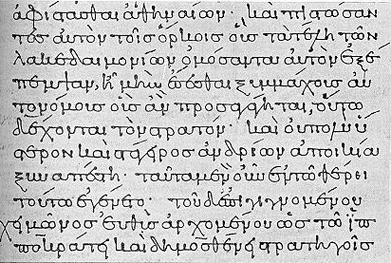
Confess - o`mologe,w (homologeo)
Thayer’s Lexicon–
  to say the same thing as another, i.e. to agree with, assent
  to confess, i.e. to admit or declare one's self guilty of what one is accused of
Therefore we confess our sins to God, by admitting our guilt and agreeing with God about our sins – that we have offended Him and (but for His mercy) are deserving of damnation for what we have done.

Slide 19
If we confess our sins . . .
If we confess our sins, he is faithful and just to forgive us our sins and to cleanse us from all unrighteousness. (1 John 1:9)
Notice John does not say “if we confess our sinfulness” or “if we confess that we sin in a general sort of way”
John says, “If we confess our sins” - When we go to God to confess our sins, we should admit to the specific sins that we know we have committed.

Slide 20
God is Faithful and Just to Forgive Us
If we confess our sins, he is faithful and just to forgive us our sins and to cleanse us from all unrighteousness. (1 John 1:9)
God has promised throughout scripture that He will forgive those who confess their guilt:
  Proverbs 28:13 - Whoever conceals his transgressions will not prosper, but he who confesses and forsakes them will obtain mercy.
  Isaiah 55:7 - Let the wicked forsake his way, and the unrighteous man his thoughts; let him return to the LORD, that he may have compassion on him, and to our God, for he will abundantly pardon.
God will be faithful to keep His promise, because God is always faithful to His word.
God is just in forgiving the sins of His people because Jesus has paid the price for those sins (cf. verse 7).

Slide 21
God is Faithful and Just to Forgive Us
If we confess our sins, he is faithful and just to forgive us our sins and to cleanse us from all unrighteousness. (1 John 1:9)
Keep in mind that this epistle was written to those whose sins are already forgiven:
  1 John 2:12 - I write to you, dear children, because your sins have been forgiven on account of his name.
Donald W. Burdick, a commentator on 1 John, makes this observation:
  John is not here speaking of the initial forgiveness that comes with salvation. The forgiveness of this verse, however, is an experience which comes after salvation. Its function is to remove that which disturbed the believer’s fellowship with God. Whereas the former is a legal remission of guilt, the latter is the Father’s forgiveness of His child to restore undisturbed communion.
Donald W. Burdick, The Epistles of John, Moody Press, 1970, p.26-27

Slide 22
After giving such strong emphasis to the idea that we are all sinners, John wants to make sure that his readers don’t get the wrong idea – John is writing these things so that they won’t sin.
⁸ If we say we have no sin, we deceive ourselves, and the truth is not in us. ⁹ If we confess our sins, he is faithful and just to forgive us our sins and to cleanse us from all unrighteousness. ¹⁰ If we say we have not sinned, we make him a liar, and his word is not in us.
^{2:1} My little children, I am writing these things to you so that you may not sin. But if anyone does sin, we have an advocate with the Father, Jesus Christ the righteous. ² He is the propitiation for our sins, and not for ours only but also for the sins of the whole world.
(1 John 1:8-2:2)

Slide 23
But in the event that someone does sin, John wants them to take comfort in the fact that we have an advocate who is constantly speaking to the Father on our behalf: Jesus the Righteous One!
⁸ If we say we have no sin, we deceive ourselves, and the truth is not in us. ⁹ If we confess our sins, he is faithful and just to forgive us our sins and to cleanse us from all unrighteousness. ¹⁰ If we say we have not sinned, we make him a liar, and his word is not in us.
^{2:1} My little children, I am writing these things to you so that you may not sin. But if anyone does sin, we have an advocate with the Father, Jesus Christ the righteous. ² He is the propitiation for our sins, and not for ours only but also for the sins of the whole world.
(1 John 1:8-2:2)

Slide 24
Jesus the Righteous One who is therefore pleasing and acceptable to God is the “propitiation” for “our” sins.
⁸ If we say we have no sin, we deceive ourselves, and the truth is not in us. ⁹ If we confess our sins, he is faithful and just to forgive us our sins and to cleanse us from all unrighteousness. ¹⁰ If we say we have not sinned, we make him a liar, and his word is not in us.
^{2:1} My little children, I am writing these things to you so that you may not sin. But if anyone does sin, we have an advocate with the Father, Jesus Christ the righteous. ² He is the propitiation for our sins, and not for ours only but also for the sins of the whole world.
(1 John 1:8-2:2)

Slide 25
Propitiation - i`lasmo,j (hilasmos)
The Greek word translated “propitiation” here is found only two times in the New Testament – here and in 1 John 4:10 where we are told that God provided Christ as the propitiation for our sins out of love for us.
Lexical Definitions:
  Louw-Nida– the means by which sins are forgiven
  Liddell-Scott – a means of appeasing
  Friberg – the means of forgiveness, way of reconciling
Note in NIV Study Bible: “God’s holiness demands punishment for man’s sin. God, therefore, out of love (4:10; John 3:16), sent His Son to make substitutionary atonement for the believer’s sin. In this way the Father’s wrath is propitiated (satisfied, appeased); his wrath against the Christian’s sin has been turned away and directed towards Christ.”

Slide 26
Christ the Righteous One is the Propitiation for Our Sins
Simply put, here is what John is telling us:
We were under the wrath of God because of sin.
Christ, the Righteous One (i.e., without sin) was pleasing to God.
God, instead of pouring out His wrath on us (who deserved it) poured out the wrath (punishment) that we deserved on Christ.
Therefore God’s anger against our sin has been satisfied and He is no longer angry with us.
And because of this we can have fellowship with Him!
The Apostle Paul expressed this same idea:
2 Corinthians 5:21 - God made him who had no sin to be sin for us, so that in him we might become the righteousness of God. (NIV)

Slide 27
John then adds a phrase to describe who all is included in the propitiation of Christ: not only for our sins . . . but also for the sins of the whole world.
⁸ If we say we have no sin, we deceive ourselves, and the truth is not in us. ⁹ If we confess our sins, he is faithful and just to forgive us our sins and to cleanse us from all unrighteousness. ¹⁰ If we say we have not sinned, we make him a liar, and his word is not in us.
^{2:1} My little children, I am writing these things to you so that you may not sin. But if anyone does sin, we have an advocate with the Father, Jesus Christ the righteous. ² He is the propitiation for our sins, and not for ours only but also for the sins of the whole world.
(1 John 1:8-2:2)

Slide 28
To Whom Does “Our” Refer in 1 John 2:2?
He is the propitiation for our sins, and not for ours only but also for the sins of the whole world. (1 John 2:2)
In the 1 John 1:1-5, the first person plural (“we”, “our”, “us”) clearly referred to John and the other apostles who had witnessed the risen Christ.
Starting in 1:6, John seems to begin using the first person plural in an axiomatic sense – meaning “anyone”:
  1:6 - If we say we [anyone] have fellowship with him while we walk in darkness, we lie…
  1:7 - But if we [anyone] walk in the light, as he is in the light, we have fellowship…
  1:8 - If we say we [anyone] have no sin, we deceive ourselves…
  1:9 - If we [anyone] confess our sins…
But here (in 2:2) it would seem most natural to understand “our” as referring to John and his (Christian) readers.

Slide 29
Who is Meant by “the Whole World” in
1 John 2:2?
He is the propitiation for our sins, and not for ours only but also for the sins of the whole world. (1 John 2:2)

Slide 30
world ko,smoj (kosmos)
Order, arrangement, ornament, adornment
  1 Peter 3:3 - Do not let your adorning be external--the braiding of hair and the putting on of gold jewelry, or the clothing you wear--
The earth or all that is in it
  Matthew 13:35 - This was to fulfill what was spoken by the prophet: “I will open my mouth in parables; I will utter what has been hidden since the foundation of the world.”
  Matthew 16:26a - For what will it profit a man if he gains the whole world and forfeits his soul?
The human race, people in general, or people without distinction
  Matthew 5:14 - You are the light of the world. A city set on a hill cannot be hidden.
  John 12:18-19 - The reason why the crowd went to meet him was that they heard he had done this sign. So the Pharisees said to one another, “You see that you are gaining nothing. Look, the world has gone after him.”
Gentiles as distinguished from Jews
  Romans 11:12 - Now if their trespass means riches for the world, and if their failure means riches for the Gentiles, how much more will their full inclusion mean!
The world of men who are hostile to God
  John 7:7 - The world cannot hate you, but it hates me because I testify about it that its works are evil.

Slide 31
Who is Meant by “the Whole World” in
1 John 2:2?
He is the propitiation for our sins, and not for ours only but also for the sins of the whole world. (1 John 2:2)
“Whole world” in this context seems to refer to the sins of people in general or perhaps all people without distinction – though not necessarily all people without exception.
Compare this with John 1:29 - The next day John saw Jesus coming toward him and said, "Look, the Lamb of God, who takes away the sin of the world!
So I would take John to mean “not our [John and his readers’] sins but also the sins of the whole [rest of] the world.”

Slide 32
For Whose Sins is Christ “the Propitiation”
(i.e. the means by which God’s wrath is appeased)?
He is the propitiation for our sins, and not for ours only but also for the sins of the whole world. (1 John 2:2)
If we take this text in an unqualified sense, John would seem to be saying that Jesus has atoned for the sins of everyone (or all Jews and Gentiles) which would then mean that everyone is going to heaven!
But of course we know even from John’s own writings that this is not the case:
  Revelation 21:8 - But the cowardly, the unbelieving, the vile, the murderers, the sexually immoral, those who practice magic arts, the idolaters and all liars-- their place will be in the fiery lake of burning sulfur. This is the second death."

Slide 33
For Whose Sins is Christ “the Propitiation”
(i.e. the means by which God’s wrath is appeased)?
If Jesus had forgiven all the sins of those mentioned in Revelation 21:8 and other passages that talk about the last judgment, then no one would have to suffer eternal punishment, because there would be no sins left to punish!
I believe, therefore that we must take “the whole world” in a more qualified sense to refer to all people without distinction, but not all people without exception.
To determine specifically who has been atoned for by Christ, we need only look in the preceding context where John tells us:
  1 John 1:7 - But if we walk in the light, as he is in the light, we have fellowship with one another, and the blood of Jesus, his Son, cleanses us from all sin.
It is for those who “walk in the light” that Christ has made atonement!

Slide 34
1:5-2:28
The First Presentation of the Three Themes of RIGHTEOUSNESS, LOVE and BELIEF in Jesus
1:5-7 - John states that:
  “God is light" (i.e. God is truth and the revealer of truth)
  A person's claim to have FELLOWSHIP with God is verified only if he "walks in the light" (i.e. lives according to God's truth).
1:8-2:6 - "Walking in the Light" Tested by RIGHTEOUSNESS
  First - in confession of sin (1:8-2:2)
  Secondly - in actual obedience (2:3-6)
2:7-17 - "Walking in the Light" Tested by LOVE
  Positively - By love of one's brother (2:7-11)
  [Parenthetical Passage in (2:12-14)]
  Negatively - By not loving the World (2:15-17)
2:18-28 - "Walking in the Light" Tested by BELIEF in Jesus the Son of God.
  Contrast Between False Teachers and True Believers (2:18-21)
  Christological Test (2:22-23)
  Exhortation to Continue in the Truth (2:24-28)

Slide 35

Class Discussion Time
https://www.weareteachers.com/moving-beyond-classroom-discussions/

Slide 36
*Class Discussion Time
It is common in our day among those who believe in an unqualified “once saved always saved” that once someone “gets their ticket punched” by walking down an aisle and getting baptized (or whatever), it no longer matters how they live their life they’re going to heaven. After looking at today’s text, what do you think John would say to someone who thinks this way?
There is a school of thought today that argues that when scripture tells us to forgive one another as God has forgiven us (Colossians 3:13), that we are to forgive people who have sinned against us, even if they never come to us and ask forgiveness. Do you think the fact that God requires us to first confess our sins to Him in order to restore (temporal) fellowship with Him could have have any bearing on how, and under what conditions, we should forgive those who sin against us?

