Slide 1
The Book of 1 John
To Download this lesson go to:
http://www.purifiedbyfaith.com/1John/1John.htm
https://revelationillustrated.com/

Slide 2
Outline of 1 John
1:1-4 - Prologue: John Introduces the Major Theme of the Letter - FELLOWSHIP WITH GOD
1:5-2:28 - The First Presentation of the Three Tests of FELLOWSHIP WITH GOD: RIGHTEOUSNESS, LOVE and BELIEF in Jesus
2:29-4:6 -The Second Presentation of the Three Tests of FELLOWSHIP WITH GOD: RIGHTEOUSNESS, LOVE and BELIEF in Jesus
4:7-5:21 - The Third Presentation of the Three Tests of FELLOWSHIP WITH GOD: RIGHTEOUSNESS, LOVE and BELIEF in Jesus
Robert Law, The Tests of Life, Third Edition, 1914, p.21-24

Slide 3
1:5-2:28 The First Presentation of the Three Tests of FELLOWSHIP WITH GOD: RIGHTEOUSNESS, LOVE and BELIEF in Jesus
1:5-7 - John states that:
“God is light" (i.e. God is truth and the revealer of truth)
A person's claim to have FELLOWSHIP with God is verified only if he "walks in the light" (i.e. lives according to God's truth).
1:8-2:6 - "Walking in the Light" Tested by RIGHTEOUSNESS
First - in confession of sin (1:8-2:2)
Secondly - in actual obedience (2:3-6)
2:7-17 - "Walking in the Light" Tested by LOVE
Positively - By love of one's brother (2:7-11)
[Parenthetical Passage in (2:12-14)]
Negatively - By not loving the World (2:15-17)
2:18-28 - "Walking in the Light" Tested by BELIEF in Jesus the Son of God.
Contrast Between False Teachers and True Believers (2:18-21)
Christological Test (2:22-23)
Exhortation to Continue in the Truth (2:24-28)

Slide 4
1 John 2:12-14 Affirmation and Encouragement to John’s Readers
¹² I am writing to you, little children, because your sins are forgiven for his name's sake. ¹³ I am writing to you, fathers, because you know him who is from the beginning. I am writing to you, young men, because you have overcome the evil one. I write to you, children, because you know the Father. ¹⁴ I write to you, fathers, because you know him who is from the beginning. I write to you, young men, because you are strong, and the word of God abides in you, and you have overcome the evil one.

Slide 5
Affirmation and Encouragement to John’s Readers
Up to this point in the letter, John has sharply denounced those who:
Walk in Darkness (1:6)
Deny their own sinfulness (1:8, 10)
Do not obey Christ’s commands (2:4)
Hate their brothers in Christ (2:9, 11)
John now takes time to encourage his readers and affirm that he views them as believers who know Jesus Christ as Savior.
John’s purpose in writing is not to shake the confidence of God’s people but give them more adequate ground for assurance. (Burdick p.35)

Slide 6
Six Parallel Statements, Arranged in Two Series of Three, Addressed to Children, Fathers, and Young Men:
Verse | Group Addressed | Comments Made
2:12 | Children | Sins are forgiven for his name's sake
2:13 | Fathers | Know him who is from the beginning
 | Young Men | Have overcome the evil one
 | Children | Know the Father
2:14 | Fathers | Know him who is from the beginning
 | Young Men | Strong The word of God abides in you Have overcome the evil one

Slide 7
Who are the “Children”, “Fathers”, and “Young Men”?
Some (Augustine, Stott) believe that John is addressing three distinct categories of Christians who are at three different levels of spiritual maturity.
A number of others (Calvin, Luther, Burdick, Kruse) believe:
“Little children” refers to all of John’s readers as it does throughout the letter (cf. 2:1, 18, 28; 3:7, 18; 4:4; 5:21)
“Fathers” and “Young Men” refer to the older and younger believers among those to whom John is writing. It is difficult to be certain whether physical or spiritual age is in view (or perhaps both).
The order in which John addresses the three groups seems to favor this view:
If John were addressing three distinct groups, it would seem more natural if he were to list them in ascending order (children, young men, fathers)
Instead it seems that he first addresses the entire group as ‘little children’, and then addresses ‘fathers’ and ‘young men’ separately.

Slide 8
Little Children…
2:12 - Your sins are forgiven for his [Jesus’] name's sake:
The forgiveness of which this verse speaks is the initial remission of the guilt of all sins – past, present, and future.
In Scripture the term “name” often is used to refer to the character of the person who bears the name (Psalm 44:5, Acts 3:16, 3 John 7). Thus the believer’s forgiveness rests upon the person and work of Christ. We are forgiven on account of His merit, not because of anything we may be or do. (Burdick p.37)
2:13 - you know the Father:
Jesus, in his high priestly prayer (as recorded in the Gospel of John), equates “knowing the Father” with having eternal life:
John 17:3 - And this is eternal life, that they know you [the Father] the only true God, and Jesus Christ whom you have sent.

Slide 9
Fathers…
2:13 - You know him who is from the beginning:
“Him who is from the beginning” is most likely a reference to the person of Jesus Christ who John described earlier (1:1) has having been “from the beginning” (= from eternity past – cf. John 1:1-2)
These mature Christians have “known” (had an intimate relationship with) Jesus for a long time – but regardless of how long they have known Him, Jesus has been around even longer still!
2:14 - you know him who is from the beginning:
This is an exact repeat of what he says in 2:13. The repetition may be for emphasis.

Slide 10
Young Men…
2:13 - You have overcome the evil one:
“the evil one” (poneros) is used five times in 1 John (2:13, 14; 3:12; 5:18, 19) and refers to the devil each time.
Besides here, John uses the word translated “to overcome” (nikao) four times in this letter:
4:4 (one time) – The readers are said to overcome those who are in the world (the antichrists) because greater is the One who is in them (God) than the one who is in the world (the devil).
5:4-5 (3 times) – Those born of God overcome the world by their faith.
Putting all this together, we can say that the author understands believers’ victory over the evil one to be achieved because
God abides in them (and He is greater than the evil one)
As a result they are able to overcome the evil one through their faith in God.
To overcome the evil one is best understood [in the context of 1 John] as rejecting all that the [Gnostics] stand for in belief and behavior. . . and by remaining faithful to the message heard from the beginning.
Colin G. Kruse, The Letters of John, The New Pillar Commentary, 2000, pp.90-91

Slide 11
Young Men…
2:14 - you are strong, and the word of God abides in you, and you have overcome the evil one:
Proverbs 20:29 - The glory of young men is their strength, but the splendor of old men is their gray hair.
Strength is the normal characteristic of youth. These young men were strong because the Word of God was dwelling in them continually (Greek present tense). As a result they had overcome the devil.
Isaiah 40:30-31 - Even youths shall faint and be weary, and young men shall fall exhausted; but they who wait for the LORD shall renew their strength; they shall mount up with wings like eagles; they shall run and not be weary; they shall walk and not faint.
Donald W. Burdick, The Epistles of John, Moody Press, 1970, p.37

Slide 12
1:5-2:28 The First Presentation of the Three Tests of FELLOWSHIP WITH GOD: RIGHTEOUSNESS, LOVE and BELIEF in Jesus
1:5-7 - John states that:
“God is light" (i.e. God is truth and the revealer of truth)
A person's claim to have FELLOWSHIP with God is verified only if he "walks in the light" (i.e. lives according to God's truth).
1:8-2:6 - "Walking in the Light" Tested by RIGHTEOUSNESS
First - in confession of sin (1:8-2:2)
Secondly - in actual obedience (2:3-6)
2:7-17 - "Walking in the Light" Tested by LOVE
Positively - By love of one's brother (2:7-11)
[Parenthetical Passage in (2:12-14)]
Negatively - By not loving the World (2:15-17)
2:18-28 - "Walking in the Light" Tested by BELIEF in Jesus the Son of God.
Contrast Between False Teachers and True Believers (2:18-21)
Christological Test (2:22-23)
Exhortation to Continue in the Truth (2:24-28)

Slide 13
1 John 2:15-17 Walking in the Light Tested by Love Negatively – By Not Loving the World
¹⁵ Do not love the world or the things in the world. If anyone loves the world, the love of the Father is not in him. ¹⁶ For all that is in the world--the desires of the flesh and the desires of the eyes and pride in possessions--is not from the Father but is from the world. ¹⁷ And the world is passing away along with its desires, but whoever does the will of God abides forever.

Slide 14
John begins this section with a command to “not love the world” or “things in the world”:
¹⁵ Do not love the world or the things in the world. If anyone loves the world, the love of the Father is not in him. ¹⁶ For all that is in the world--the desires of the flesh and the desires of the eyes and pride in possessions--is not from the Father but is from the world. ¹⁷ And the world is passing away along with its desires, but whoever does the will of God abides forever. (1 John 2:15-17)

Slide 15
Furthermore, John tells us, if anyone does love the world then “the love of the Father is not in him”.
¹⁵ Do not love the world or the things in the world. If anyone loves the world, the love of the Father is not in him. ¹⁶ For all that is in the world--the desires of the flesh and the desires of the eyes and pride in possessions--is not from the Father but is from the world. ¹⁷ And the world is passing away along with its desires, but whoever does the will of God abides forever. (1 John 2:15-17)

Slide 16
If anyone loves the world, the love of the Father is not in him. (1 John 2:15b)
In the Greek, “the love of the Father “ could be interpreted in any of the following ways:
The believer’s love for the Father;
The Father’s love for the believer;
Love (in the believer) which originates from the Father
But in the present context it is clear that ‘the love of the Father’ is the believer’s love for the Father, because it stands in opposition to the believer’s love of the world. (Kruse p.95)
John here speaks of love as supreme devotion which excludes all other loyalties. A person can be totally devoted to God or to the world, but not both at the same time. (Burdick p.38-39)
c.f. Matthew 6:24 – No one can serve two masters, for either he will hate the one and love the other, or he will be devoted to the one and despise the other. You cannot serve God and money.

Slide 17
John then gives two reasons why Christians should not love the world: Reason # 1 - Because the attitudes of the world described in this verse do not come from God, but from the evil world system that Satan has set in opposition to God.
¹⁵ Do not love the world or the things in the world. If anyone loves the world, the love of the Father is not in him. ¹⁶ For all that is in the world--the desires of the flesh and the desires of the eyes and pride in possessions--is not from the Father but is from the world. ¹⁷ And the world is passing away along with its desires, but whoever does the will of God abides forever. (1 John 2:15-17)

Slide 18
John then gives two reasons why Christians should not love the world: Reason # 2 - Because the world is temporary and we as Christians are called to an eternal life with God.
¹⁵ Do not love the world or the things in the world. If anyone loves the world, the love of the Father is not in him. ¹⁶ For all that is in the world--the desires of the flesh and the desires of the eyes and pride in possessions--is not from the Father but is from the world. ¹⁷ And the world is passing away along with its desires, but whoever does the will of God abides forever. (1 John 2:15-17)

Slide 19
Do not love the world or the things in the world. (1 John 2:15a)
Exactly what does John mean when he tells us not to “love the world or the things in the world”? How does this square with other things that we are told in scripture? For example:
Jesus says that the second greatest commandment is to “love your neighbor as yourself.” (Matthew 22:39b)? Aren’t our neighbors in the world?
Earlier in this letter, John told us that we are to love our Christian brothers (1 John 2:7-11)? Aren’t our Christian brothers in the world?
Why does John tell us that “God so loved the world” (John 3:16), but then tell us to not love the world? Don’t the scriptures command us to be “imitators of God” (Ephesians 5:1)?

Slide 20
love - avgapa,w agapao
Friberg Lexicon:
Toward persons: love, be loyal to, regard highly
Toward things: value, delight in, strive for

Slide 21
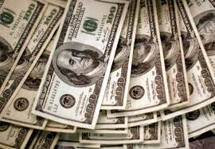
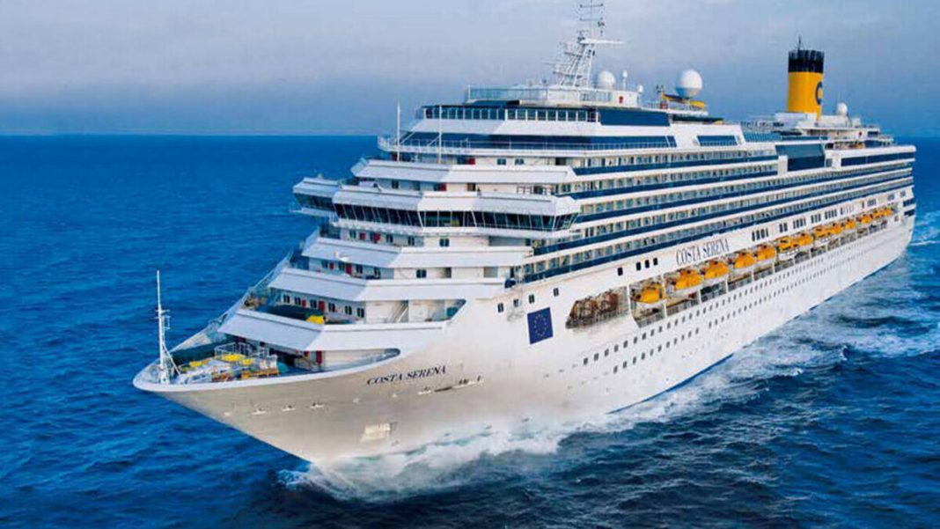
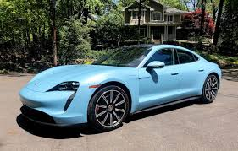
Do not love the world or the things in the world. (1 John 2:15a)
So, when John tells us not to “love… the things in the world” – If loving a thing means to value, delight in or strive for a thing – Does this mean we shouldn’t value, delight in or strive for things like:

Slide 22
What in the world does John mean?
Obviously John is not saying that we shouldn’t love people, because we are commanded to do so (even by John himself).
The love involved in this exhortation carries a different meaning from the love (of fellow believers) mentioned in 2:10. There love is focused on the well being of another, whereas here it is focused on the pleasure and gratification one hopes to receive. (Kruse p.94)
Colin G. Kruse, The Letters of John, The New Pillar Commentary, 2000, p.94

Slide 23
What in the world does John mean?
Likewise, I don’t believe that John is forbidding us to enjoy good things in this world, like:
Food and drink - So, whether you eat or drink, or whatever you do, do all to the glory of God. (1 Corinthians 10:31)
Good Health - Beloved, I pray that all may go well with you and that you may be in good health, as it goes well with your soul. (3 John 1:2)
Everything! - For everything created by God is good, and nothing is to be rejected if it is received with thanksgiving. (1Timothy 4:4)
As verse 16 reveals, John has in mind men’s attitudes toward things rather than the material things themselves.
Donald W. Burdick, The Epistles of John, Moody Press, 1970, p.38

Slide 24
In verse 16, John enumerates the kind of things he has in mind when he talks about the things in the world: - the desires of the flesh - the desires of the eyes - pride in possessions
¹⁵ Do not love the world or the things in the world. If anyone loves the world, the love of the Father is not in him. ¹⁶ For all that is in the world--the desires of the flesh and the desires of the eyes and pride in possessions--is not from the Father but is from the world. ¹⁷ And the world is passing away along with its desires, but whoever does the will of God abides forever. (1 John 2:15-17)

Slide 25
the desires of the flesh evpiqumi,a th/j sarko.j epithumia tes sarx
Burdick (p. 179) - The passionate desire of the flesh for immediate self satisfaction.
Kruse (p. 95) – [the desires of the flesh] is a general category and the second and third elements of those things which comprise the world [‘the desires of the eyes’ and ‘pride in possessions’] are subcategories.

Slide 26
the desires of the eyes evpiqumi,a tw/n ovfqalmw/n epithumia ton ophthalmon
Those sinful cravings which are aroused by what people see, that leads to covetousness and sinful behavior.
Biblical examples:
Eve’s desire for the forbidden tree as a “delight to the eyes”, (Genesis 3:6)
Achan looking with covetous desire at the beautiful robe and silver and gold, which he then stole (Joshua 7:21)
David’s lustful looking after Bathsheba as she bathed (2 Samuel 11:2)
Colin G. Kruse, The Letters of John, The New Pillar Commentary, 2000, p.95

Slide 27
pride in possessions avlazonei,a tou/ bi,ou alazoneia tou biou
NASB – the boastful pride of life
Burdick (p. 39) – that proud pretension that glories in material things. It is the attitude which assumes that one is more than he really is, simply because of his many material possessions; it is the spirit that is boastfully confident in wealth rather than in God, assuming one’s life consists of that which one possesses (Daniel 4:30; Luke 12:16-21).
Stott (p.100) – The desire to shine or outshine others in luxurious living

Slide 28
What in the world does John mean?
So, in summary, when John tells us to not love the world or the things in the world:
John is not saying that we shouldn’t love people, because we are commanded to love even our enemies (Luke 6:35).
But John is warning us not to imitate the sinful behavior of the people in this world.
John is not saying that we can’t take pleasure in the temporal things of this world that God provides for our enjoyment (1Timothy 6:17).
But John is warning us not to desire the pleasures of this world that God has forbidden.

Slide 29
What in the world does John mean?
So, in summary, when John tells us to not love the world or the things in the world:
John is not saying that it’s wrong to have and enjoy the material possessions.
John is warning us that our ultimate sense of worth and security must come from God alone. The apostle Paul expresses a similar idea when he says:
Command those who are rich in this present world not to be arrogant nor to put their hope in wealth, which is so uncertain, but to put their hope in God, who richly provides us with everything for our enjoyment. (1 Timothy 6:17)

Slide 30
John reminds his readers – as he did just a few verses earlier (2:8) – that the evil world system around us, for all of it’s allures and temptations, is in the process of passing away and will soon be gone.
¹⁵ Do not love the world or the things in the world. If anyone loves the world, the love of the Father is not in him. ¹⁶ For all that is in the world--the desires of the flesh and the desires of the eyes and pride in possessions--is not from the Father but is from the world. ¹⁷ And the world is passing away along with its desires, but whoever does the will of God abides forever. (1 John 2:15-17)

Slide 31
In contrast to this world which is passing away, the man who does the will of God (by avoiding sinful lusts, loving the brothers, etc.) abides forever! Why would someone who has what is eternal throw it away for something that is only temporary?
¹⁵ Do not love the world or the things in the world. If anyone loves the world, the love of the Father is not in him. ¹⁶ For all that is in the world--the desires of the flesh and the desires of the eyes and pride in possessions--is not from the Father but is from the world. ¹⁷ And the world is passing away along with its desires, but whoever does the will of God abides forever. (1 John 2:15-17)

Slide 32
1:5-2:28 The First Presentation of the Three Tests of FELLOWSHIP WITH GOD: RIGHTEOUSNESS, LOVE and BELIEF in Jesus
1:5-7 - John states that:
“God is light" (i.e. God is truth and the revealer of truth)
A person's claim to have FELLOWSHIP with God is verified only if he "walks in the light" (i.e. lives according to God's truth).
1:8-2:6 - "Walking in the Light" Tested by RIGHTEOUSNESS
First - in confession of sin (1:8-2:2)
Secondly - in actual obedience (2:3-6)
2:7-17 - "Walking in the Light" Tested by LOVE
Positively - By love of one's brother (2:7-11)
[Parenthetical Passage in (2:12-14)]
Negatively - By not loving the World (2:15-17)
2:18-28 - "Walking in the Light" Tested by BELIEF in Jesus the Son of God.
Contrast Between False Teachers and True Believers (2:18-21)
Christological Test (2:22-23)
Exhortation to Continue in the Truth (2:24-28)

Slide 33
Class Discussion Time
https://www.weareteachers.com/moving-beyond-classroom-discussions/

Slide 34
*Class Discussion Time
John after being somewhat tough on his readers and giving them strong warnings takes time to give them a word of encouragement. Is there a lesson in this for us in giving strong warnings to others?
I have stated that I don’t think there is a problem, in and of itself, with having abundant material possessions – but those who prosper do face additional temptations. The following scriptures address some of the problems that can accompany riches and physical prosperity:
Give me neither poverty nor riches; feed me with the food that is needful for me, lest I be full and deny you and say, "Who is the LORD?" or lest I be poor and steal and profane the name of my God. (Pro 30:8-9)
And Jesus said to his disciples, "Truly, I say to you, only with difficulty will a rich person enter the kingdom of heaven. (Mat 19:23)
In light of these passages and in light of John’s warnings, what are your thoughts on Christians having a lot of money?

