Slide 1

New Covenant Theology

Slide 2

Questions Raised by New Covenant Theology

Slide 3
Are OT Laws Binding on Christians Today? (Review)
Where We Are in Our Study:
  We are still looking at the first question that I raised concerning New Covenant Theology: Are OT laws binding on Christians today?
  We’ve spent the past two weeks looking at a passage where Jesus addresses this very issue: the second half of the “Sermon on the Mount” as it is laid out in Matthew 5:17-48.
This week I would like to do two things:
  I want to begin by giving a brief review of what we learned from Matthew 5:17-48 as it relates to New Covenant Theology.
  After that, I would like to present some comments on Matthew 5:17-48 from a respected Biblical scholar who has an opposing viewpoint on this passage.

Slide 4
Brief Review of Mat. 5:17-48
In Matthew 5:17-48, we saw that:
  Jesus tells us that he has not come to set aside the OT scriptures as though they were of no value or importance.
  The purpose of the OT scriptures and the commandments within them was to point to Jesus as the one who fulfills them.
  Jesus then, takes us through a series of six examples, where he shows us how to “keep” the OT commandments by listening to him and doing what he says.
In each of the six examples Jesus follows the same pattern:
  He begins by saying: “You have heard that it was said to those of old…”
  Quotes or paraphrases an OT command(s)
  Then says: “But I say to you…” at which point he adds to, upgrades, and, in some cases, even does away with the OT command.

Slide 5
Brief Review of Mat. 5:17-48
Here is a Summary of Jesus’ six examples:

Slide 6
Brief Review of Mat. 5:17-48
Here is a Summary of Jesus’ six examples:
The OT Command | What Jesus Does to the Command
#1 - You Shall Not Murder (Exodus 20:13) | Jesus extends the prohibition against murder to a prohibition against unrighteous anger.

Slide 7
Brief Review of Mat. 5:17-48
Here is a Summary of Jesus’ six examples:
The OT Command | What Jesus Does to the Command
#1 - You Shall Not Murder (Exodus 20:13) | Jesus extends the prohibition against murder to a prohibition against unrighteous anger.
#2 - You Shall Not Commit Adultery (Exodus 20:14) | Jesus extends the prohibition against adultery to a prohibition against sexual lust.

Slide 8
Brief Review of Mat. 5:17-48
Here is a Summary of Jesus’ six examples:
The OT Command | What Jesus Does to the Command
#1 - You Shall Not Murder (Exodus 20:13) | Jesus extends the prohibition against murder to a prohibition against unrighteous anger.
#2 - You Shall Not Commit Adultery (Exodus 20:14) | Jesus extends the prohibition against adultery to a prohibition against sexual lust.
#3 - Give Her a Certificate of Divorce (Deut. 24:1-4) | Jesus upgrades the OT restriction on divorce to something much stricter: No divorce allowed (except for infidelity on the part of the spouse)

Slide 9
Brief Review of Mat. 5:17-48
Here is a Summary of Jesus’ six examples:
The OT Command | What Jesus Does to the Command
#1 - You Shall Not Murder (Exodus 20:13) | Jesus extends the prohibition against murder to a prohibition against unrighteous anger.
#2 - You Shall Not Commit Adultery (Exodus 20:14) | Jesus extends the prohibition against adultery to a prohibition against sexual lust.
#3 - Give Her a Certificate of Divorce (Deut. 24:1-4) | Jesus upgrades the OT restriction on divorce to something much stricter: No divorce allowed (except for infidelity on the part of the spouse)
#4 - You Shall Not Swear Falsely (Lev 19:12, Numbers 30:2) | Jesus replaces all OT laws governing oaths with a simple command to tell the truth.

Slide 10
Brief Review of Mat. 5:17-48
Here is a Summary of Jesus’ six examples:
The OT Command | What Jesus Does to the Command
#1 - You Shall Not Murder (Exodus 20:13) | Jesus extends the prohibition against murder to a prohibition against unrighteous anger.
#2 - You Shall Not Commit Adultery (Exodus 20:14) | Jesus extends the prohibition against adultery to a prohibition against sexual lust.
#3 - Give Her a Certificate of Divorce (Deut. 24:1-4) | Jesus upgrades the OT restriction on divorce to something much stricter: No divorce allowed (except for infidelity on the part of the spouse)
#4 - You Shall Not Swear Falsely (Lev 19:12, Numbers 30:2) | Jesus replaces all OT laws governing oaths with a simple command to tell the truth.
#5 - An Eye for an Eye (Exodus 21:23-25) | Jesus tells us that (at times) we must be willing to set aside even rightful demands for justice and be willing instead to suffer personal loss.

Slide 11
Brief Review of Mat. 5:17-48
Here is a Summary of Jesus’ six examples:
The OT Command | What Jesus Does to the Command
#1 - You Shall Not Murder (Exodus 20:13) | Jesus extends the prohibition against murder to a prohibition against unrighteous anger.
#2 - You Shall Not Commit Adultery (Exodus 20:14) | Jesus extends the prohibition against adultery to a prohibition against sexual lust.
#3 - Give Her a Certificate of Divorce (Deut. 24:1-4) | Jesus upgrades the OT restriction on divorce to something much stricter: No divorce allowed (except for infidelity on the part of the spouse)
#4 - You Shall Not Swear Falsely (Lev 19:12, Numbers 30:2) | Jesus replaces all OT laws governing oaths with a simple command to tell the truth.
#5 - An Eye for an Eye (Exodus 21:23-25) | Jesus tells us that (at times) we must be willing to set aside even rightful demands for justice and be willing instead to suffer personal loss.
#6 - Love your Neighbor (Leviticus 19:18) Hate your Enemy (Psalm 139:21-22) | Jesus ends the OT practice of hating the enemies of God by extending the command to love your neighbor to a command to love your enemies.

Slide 12
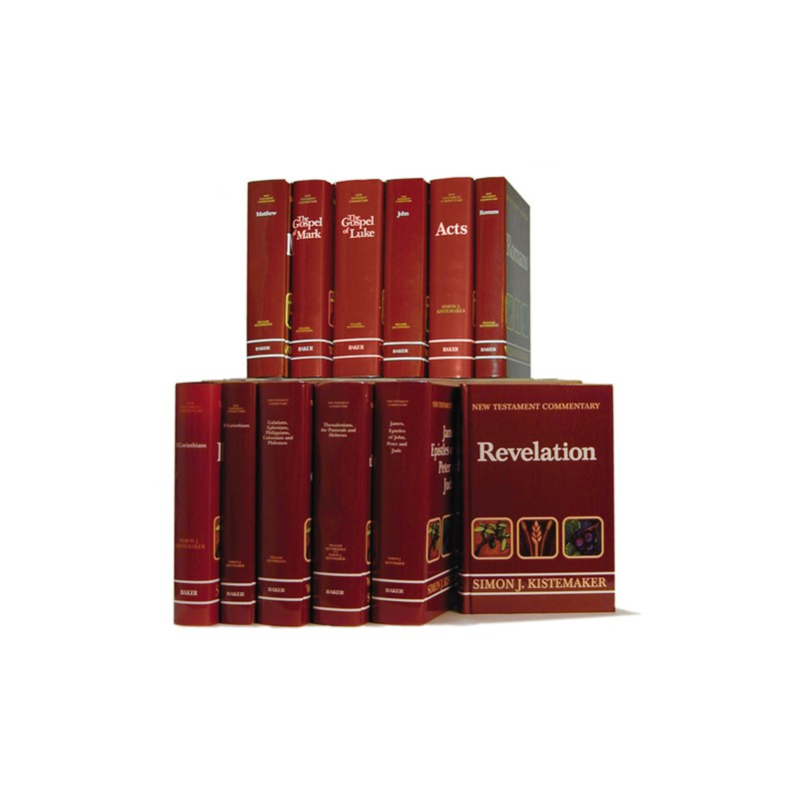
Comments on Mat. 5:17-48 From an Opposing Viewpoint

Slide 13
Comments on Mat. 5:17-48 From an Opposing Viewpoint
I’m going to give you an example of how a Dutch Reformed (similar to Presbyterian) scholar would approach Mat. 5:17-48.
The scholar I am using for this example is William Hendriksen, a scholar for whom I have a great deal of respect and with whom I agree in many other areas of Biblical teaching.
Hendriksen has written some excellent commentaries on a number of NT books, and has authored a number of other books as well.
Because Hendriksen is Dutch Reformed, he will disagree with a number of things that we believe as Baptists.
As a Reformed writer, Hendriksen would also disagree with many of the things that I have been teaching you about New Covenant Theology (NCT). He would see much more continuity between the OT and NT laws than I would.
So why do I want to present his perspective to you?
Because a number of you have said that, while the things that I’ve been teaching you about NCT make sense and seem Biblical, you would like to see how a good Bible scholar who does not agree with NCT, would argue against some of the things that I’ve been saying and then hear me respond to their arguments.

Slide 14
Comments from William Hendriksen (Mat. 5:17-48)
¹⁷ Do not think that I have come to abolish the Law or the Prophets; I have not come to abolish them but to fulfill them. ¹⁸ For truly, I say to you, until heaven and earth pass away, not an iota, not a dot, will pass from the Law until all is accomplished. ¹⁹ Therefore whoever relaxes one of the least of these commandments and teaches others to do the same will be called least in the kingdom of heaven, but whoever does them and teaches them will be called great in the kingdom of heaven. ²⁰ For I tell you, unless your righteousness exceeds that of the scribes and Pharisees, you will never enter the kingdom of heaven.
Christ’s opponents even now had begun to regard him as a destructive revolutionist, an iconoclast who wanted to break every tie with the past… The opponents were wrong. (p.288)
Not until the universe in its present form disappears will even the smallest part of the Old Testament that requires fulfillment fail to be fulfilled. Every type will be exchanged for its antitype, Every prediction will be verified. The law’s demand will be fully met. (p.291)
[Christ] insists that every commandment of that which is truly God’s moral law – the very law which he is about to discuss in greater detail in 5:21ff – must be kept. Nothing must be annulled or cancelled. (p.292 – emphasis added)

Slide 15
Comments from William Hendriksen (Mat. 5:17-48)
Concerning Jesus’ six examples of OT commands where I showed that he follows this pattern:
  He begins by saying: “You have heard that it was said to those of old…”
  Quotes or paraphrases an OT command(s)
  Then says: “But I say to you…” at which point he makes a number of comments concerning that command.
Hendriksen comments (p.295):
  The formula, “You have heard that it was said” presents a difficulty, since the following phrase considered by itself, can be translated either “to the men of long ago” (R.S.V. “to the men of old”) or “by the men of long ago.” Many translators and commentators prefer to. Several prefer by.
  According to the first view Jesus meant that Moses in the law said something to the fathers, and that Jesus now “assumes a tone of superiority over the Mosaic regulations” (A.T. Robertson, Word Pictures, Vol. I, p. 44)
  According to the second view Jesus meant that by men of long ago, that is by the expositors of the law, the rabbis, an interpretation had been presented with which he disagrees or which he considers as being dangerously incomplete…
Can you guess which view Hendriksen favors?

Slide 16
Comments from William Hendriksen (Mat. 5:17-48)
And technically, Hendriksen is right: grammatically, the Greek can be translated either way:
  “You have heard that it was said to those of old…”
  “You have heard that it was said by those of old…”
But, without getting into the technical grammatical details, I can tell you this: the first translation is by far the most common way of translating this particular Greek construction.
This probably explains why the vast majority of mainstream English translations go with the first option (e.g. ESV, NAS, NET, NIV, NLT, RSV). The only mainstream translation that I’m aware of that goes with the second option is the KJV.
Normally, before going with an highly unusual way of translating a Greek phrase, you would probably need to show that something in the context requires us to translate it that way.
And that is exactly what Hendriksen tries to do.

Slide 17
Comments from William Hendriksen (Mat. 5:17-48)
Here are the reasons that Hendriksen gives (p. 296) for going with the less common translation: “You have heard that it was said by [rather than to] those of old…” :
  It would be very strange that Jesus, having just affirmed in most emphatic terms that he had not come to set aside the law or the prophets, would now suddenly turn around and do this very thing.
  Had Jesus been referring to what Moses in the law had commanded he would have used different language; for example, “Moses commanded” (Mat. 8:4), or “It is written” (Mat. 4:4, 7, 10; Luke 2:23; 4:4).
  In later Jewish writings such famous rabbans as Hillel and Shammai were called “fathers of antiquity.” The designation “men of long ago” is accordingly an excellent designation for those who had orally interpreted the written Old Testament.

