Slide 1
New Covenant Theology

Slide 2
Questions Raised by New Covenant Theology
What about keeping the Sabbath?
What does/did it mean to keep the Sabbath?
Who did God command to observe the Sabbath?
Are Christians today obligated to keep the Sabbath?

Slide 3
What about “keeping the Sabbath”?
The word “Sabbath” comes from the Hebrew word, shabat – which means “to cease, desist, rest”:
While the earth remains, seedtime and harvest, cold and heat, summer and winter, day and night, shall not cease." (Gen 8:22)
So these three men ceased to answer Job, because he was righteous in his own eyes. (Job 32:1)
So to “keep” a Sabbath day meant to cease from regular activities and rest from one’s work on that day.

Slide 4
What about “keeping the Sabbath”?
We saw last time, that even among those who tell us that we should “keep the Sabbath”, there is a lot of disagreement.
For example, there is disagreement on what day of the week we are to observe the Sabbath: Saturday or Sunday?
Of the people that you know of who say that we should be “keeping the Sabbath”, do the majority hold to a Saturday Sabbath or a Sunday Sabbath?
Are there passages in the Bible where God commands men to observe a Sabbath day on Saturday, the seventh day of the week? If so:
What are some of those passage(s)?
For each passage given, tell us who God is commanding to observe a Sabbath (rest) on Saturday.
What passage(s) in the Bible tell us that God commands men to observe a Sabbath day on Sunday?

Slide 5
What about “keeping the Sabbath”?
There is also disagreement among those who tell us that we should “keep the Sabbath”, over the specifics of what should and should not be done on the Sabbath.
Of the people that you know of who say that we should be keeping the Sabbath, what are some of the things they say:
Should be done on the Sabbath?
Should not be done on the Sabbath?
And what do they think should be done about people who violate the Sabbath (as they understand it)?
What did the OT texts that we looked at last week say concerning these things (Exodus 31:15; Deuteronomy 5:14; Isa. 58:13–14)?

Slide 6
What did it mean to “keep the Sabbath?
We saw last time that the Sabbath was a “sign” of the Mosaic Covenant given exclusively to the nation of Israel at Mount Sinai. (Exodus 31:16-17)
We also saw that the Sabbath, as given to Israel, was a commemoration of what God did on the seventh day of the creation week as recorded in the book of Genesis (2:1-4).
When was the book of Genesis (which includes the written record of God resting on the seventh day) given by God?
Do we have any evidence that anyone prior to Moses was told that God rested on the seventh day?
Do we have any evidence in scripture of anyone observing a Sabbath day prior to Moses?
According to Nehemiah, who did God use to make “known” his “holy Sabbath” (Neh. 9:14)?
If God’s resting on the seventh day and the institution of a Sabbath day was not known prior to Moses – would we have any reason to believe that observing a Sabbath day is a “creation ordinance” binding on all men in all ages?

Slide 7
What about “keeping the Sabbath”?
What about Christians today? Are we under obligation to observe a Sabbath day of rest?
As you know, Christians today are under the New Covenant.
Since the coming of the New Covenant, there is no command given in the New Testament that requires us to observe a Sabbath day – or day of “rest”.
The only “Sabbath” that we are taught to observe in the NT is that we are to cease from doing work to gain favor with God and instead we are to rest in Christ’s work by faith:
For we who have believed enter that rest… ⁹ So then, there remains a Sabbath rest for the people of God, ¹⁰ for whoever has entered God's rest has also rested from his works as God did from his. ¹¹ Let us therefore strive to enter that rest … ¹⁴ Since then we have a great high priest who has passed through the heavens, Jesus, the Son of God, let us hold fast our confession… ¹⁶ Let us then with confidence draw near to the throne of grace, that we may receive mercy... (Heb. 4:3,9-11, 14,16a)

Slide 8
What about “keeping the Sabbath”?
Furthermore there are at least two places in the New Testament that explicitly teach that we are not required to keep a Sabbath day (or any other OT holy day or feast day) :
Therefore let no one pass judgment on you in questions of food and drink, or with regard to a festival or a new moon or a Sabbath. ¹⁷ These are a shadow of the things to come, but the substance belongs to Christ. (Col. 2:16-17 cf. Ezek. 45:17)
One person esteems one day as better than another, while another esteems all days alike. Each one should be fully convinced in his own mind. (Rom. 14:5)

Slide 9
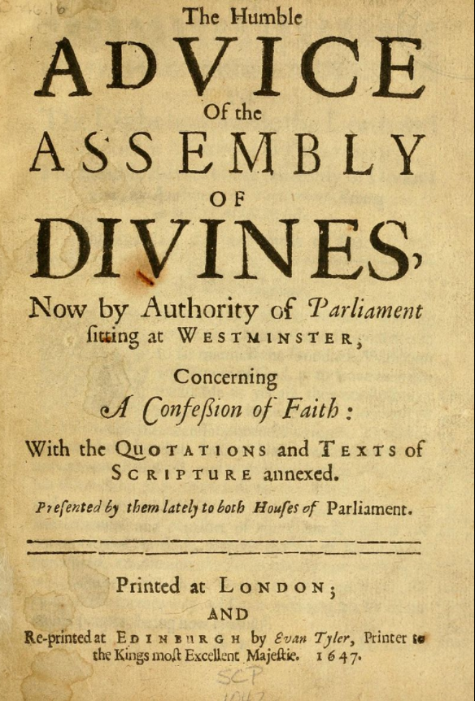
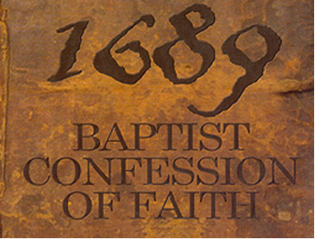
A Look at What The Westminster Confession of Faith (1646) and The London Baptist Confession of Faith (1689) Say About the Sabbath

