Slide 1
New Covenant Theology

Slide 2
Questions Raised by New Covenant Theology
What about keeping the Sabbath?
What does/did it mean to keep the Sabbath?
Who did God command to observe the Sabbath?
Are Christians today obligated to keep the Sabbath?

Slide 3
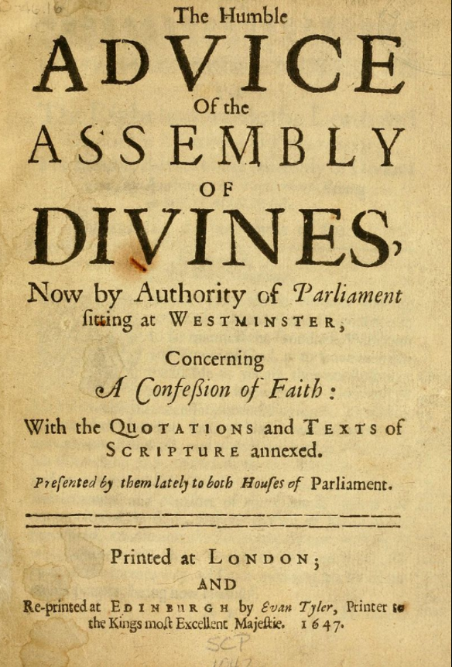
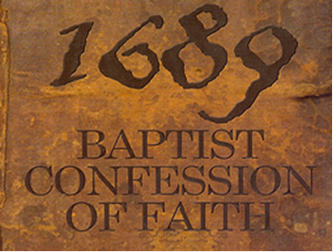
A Look at What The Westminster Confession of Faith (1646) and The London Baptist Confession of Faith (1689) Say About the Sabbath

Slide 4
A Look at What the WCF (1646) and the LBCF (1689) Say About the Sabbath
These two confessions of faith have been used by many Reformed denominations and churches in the English speaking world since the Reformation to define what they believe to be orthodox biblical teaching.
I, and I think most of you, would be in complete agreement with the vast majority of what is taught in these documents.
That being said, the documents are not scripture and therefore they are fallible – as illustrated by the fact that the London Baptist Confession of 1689 was written to correct erroneous teachings in the Westminster Confession of Faith.
Indeed, these two confessions themselves both teach:
The Supreme Judge, by which all controversies of religion are to be determined… can be no other but the Holy Spirit speaking in the Scripture. (WCF 1.10)
It is in this spirit that we, like the noble-minded Bereans of Acts 17:11, will be examining the scriptures to see if the things written in these documents concerning the Sabbath are true.

Slide 5
A Look at What the WCF (1646) and the LBCF (1689) Say About the Sabbath
In the sections we will be looking at (on the Sabbath), there is very little difference between the WCF and the LBCF.
So I’m going to go ahead and use the LBCF since that is the one we would agree with the most, overall.
The statements in the LBCF that address observing the Sabbath (on Sunday) are all contained within Chapter 22, which is entitled: Of Religious Worship and the Sabbath Day.
The relevant comments are contained within paragraphs 7 and 8, and therefore those are the ones that we will be looking at.

Slide 6
What the LBCF (1689) Has to Say About the Sabbath
LBCF 22.7a: As it is the law of nature, that in general a proportion of time, by God's appointment, be set apart for the worship of God, so by his Word, in a positive moral, and perpetual commandment, binding all men, in all ages, he hath particularly appointed one day in seven for a sabbath to be kept holy unto him…
The verse they cite to support this assertion:
⁸ Remember the Sabbath day, to keep it holy. ⁹ Six days you shall labor, and do all your work, ¹⁰ but the seventh day is a Sabbath to the LORD your God. On it you shall not do any work, you, or your son, or your daughter, your male servant, or your female servant, or your livestock, or the sojourner who is within your gates. (Exodus 20:8-10)
Does this verse cited by the LBCF support all that they assert?

Slide 7
What the LBCF (1689) Has to Say About the Sabbath
Specifically, is the command to observe the Sabbath given in Exodus 20:8 a “perpetual commandment, binding all men, in all ages”? Keep in mind:
The commandment given in Exodus 20:8 is a part of the Ten Commandments which God introduces by saying, “I am the LORD your God, who brought you out of the land of Egypt, out of the house of slavery…” (Exodus 20:1-2)
Clearly God is not speaking here to “all men in all ages”! He is speaking specifically to the nation of Israel.
The Lord later refers to the Ten Commandments as the “words of the [Mosaic] covenant”: the LORD said to Moses, “Write these words, for in accordance with these words I have made a covenant with you and with Israel.” ... And he wrote on the tablets the words of the covenant, the Ten Commandments. (Exodus 34:27)
Scripture tells us that the laws of the Mosaic Covenant were not given to any other nation (Psalm 147:19-20).
So why would we assume that this command to observe a Sabbath day in Exodus 20:8 is a is a “perpetual commandment, binding all men, in all ages”?

Slide 8
What the LBCF (1689) Has to Say About the Sabbath
LBCF 22.7b: [The commandment to observe a Sabbath day] which from the beginning of the world to the resurrection of Christ was the last day of the week, and from the resurrection of Christ was changed into the first day of the week, which is called the Lord's day: and is to be continued to the end of the world as the Christian Sabbath, the observation of the last day of the week being abolished.
The verses they cite to support this assertion are:
Now concerning the collection for the saints: as I directed the churches of Galatia, so you also are to do. ² On the first day of every week, each of you is to put something aside and store it up, as he may prosper, so that there will be no collecting when I come. (1Cor. 16:1-2)
On the first day of the week, when we were gathered together to break bread, Paul talked with them, intending to depart on the next day, and he prolonged his speech until midnight. (Acts 20:7)
I was in the Spirit on the Lord's day, and I heard behind me a loud voice like a trumpet (Rev. 1:10)
Do these verses cited by the LBCF support all that they assert?

Slide 9
What the LBCF (1689) Has to Say About the Sabbath
Specifically, do any of the verses cited state, or even necessarily imply, that:
A Sabbath day was observed on the last day of the week “from the beginning of the world to the resurrection of Christ”?
The Sabbath day was “changed ” from the last day of the week “into the first day of the week”?

Slide 10
What the LBCF (1689) Has to Say About the Sabbath
LBCF seems to assume that if Paul:
Directed the members of the Corinthian and the Galatian churches set aside money for a special collection on the “first day of every week” (i.e. Sunday)
Met with the church at Troas on one occasion to “break bread” and give a long sermon on the “first day of the week” (i.e. Sunday)
Then all Christians in Paul’s day must have met for church on Sunday.
But we don’t know that’s the case, because the passages don’t say that!
Furthermore, I believe the LBCF assumes that when John talks about being “in the Spirit on the Lord’s Day”:
John must be talking about Sunday, since that is the day that the Lord rose from the dead
John must have viewed Sunday as some kind of special day.
But again, we don’t know that either of these things are true, since neither idea is directly stated in this passage or any other passage of scripture.

Slide 11
What the LBCF (1689) Has to Say About the Sabbath
For the sake of argument, let’s assume that all, or at least most of, the churches in Paul’s day did, in fact:
Meet for church on Sunday
View Sunday as a special day, calling it the “Lord’s Day”, because it was the day of the week that Christ rose from the dead.
Does this necessarily mean that:
The OT Sabbath has been changed from Saturday to Sunday and all Christians are now required to observe a “day of rest” on Sunday?
Does it even mean that all NT Christians are required to go to church on Sunday?

Slide 12
Prescriptive Versus Descriptive
Consider this example:
Acts 20:7 says that when Paul visited Troas, they met on “the first day of the week”.
From this (and 1Cor. 16:1-2 which also refers to the “first day of the week”) the LBCF infers that all Christians should meet on the first day of the week (and keep it as a the new Sabbath).
But the very next verse (Acts 20:8) tells us they met in an “upper room”.
And there seems to be a pattern in the NT of Christians meeting in an upper room:
Jesus met with his disciples for the Last Supper in an “upper room” (Mark 14:15, Luke 22:12)
After watching Jesus ascend into heaven, the disciples met in an “upper room” in Jerusalem for a time of prayer (Acts 1:13)
Peter raised Tabitha from the dead in an “upper room” (Acts 9:39-40)
So should all Christians meet for church in an upper room?

Slide 13
Prescriptive Versus Descriptive
Consider another example :
As we’ve seen, Acts 20:7 says that when Paul visited Troas, they met on “the first day of the week”.
But Acts 2:46 tells us that the early Christians met together every day (in the temple). And they met in their homes and ate together.
So should all Christians meet for church every day? And meet in each other’s homes for a meal?

Slide 14
What the LBCF (1689) Has to Say About the Sabbath
Chapter 22: Of Religious Worship and the Sabbath Day
The sabbath is then kept holy unto the Lord, when men, after a due preparing of their hearts, and ordering their common affairs aforehand, do not only observe a holy rest all day, from their own works, words and thoughts, about their worldly employment and recreations, (Isaiah 58:13; Nehemiah 13:15-22) but are also taken up the whole time in the public and private exercises of his worship, and in the duties of necessity and mercy. (Matthew 12:1-13)

Slide 15
Questions?

