Slide 1
New Covenant Theology

Slide 2
Questions Raised by New Covenant Theology

Slide 3
Questions Raised by New Covenant Theology
What are the competing theological systems to New Covenant Theology?
What questions do these competing views raise that we need to evaluate and consider?

Slide 4
Competing Systems to New Covenant Theology
We will look at two major competing theological systems to New Covenant Theology:
Dispensationalism
Covenant Theology

Slide 5
Dispensationalism
It is hard to summarize dispensational theology as a whole because so many different forms of it have emerged over the years. But I will try to give you an overview that sums up the common beliefs held by most Dispensationalists.
Dispensationalism sees God as dividing human history into several distinct time periods or “dispensations” (from the Greek word OIKONOMIA – 1Cor 9:17; Eph. 1:10)
As dispensationalists see it, each dispensation is a period of time during which man is tested in respect to obedience to some specific revelation of the will of God.

Slide 6
Dispensationalism
Dispensationalists vary as to how many dispensations they claim there are, but it seems to be common for dispensationalists to come up with seven dispensations.
So for example, C.I. Scofield suggests the following dispensations:
Innocence (Before the Fall)
Conscience (Adam to Noah)
Government (Noah to Babel)
Promise (Abraham to Moses)
Law (Moses to Christ)
Grace (Pentecost to the Rapture)
Kingdom (Future Millennial kingdom where Christ rules on earth for a thousand years).

Slide 7
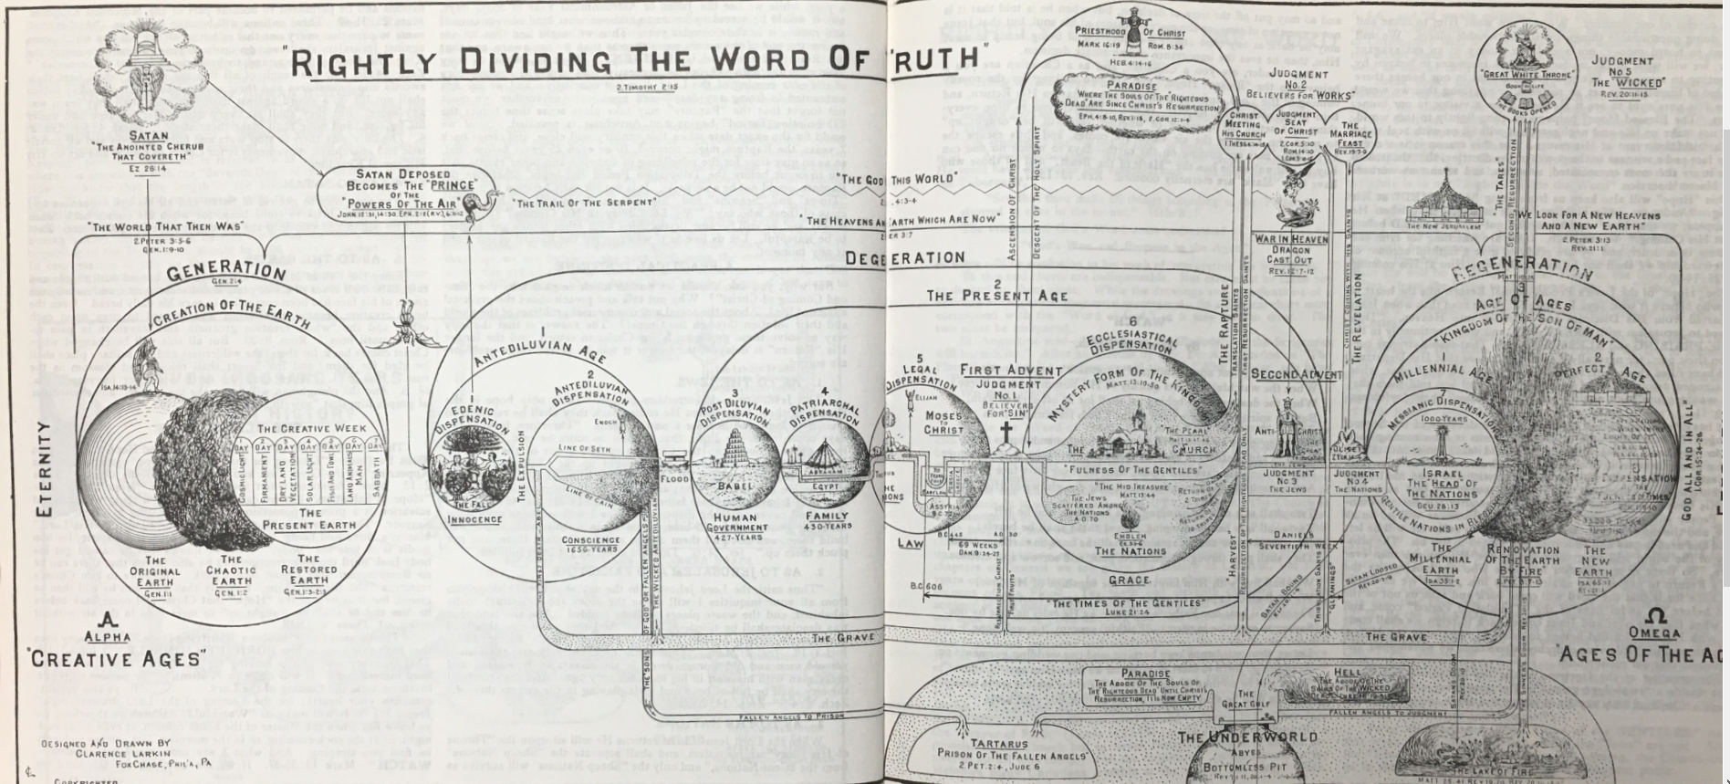
Dispensationalism
At times, Dispensationalists can be quite detailed in their descriptions of dispensations:

Slide 8
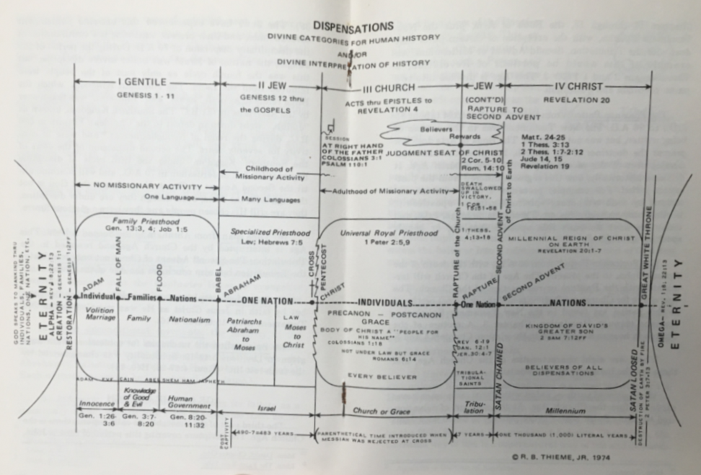
Dispensationalism
At times, Dispensationalists can be quite detailed in their descriptions of dispensations:

Slide 9
Dispensationalism
Dispensationalists, especially the more old line Dispensationalists, focus a lot of attention on Biblical prophecies and what they see coming in the future.
They get a many of their ideas about the future by interpreting the heavily symbolic passages in the book of Revelation as a literal description of things that will happen in the future.
And Dispensationalists (especially the old line Dispensationalists) seem to get especially excited about what they think are the beginnings of future things that they think they see happening today!
It is common for Dispensationalists to hold very strongly to their dispensational views – to a point where someone who denies those views is looked upon as a heretic or worse!

Slide 10
A Brief History of Dispensationalism
John Nelson Darby (1800–82) who strongly influenced the Plymouth Brethren of the 1830s is generally considered to be the Father of Dispensationalism.
Darby traveled extensively to continental Europe, New Zealand, Canada, and the United States in an attempt to make converts to the Brethren philosophy.
While his Brethren ecclesiology failed to catch on in America, Darby’s dispensational views were adopted, modified, and made popular in the United States by C. I. Scofield's Reference Bible.
The Scofield Reference Bible (first published in 1909) displayed overtly dispensationalist notes on the pages of the Biblical text. The Scofield Bible became a popular Bible used by independent Evangelicals in the United States.
Evangelist and Bible teacher Lewis Sperry Chafer (1871–1952) was influenced by Scofield; he founded the Dallas Theological Seminary in 1924, which has become the main institution of dispensationalism in America.

Slide 11
A Brief History of Dispensationalism
Charles Caldwell Ryrie (1925–2016), an American Bible scholar who is considered one of the most influential theologians of the 20th century, was another notable proponent of classic premillennial dispensationalism.
Ryrie served as professor of systematic theology and dean of doctoral studies at Dallas Theological Seminary and was the editor of The Ryrie Study Bible, containing more than 10,000 of Ryrie's explanatory notes, many of which espouse his dispensational views. First published in 1978, it has sold more than 2 million copies.
In recent years (starting around 1990) a new version of dispensationalism began to emerge known a “Progressive Dispensationalism”. Proponents of this view include Robert Saucy, Craig Blaising, Darrell Bock, Bruce Ware, John MacArthur and others.
Progressive Dispensationalism dropped some of what they see as the more radical, less defensible tenants of early Dispensationalism, while still holding on to many of the fundamental underlying ideas.

Slide 12
The Essential Beliefs of Dispensationalism
From my own observations of Dispensationalism, including both Old Dispensationalists as well as Progressive Dispensationalists I would boil down their beliefs as follows:
They believe God has divided human history into distinct periods of time (which they call dispensations) in which He operates in distinct ways. On this point, they do not differ all that much from what we say concerning NCT – except that they use the term “dispensations” to describe those periods of history while we use the term that they Bible uses to describe those periods of time, i.e. “covenants”.
When it comes to the fulfillment of prophesy, do not believe that what is taught in the NT takes precedent over what is said in the OT.
They describe themselves as having a “literal” hermeneutic, whereby they believe in interpreting the Bible “literally”. But what they really mean by this is that when the NT interprets an OT promise as being fulfilled spiritually, they insist that, even though the NT doesn’t mention it, there is still a further physical fulfillment coming.
As a result of the above hermeneutic, they believe that a time is coming in the future, when God will reestablish the nation of Israel as a believing nation and will deal with them in a way that is distinct from how he deals with the Gentiles, just as he did in the OT times.

Slide 13
The Essential Beliefs of Dispensationalism
So for example, when Jeremiah says:
"Behold, the days are coming, declares the LORD, when I will make a new covenant with the house of Israel and the house of Judah, not like the covenant that I made with their fathers on the day when I took them by the hand to bring them out of the land of Egypt, my covenant that they broke, though I was their husband, declares the LORD. For this is the covenant that I will make with the house of Israel after those days, declares the LORD: I will put my law within them, and I will write it on their hearts. And I will be their God, and they shall be my people. (Jer. 31:31-33)
The dispensationalist see this promise as being fulfilled literally by Jesus when he re-establishes the nation of Israel (and Judah?) in Palestine during a future Millennial reign.

Slide 14
The Essential Beliefs of Dispensationalism
We could, of course, point put out to the Dispensationalists that, in Hebrews 8 and following, the writer of Hebrews quotes Jeremiah 31 extensively and speaks as though it has already been fulfilled in the present New Covenant Age that has come immediately subsequent to, and as a result of, Christ’s death on the cross.
Likewise the Apostle Paul’s discussion of the New Covenant in 2 Corinthians 3 seems to assume that the New Covenant is happening now as the Spirit indwells the Gentiles to whom Paul has carried the Gospel.
But the dispensationalist would respond that what the NT writers are saying about Jeremiah 31 already being fulfilled by the inclusion of the Gentiles in the New Covenant age is only a partial fulfillment of what God promised there.
They believe there is still a literal fulfillment coming in the future for the physical descendants of Abraham who will then be a part of a physical, believing nation of Israel.
Do you find this understanding of the NT writers to be persuasive?

Slide 15
The Essential Beliefs of Dispensationalism
The biggest difficulty I have with the Dispensationalist belief about a future physical Israel (that is once again separate from the Gentiles) is trying to reconcile that view with Paul’s whole argument in Ephesians 2 (and other similar passages):
Therefore remember that at one time you Gentiles … were … separated from Christ, alienated from the commonwealth of Israel and strangers to the covenants of promise, having no hope and without God in the world. But now in Christ Jesus you who once were far off have been brought near by the blood of Christ. For he himself is our peace, who has made us both one and has broken down in his flesh the dividing wall of hostility by abolishing the law of commandments expressed in ordinances, that he might create in himself one new man in place of the two, so making peace, and might reconcile us both to God in one body through the cross, thereby killing the hostility. And he came and preached peace to you who were far off and peace to those who were near. For through him we both have access in one Spirit to the Father. So then you are no longer strangers and aliens, but you are fellow citizens with the saints and members of the household of God… (Eph 2:11-19)
Do you see a problem trying to reconcile what Paul says here with the kind of future that the Dispensationalists envision for a physical nation of Israel?

Slide 16
Questions?

