Slide 1
New Covenant Theology

Slide 2
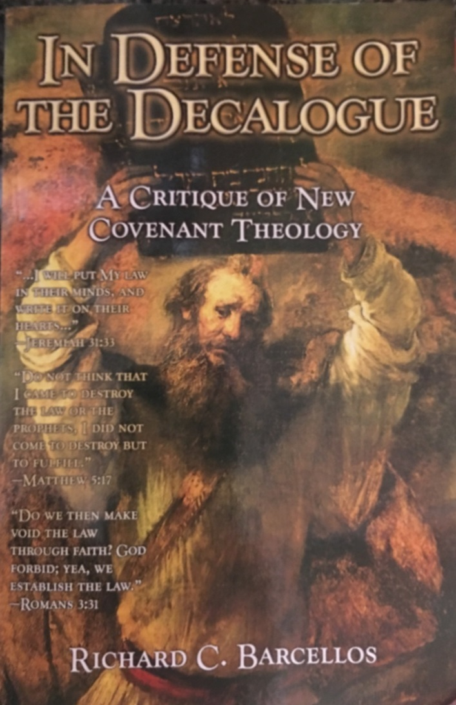
An Examination of Reformed Baptist Arguments Against New Covenant Theology

Slide 3
Chapter 2 NCT and the Identity of the Old Covenant
Last week we saw:
At the beginning of this chapter (page 33), Barcellos raises what he calls a most important question: “Does the Bible view the Ten Commandments as a unit, functioning any other way than as Old Covenant law?”
He goes on to claim that: “Three NT texts, 2 Cor. 3:3, Eph. 6:2-3, and 1Tim. 1:8-11 … demonstrate that the Ten Commandments do indeed function outside the Old Covenant as a unit”(p.34)
We spent some time discussing what Barcellos means when he talks about “the Ten Commandments function[ing] outside the Old Covenant as a unit.”
We concluded that when Barcellos says that he thinks “the Ten Commandments function outside the Old Covenant as a unit”, what he is really saying is that all ten of the Ten Commandments (including the command to observe the Sabbath) are still binding on believers in the New Covenant.

Slide 4
Chapter 2 NCT and the Identity of the Old Covenant
Barcellos spends the remainder of chapter 2 giving (what he calls) an “exposition” of the three NT passages (2 Cor. 3:3, Eph. 6:2-3, and 1Tim. 1:8-11) that he claims demonstrate that all ten of the Ten Commandments (including the command to observe the Sabbath) are still binding on believers in the New Covenant.
Last week we looked at Barcellos’ “exposition” of 2Cor 3 where he claims that since Paul didn’t say that the law written on the stones at Mt. Sinai is different from the law written on the hearts of New Covenant believers, then the law written on the hearts must be the same law that was written on the stones (i.e. the Ten Commandments).
What did we say was wrong with this argument?
Barcellos’ argument is a classical example of a logical fallacy known as the “argument from silence.”
Although Paul doesn’t tell us in 2 Cor. 3 that the OT law (written on the stones) is different than the NT law written on the hearts (because it didn’t suit his purpose to do so), he and the other NT writers do tell us in other NT passages that the New Covenant law of Christ is different than the OT law of Moses.

Slide 5
Chapter 2 NCT and the Identity of the Old Covenant
On page 38 Barcellos begins an “exposition” of Ephesians 6:2-3:
“Honor your father and mother” (this is the first commandment with a promise), “that it may go well with you and that you may live long in the land.” (ESV)
“Honor your father and mother”--which is the first commandment with a promise– “that it may go well with you and that you may enjoy long life on the earth.” (NIV).
Do you see a difference in the above translations? If so, what?
Paul is citing Ex. 20:12 where the Hebrew word adamah can be translated either “land” or “earth”, depending on the context.
Paul, in Eph. 6:2, uses the Greek word ge, which can be translated either “land” or “earth”, depending on the context.

Slide 6
Chapter 2 NCT and the Identity of the Old Covenant
Beginning on page 38 Barcellos makes several observations about this passage:
“First the fifth commandment of the Decalogue is introduced as support that obedience to parents is right.” (p.38)
Does Paul introduce the fifth commandment as support? Or does he simply cite it as a timeless moral principle that is a part of the Old Covenant as well as the New?
As an apostle, Paul does not need OT “support” to in order to authoritatively instruct NT believers.
But, when teaching a timeless moral principle that is binding in both the Old and New Covenants, Paul may give an OT citation, and will sometimes even say something like “as the Law also says” (cf. 1Cor. 14:34)

Slide 7
Chapter 2 NCT and the Identity of the Old Covenant
Barcellos continues:
“Second, the fifth commandment is introduced as the first commandment with a promise.” (p.39)
“Third, Paul views the Decalogue as a whole unit and in a positive light.” (p.39)
I have to take issue with the way he has worded this. Paul teaches that the principle found in the fifth commandment (honor your parents) is binding on the New Covenant believers that he’s writing to, but Paul says nothing about the all Ten Commandments being a “unit”, and therefore (by implication) equally binding on New Covenant believers.
“Fourth, the promise stated is applied to children in Asia Minor in the first century.” (p.39)

Slide 8
Chapter 2 NCT and the Identity of the Old Covenant
On page 40, Barcellos makes what I find to be a very interesting statement concerning the fifth commandment and the promise given to those who obey it:
This promise originally referred to the Promised Land of the Abrahamic Covenant… However the utility of the Decalogue transcends the promised land under the New Covenant. This shows us that the Decalogue is still binding as a unit under the New Covenant, though not in the same manner as it was in the Old. The law is the same; its application modified to fit the conditions brought in by the death of Christ and the inauguration of the New Covenant.

Slide 9
Chapter 2 NCT and the Identity of the Old Covenant
If Barcellos accepts that the “application” of the fifth commandment has been “modified to fit the conditions brought in by the death of Christ and the inauguration of the New Covenant” then will he likewise accept that the third commandment (to “Keep the Sabbath”) has been “modified to fit the conditions brought in by the death of Christ and the inauguration of the New Covenant”?
Paul tells us in his letter to the Colossians that “Christ… canceled the written code, with its regulations [i.e. the Law, including the Ten Commandments]… nailing it to the cross... Therefore do not let anyone judge you … with regard to a religious festival, a New Moon celebration or a Sabbath day. These are a shadow of the things that were to come; the reality, however, is found in Christ.”(Col 2:13-17 NIV).
The writer of Hebrews tells us that the Sabbath rest for New Covenant believers is ceasing from their own works and resting in Christ’s finished work on our behalf (Heb. 4:9-16)
In other words, since “the death of Christ and the inauguration of the New Covenant”, the command to keep the Sabbath day has been “modified” since it was only a shadow of a reality that has now come.

Slide 10
Chapter 2 NCT and the Identity of the Old Covenant
On page 40, Barcellos summarizes his argument from Eph. 6:2-3 that the Ten Commandments are an inseparable unit that are all equally binding on New Covenant believers.
He begins his summary by saying: “The Decalogue was given as and is always assumed to be ‘an inseparable unit’ in the Old Testament under the Old Covenant.” (emphasis added)
I agree that the Ten Commandments were “an inseparable unit” in the Old Covenant. In fact, I believe the entire Mosaic Law was an inseparable unit in the Old Covenant, which is why I have a problem with Covenant theologians like Barcellos dividing the Law into three parts: moral, civil, and ceremonial.
Barcellos continues: “Jeremiah assumes this in Jer. 31:33. Paul assumes this in both 2 Cor. 3 and here in Ephesians 6.”
While I agree that the Ten Commandments were an inseparable unit in the Old Covenant, none of the passages that he cites actually say that.

Slide 11
Chapter 2 NCT and the Identity of the Old Covenant
But it is on his next point that Barcellos makes a really big leap in logic: However [Paul] assumes this after the Old Covenant has been replaced by the New Covenant. So even after the New Covenant replaces the Old Covenant, the Ten Commandments are viewed as a unit outside the Old Covenant [i.e. in the New Covenant]. (emphasis original)
Let’s assume, for the sake of argument, that Eph. 6:2-3 did say that the Ten Commandments were equally binding in the Old Covenant.
Would this mean that Paul viewed the Ten Commandments as an inseparable unit and that all ten of them are now equally binding on New Covenant believers?

Slide 12
Chapter 2 NCT and the Identity of the Old Covenant
As I see it, Barcellos’ reasoning on Eph. 6:3 runs something like this:
Paul identifies the fifth commandment (and it’s promise) as binding on New Covenant believers.
By mentioning the fact that the fifth commandment is “the first commandment with a promise”, Paul is alluding to the fact that the fifth commandment is one of the Ten Commandments.
By alluding to the fact that the fifth commandment is one of the Ten Commandments, Paul is implying (though he never actually says so) that the Ten Commandments are (or at least were) “an inseparable unit.”
And so if the Ten Commandments were an inseparable unit in the Old Covenant and Paul, writing in the New Covenant says that the fifth commandment is still binding on New Covenant believers, then all Ten Commandments are still binding on New Covenant believers.
Do you think Barcellos line of reasoning is sound? Why or Why not?

Slide 13
For Next Time…
If you haven’t already done so, I encourage you to read the remainder of Chapter 2 (from page 38-59) before we meet again next week and come prepared to discuss it.

Slide 14
Other Questions?

