Slide 1
New Covenant Theology

Slide 2
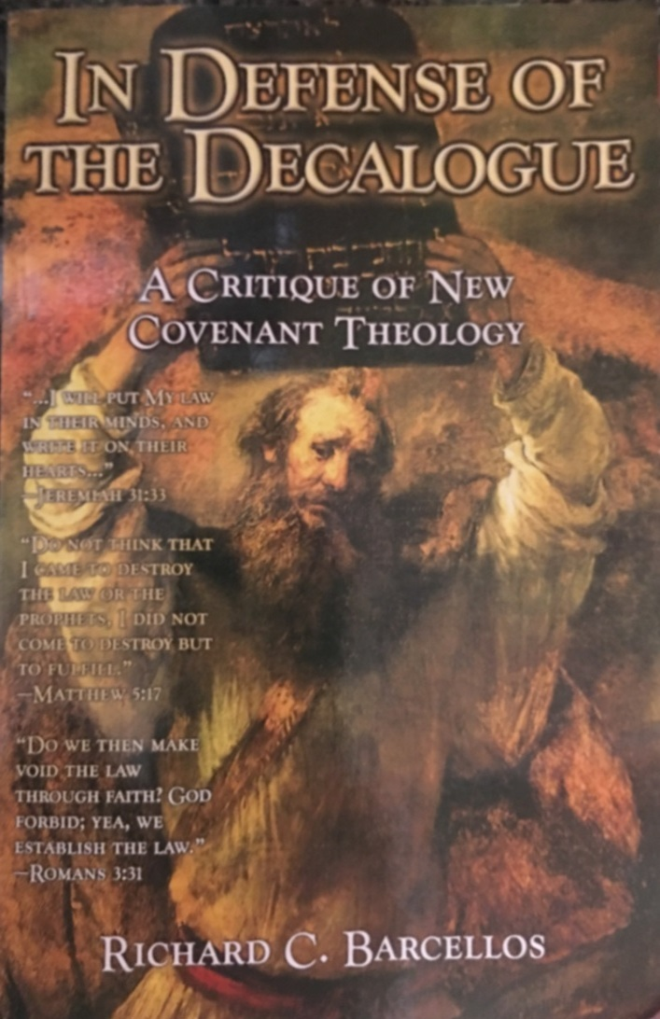
An Examination of Reformed Baptist Arguments Against New Covenant Theology

Slide 3
Chapter 5 NCT and the Identity of the Moral Law
In this chapter, Barcellos argues that the Ten Commandments are “the Moral Law” and that NCT is wrong to not recognize that.
The majority of his focus in this chapter is on Romans 2:14-15 where it says:
For when Gentiles, who do not have the law, by nature do what the law requires, they are a law to themselves, even though they do not have the law. They show that the work of the law is written on their hearts, while their conscience also bears witness, and their conflicting thoughts accuse or even excuse them (Rom 2:14-15)
We discussed this passage several weeks ago. Let’s do a quick review of what we said about it.

Slide 4
The “Law” Written on the Heart (Romans 2:14-15)
¹⁴ For when Gentiles, who do not have the law, by nature do what the law requires, they are a law to themselves, even though they do not have the law.
This verse tells us that even though the Gentiles had never had God’s law proclaimed to them or written out for them (like the Jews had), they show by their behavior that they do have a knowledge of God’s moral demands.
How so?
There was, in Paul’s day, a “widespread Greek tradition to the effect that all human beings possess an ‘unwritten’ or ‘natural’ law – an innate moral sense of ‘right and wrong.’ ” (see Douglas Moo’s commentary on Romans, p.150 fn. 34).

Slide 5
The “Law” Written on the Heart (Romans 2:14-15)
¹⁴ For when Gentiles, who do not have the law, by nature do what the law requires, they are a law to themselves, even though they do not have the law.
We see here that Paul affirms this idea (that men have an innate moral sense of right and wrong) when he tells us that Gentiles “do what the law requires” through a natural, inborn capacity.
Or, as the NLT translates this verse: Even Gentiles, who do not have God's written law, show that they know his law when they instinctively obey it, even without having heard it.
Paul’s point is that Gentiles outside of Christ regularly obey their parents, refrain from murder and robbery, and so on. (Doug Moo, p.150)
And when men recognize and do the things that the law says are right and good, they show that they do, in fact, have an innate knowledge of God’s righteous requirements.
Therefore it is just for God to hold them accountable when they fail to meet these righteous requirements.

Slide 6
The “Law” Written on the Heart (Romans 2:14-15)
¹⁵ They show that the work of the law is written on their hearts, while their conscience also bears witness, and their conflicting thoughts accuse or even excuse them ¹⁶ on that day when, according to my gospel, God judges the secrets of men by Christ Jesus.
Verse 15 describes the Gentile’s instinctive knowledge of God’s moral requirements when it says, “the law is written on their hearts” [i.e. their innermost thoughts].
Paul then goes on to tell us how that “law” operates within their “heart” : It operates through their “conscience”, so that as they evaluate their own thoughts and behaviors they will often judge their own behavior as:
Wrong (and thus will “accuse” themselves)
Or perhaps right in some cases (and thus will “even excuse” themselves in certain situations).
Paul then tells us that those innermost thoughts, where they condemn themselves for wrong behavior, will serve as the basis for their condemnation in the Day of Judgment.

Slide 7
The “Law” Written on the Heart (Romans 2:14-15)
¹⁵ They show that the work of the law is written on their hearts, while their conscience also bears witness, and their conflicting thoughts accuse or even excuse them ¹⁶ on that day when, according to my gospel, God judges the secrets of men by Christ Jesus.
Some points of clarification on this verse:
Paul is not claiming here that these Gentiles have perfect knowledge of God’s Law.
Our conscience, like everything else, has been corrupted by the Fall, which is why in other passages Paul can say things like :
The consciences of unbelievers are “defiled” (Titus 1:15)
Evil people can eventually destroy their conscience to the point where it becomes “seared as with a hot iron” (1 Timothy 4:2 - NIV).
Paul’s only point in this passage is that people who do wrong know better – even in the absence of law – and that knowledge will be the basis of their condemnation on the Day of Judgment.

Slide 8
Chapter 5 NCT and the Identity of the Moral Law
Barcellos approach to this passage is very different: His aim is to prove from this passage that the Law written on the Gentile’s hearts is the Ten Commandments! Therefore the Ten Commandments are God’s Moral Law.
Here is the logic he uses to get to this conclusion (p. 79):
The first reference to the law in verse 14 obviously refers to the law possessed by the Jews
This law is mentioned at the end of verse 12, in verses 13 and 14, and in several places in verses 17-27.
In verses 21 and 22 reference is made to commands contained in the Decalogue. Paul therefore gives the impression that what he means by the law the Jews possessed is… the Decalogue.
Elsewhere in Romans, Paul refers to the law of the Old Covenant and immediately quotes parts of the Decalogue (see Rom. 13:8-10)
What do you think of Barcellos logic?

Slide 9
Chapter 5 NCT and the Identity of the Moral Law
Barcellos anticipates an opposing view (p.79): Some might want to say that the law of the Jews being referred to by Paul is… the whole Law of Moses, which includes the moral, ceremonial, and civil law of the Old Covenant. This would mean that… God writes Old Covenant ceremonial and civil laws on the hearts of men, an untenable proposition.
If, as Barcellos contends, the law God writes on the heart (i.e. puts in the conscience) of Gentiles is the Ten Commandments, then this would mean that Gentiles know in their hearts from birth that they need to rest from their work on Saturday and spend that day worshipping God? Is that a tenable proposition?

Slide 10
Chapter 6 NCT and Hermeneutical Presuppositions
In this chapter, Barcellos challenges the NCT maxim that if an OT command is not repeated in the NT then it is not binding.
He asks: What is the exegetical basis for such a claim? There is none. (p.86)
How would you answer this challenge?
I find the exegetical basis for such a claim in the numerous passages of the NT that tell us that the OT Law no longer serves as law for New Covenant believers. (e.g. Rom. 6:15; 8:1-2; 1Cor. 9:20-21; Gal 3:23-25; 5:18; Eph. 2:15; Col. 2:14)
Instead of “keeping” the OT Law (which the NT never tells us to do) we are to “fulfill” the Law by obeying the Law of Christ and his apostles (Mat 5:17ff; Rom. 13:8-9; Gal 5:18ff)

Slide 11
Chapter 6 NCT and Hermeneutical Presuppositions
We could challenge Barcellos by turning his own question back on him: Does Barcellos believe we are bound by every OT law that is not repealed in the NT?
If so, would he say that we are bound by the following OT laws that are not repealed in the NT?
Do not cut the hair at the sides of your head or clip off the edges of your beard. (Lev. 19:27 NIV)
You shall not sow your field with two kinds of seed, nor shall you wear a garment of cloth made of two kinds of material. (Lev. 19:19)
For anyone who curses his father or his mother shall surely be put to death; (Lev. 20:9)

Slide 12
For Next Time…
Read Chapters 7 (from pages 87-107) before we meet again and come prepared to discuss it.

Slide 13
Other Questions?

