Slide 1
New Covenant Theology Final Overview!

Slide 2
Why We Did a Series on New Covenant Theology (NCT)
The Bible explicitly refers to the “New Covenant” in a number of passages and builds theology and application on it.
NCT helps us rightly understand and apply the Word of God.
NCT helps us appreciate and make sense of the unfolding of God’s sovereign plan of redemption as it was progressively revealed in the scriptures.

Slide 3
There Are Five Major Covenants Explicitly Taught in the Bible
Can you name them?
Noahic (Genesis 9:8-17)
Abrahamic (Genesis 12-17)
Mosaic or “Old” (Exodus 19-24)
Davidic (2Samuel 23:5, Psalm 89:3)
New (Jer.31:31-34 ; Heb.7-13; 2Cor.3:6-18)
The first four major covenants all pointed to and were ultimately fulfilled in the New Covenant

Slide 4
The Structure and Message of the Bible
Based on a Chart Originally Developed by David N. Steele
The Triune God
(1) The Father
(2) The Son (Jesus Christ)
(3) The Holy Spirit
Gentiles (The Nations of the World)
Unbelieving Jews and Gentiles
Jews (The Nation of Israel)
The Church (Christ’s Body)
Composed of Believing
Jews and Gentiles
“Christians”
The Incarnation
(John 1:1-3,14)
Ascension
(Luke 24; Acts 1)

(1)
(2)
( 3 )
“R”
Creation
Abraham
Moses
the Law Giver
King David
Jesus Christ
Holy Spirit
)()()()()(
The Four Gospels
The Book of Acts
Chs. 1-12 Peter (Jews) AD 30-44
Chs. 13-28 Paul (Gentiles) AD 44-60
The Call of Abraham
(the Father of the Jews)
(1) Birth
(2) Baptism
The
Fall
(Adam)
(3) Public Ministry
Letters to Churches and
Individual Christians - Revelation

= Crucifixion
The
Flood
(Noah)
“R” = Resurrection
Jews (The Nation of Israel)
Gentiles (The Nations of the World)
Unbelieving Jews and Gentiles
4000
2300
2000
1400
1000
5BC
AD 28
44
95
The Old Testament (39 Books)
Written in Hebrew
Genesis --- (Promises -- Prophecy) --- Malachi
400
Years
The New Testament (27 Books & Letters)
Written in Greek
Matthew ----- (Fulfillment) ------ Revelation

Slide 5
The New Testament Contrasts and Compares Some of the Major Covenants
By far, the most common comparison and contrast of covenants made in the NT is between:
The Old (or Mosaic) Covenant
The New Covenant

Slide 6
A Comparison of the Old and New Covenants
The
Old Covenant
The
New Covenant
Fundamentally Different
Superior
Fulfills
Replaces

Slide 7
The New Covenant Is Fundamentally Different From the Old Covenant
The Old Covenant
The New Covenant
Made with One Nation
Includes Many Nations
Included Believers and Unbelievers
Includes Believers Only
Focused on Physical Blessings
Physical Health
Physical Wealth
Military Victory
Focuses on Spiritual Blessings
Spiritual Health
Spiritual Wealth
Spiritual Victory

Slide 8
The New Covenant is Superior to the Old Covenant
Old Covenant
Gives Way To
New Covenant
Slavery (Gal. 5:1)
Gives Way To
Freedom (Gal. 5:1)
Mediator, Moses (Jn. 1:17)
Gives Way To
Mediator, Christ (Jn. 1:17)
Law of Moses (1Cor 9:20)
Gives Way To
Law of Christ (1Cor. 9:21)
Ministry of Death (2Cor 3:7)
Gives Way To
Ministry of Spirit (2Cor. 3:8)
Writing on Stones (2Cor 3:3)
Gives Way To
Writing on Hearts (2Cor 3:3)
Fading Glory (2Cor 3:10)
Gives Way To
Abiding Glory (2Cor 3:11)
Ministry of Condemnation
(2Cor 3:9)
Gives Way To
Ministry of Righteousness
(2Cor 3:9)
Disobedient People (Heb.8:9)
Gives Way To
Obedient People (Heb.8:10)
People Who Do Not "Know the Lord" (Jer.2:8; 4:22; 9:3)
People Who "Know the Lord" (Jer. 31:34; 24:7)
Gives Way To

Slide 9
The New Covenant Fulfills the Old Covenant
The Old Testament (Law and Prophets) Contained Many:
Specific Commands
Promises
Prophesies
Types and Shadows
Christ Fulfills the Old Testament By His Entire Mission:
By what He was
By what He taught
By what He did
By what He is still doing
And by what he will yet do

Slide 10
The New Covenant Replaces The Old Covenant
Hebrews 8:7-8,13 - For if that first covenant had been faultless, there would have been no occasion to look for a second. ⁸ For he finds fault with them when he says: "Behold, the days are coming, declares the Lord, when I will establish a new covenant with the house of Israel and with the house of Judah… ¹³ In speaking of a new covenant, he makes the first one obsolete. And what is becoming obsolete and growing old is ready to vanish away.
Other Passages that teach this idea:
2 Corinthians 3:6-11
Ephesians 2:14-16
Colossians 2:14-17

Slide 11
The New Testament Contrasts and Compares Some of the Major Covenants
By far, the most common comparison and contrast of covenants made in the NT is between:
The Old (or Mosaic) Covenant
The New Covenant
In Galatians 3:15-25 a Comparison is made between:
The Abrahamic Covenant
The Old Covenant
The New Covenant

Slide 12
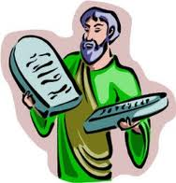
Promise and Law - Galatians 3:15-25
The Call
of
Abraham
(Gen. 12:1-3)
Promise(s)
Fulfillment
The Law of Moses
In the Abrahamic Covenant, God promised Abraham an “offspring” (3:15-17)
Did not set aside the promise to Abraham (Gal. 3:17-18)
Was added “because of [i.e. to increase] transgressions” (Gal. 3:19)
Was to remain in force only until Christ came (Gal 3:19a, 24)
Now that [the New Covenant era of] faith has come, we are no longer under the guardianship of the Law (Gal.3:25)
430 years later
Law Added UNTIL
Jesus Christ,
the Promised Offspring Came

Slide 13
Questions Raised by New Covenant Theology

Slide 14
Questions Raised by New Covenant Theology
Are the laws and commandments given in the Old Testament binding on New Covenant Christians today?
What about keeping the Sabbath?
What does/did it mean to keep the Sabbath?
Are Christians today obligated to keep the Sabbath?
What about Tithing?
What are the competing theological systems to New Covenant Theology?
What questions do these competing views raise that we need to evaluate and consider?

Slide 15
Questions Raised by New Covenant Theology
We spent several weeks looking at the first question that I raised concerning New Covenant Theology: Are OT laws binding on Christians today?
To summarize our answer:
A number of NT passages clearly teach that we are no longer under the Law of Moses, but are now under the Law of Christ. In that sense, we no longer bound by OT Law (Hebrews 8:6-13 cf. Hebrews 7:12; Galatians 3:15-25; Ephesians 2:14-16) .
However, there are many timeless moral principles which bind men of all ages – even those whom God has not given an external revelation of his laws (Rom 2:11-16).
Therefore we (along with the NT writers) can still look at OT texts that teach these timeless moral principles and learn from them (e.g.. Eph. 6:1-3; 1Cor. 14:33b-34).
Furthermore, Jesus and the NT writers teach us that by obeying what Jesus teaches us in the NT, we are fulfilling all that the OT law pointed to (Mat. 5:17-48, Rom. 13:8-10).

Slide 16
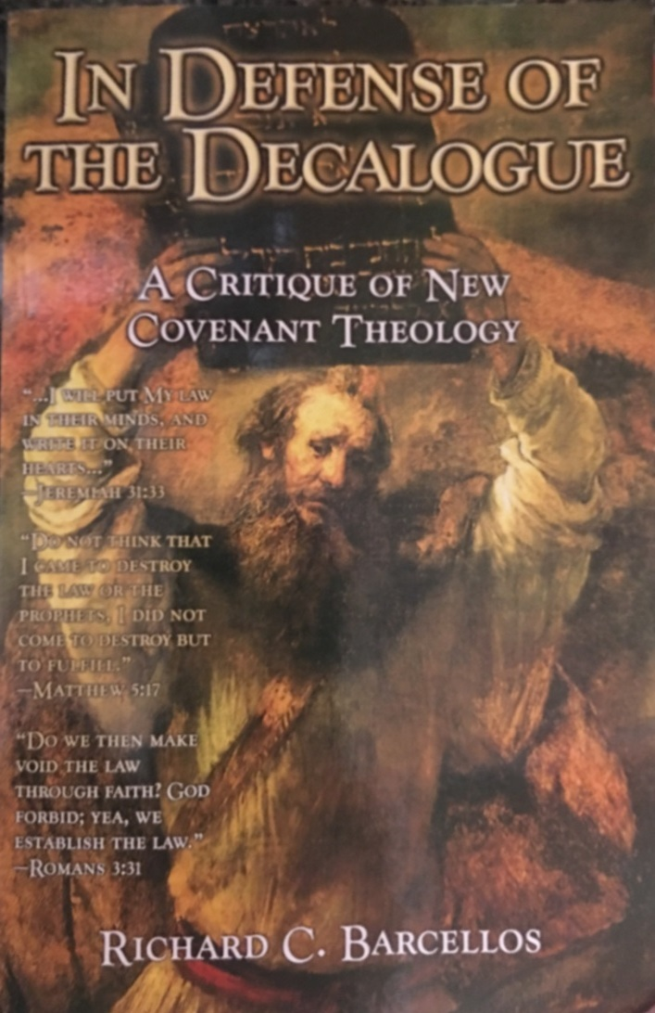
An Examination of Reformed Baptist Arguments Against New Covenant Theology

Slide 17
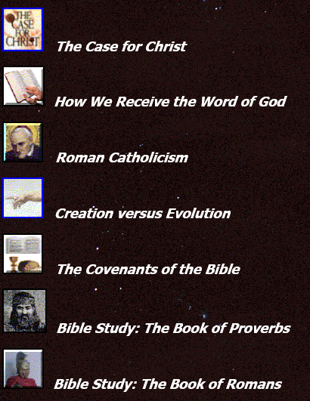
To Review Any of the Materials Covered in Class…
Go to: http://www.purifiedbyfaith.com/
Click Here
Then Here

Slide 18
Preview of Things to Come…
Next week, Stephen is going to give me a short break and teach a series on the “one another” passages of scripture.
After that I plan to start a new series on Church History.

Slide 19
Other Questions?

