Slide 1
How to Raise Wise, Godly Children
Training Your Child to Obey
Dealing with Rebellion
Training in Righteousness
Aiming for the Heart

Slide 2
What is Proper Biblical Discipline?
Proper biblical discipline occurs when a parent, acting in faith toward God and love toward his children, makes careful, timely, measured, and controlled use of physical punishment to underscore the importance of obeying God, thus rescuing the child from continuing in his foolishness until death.*
*Paraphrased from Tedd Tripp, Shepherding a Child’s Heart

Slide 3
Excuses Parents Use for Not Spanking
I’m afraid it will make him rebellious and angry.
As a parent, you want your children to love and appreciate you. You want them to think Mom and Dad are great. You may be afraid that spanking will make them think you’re a big meanie. Proverbs states the opposite:
Discipline your son, and he will give you peace; he will bring delight to your soul. (Proverbs 29:17 NIV)
Rather than discipline producing angry, sullen children, it produces children that bring you delight and give you peace.

Slide 4
Excuses Parents Use for Not Spanking
My child is not old enough to understand why he’s being disciplined*
I’ve heard moms brag about how smart their babies are; their six month old can wave bye-bye or clap his hands and play pat-a-cake upon encouragement. By eight months he has an enormous understanding of vocabulary. He responds to such instructions as, “Come to Mama,” “Blow kisses,” and “Hug your baby doll.” Yet these same moms who brag about how smart their babies are say, “Oh, he’s just too young to understand the word ‘No.’”
Children are old enough to learn “No” when they are old enough to do something that requires you to tell them “No.”
*Gleaned from Ginger Plowman, Don’t Make Me Count to Three

Slide 5
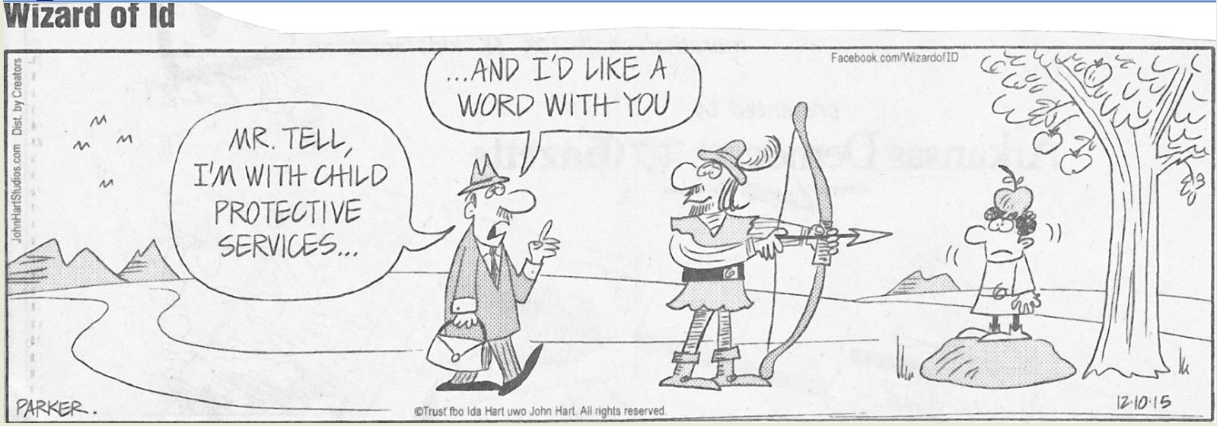
Excuses Parents Use for Not Spanking
I’m afraid of being arrested for child abuse.

Slide 6
Excuses Parents Use for Not Spanking
I’m afraid of being arrested for child abuse*
There is validity to this concern. You must be careful to avoid unnecessary exposure to being reported by someone who does not approve of spanking. Spanking should be done in the privacy of the home.
Ultimately this is a question of faith. Will I obey God even when there are risks attached to obeying?
*Gleaned from Tedd Tripp, Shepherding a Child’s Heart

Slide 7
Excuses Parents Use for Not Spanking
Questions:
Do you sometimes have a hard time believing that spanking your child is an act of love?
Are you sometimes tempted to think that spanking your child doesn’t really do any good? If so, what is it that makes you think that?
What other excuses (besides the ones we have mentioned in this section) have you heard other parents give (or perhaps you yourself have given!) for not spanking a disobedient child?

