Slide 1
The Book of Proverbs
The Importance of Self-Control
Proverbs

Slide 2
What Is Self-Control?
Self-control is choosing the helpful thing or the most important thing rather than the harmful thing or the less important thing.
Self-control is the skill of saying “no” to harmful or sinful desires, even when it’s hard to do.
A person who lacks self-control is a disaster waiting to happen:
A man without self-control is like a city broken into and left without walls. (25:28)
They are defenseless against the ravages of their own sin
Often others, seeing their weakness, will take advantage of them
The Proverbs speak of a number of areas where the lack of self-control can show up in our life – all of them with devastating consequences.

Slide 3
Areas Where You Need Self-Control
Overindulgence and Alcoholism:
Do not join those who drink too much wine or gorge themselves on meat, for drunkards and gluttons become poor, and drowsiness clothes them in rags. (23:19-21 NIV)
Rage and Anger:
A fool gives full vent to his anger, but a wise man keeps himself under control. (29:11 NIV)
A hot-tempered man must pay the penalty; if you rescue him, you will have to do it again. (19:19 NIV)
Failure to Control Your Tongue:
He who guards his mouth and his tongue keeps himself from calamity. (21:23 NIV)
A man of knowledge uses words with restraint, and a man of understanding is even-tempered. Even a fool is thought wise if he keeps silent, and discerning if he holds his tongue. (17:27 NIV)

Slide 4
Areas Where You Need Self-Control
We see numerous other areas in our day where people are out of control:
Drug Addictions
Gambling addictions
Sexual Addictions
Video Game Addictions
Compulsive Spenders
Inability to say “no” to people who try to take advantage of you
What are some areas where younger children tend to be lacking in self-control?
Sitting still and listening or playing quietly
Work first and play later
Waiting for something they want

Slide 5
Lack of Self-Control in Children
“Marshmallow man” Walter Mischel is an Ivy League professor known for his experiments in self-control. Nearly 50 years ago, he created a test to see how various five-year-olds would respond to being left alone with a marshmallow for 15 minutes with instructions not to eat it — and with the promise that if they didn’t, they would be given two. The New York Times reports:
Famously, preschoolers who waited longest for the marshmallow went on to have higher SAT scores than the ones who couldn’t wait. In later years they were thinner, earned more advanced degrees, used less cocaine, and coped better with stress. As these first marshmallow kids now enter their 50s, Mr. Mischel and colleagues are investigating whether the good delayers are richer, too.
http://www.nytimes.com/2014/09/14/opinion/sunday/learning-self-control.html?_r=0

Slide 6
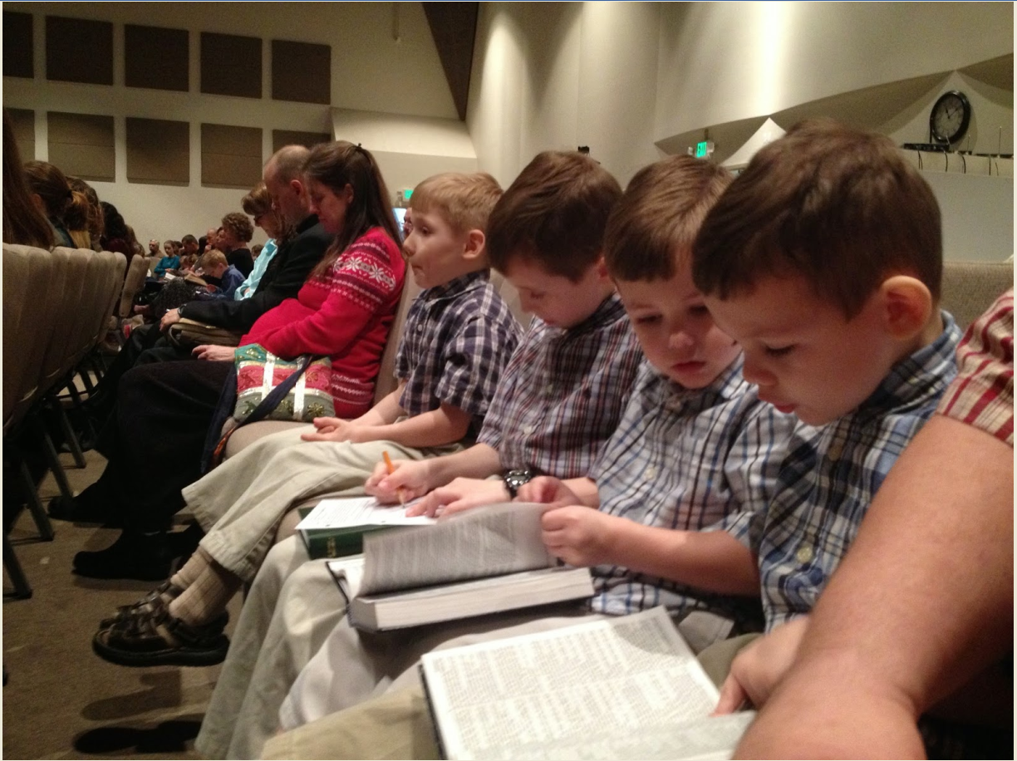
Lack of Self-Control in Children
Is it possible for children to be characterized by self-control?

