Slide 1
How to Raise Children to Become Wise, Responsible, Godly Adults
Training Your Child to Obey
Dealing with Rebellion
Training in Righteousness
Aiming for the Heart

Slide 2
“Tools” for Training in Righteousness
Spanking/Consequences
Teaching/Instructing
Rebuking/Correcting
Developmental Activities
Modeling by Personal Example

Slide 3
Developmental Activities
We are in the process of looking at three types of developmental activities:
Work
Education
Recreation

Slide 4
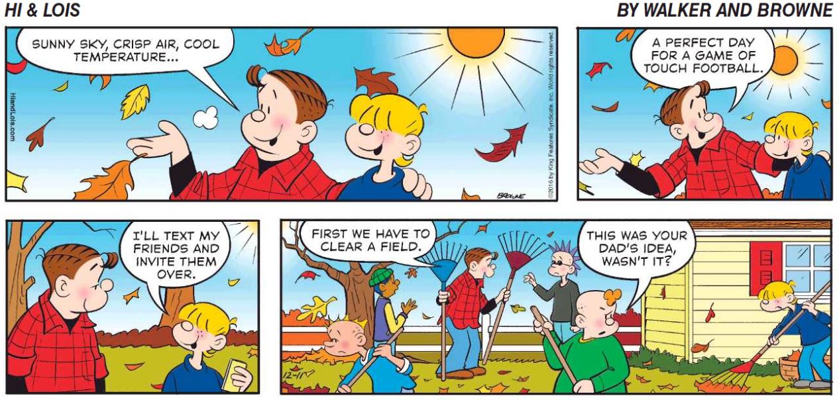
Developmental Activities

Slide 5
Recreation
We will look at several areas of recreation:
Sports
Music
Games
Audio / Video
Vacations and Day Trips

Slide 6
Audio / Video
This is a very broad category that I’m using to discuss a variety things:
Movies (both in Theaters or on DVDs)
Television (shows, documentaries, news, etc.)
YouTube videos of various stripes
Sermon Videos (or Audio)
Talk Radio
Plays and Dramas
Like everything else in our fallen world, audio/visual materials can be:
Very Helpful and Uplifting
Very Harmful and Destructive
Or Some Combination of the Two

Slide 7
Audio / Video
Because video materials involve our eyes and ears, they can have a profound effect on us emotionally.
A strictly audio presentation, on the other hand, is more likely to stimulate thinking.
In our day, movies and television, especially, play a huge role in shaping our culture and how we think (even Christians).
There are two extremes in dealing with the tremendous influence of audio/video:
Parents who deny the tremendous influence of audio video and therefore set no “guard rails” for their kids (or themselves!) in this area
Parents who, fearing the potential negative effects of audio/video, try to cut their kids off from any exposure to it – even material that could be beneficial.

Slide 8
Audio / Video
Some ways you can use audio/video to benefit your kids:
Audio/Video presentations (sermons, talks, debates, documentaries) can be a helpful aid in educating your kids.
Even though we tend to associate movies with the bad influence of Hollywood (and many of them are), there are some really good and beneficial movies available:
Movies that portray events in the Bible
Movies on the great role models in Christian history
Movies that show the virtues and struggles involved in Christian living
Secular movies that idealize the best in human behavior and virtue or show the folly of sin and vice
Movies that give an accurate view of events in history

Slide 9
Audio / Video
Some things to beware of concerning your kids exposure to audio/video:
Your need to shamelessly insist on monitoring any and all audio/video materials that your kids are exposing themselves to – although this does become more difficult as they get older and gain more independence.
Consider exposing your kids to audio/visual materials that are contrary to the Christian worldview and then spending time discussing and critiquing it with them. Start by asking them lots of questions!

Slide 10
Questions on Audio / Video
Tell us where (and why) do you land on the continuum between:
Parents who restrict their kids from watching almost anything for fear that they will be harmed by what they see
Parents make no effort whatsoever to monitor or restrict what their kids watch?
What are some movies/videos/programs, etc. that you have seen that you would recommend to the class?

