Slide 1


Slide 2

Review
During the NT period, the Roman Empire controlled the whole of Mediterranean Europe, North Africa and the Middle East.
The Empire was made up of a vast variety of ethnic and religious groups.
What did I say last week were the three main things these diverse groups had in common that held the Roman Empire together?
  A Common Political Loyalty
  A Common Economy
  A Common Intellectual Culture (which included religion and philosophy)

Slide 3
Review
Was Rome a Republic or an Empire? Explain your answer.
  Rome started as a kingdom – 753 BC to 510 BC
  It became an aristocratic republic – 510 BC to 44 BC
  It became an empire under Augustus Caesar – 31 BC
What new Testament passage mentions Caesar Augustus?
  In those days a decree went out from Caesar Augustus that all the world should be registered. (Luke 2:1)
Who were the two great enemies of Rome from whom the emperor provided protection in the days of Augustus?
  The mighty Parthian (Persian) Empire in the east (modern day Iran)
  The Germanic tribes who lived across the Rhine and Danube rivers in the north.

Slide 4
Review
What single Roman conquest gave Rome a significant economic boost, became a major source of grain and opened up trade routes to the east?
  Egypt
Finish this statement from last week’s lesson and explain what it means: “The armies of Rome vanquished the East, but Eastern culture…
  vanquished Rome”.
  By the 1st century BC, the Greek language, Greek methods of education, Greek art and literature, and Greek philosophy and science had taken root across the entire Roman Empire.

Slide 5
Review
What were the two major languages spoken in the Roman empire and in which portions of the empire were they spoken?
  Everyone in the eastern half of the Empire who lived in a city spoke Greek as his first language.
  In the western half of the Empire, Latin was the first language, but most educated people would have spoken Greek as their second language.

Slide 6
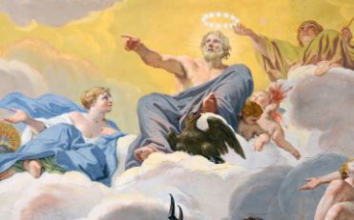
Roman Religious Culture
Now while Paul was waiting for [Silas and Timothy] at Athens, his spirit was provoked within him as he saw that the city was full of idols. (Act 17:16)
https://commons.wikimedia.org/wiki/File:Ceiling_%22Council_of_the_Gods%22_in_Galleria_Borghese_(Rome).jpg

Slide 7
*Roman Religious Culture
This social and political setting into which Christianity was born was also a world where religion flourished – indeed, in the everyday lives of people throughout the Roman Empire, religion was a pervasive and powerful force.
At the time of Jesus and the apostles, there were four main forms of religion in the Empire (apart from Judaism):
  Traditional Pagan religion
  Emperor-worship
  The Eastern mystery cults
  Philosophy
* Needham, Nick. 2,000 Years of Christ's Power Vol. 1: The Age of the Early Church Fathers (Kindle: 323-326)

Slide 8
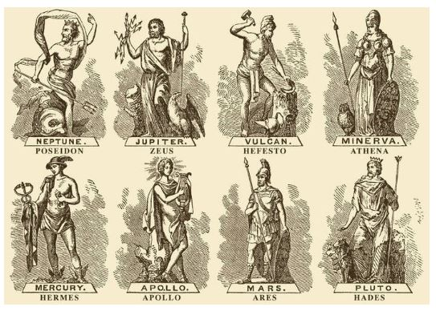
Roman Traditional Pagan Religion
https://www.vecteezy.com/vector-art/103102-greek-gods

Slide 9
*Roman Traditional Pagan Religion
Roman Pagan Religion involved the worship of a family of gods headed by the chief god whose Greek name was Zeus (Jupiter or Jove in Latin).
There were different gods for almost every aspect of life. For example:
  Poseidon (Latin, Neptune) god of the sea and earthquakes
  Hephaestus (Latin, Vulcan) god of fire and blacksmithing
  Athena (Latin, Minerva) goddess of wisdom, poetry, art, and the strategic side of war
  Mercury (Latin, Hermes) god of commerce and travel, and messenger of the gods
  Apollo – god of the sun, music, healing, and herding
  Ares (Latin, Mars) god of war
  Hades (Latin, Pluto) god of the dead, king of the underworld
  Aphrodite (Latin, Venus) goddess of love and beauty
  Artemis (Latin, Diana ) goddess of the moon, hunting, and nursing
* Needham, Nick. 2,000 Years of Christ's Power Vol. 1: The Age of the Early Church Fathers (Kindle: 327-331)

Slide 10
*Roman Traditional Pagan Religion
People tried to obtain the blessing of the gods in all the affairs of life: in agriculture, business, marriage, politics, war.
Pagan worship involved such things as animal sacrifices, prayer, and various ways of trying to find out the will of the gods (e.g. through divination, dreams and prophecy).
This traditional Pagan religion was the official faith of the Roman Empire, funded and upheld by the state, and regarded as essential to its survival and prosperity.
The emperor himself was the high priest (“pontifex maximus”) of traditional Paganism.
Family heads and elected city leaders were expected to carry out its ceremonies as part of their normal duties.
* Needham, Nick. 2,000 Years of Christ's Power Vol. 1: The Age of the Early Church Fathers (Kindle: 327-331)

Slide 11
*Roman Traditional Pagan Religion
And when the crowds saw what Paul had done, they lifted up their voices, saying in Lycaonian, "The gods have come down to us in the likeness of men!" Barnabas they called Zeus, and Paul, Hermes, because he was the chief speaker. And the priest of Zeus, whose temple was at the entrance to the city, brought oxen and garlands to the gates and wanted to offer sacrifice with the crowds. But when the apostles Barnabas and Paul heard of it, they tore their garments and rushed out into the crowd, crying out, "Men, why are you doing these things? We also are men, of like nature with you, and we bring you good news, that you should turn from these vain things to a living God, who made the heaven and the earth and the sea and all that is in them. (Acts 14:11-15)

Slide 12
*Roman Traditional Pagan Religion
About that time there arose no little disturbance concerning the Way. For a man named Demetrius, a silversmith, who made silver shrines of Artemis, brought no little business to the craftsmen. These he gathered together, with the workmen in similar trades, and said, "Men, you know that from this business we have our wealth. And you see and hear that not only in Ephesus but in almost all of Asia this Paul has persuaded and turned away a great many people, saying that gods made with hands are not gods. And there is danger not only that this trade of ours may come into disrepute but also that the temple of the great goddess Artemis may be counted as nothing, and that she may even be deposed from her magnificence, she whom all Asia and the world worship." When they heard this they were enraged and were crying out, "Great is Artemis of the Ephesians!“ (Acts 19:23-28)

Slide 13
*Roman Traditional Pagan Religion
Traditional Pagan religion was also part of the literary and artistic culture of the Empire, because it formed the religious background of the two great epic poems, the Iliad and the Odyssey.
These had been written several centuries before the birth of Christ and were usually ascribed to the Greek poet Homer (active around 750 BC).
The Iliad, Odyssey and Aeneid were the most admired works of literature in the Greek and Roman world, and often depicted the characters and activities of the traditional Pagan gods.
* Needham, Nick. 2,000 Years of Christ's Power Vol. 1: The Age of the Early Church Fathers (Kindle: 331-338)

Slide 14
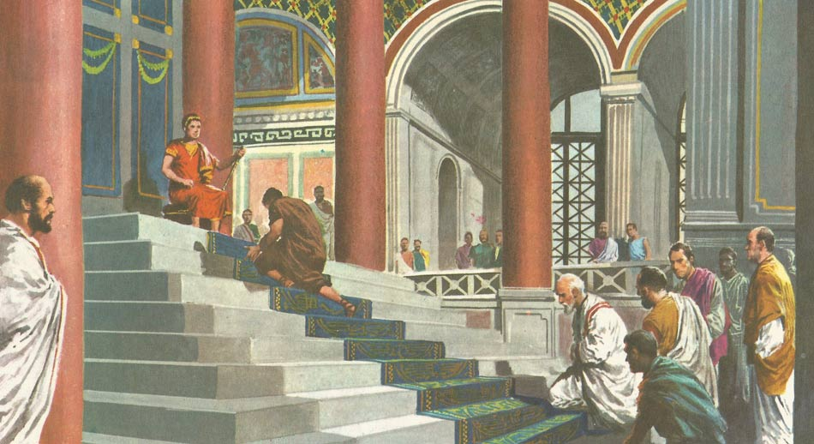
Roman Emperor Worship
http://www.daviddarling.info/encyclopedia_of_history/D/Diocletian.html

Slide 15
*Roman Emperor Worship
The amazing growth of Rome’s dominion over the Mediterranean world encouraged the Romans to believe that there was a special divine power at work, creating the Empire, and that this power was especially connected with the emperor.
Hellenism gave a powerful stimulus to this belief; Hellenistic culture already saw kings as divine figures, gods incarnate.
When the ideals of Hellenism flowed into the Roman world, they gave rise to the practice of worshipping the emperor.
* Needham, Nick. 2,000 Years of Christ's Power Vol. 1: The Age of the Early Church Fathers (Kindle: 338-342)

Slide 16
*Roman Emperor Worship
In the Eastern half of the Empire, where Hellenistic values were more deeply rooted, people worshipped the emperor in his own lifetime as a living god.
In the West, however, emperor-worship was less open and obvious; people normally worshipped, not the emperor himself, but the genius of the emperor (i.e. the “divine power” that stood behind him).
The Senate raised some emperors, such as Augustus, to the ranks of the gods after they had died, and people then prayed to them throughout East and West.
* Needham, Nick. 2,000 Years of Christ's Power Vol. 1: The Age of the Early Church Fathers (Kindle: 342-345)

Slide 17
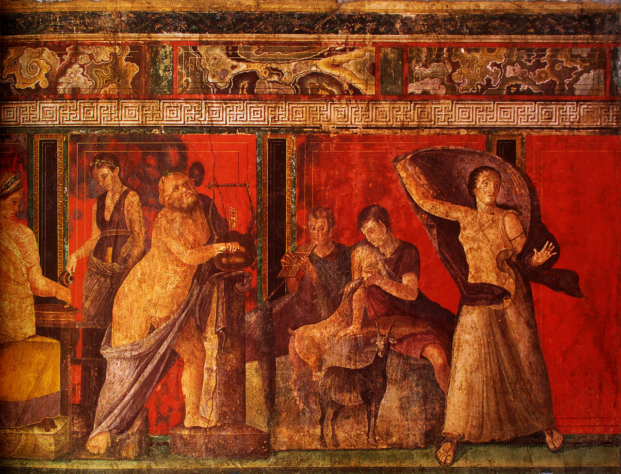
The Eastern Mystery Cults.
https://en.wikipedia.org/wiki/Villa_of_the_Mysteries#/media/File:Fresque_des_myt%C3%A8res,_Pomp%C3%A9i.jpg

Slide 18
*The Eastern Mystery Cults.
These were forms of religion which had a more recent origin than traditional Roman Paganism.
These cults had spread across the Empire from the east, and were much more intimate and emotional faiths than traditional Paganism or emperor-worship.
A mystery cult involved the worshipper in a close personal relationship with his god or goddess.
The worship of the cult deities made an overpowering appeal to the physical senses and feelings of the worshipper, involving song, dance, musical instruments, public processions, religious feasting, ritualistic animal sacrifices, and group acts of sexual immorality.
Worshippers often fell into ecstatic states of trance and prophecy as they took part in the worship.
* Needham, Nick. 2,000 Years of Christ's Power Vol. 1: The Age of the Early Church Fathers (Kindle: 346-353)

Slide 19
*The Eastern Mystery Cults.
The cults were also much more like the Christian Church than the other types of religion were, in the sense that a worshipper had to join a mystery cult by a personal decision of his own, and be initiated into membership by special ceremonies.
The very name “mystery” comes from the Greek word mysterion, which means “secret ritual or teaching”.
All the Eastern Mystery cults promised eternal life after death to their followers; indeed, this was their greatest appeal – traditional Paganism and emperor-worship offered no such consolations in the face of death.
* Needham, Nick. 2,000 Years of Christ's Power Vol. 1: The Age of the Early Church Fathers (Kindle: 353-362)

Slide 20
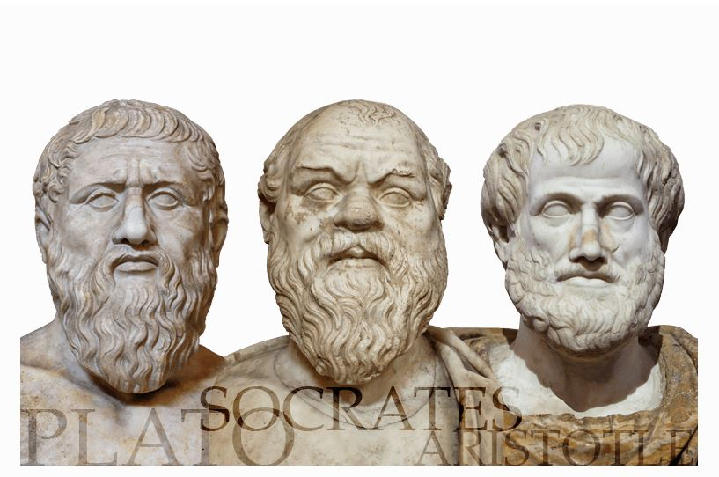
Philosophy in the Roman Empire
[While waiting in Athens, Paul] reasoned in … the marketplace every day with those who happened to be there. Some of the Epicurean and Stoic philosophers also conversed with him. (Act 17:17-18)

Slide 21
*Philosophy in the Roman Empire
In the Roman Empire, philosophy was not just an academic subject taught in universities. It was a total way of life which promised peace and fulfilment to those who practiced it.
However, it was not a mass movement; philosophers came almost exclusively from the educated classes.
At the time of Jesus, there were three chief types or “schools” of philosophy competing for people’s allegiance, all originating from the Greek city of Athens, the birthplace of European thought:
  Platonism
  Epicureanism
  Stoicism
* Needham, Nick. 2,000 Years of Christ's Power Vol. 1: The Age of the Early Church Fathers (Kindle: 362-366)

