Slide 1


Slide 2

Review
This social and political setting into which Christianity was born was also a world where religion flourished – indeed, in the everyday lives of people throughout the Roman Empire, religion was a pervasive and powerful force.
At the time of Jesus and the apostles, what did we say were the four main forms of religion in the Roman Empire (besides Judaism)?
  Traditional Pagan religion
  Emperor-worship
  The Eastern mystery cults
  Philosophy

Slide 3
Review
Roman Pagan Religion involved the worship of a family of gods headed by a chief god whose name was what?
  Zeus (Latin: Jupiter or Jove)
There were different Roman gods for almost every aspect of life. Name three of the Greek/Roman gods that we talked about last week and tell what each god was known for.
Are there any Greek gods mentioned by name in the NT? If so, who are they and where are they mentioned?
  Barnabas and Paul were thought to be Zeus and Hermes in Acts 14:12-13.
  Artemis is mentioned five times in Acts 19:24-35 where Paul, through the proclamation of the Gospel, is said to have hurt the profits of the Ephesian idol makers.

Slide 4
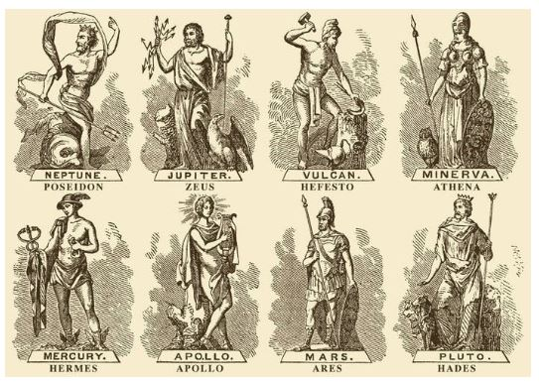
Greek/Roman Gods
  Poseidon (Latin, Neptune) god of the sea and earthquakes
  Hephaestus (Latin, Vulcan) god of fire and blacksmithing
  Athena (Latin, Minerva) goddess of wisdom, poetry, art, and the strategic side of war
  Mercury (Latin, Hermes) god of commerce and travel, and messenger of the gods
  Apollo – god of the sun, music, healing, and herding
  Ares (Latin, Mars) god of war
  Hades (Latin, Pluto) god of the dead, king of the underworld
  Aphrodite (Latin, Venus) goddess of love and beauty
  Artemis (Latin, Diana ) goddess of the moon, hunting, and nursing
Go Back to Review

Slide 5
Review
The amazing growth of Rome’s dominion over the Mediterranean world encouraged the Romans to believe that there was a special divine power at work, creating the Empire. In the minds of many Romans, this power was especially connected with whom?
  the emperor
The Eastern Mystery Cults were said to have many things in common with Christianity. Name some of the similarities:
  Worshippers of the Eastern Mystery Cults had to join a mystery cult by a personal decision
  Had to be initiated into membership by special ceremonies.
  Were promised eternal life after death
  Worship of the cult deities involved song, dance, musical instruments, public processions, religious feasting, and prophecy

Slide 6
Review
In the Roman Empire, philosophy was not just an academic subject taught in universities. It was a total way of life which promised peace and fulfilment to those who practiced it.
Name the three chief types or “schools” of philosophy competing for people’s allegiance during the NT period:
  Platonism
  Epicureanism
  Stoicism
Does the NT refer to any of these philosophies by name? If so, which ones and where are they mentioned?
  Epicurean and Stoic philosophers interacted with the Apostle Paul in Act 17:17-18

Slide 7
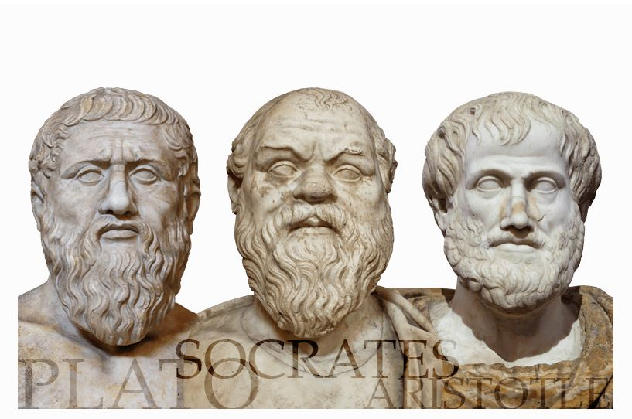
Philosophy in the Roman Empire
[While waiting in Athens, Paul] reasoned in … the marketplace every day with those who happened to be there. Some of the Epicurean and Stoic philosophers also conversed with him. (Act 17:17-18)
https://www.michaeloart.com/wp-content/uploads/2015/02/plato-socrates-aristotle.png

Slide 8
*Philosophy in the Roman Empire
This morning we will be looking at four “schools” of philosophy competing for people’s allegiance at the time of Christ and the apostles:
  Platonism
  Epicureanism
  Stoicism
  Cynicism
*Needham, Nick. 2,000 Years of Christ's Power Vol. 1: The Age of the Early Church Fathers (Kindle: 362-366)

Slide 9
*Platonism
Named after the great Athenian philosopher Plato (427–347 BC).
Socrates (470–399 BC), Plato’s teacher, had been condemned to death, as an incredulous corrupter of youth.
Socrates, himself, never wrote down any of his ideas, so it's hard for us to know exactly what Socrates believed because everything that we know about him comes from the writings of those who knew him (i.e. Plato and others).
Plato wrote several dialogues in Socrates’ defense, and by the first century Socrates was considered one of the greatest sages of antiquity.
Along with his teacher, Socrates, and his most famous student, Aristotle (384–322 BC), Plato laid the foundations of Western philosophy and science. (Plato; Encyclopedia Britannica)
*Gonzalez, Justo; The Story of Christianity: Vol. 1: The Early Church to the Dawn of the Reformation; p. 22-24

Slide 10
*Platonism
Plato believed there were two realities:
  The ideal, unchanging, eternal realm of God
  The constantly changing world of space and time where we live
Plato taught that everything in our physical world is a copy or attempt to represent the ultimate reality that exists in the eternal realm.
The human soul, according to Platonists, was itself eternal (that is, the soul had existed from all eternity, and was by nature immortal and incapable of being destroyed), and therefore the soul had more in common with God than with the world.
By contemplating God, Plato believed that the philosopher will become more and more like God – which he believed to be the philosopher’s ultimate goal.
*Needham, Nick. 2,000 Years of Christ's Power Vol. 1: The Age of the Early Church Fathers (Kindle: 378-380)

Slide 11
*Platonism
Many of the early Church fathers were converts from Platonism, and its general religious outlook continued to exert a strong influence on them, especially in two areas:
  Jesus’ Divinity
  Conflict Between Spiritual and Physical
*Needham, Nick. 2,000 Years of Christ's Power Vol. 1: The Age of the Early Church Fathers (Kindle: 380-390)

Slide 12
*Platonism and Jesus’ Divinity
The thinking of many early theologians was strongly colored by Platonism’s extreme emphasis on the sheer gulf between the changing physical world in which we live and the eternal unchanging God.
This made it difficult for some Christian thinkers to understand how an unchanging God could have entered the world by becoming a man in Jesus Christ
To solve the problem, they were tempted to say that Christ was something less than absolutely divine.
It was not until the Arian controversy was debated and resolved in the 4th century that the Church finally purged this idea out of its theology.
*Needham, Nick. 2,000 Years of Christ's Power Vol. 1: The Age of the Early Church Fathers (Kindle: 380-390)

Slide 13
*Platonism and the Conflict Between the Spiritual and the Physical
Platonism’s teaching on the superiority of the soul and the spiritual life over the body and physical life held powerful attractions for many Christians.
It produced a tendency in some of them to interpret the spiritual life as a war between body and soul.
Taken to its logical conclusion, this resulted in the belief-system known as Gnosticism – a set of teachings that were already beginning to take root at the time of the apostles and developed into a fuller form beginning in the second century.
*Needham, Nick. 2,000 Years of Christ's Power Vol. 1: The Age of the Early Church Fathers (Kindle: 380-390)

Slide 14
*Epicureanism
Epicureanism, named after Epicurus (342-270 BC), who founded a school of philosophy in Athens in about 307 BC.
Epicurus taught that pleasure was the supremely desirable quality.
However, he did not define pleasure in terms of physical self-indulgence.
According to Epicurus, people could achieve true happiness only by a life of quietness, retirement, peace and self-control.
Unlike Platonism, Epicureanism was an anti-religious philosophy:
  Epicurus said that fear of the gods and of what happened after death was one of the main causes of human anxiety. But in reality, the gods took no interest in humanity or human affairs, and there was no life after death.
  Epicurus held that people must recognize this, if they were to be free from fear and live happy and peaceful lives.
*Needham, Nick. 2,000 Years of Christ's Power Vol. 1: The Age of the Early Church Fathers (Kindle: 390-396)

Slide 15
*Stoicism
This school of philosophy did not have a single founder. Its main thinkers were three Greek philosophers: Zeno (334-262 BC), Cleanthes (died 232 BC) and Chrysippus (280-207 BC).
The name “Stoic” comes from the Stoa, a hall in Athens where Zeno taught.
Stoics were materialists; they held that everything was ultimately made of matter. They defined the matter from which everything is made as a kind of fire.
Stoics were basically fatalists who believed that the universe was controlled by a power to which they gave different names – God, Fate, Providence, Reason.
*Needham, Nick. 2,000 Years of Christ's Power Vol. 1: The Age of the Early Church Fathers (Kindle: 396-408)

Slide 16
*Stoicism
Ancient Stoicism taught that men must achieve tranquility by accepting what Fate had determined for them and suppressing any desires for that which they could not have.
Thus the Stoic soul stood firm in the storms of life by practicing apathy, the discipline of not being attached to people or things. If a person was not emotionally attached to things, he could not be victimized and thus could live in tranquility.
Stoics called for the virtue of courage in facing whatever was to come.
Christians often admired Stoic convictions, once those convictions were refitted for Christian teaching.
For example, Stoics called for facing suffering with courage, independence from the things of this world, and a trust in a greater providence.
*Shelley, Dr. Bruce L.. Church History in Plain Language: Fourth Edition (p. 37). Thomas Nelson.

Slide 17
*Stoicism
The great Stoic philosophers of the 1st century AD, Seneca (4 BC-AD 65) and Epictetus (AD 55-135), often spoke in an almost Christian way in their writings about morality, and Christians read them with admiration.
Stoicism was quite influential on early Christian thinking about ethical issues and ideas of divine providence.
*Needham, Nick. 2,000 Years of Christ's Power Vol. 1: The Age of the Early Church Fathers (Kindle: 396-408)

Slide 18
*Cynicism
For the Cynics, the purpose of life was to:
  Live in virtue
  Live in agreement with nature.
Cynics believed that, as reasoning creatures, they could gain happiness by rigorous training and by living in a way which is natural for themselves, rejecting all conventional desires for wealth, power, sex, and fame.
Instead, they believed that they were to lead a simple life free from all possessions.
*Based on notes taken from James White’s 2016 Church History Series; Lesson 5 – Greek Philosophy

Slide 19
*Cynicism
The Cynics were:
  Ascetics (practiced severe self-discipline and abstention)
  Antinomians (against the established norms)
  Anti-intellectuals
  Highly individualistic
They despised the speculative theories of the academics which they thought had no practical benefit for the individual, but enslaved him with false obligations.
They ridiculed luxury and sensual pleasures and idolized poverty.
*Based on notes taken from James White’s 2016 Church History Series; Lesson 5 – Greek Philosophy

Slide 20

From Jerusalem to the Ends of the Earth
But you will receive power when the Holy Spirit has come upon you, and you will be my witnesses in Jerusalem and in all Judea and Samaria, and to the end of the earth. (Acts 1:8)
http://wallpaperscristaos.com.br/christianwallpapers/to-the-ends-of-the-earth

Slide 21
*From Jerusalem to the Ends of the Earth
In its first years, Christianity was a religious movement which blossomed exclusively within the confines of Judaism, and revolved around Jerusalem as its spiritual home.
The original followers of Jesus were all Jews, and they had no intention of being anything other than faithful and pious Jews. They continued to worship in the Jerusalem temple, to obey the law of Moses, and to have a negative attitude towards Gentiles.
Yet by the end of the first century, events had transplanted the Church from its original Jewish soil into the Gentile world, where it became an almost exclusively Gentile movement.
How did this astonishing change take place? We find some clues in the book of Acts.
*Needham, Nick. 2,000 Years of Christ's Power Vol. 1: The Age of the Early Church Fathers

