Slide 1


Slide 2

Review
From an early date, traditions began to appear claiming that one or another of the apostles had preached in a particular region, or had suffered martyrdom in one way or another.
Most of these traditions are nothing more than the result of the desire of a church in a particular city to claim an apostolic origin. But some of these traditions are more credible than others.
Of the various traditions of the apostles final years and death, which is considered most reliable by historians?
  That Peter was in Rome, and that he suffered martyrdom in that city during Nero’s persecution.

Slide 3
Review
By what method was Peter said to have died and what scriptural prophesy seems to have pointed to this kind of death?
  We are also told that Peter was crucified—according to one version, upside-down.
  [Jesus speaking:] “Truly, truly, I say to you, when you were young, you used to dress yourself and walk wherever you wanted, but when you are old, you will stretch out your hands, and another will dress you and carry you where you do not want to go.” (This he said to show by what kind of death he was to glorify God.) (John 21:18-19)

Slide 4
Review
The Book of Acts ends around AD 60-62, with the Apostle Paul under house arrest, awaiting trial in Rome for two whole years (Acts 28:30).
How and when was Paul thought to have died?
  Ancient writers agree that he died in Rome—probably beheaded, as befitted a Roman citizen—at the time of Nero (somewhere between AD 64 and 68)
In AD 57, Paul told the Christians in Rome that he planned to visit them on his way to Spain (Romans 15:24,28). Did Paul ever make it to Spain?
  We’re not sure. Some historians think that Paul went to Spain between the end of Acts and his death at the hands of Nero. But there are chronological difficulties with this view.

Slide 5
Review
How long was the Apostle John thought to have lived and where was he thought to have been living at the time of his death?
  A trustworthy tradition speaks of John as a teacher at Ephesus, where he died around AD 100.
According to the two accounts given in Eusebius (AD 260-340), how did the Apostle James (half brother of Christ and author of the book of James) die?
  An account by Josephus (AD 30-100) says James was stoned to death by Ananus, the high priest.
  An account by Hegesippus (AD 100-180) says the Jewish leaders threw him down from a pinnacle of the temple and then stoned and clubbed him to death.

Slide 6
Review
What development took place late in the second century that greatly hinders the task of the historian trying to determine what actually happened in the later career of the apostles?
  Churches in every important city began claiming apostolic origins.
Which Apostle does Spain, with little to no historical evidence, claim as a “patron saint” who they say proclaimed the Gospel in their country.
  The Apostle James, who the Spaniards know as “Santiago”.
Which Apostle do some claim carried the Gospel to India?
  Thomas

Slide 7
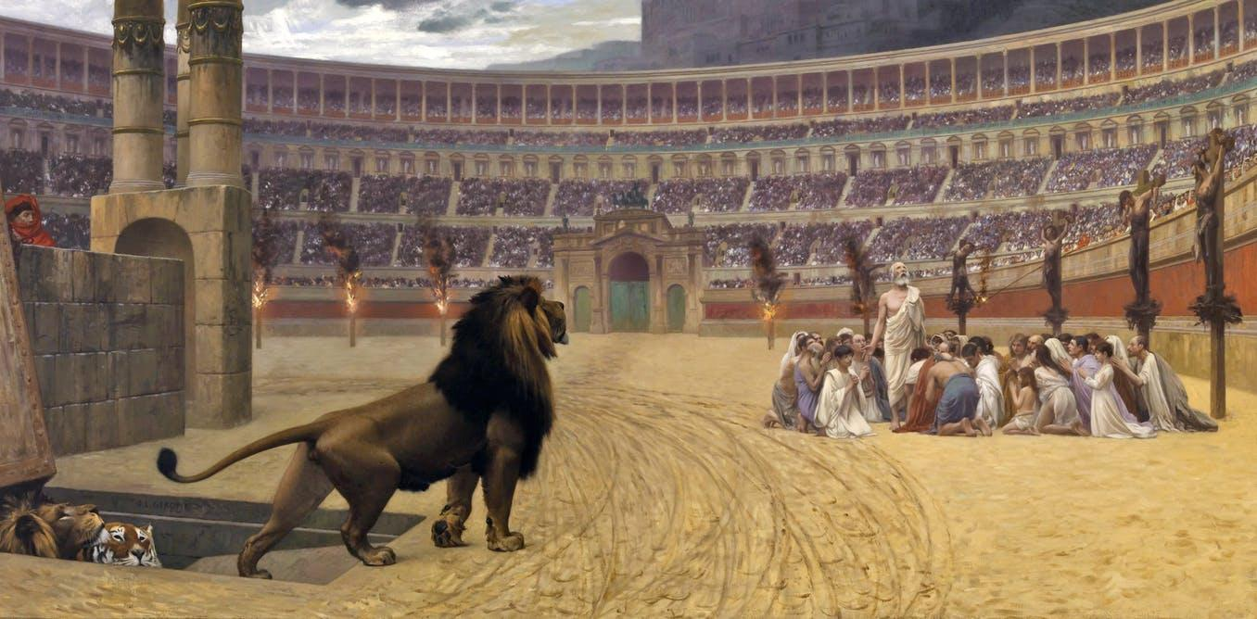
First Conflicts With the State
I know that you have but little power, and yet you have kept my word and have not denied my name
(Rev 3:8)
https://www.sutori.com/story/world-religions-christianity-7ba5

Slide 8
*First Conflicts With the State
In most of the New Testament it is the Jews who persecute Christians, who in turn seek refuge under the wing of Roman authorities.
This happens, for instance, in Acts 18 when some Jews in Corinth accuse Paul before Proconsul Gallio, saying that “this man is persuading men to worship God contrary to the Law,” to which Gallio answers: "If it were a matter of wrongdoing or vicious crime, O Jews, I would have reason to accept your complaint. But since it is a matter of questions about words and names and your own law, see to it yourselves. I refuse to be a judge of these things." (Act 18:14-15)
*Gonzalez, Justo; The Story of Christianity: Vol. 1: The Early Church to the Dawn of the Reformation; p.42

Slide 9
*First Conflicts With the State
Later, Acts 21 tells us that when there is a riot because some claim that the Apostle Paul has brought a Gentile to the Temple, and some Jews try to kill the apostle, it is the Romans who save his life (Acts 21:30-32).
And so we see that in NT times, Romans, Jews, and Christians all understood that the conflict taking place between Jews and Christians was an internal conflict within Judaism.
As long as things were relatively orderly, Romans preferred to stay out of such matters.
But when there was a riot or any disorderly conduct, Rome intervened to restore order, and sometimes to punish the disorderly.
*Gonzalez, Justo; The Story of Christianity: Vol. 1: The Early Church to the Dawn of the Reformation; p.42

Slide 10
*First Conflicts With the State
A good illustration of this policy was the expulsion of Jews from Rome by Emperor Claudius, in AD 51. Acts 18:2 mentions this expulsion, but does not explain the reason for it.
Suetonius, a Roman historian, says that Jews were expelled from the capital city for their disorderly conduct “because of Chrestus.”
Most historians agree that “Chrestus” refers to Christ, and that what actually took place in Rome was that the Christian proclamation caused so many riots among Jews that the emperor decided to expel them all from Rome.
At that time, Romans still saw the conflict between Christians and Jews as an internal matter within Judaism.
*Gonzalez, Justo; The Story of Christianity: Vol. 1: The Early Church to the Dawn of the Reformation; p.42

Slide 11
*First Conflicts With the State
But the distinction between Christians and Jews became clearer as the church gained more converts from the Gentile population, and the ratio of Jews in its ranks diminished.
There are also indications that, as Jewish nationalism increased and eventually led to rebellion against Rome, Christians—particularly the Gentiles among them—sought to put as much distance as possible between themselves and the Jewish rebellion against Rome.
Consequently, Roman authorities began to recognize Christianity as a religion distinct from Judaism.
This new consciousness of Christianity as a separate religion was at the root of two and a half centuries of persecution by the Roman Empire, from the time of Nero to the conversion of Constantine.
*Gonzalez, Justo; The Story of Christianity: Vol. 1: The Early Church to the Dawn of the Reformation; pp.42-43

Slide 12
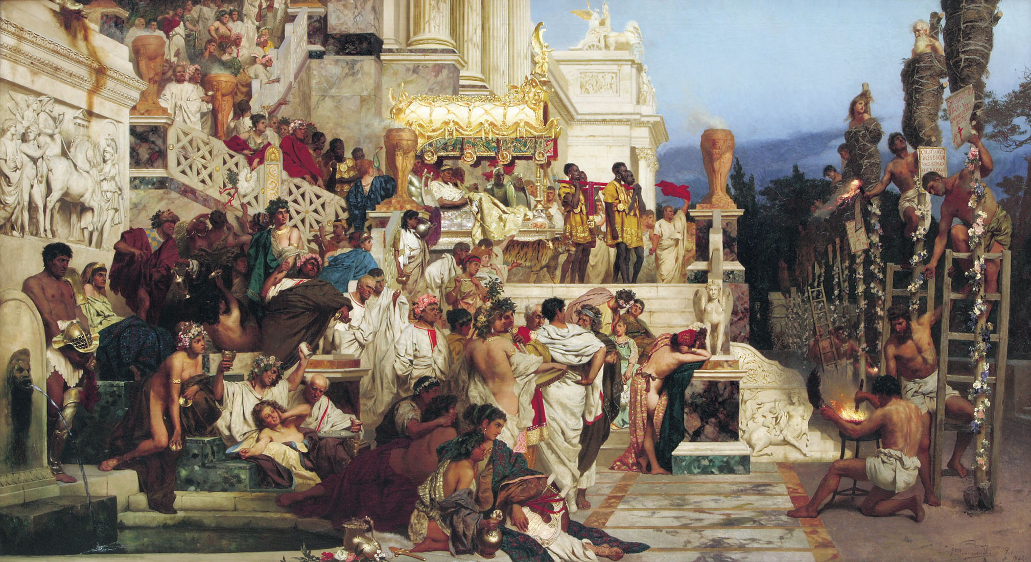
Persecution Under Nero
And [the Christians] have conquered [Satan] by the blood of the Lamb and by the word of their testimony, for they loved not their lives even unto death.
(Rev 12:11)
By Henryk Siemiradzki - www.abcgallery.com, Public Domain, https://commons.wikimedia.org/w/index.php?curid=320986

Slide 13
*Persecution Under Nero
Through his mother’s manipulation, Nero became emperor in AD 54 (at the age of 16).
At first he was a reasonable ruler, not entirely unpopular, whose laws in favor of the dispossessed were well received by the Roman populace.
But he became increasingly infatuated by his dreams of grandeur and his lust for pleasure, and surrounded himself with a court where all vied to satisfy his every whim.
Ten years after his accession to the throne, he was despised by the general population as well as by the poets and artists, who were offended by the emperor’s claim that he was one of them.
Soon the rumor began circulating that he was insane.
*Gonzalez, Justo; The Story of Christianity: Vol. 1: The Early Church to the Dawn of the Reformation; pp.43-44

Slide 14
*Persecution Under Nero
Such was the state of affairs when, on the night of June 18, AD 64, a great fire broke out in Rome.
It appears that Nero was several miles away, in his palace at Antium, and that as soon as he heard the news he hurried to Rome, where he tried to organize the fight against the fire.
He opened the gardens of his palace, as well as other public buildings, to those made homeless by the fire.
In spite of this, there were those who suspected the emperor, whom many believed was insane, of having ordered that certain sections of the city be put to the torch.
The fire lasted six days and seven nights, and then flared up sporadically for three more days.
Ten of the fourteen sections of the city were destroyed. In the midst of their sufferings, the people clamored for justice.
*Gonzalez, Justo; The Story of Christianity: Vol. 1: The Early Church to the Dawn of the Reformation; p.44

Slide 15
*Persecution Under Nero
Soon the rumor arose—and persists to this day in many history books—that Nero had ordered the city destroyed so he could rebuild it according to his fancy.
The Roman historian Tacitus, who may well have been present at the time, records several of the rumors that circulated, but seems inclined to believe that the fire began accidentally in an oil warehouse.
More and more, the people began to suspect the emperor.
A rumor circulated that he had spent most of the time during the fire atop a tower on the Palatine, dressed as an actor, playing his lyre and singing about the destruction of Troy.
Then the story was that, in his presumptuousness as a poet, he had ordered the city destroyed so that the fire would inspire in him a great epic poem.
*Gonzalez, Justo; The Story of Christianity: Vol. 1: The Early Church to the Dawn of the Reformation; p.44

Slide 16
*Persecution Under Nero
Nero tried to allay such suspicions, but it soon became clear that he would not succeed in this as long as there was no one else to blame.
Two of the areas that had not burned had many Jewish and Christian residents.
Therefore, Nero decided to blame the Christians for starting the fire.
*Gonzalez, Justo; The Story of Christianity: Vol. 1: The Early Church to the Dawn of the Reformation; p.44

Slide 17
*Persecution Under Nero
Tacitus tells the story:
  In spite of every human effort, of the emperor’s largesse, and of the sacrifices made to the gods, nothing sufficed to allay suspicion nor to destroy the opinion that the fire had been ordered. Therefore, in order to destroy this rumor, Nero blamed the Christians, who are hated for their abominations, and punished them with refined cruelty. Christ, from whom they take their name, was executed by Pontius Pilate during the reign of Tiberius. Stopped for a moment, this evil superstition reappeared, not only in Judea, where was the root of the evil, but also in Rome, where all things sordid and abominable from every corner of the world come together. Thus, first those who confessed [that they were Christians] were arrested, and on the basis of their testimony a great number were condemned, although not so much for the fire itself as for their hatred of humankind.
*Gonzalez, Justo; The Story of Christianity: Vol. 1: The Early Church to the Dawn of the Reformation; p.45

Slide 18
*Persecution Under Nero
These words from Tacitus are of great value, for they are one of the most ancient extant indications of how pagans viewed Christians.
Reading these lines, it is clear that Tacitus did not believe that the fire in Rome was set by Christians. Furthermore, he did not approve of Nero’s “refined cruelty.”
But, all the same, this good and cultured Roman believed a great deal of what was being said about the “abominations” of Christians and their “hatred of humankind.”
*Gonzalez, Justo; The Story of Christianity: Vol. 1: The Early Church to the Dawn of the Reformation; p.45

Slide 19
*Persecution Under Nero
Tacitus, and other authors writing contemporaneously, do not detail these supposed “abominations.” Second-century authors would be more explicit.
But, in any case, Tacitus believed the rumors, and thought that Christians hated humankind.
This last charge makes sense if one remembers that all social activities—the theater, the army, classic literature, sports—were so entwined with pagan worship that Christians often felt the need to abstain from them.
Therefore, to the eyes of a Roman such as Tacitus, who loved his culture and society, Christians appeared as haters of humankind.
*Gonzalez, Justo; The Story of Christianity: Vol. 1: The Early Church to the Dawn of the Reformation; p.45

Slide 20
*Persecution Under Nero
But Tacitus goes on:
  Before killing the Christians, Nero used them to amuse the people. Some were dressed in furs, to be killed by dogs. Others were crucified. Still others were set on fire early in the night, so that they might illumine it. Nero opened his own gardens for these shows, and in the circus he himself became a spectacle, for he mingled with the people dressed as a charioteer, or he rode around in his chariot. All of this aroused the mercy of the people, even against these culprits who deserved an exemplary punishment, for it was clear that they were not being destroyed for the common good, but rather to satisfy the cruelty of one person.
*Gonzalez, Justo; The Story of Christianity: Vol. 1: The Early Church to the Dawn of the Reformation; pp.45-46

Slide 21
*Persecution Under Nero
Once again the pagan historian, while showing no love for Christians, indicates that the reason for this persecution was not justice, but the whim of the emperor.
These lines are also one of the few surviving pagan testimonies of the cruel tortures to which those early martyrs were subjected.
It is difficult to know the extent of Nero’s persecution.
Christian writers from the latter part of the first century, and early in the second, recall the horrors of those days.
On the other hand, there is no mention of any persecution outside the city of Rome, and therefore it is quite likely that this persecution, although exceedingly cruel, was limited to the capital of the empire.
*Gonzalez, Justo; The Story of Christianity: Vol. 1: The Early Church to the Dawn of the Reformation; p.46

Slide 22
*Persecution Under Nero
Although at first Christians were charged with arson, soon they were persecuted for merely being Christian—and for all the supposed abominations connected with that name.
Ancient writers tell us that Nero issued an edict against Christians. But such an edict, if it ever existed, is no longer extant.
In AD 68, Nero was deposed by a rebellion that gained the support of the Roman senate, and killed himself.
The persecution ceased, although nothing was done to rescind whatever laws Nero had passed against Christians.
A period of such political turmoil followed that the year 69 is known as the year of four emperors. Eventually, Vespasian gained control of the government, and during his reign and that of his son Titus Christians were generally ignored by the authorities.
*Gonzalez, Justo; The Story of Christianity: Vol. 1: The Early Church to the Dawn of the Reformation; p.46

Slide 23
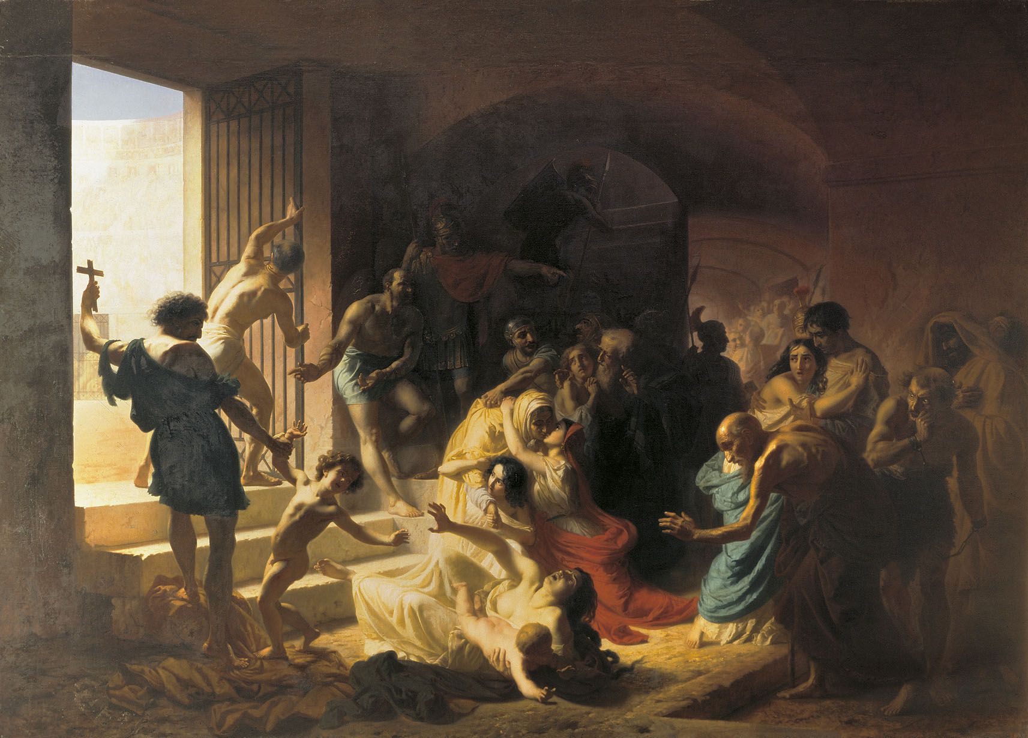
Reasons for Christian Persecution
A mysterious name was written on her forehead: "Babylon the Great, Mother of All Prostitutes and Obscenities in the World."
I could see that she was drunk-- drunk with the blood of God's holy people who were witnesses for Jesus. I stared at her in complete amazement.
(Rev 17:5-6 NLT)
https://upload.wikimedia.org/wikipedia/commons/0/0a/Konstantin_Flavitsky_-_Christian_Martyrs_in_Colosseum.jpg

