Slide 2
Review
Give the names of the two Anabaptist leaders who lead in the writing of the Schleitheim Confession.
Michael Sattler
Wilhelm Reublin
How did Michael Sattler die?
He was captured and tortured to death for his beliefs, but stayed true to his faith until the end.
What happened to Wilhelm Reublin at the end of his life?
He turned away from his faith and ended up going back to Catholicism and living off the money of the people who had killed Michael Sattler.

Slide 3
The Münster Rebellion
The cages that held the bodies of the tortured and executed Münster Rebellion leaders were hoisted up the St. Lambert's Cathedral tower in 1536. The cages still hang there today.
https://imgur.com/a/xt0XrmY?ref=hvper.com&utm_source=hvper.com&utm_medium=website

Slide 4
The Münster Rebellion
In 1530, Münster was a divided city. It was governed by a city council that was strongly influenced by the Roman Catholics, but there were a number of Lutherans and Anabaptists living in the city as well. ¹
The city had a lot of money, nice homes, and was very beautiful. ²
Germany, at this time, was still recovering from a 1525 peasant uprising that didn’t have much of an effect on Münster, but frayed the nerves of the ruling class across the Holy Roman Empire. ¹
To make matters worse, Europe was also still reeling from the startling intensity of the Protestant Reformation, 13 years after Martin Luther nailed up his 95 theses. ¹
¹ https://www.mentalfloss.com/article/502284/why-3-man-sized-cages-hang-medieval-german-church-steeple
² James White – 2016 Church History Series #66 – Munster Concluded

Slide 5
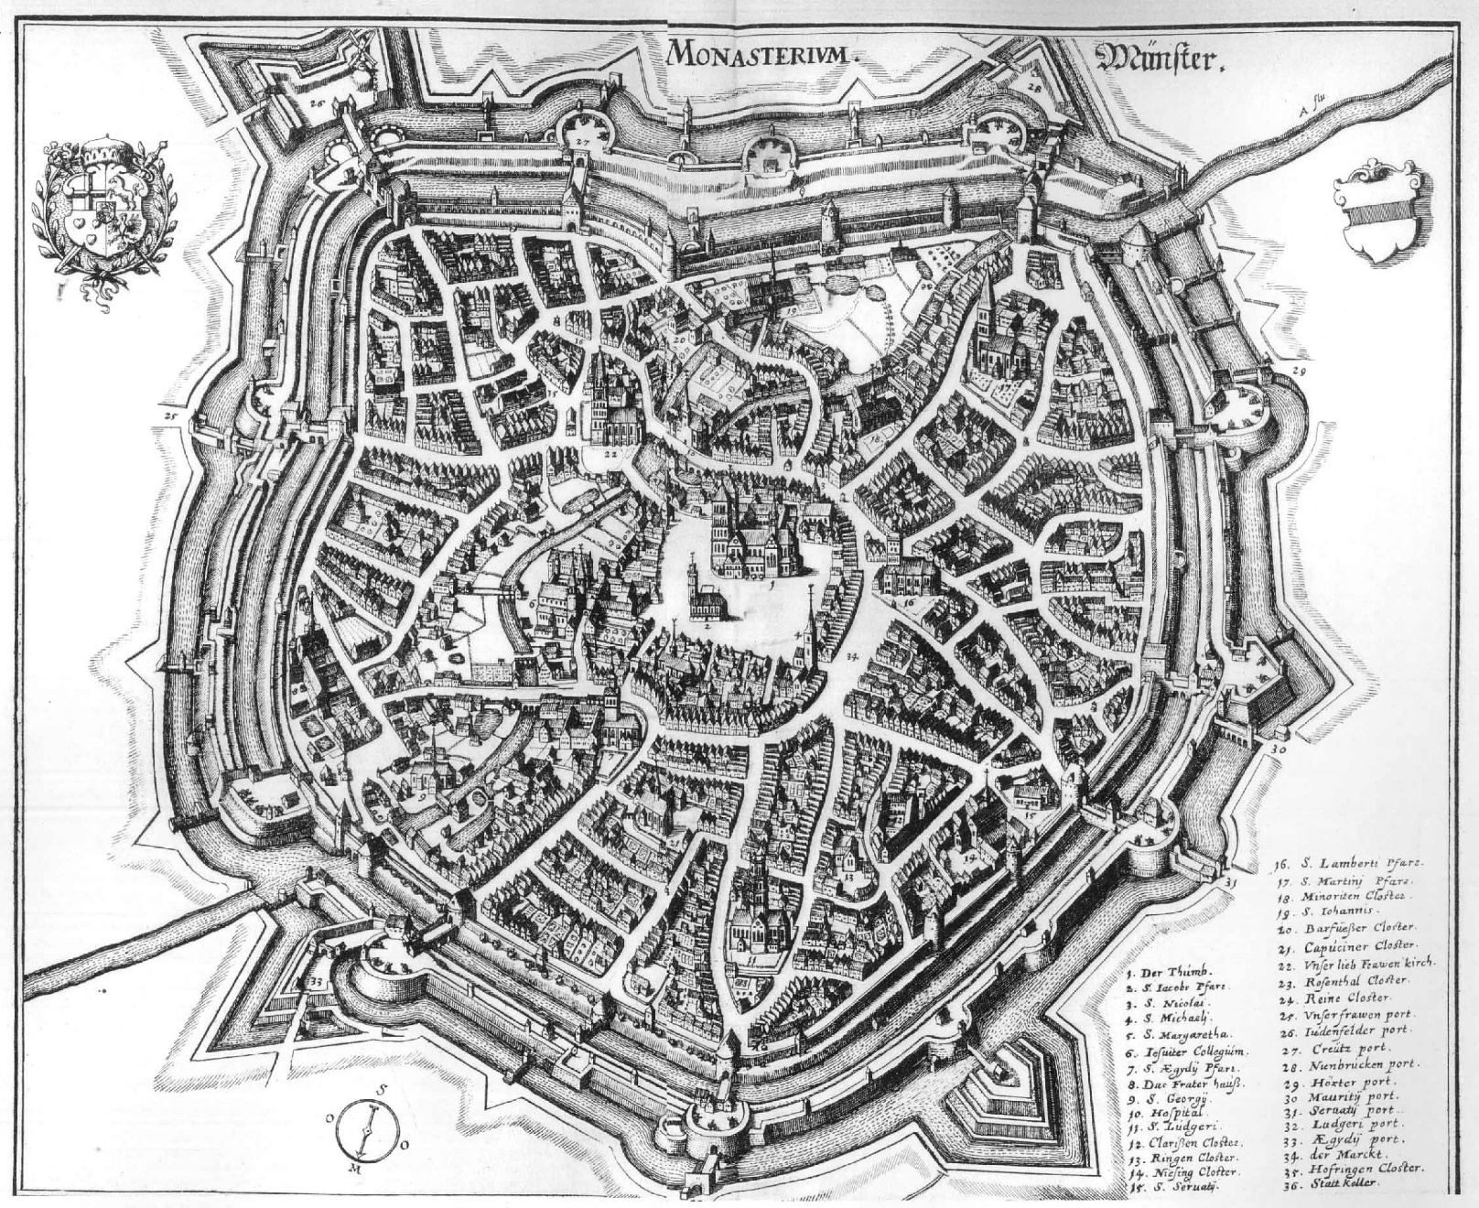
City of Münster
https://pages.uoregon.edu/dluebke/Reformations441/Muenster_merian.JPG

Slide 6
The Münster Rebellion
Against this backdrop, an evangelical Protestant preacher named Bernhard Rothmann began preaching against Catholic doctrine and drew a large following in Münster, particularly among the peasants and the trade guilds.
Alarmed at his threat to their dominance, the Catholic Church banned him from the pulpit.
But in February 1532, a mob of his supporters stormed St. Lambert’s church—the main parish church in Münster—and installed Rothmann as its preacher.
That May, Franz von Waldeck was elected prince-bishop of Münster, becoming the highest-ranking Church official in town.
https://www.mentalfloss.com/article/502284/why-3-man-sized-cages-hang-medieval-german-church-steeple

Slide 7
The Münster Rebellion
Rothmann’s Protestant rabble-rousing threatened to turn Münster against the Catholic Church, which would render the new prince-bishop's position powerless.¹
Von Waldeck hired mercenary cavalry to blockade Münster until its citizens expelled Rothmann and his allies—but the city council, under pressure from Rothmann’s supporters, refused.¹
Then the people of Münster struck back: On the day after Christmas 1532, about 900 armed men, conducted a midnight raid on von Waldeck’s nearby palace. ²
The bishop was away for the holiday, so they captured several high church officials and military officers and held them as hostages. ²
¹ https://www.mentalfloss.com/article/502284/why-3-man-sized-cages-hang-medieval-german-church-steeple
² Arthur, Anthony. The Tailor-King (p. 22). St. Martin's Publishing Group

Slide 8
The Münster Rebellion
But after a neighboring noble stepped in to mediate the conflict, von Waldeck signed a treaty of religious toleration on February 14, 1533, allowing Protestant pastors to preach from Münster’s parish churches.
That caught the attention of a band of Dutch Anabaptists led by one Jan Matthys, who for years had been persecuted for their faith and chased from town to town throughout the Low Countries.
When Matthys sent two of his Anabaptist followers to Münster in January 1534, Rothmann embraced them. The Anabaptists reportedly rebaptized 1400 people (20 percent of the city’s adult population) within a week of their arrival.
Along the way, they spread Matthys’s apocalyptic prophesy: Jesus Christ would return to Earth that Easter, and all Christians needed to prepare themselves for the imminent end of the world.
https://www.mentalfloss.com/article/502284/why-3-man-sized-cages-hang-medieval-german-church-steeple

Slide 9
The Münster Rebellion
On February 11, 1534, the Münster city council granted full religious toleration to Anabaptists, who began referring to Münster as the “New Jerusalem.”
They sent out messengers far and wide to recruit new believers to the city.
As the month went on, armed city employees reportedly moved through the city warning those who refused adult baptism to flee, reportedly crying “Get out of here, you godless. God will punish you!”
When Matthys arrived, he delivered a sermon calling for the execution of Catholics and Lutherans alike.
He preached, “Everywhere we are surrounded by dogs and sorcerers and whores and killers and the godless and all who love lies and tell them!”
https://www.mentalfloss.com/article/502284/why-3-man-sized-cages-hang-medieval-german-church-steeple

Slide 10
The Münster Rebellion
When the execution idea failed to fly, Matthys’s advisors convinced him to settle for expelling the Catholics and Lutherans from the city.
More than 2000 Catholics and moderate Protestants poured out of Münster—and just as many Anabaptists streamed in from the countryside to replace them.
By February 23, 1534, a new city council election gave the Anabaptists, led by Matthys, full control of Münster.
Watching these developments from outside the walls, Bishop von Waldeck prepared to besiege the city with a mercenary army in hopes of reestablishing Catholic control.
https://www.mentalfloss.com/article/502284/why-3-man-sized-cages-hang-medieval-german-church-steeple

Slide 11
The Münster Rebellion
Münster simultaneously prepared to battle von Waldeck and to meet Jesus Christ.
The citizens beefed up the city walls. They rounded up all residents who hadn’t yet been rebaptized and forced them to accept baptism or leave.
They confiscated food and weapons from departing Catholics, and then, in March, the city council abolished private property altogether.
That month, Matthys also had all archives, documents, contracts, accounts, and ledgers destroyed in an attempt to abolish all debt.
“Everything that Christian brothers and sisters have belongs to the one as well as to the other,” Rothmann preached.
Meanwhile, von Waldeck’s troops surrounded the city and the siege began.
https://www.mentalfloss.com/article/502284/why-3-man-sized-cages-hang-medieval-german-church-steeple

Slide 12
The Münster Rebellion
On April 5, 1534, Easter came—but Christ did not.
With his apocalyptic prophecy shattered, Matthys claimed to have a divine vision. He mounted a horse and sallied forth with a small entourage to personally break von Waldeck’s siege and free the city.
But his plan failed miserably: Von Waldeck’s troops ran Matthys through with a spear, and then put his head on a spike in front of the city gates for all of Münster to see. The Anabaptists’ prophet was dead.
To quell the city’s rising panic, Matthys’s main lieutenant, a 25-year-old tailor named Jan of Leiden, gave a speech reinterpreting the apocalyptic prophesy and postponing doomsday.
On April 8, he dissolved the elected city council and appointed 12 elders to run the city.
https://www.mentalfloss.com/article/502284/why-3-man-sized-cages-hang-medieval-german-church-steeple

Slide 13
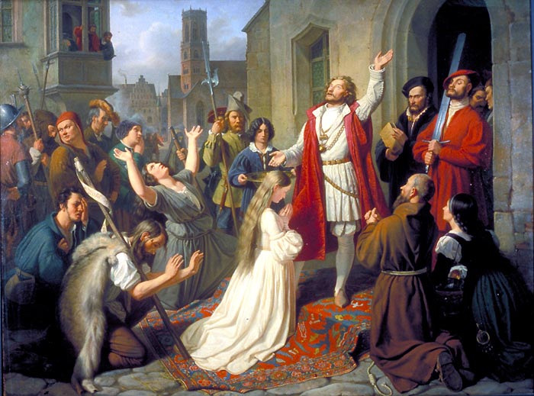
Jan of Leiden
An 1840 painting of Jan of Leiden baptizing a girl
https://upload.wikimedia.org/wikipedia/commons/b/bb/MuensterJohannVanLeydenTaufe.jpg

Slide 14
The Münster Rebellion
Münster became increasingly militarized: Armed bands of citizens lived communally near their posts by the city gates, and two church steeples were repurposed as platforms for cannons.
But as the city transformed, it still faced threats from the outside.
Von Waldeck launched a massive engineering project to drain the moat surrounding Münster and allow his troops to attack the city gates.
He conscripted over 2000 farmers from the surrounding land to leave their spring planting aside and dig a drainage ditch under cover of night.
https://www.mentalfloss.com/article/502284/why-3-man-sized-cages-hang-medieval-german-church-steeple

Slide 15
The Münster Rebellion
With the moat drained, von Waldeck's cannons pummeled Münster's walls for four straight days.
But when the prince-bishop finally attacked on May 25, the Anabaptists staved off his disorganized and reportedly drunk mercenaries.
In June, an Anabaptist woman named Hille Feicken hatched a plan to assassinate von Waldeck and break the siege.
She was inspired by the character Judith (from the Jewish Apocrypha), who during the siege of Bethulia seduced the attacking general Holofernes and beheaded him in his sleep.
Early in the morning on June 16, Feicken snuck out of Münster to seduce von Waldeck—but unlike Judith, she was quickly discovered, captured, and executed.
https://www.mentalfloss.com/article/502284/why-3-man-sized-cages-hang-medieval-german-church-steeple

Slide 16
The Münster Rebellion
Soon after Feicken’s death, Jan of Leiden announced his plans to legalize polygamy and make marriage mandatory for all women—even those who had living Catholic or Protestant husbands in exile.
Those who refused to marry were imprisoned in church cloisters, where preachers attempted to reeducate them.
Historians speculate that Jan of Leiden’s motives were partially demographic: At that point, there were 2000 adult men and over 5500 adult women in Münster.
The unmarried women were not under the protection—or control—of a husband, who might prevent them from sneaking off like Hille Feicken did.
https://www.mentalfloss.com/article/502284/why-3-man-sized-cages-hang-medieval-german-church-steeple

Slide 17
The Münster Rebellion
Rothmann defended Jan of Leiden's decision. “God wills to create something new on earth,” he wrote. “Just as the women commonly have been lords and have had their own way, now among us he has subjected the women to the men, so that all of them, young as well as old, have to let themselves be ruled by the men according to the word of God.”
The polygamy announcement drew major backlash. On the night of July 30, 1534, 47 conspirators, led by a blacksmith named Heinrich Mollenhecke, attempted to overthrow the city government.
They managed to take Jan of Leiden prisoner and hole up in the city hall, but the majority of Münster didn’t rally to the conspirators’ cause.
https://www.mentalfloss.com/article/502284/why-3-man-sized-cages-hang-medieval-german-church-steeple

Slide 18
The Münster Rebellion
Loyalists surrounded the mutineers, forcing them to surrender and free Jan of Leiden.
Over the next four days, all 47 conspirators were shot or beheaded.
The polygamy plan went forward, and every woman in Münster was married. (Jan of Leiden himself reportedly took as many as 16 wives over the next year, including Jan Matthys’s widow.)
Meanwhile, von Waldeck's siege continued. He launched yet another assault in August 1534, which the Anabaptists narrowly repelled.
https://www.mentalfloss.com/article/502284/why-3-man-sized-cages-hang-medieval-german-church-steeple

Slide 19
The Münster Rebellion
Afterward, a new Anabaptist prophet, a goldsmith named August Johann Dusentschuer, proclaimed that Jan of Leiden should rule as king.
Jan of Leiden accepted the prophecy, adding that God had revealed to him that he was to be the new King David and he was to rule until Jesus’s return to Earth.
He replaced the Council of Elders with a royal court and began wearing a crown and carrying a scepter.
Over the winter, von Waldeck choked off all remaining routes in or out of Münster with walls and moats.
The city ran out of grain and residents began slaughtering young cows for food. “Anyone who still has something must share with his brother,” Jan of Leiden declared.
https://www.mentalfloss.com/article/502284/why-3-man-sized-cages-hang-medieval-german-church-steeple

Slide 20
The Münster Rebellion
But by April, facing a mounting famine, the king dismissed exhausted and hungry women, children, and old men from the city. About 1600 armed men remained within the walls.
As life inside of Münster became increasingly grim, Jan of Leiden promised his subjects that God would deliver them from the prince-bishop's besieging army.
“God will smite them in their hearts, so that they will run away,” he predicted. But by Easter, he clarified that he meant his promise of deliverance in a metaphorical, spiritual sense—not literally.
https://www.mentalfloss.com/article/502284/why-3-man-sized-cages-hang-medieval-german-church-steeple

Slide 21
The Münster Rebellion
In May 1535, an Anabaptist carpenter named Heinrich Gresbeck tried to flee Münster, but was captured by von Waldeck’s troops.
In exchange for his life, he agreed to help the besiegers take the city.
On the night of June 25, 1535, he led 300 of von Waldeck’s soldiers into town through a poorly guarded city gate.
The prince-bishop’s forces fought their way through the streets of Münster for hours, killing over 600 Anabaptists before the city surrendered.
They took Jan of Leiden, his viceroy Bernard Knipperdollinck, and another Anabaptist leader named Bernard Kretchtinck prisoner.
https://www.mentalfloss.com/article/502284/why-3-man-sized-cages-hang-medieval-german-church-steeple

Slide 22
The Münster Rebellion
They never did find Bernard Rothman. Twenty years later his wanted posters were still hung up in Europe. No one knows what happened to him.
All the other men of the city were killed as well as most of the women.
On January 22, 1536, in Munster, carts were tied together with boards placed across them and a central pole in the middle.
The prince-bishop gathered a crowd in front of city hall to see Jan of Leiden, Knipperdollinck, and Kretchtinck tortured and killed.
Each person was to be tortured for one full hour before they were killed and they had to be conscious the entire time.
James White – 2016 Church History Series #66 – Munster Concluded

Slide 23
The Münster Rebellion
All three men were chained to the same pole. But they were only tortured one at a time.
The last man had to watch the other two be tortured and die. They set tongs in the fire to get them red hot and pull their body apart one small piece at a time and then stab them to death after one hour.
Their bodies were then hoisted in 3 cages on a tower of the St. Lambert’s Cathedral for 50 years, with their rotting corpses. Then they took them down, removed the bodies and put the cages back up. They are still there to this day.
In WWII a bomb hit the steeple, they took them down, fixed the temple, and put them back up there.
In the 21st century, there was a vote taken and they agreed to keep them up there.
James White – 2016 Church History Series #66 – Munster Concluded

Slide 24
Menno Simons
https://imgur.com/a/xt0XrmY?ref=hvper.com&utm_source=hvper.com&utm_medium=website

Slide 25
Class Discussion Time
https://www.weareteachers.com/moving-beyond-classroom-discussions/

Slide 26
*Class Discussion Time
What kind of psychology was at work to cause a town of otherwise very normal people to suddenly go along with such an extreme leader and go against norms they’ve held to all of their lives? Have we seen this kind of behavior in modern times?
Can you understand why an incident like this would give Anabaptists such a bad name among Europeans?
Do you have a topic or question that you would like to see us to discuss?

