Slide 2
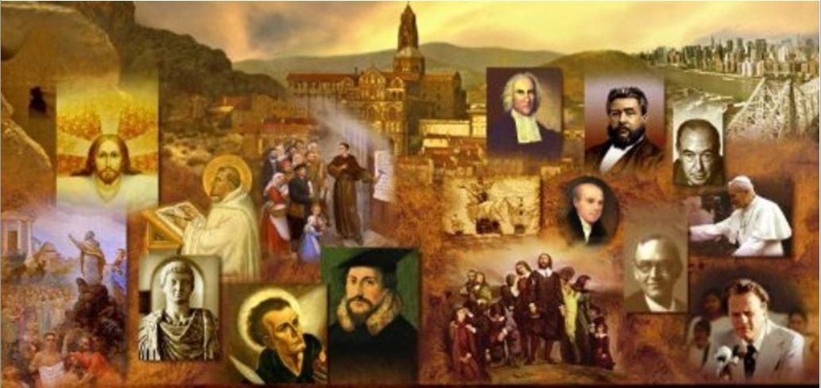
Review
Describe what Münster was like prior to the rebellion.
Beautiful, wealthy, well-fortified, religious tolerance
What was it about Bernhard Rothmann that made him so influential?
He was wealthy, owned a printing press, and knew how to express ideas in a compelling way.
What did both Jan Matthys and (later) Jan of Leiden claim about themselves that made people feel like they should listen to them?
They both claimed to hear directly from God
They both threatened violence to those who would not obey

Slide 3
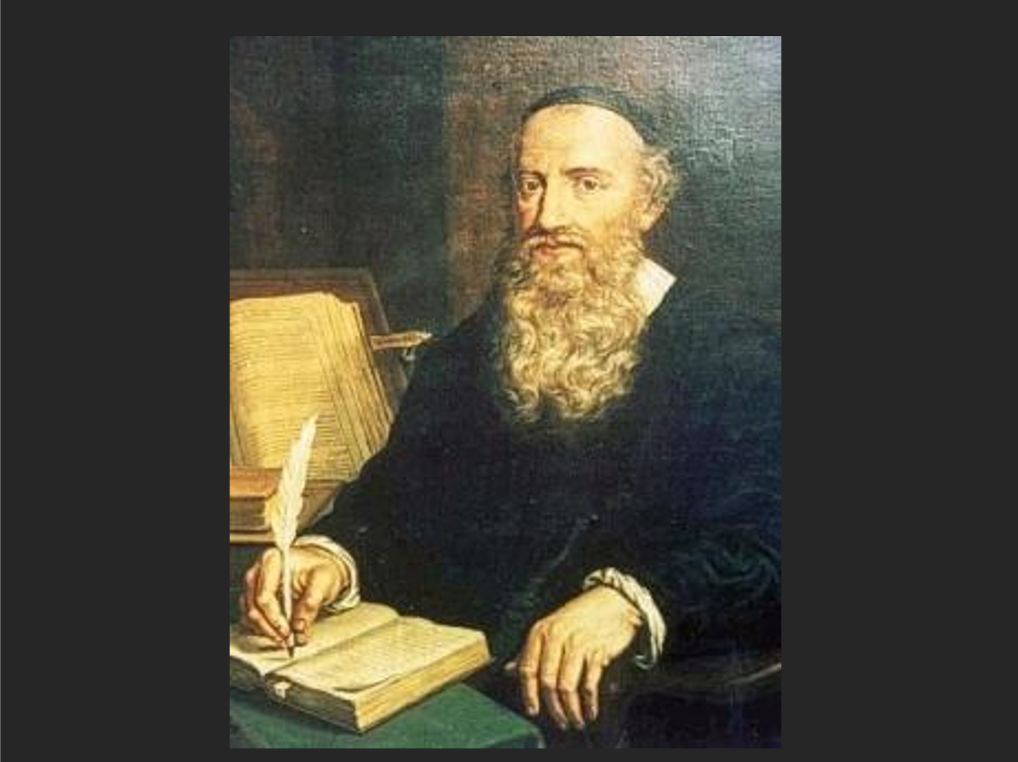
Menno Simons
https://imgur.com/a/xt0XrmY?ref=hvper.com&utm_source=hvper.com&utm_medium=website

Slide 4
Menno Simons
The single most influential group of Anabaptists proved to be the Mennonites.
Their name derives from the greatest Anabaptist of the Reformation era, indeed one of the greatest religious leaders of the 16th century – Menno Simons (1496-1561).
Born in the Netherlands, Menno’s religious journey started off within Roman Catholicism when he was ordained to the priesthood in 1524.
His doubts, however, began early: in 1525 he began having serious problems with transubstantiation, and in 1529 he began to question infant baptism.
He had soon abandoned both, but concealed his new beliefs and continued in the Roman Catholic priesthood.
He was later to condemn himself bitterly for this hypocrisy.
Needham, Nick. 2,000 Years of Christ's Power Vol. 3: Renaissance and Reformation

Slide 5
Menno Simons
The crisis for Menno came when his brother Peter, together with many other Anabaptists, became caught up in the revolutionary enthusiasm of the Münster episode.
While the brutal Radical regime of Jan of Leyden ruled in the north German city, and the New Jerusalem seemed to be at hand, 300 Dutch Anabaptists (including Peter Simons) took up arms and seized a monastery near Bolsward (in the Netherlands) in March of 1535.
They were besieged there by government forces for eight days, and eventually all 300 Anabaptists were killed.
Menno was devastated.
Needham, Nick. 2,000 Years of Christ's Power Vol. 3: Renaissance and Reformation

Slide 6
Menno Began to Preach Against Violence
Although Menno believed that his brother and the other Anabaptists were profoundly wrong to resort to violence, he admired their willingness to act out their faith and die for it.
It contrasted unbearably with his own hypocrisy: secretly an Anabaptist, outwardly a Roman Catholic priest.
And so the mask came off. For the next year, Menno tried to enact an evangelical reform in his parish.
He also wrote a treatise against the Münsterites, The Blasphemy of Jan of Leyden, where Menno advocated pacifism as the proper Christian attitude.
However, even this stance as a reforming priest did not satisfy Menno’s conscience, and after a year he abandoned his clerical profession entirely to become an itinerant Anabaptist evangelist.
Needham, Nick. 2,000 Years of Christ's Power Vol. 3: Renaissance and Reformation

Slide 7
Menno Began to Preach Against Violence
Menno soon found himself among a small company of seven or eight Anabaptists who asked him to become their pastor.
He agreed, and was ordained in 1537.
Menno spent the rest of his life as a hunted man; in the aftermath of the Münster fiasco, all Anabaptists were perceived as revolutionary anarchists by the governments of Europe.
Menno had to preach by night to secret gatherings, baptizing people in streams and lakes. And yet his success in planting churches and ordaining pastors for them was phenomenal.
It becomes even more amazing when we consider that Menno’s wife and three children accompanied him in his hazardous travels, and that for much of his life he seems to have been a cripple.
Needham, Nick. 2,000 Years of Christ's Power Vol. 3: Renaissance and Reformation

Slide 8
Menno Began to Preach Against Violence
Although Menno was Dutch, he actually spent only a few years of his ministry in his native Netherlands; most of his ministry was carried out in northern Germany.
Almost single-handedly, Menno saved Dutch and north German Anabaptism from the fanaticism that had manifested itself at Münster.
His polemic against the violent Münsterite wing of the movement was vigorous, merciless, and unceasing.
Even after Münster itself had fallen, many Dutch and north German Anabaptists were still enthralled with the idea of establishing God’s kingdom by force of arms.
Organized by John of Batenburg, they formed into mobile guerrilla squads, the Zwaardgeesten (“sword-minded”), who spread terror across the countryside, destroying church buildings and killing anyone who stood in their path.
Needham, Nick. 2,000 Years of Christ's Power Vol. 3: Renaissance and Reformation

Slide 9
Menno Began to Preach Against Violence
Batenburg himself was eventually caught and executed, but the violence continued.
Menno was instrumental, by his preaching, writing, and personal example, in turning the Anabaptist tide against the Zwaardgeesten, and reclaiming the movement for pacifism.
Perhaps this was Menno’s greatest achievement: to convert Dutch and north German Anabaptism from a movement of revolutionary anarchism to a Church of peace-loving martyrs.
Out of the crucible of this transformation came, in 1562, the first edition of a publication that would later be called The Martyrs’ Mirror.
A product of the Dutch Mennonites, this volume chronicled in moving detail the martyrdoms of many of the peaceful Anabaptists, including Michael Sattler.
Needham, Nick. 2,000 Years of Christ's Power Vol. 3: Renaissance and Reformation

Slide 10
Menno Preached Against Spiritualism
Menno also fought hard and largely successfully to purify the Dutch and north German Anabaptists from the Spiritualist wing of Radicalism, with its reliance on new private revelations.
Menno’s chief opponent here was David Joris. Joris claimed to be a prophet standing in succession to Jan of Leiden of Münster; he exalted the “inward Word” of personal revelation over the outward word of Scripture.
His cult of inner spirituality led him to reject all external forms of religion, including believers’ baptism.
Perhaps conveniently, this enabled Joris to conform to the Reformed Church of Basel, while at the same time secretly printing and distributing books, tracts, and letters in which he advocated his extreme spiritualizing views.
Needham, Nick. 2,000 Years of Christ's Power Vol. 3: Renaissance and Reformation

Slide 11
Menno Preached Against Spiritualism
Menno’s literary warfare with Joris was fierce.
Menno was uncompromising in his rejection of the appeal to private revelations:
Are you claiming that the teaching of Christ and of His apostles was imperfect, and that your teachers are now bringing forth the perfect doctrine? I respond that teaching and believing such things is the most horrible blasphemy!
And again:
My brothers, I declare the truth to you and do not lie: I am no Enoch, no Elijah; I am not someone who sees visions. I am not a prophet who can teach and prophesy anything, other than what is written in the Word of God as understood through the Spirit ... I have no visions, I have no angelic inspirations. In fact I do not even desire them, in case I should be deceived. The Word of Christ alone: that is enough for me!
Needham, Nick. 2,000 Years of Christ's Power Vol. 3: Renaissance and Reformation

Slide 12
Menno Preached Against Spiritualism
Menno’s crusade against private revelations gave a strongly biblical flavor to the Mennonite Anabaptists.
Whatever else they might be, they were determined to be people of the Scriptures, not people of dreams and visions.
Most of Menno’s characteristic theology appears in his most influential writing, The Foundation of Christian Doctrine (1540), which became the Mennonite equivalent of Calvin’s Institutes.
Some of it is simply a restatement of traditional Christian teaching: the Trinity, Christ as God and man, and so forth.
Needham, Nick. 2,000 Years of Christ's Power Vol. 3: Renaissance and Reformation

Slide 13
Menno Differed With Both Catholics and Reformers
In what ways, however, did Menno’s theology depart from that of his Roman Catholic and Protestant contemporaries and pursue a distinctively Anabaptist outlook?
In the first instance, Menno clearly rejected the doctrine of original sin as classically understood in the Western Church.
The atoning death of Christ, which Menno held was universal in extent, had put all human beings in a state of acceptance with God, until they reached the age of discretion and deliberately sinned.
Only then did God impute guilt. Prior to this, all children were “like Adam and Eve before the fall, innocent and blameless”.
Needham, Nick. 2,000 Years of Christ's Power Vol. 3: Renaissance and Reformation

Slide 14
Menno Differed With Both Catholics and Reformers
Since infants were guiltless, they did not need baptism for the remission of sins. Menno’s denial of original guilt was therefore basic to his denial of infant baptism.
He did, however, believe that every infant had a seed of corruption in his or her soul which would eventually manifest itself in sinful actions.
Menno also endorsed a “heavenly flesh” Christology that was widely held among the Radicals.
In order to preserve Christ from any taint of sin, or even the possibility of sin, Menno felt he must deny that Christ took flesh from Mary.
The Savior's flesh was a special heavenly creation which was then implanted in Mary’s womb; therefore Christ did not receive His human nature from the Virgin.
Menno’s heavenly flesh Christology was to be a constant source of stormy conflict between himself and Magisterial Protestants.
Needham, Nick. 2,000 Years of Christ's Power Vol. 3: Renaissance and Reformation

Slide 15
Menno Differed With Both Catholics and Reformers
Menno completely rejected Zwingli’s doctrine of predestination, which Menno condemned as “an abomination of abominations”.
For Menno, human free will, in the sense of an ultimately self-generated choice to cooperate with God’s grace, was essential.
The Lutheran and Reformed understanding of human bondage to sin and divine election to salvation he regarded as sheer excuses for wickedness.
For the same reason, Menno also repudiated the doctrine of forensic justification by faith alone. This he felt was a threat to the urgency and seriousness of the new life of obedience in Christ.
Needham, Nick. 2,000 Years of Christ's Power Vol. 3: Renaissance and Reformation

Slide 16
Menno Differed With Both Catholics and Reformers
Menno poured his withering scorn on Lutherans:
The Lutherans teach and believe that faith alone saves, without any contribution from works. They emphasize this doctrine so much, it looks as if works were totally unnecessary – in fact, as if faith by its nature could not tolerate any work standing beside it ... They start up a psalm, “The chain is broken, now we are free, praise the Lord!” while the beer and the wine come running out of their drunken mouths and noses. Anyone who can simply recite this off by heart, no matter how sinfully he lives, is regarded as a good evangelical man and a brother!
Needham, Nick. 2,000 Years of Christ's Power Vol. 3: Renaissance and Reformation

Slide 17
Menno’s Views on Sola Scriptura
Menno’s doctrine of Scripture occupied a more complex position between Roman Catholicism and Protestantism.
On the one side, he stood with Rome in accepting the apocrypha as divinely inspired and canonical.
On the other side, he strongly endorsed the supreme and final authority of Scripture (“sola Scriptura”), refusing to let this be undercut by any appeal to tradition (or to private revelations, as we have seen in his campaign against David Joris).
Even here, though, there were differences between Menno’s version of sola Scriptura and the version articulated by the Protestant Reformers.
Needham, Nick. 2,000 Years of Christ's Power Vol. 3: Renaissance and Reformation

Slide 18
Menno’s Views on Sola Scriptura
First, Menno severely downplayed the significance and authority of the Old Testament.
For Menno, and the Anabaptists generally, sola Scriptura tended to mean “the New Testament alone”.
This was because Menno stressed the discontinuity between the two testaments to the point where it became a virtual dichotomy, with the New supplanting the Old.
This enabled Menno to offer a far simpler and clearer justification of Anabaptist ethics (pacifism, the rejection of the Christian state and of oaths, etc.) and ecclesiology (the rejection of infant baptism), since traditional Christianity often appealed to the Old Testament to vindicate these practices.
Needham, Nick. 2,000 Years of Christ's Power Vol. 3: Renaissance and Reformation

Slide 19
Menno’s Views on Sola Scriptura
Second, Menno’s concept of sola Scriptura disallowed any appeal to tradition. This was not the stance of the Protestant Reformers.
As we have seen, they habitually appealed to the early Church fathers, not as infallible authorities, but as witnesses to the true interpretation of Scripture; and they saw themselves as standing in line with the Trinitarian and Christological formulations of the patristic era, especially the ecumenical Councils and Creeds of Nicaea, Constantinople, Ephesus, and Chalcedon.
In other words, the Protestant Reformers operated within a framework of deference to the early Church, and a concept of the subordinate authority of the Church’s creedal tradition.
Needham, Nick. 2,000 Years of Christ's Power Vol. 3: Renaissance and Reformation

Slide 20
Menno’s Views on Sola Scriptura
Menno, by contrast, refused to concede any role to tradition as a subordinate authority.
He self-consciously tried to cut scripture loose from all prior Church reflection on its meaning, so that scriptural truth might stand unaided and shine simply by its own light.
This meant that when controversies over the Trinity broke out within Anabaptism, Menno’s Scripture principle ruled out any use of the extra-scriptural language of Nicaea and the Cappadocian fathers (“homoousios”, “eternal generation”, and so forth).
Needham, Nick. 2,000 Years of Christ's Power Vol. 3: Renaissance and Reformation

Slide 21
Menno’s Disputes With Other Anabaptists
The latter years of Menno’s ministry were clouded by internal disputes among the Mennonites over the practice of “shunning”.
All Anabaptists agreed on the use of the ban (excommunication), though with varying degrees of rigor; Mennonites were distinguished by adding to the ban a further discipline of shunning the banned individual.
This meant that no social contact was permitted with him or her.
Menno at first had some reservations about this, but he was eventually won over to a strict position: if a husband or wife was banned, the marital partner must break off all marital duties – and would be banned himself/herself for refusing to do so.
Needham, Nick. 2,000 Years of Christ's Power Vol. 3: Renaissance and Reformation

Slide 22
Menno’s Disputes With Other Anabaptists
The controversy spilled out of the Mennonite ranks to affect the other major Anabaptist groups.
In 1557, the Mennonites banned all the Swiss Brethren, Hutterites, and disciples of Pilgram Marpeck, because of their weak view of the ban!
Divisions were intensified when the Mennonites went further by denying the validity of the baptism practiced by these other Anabaptist bodies.
Tragically, this kind of disharmony among the Anabaptists magnified the perception that they were a warring wasteland of sects who could be spiritually discounted by their Roman Catholic, Lutheran, and Reformed opponents.
Needham, Nick. 2,000 Years of Christ's Power Vol. 3: Renaissance and Reformation

Slide 23
Our Modern Anabaptist Heritage
https://imgur.com/a/xt0XrmY?ref=hvper.com&utm_source=hvper.com&utm_medium=website

Slide 24
Class Discussion Time
https://www.weareteachers.com/moving-beyond-classroom-discussions/

Slide 25
*Class Discussion Time
Menno believed that those who claimed to receive direct revelation from God were, in effect, claiming that the teaching of Christ and of His apostles was imperfect, and that they were now bringing forth the perfect doctrine. Do you agree with his assessment?
Does Menno’s strong beliefs about the requirement for Christians to have good works in order to be saved cause you to wonder how well he understood the gospel?
Menno’s view of Sola Scriptura ruled out any the use of the extra-scriptural language in defining our doctrines so as to counter the false beliefs of heretics. Do you agree with him on this point?
Menno and the Mennonites came to hold a very strict position on excommunication to a point where:
If a husband or wife was banned, they required the marital partner to break off all marital duties – and any marital partner who refused to do this would be banned as well.
They would ban other churches or groups who held to a weaker view of excommunication than they did.
Do you have a topic or question that you would like to see us to discuss?

