Slide 2
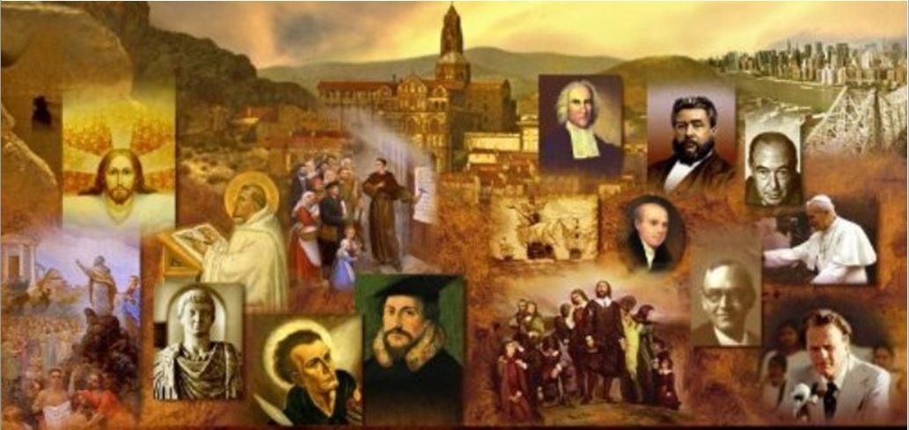
Review
Who was it that almost single-handedly saved Dutch and north German Anabaptism from the fanaticism that had manifested itself at Münster?
Menno Simmons
Explain Menno’s “heavenly flesh” Christology.
In order to preserve Christ from any taint of sin, Menno felt that the Savior's flesh was a special heavenly creation which was then implanted in Mary’s womb; therefore Christ did not receive His human nature from the Virgin.
What Mennonite teaching brought them into conflict with other Anabaptists?
An overly strong view of excommunication that led them to excommunicate all the Swiss Brethren, Hutterites, and disciples of Pilgram Marpeck, because of their weak view of excommunication!

Slide 3
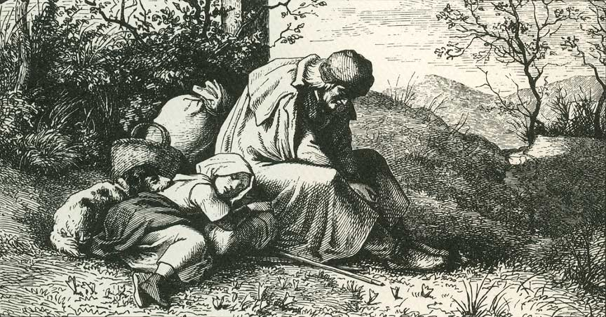
Jacob Hutter and the Hutterites
https://www.plough.com/en/topics/faith/witness/jakob-and-katharina-hutter

Slide 4
Jacob Hutter and the Hutterites
The Hutterites are a branch of Anabaptists who, like the Amish and Mennonites, trace their roots to the Radical Reformation of the early 16th century.
Under the leadership of their founder, Jacob Hutter, the Hutterites pooled their money and possessions in a common treasury, in keeping with what they believed to be the early Christian practice (from Acts 2).
Since the death of Hutter in 1536, the Hutterites continued their practice of living in a communal society, and embarked on a series of migrations through central and eastern Europe.
The Hutterites migrated to Russia in 1770 and about a hundred years later to North America.
Today, almost all Hutterites live in Western Canada and the upper Great Plains of the United States.
https://en.wikipedia.org/wiki/Hutterites

Slide 5
Our Modern Anabaptist Heritage
https://imgur.com/a/xt0XrmY?ref=hvper.com&utm_source=hvper.com&utm_medium=website

Slide 6
Our Modern Anabaptist Heritage
Today the direct descendants of the Anabaptists are the Mennonites and the Hutterites.
Americans probably think of them as bearded farmers and their bonnet-covered wives driving their horses and buggies across some Pennsylvania or Iowa countryside. No automobiles; no buttons; no zippers.
In fact only one section of the Mennonites, the Old Order Amish, holds tenaciously to the old ways.
The majority of Mennonites look like any other Americans and consume their share of energy like the rest of us.
Shelley, Dr. Bruce L.. Church History in Plain Language: Fourth Edition (pp. 258-259).

Slide 7
Our Modern Anabaptist Heritage
What unites the various types of Mennonites is not a style of dress or a mode of transportation but a shared set of beliefs and values.
Many of these beliefs are now accepted by other Christians.
The distant relatives of the Anabaptists today include the Baptists, the Quakers and, in one sense, the Congregationalists.
In fact, in their belief in the separation of church and state the Anabaptists are the forerunners of practically all modern Protestants.
Shelley, Dr. Bruce L.. Church History in Plain Language: Fourth Edition (pp. 258-259).

Slide 8
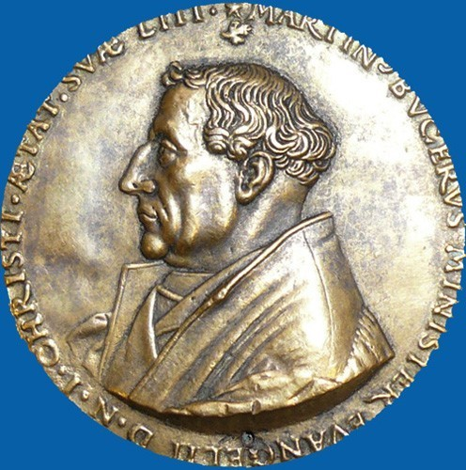
Martin Bucer
https://www.museeprotestant.org/en/notice/martin-bucer-3/

Slide 9
Martin Bucer
The Reformation in Strasbourg played a central part in shaping the distinctive outlook of the Reformed Churches.
A number of leading Reformed theologians taught in the city at various times. Martin Bucer (1491-1551) was the most important of these.
Born in south-western Germany, he became a Dominican friar in his youth, drank deeply of the Christian humanism of Erasmus, and devoted himself to the early Church fathers.
The Heidelberg disputation in April 1518 won him over to Luther’s cause.
Needham, Nick. 2,000 Years of Christ's Power Vol. 3: Renaissance and Reformation

Slide 10
Martin Bucer
As a result, Bucer abandoned the Dominican order in 1521, and married an ex-nun, Elizabeth Silbereisen, in 1522.
After the Roman Catholic Church excommunicated him for his “Lutheran” preaching in south-western Germany, he sought refuge in Strasbourg in 1523.
Once in Strasbourg, Bucer swiftly took over leadership of the reform movement in the city.
Bucer produced Strasbourg’s new Protestant liturgy in 1524, and in 1530 became president of the city’s “Church council”.
Under Bucer’s guidance, the Strasbourg Reformation steered a middle path between Zwingli and Luther, but with more of a leaning towards Lutheran thinking.
Needham, Nick. 2,000 Years of Christ's Power Vol. 3: Renaissance and Reformation

Slide 11
Martin Bucer
Bucer was present with Zwingli at the Marburg Colloquy in 1529, where the Lutheran and Reformed branches of Protestantism finally ended up parting ways.
Nevertheless, after the failure of Marburg, Bucer came up with a more traditional doctrine of the eucharist than Zwingli had held.
He argued that Christ’s body and blood are “exhibited” and “offered” through the bread and wine, so that believers do truly “receive” Christ by faith when they eat and drink.
Bucer even managed to secure agreement with Luther in 1536 at the Wittenberg Concord, in which those present agreed that Christ’s body and blood are truly and objectively given “with” the bread and wine, and are received even by the “unworthy”.
Needham, Nick. 2,000 Years of Christ's Power Vol. 3: Renaissance and Reformation

Slide 12
Martin Bucer
However, the Wittenberg Concord was later nullified by Bucer’s refusal to accept that unbelievers receive Christ’s body and blood, a point that was crucial for Luther.
Bucer defined the “unworthy” who receive Christ’s body and blood as true believers who participate in the Supper in an unworthy way.
But those who have no faith at all, Bucer said, receive only bread and wine.
Bucer’s quest for harmony with Lutherans was typical of his lifelong passion for Christian unity, of which he was the outstanding advocate among 16th century Protestants.
What Bucer primarily sought was unity with other leaders of the Magisterial Reformation, but Bucer was also committed to dialogue with Roman Catholics.
Needham, Nick. 2,000 Years of Christ's Power Vol. 3: Renaissance and Reformation

Slide 13
Martin Bucer
Bucer was even willing to learn from Anabaptists, despite finding them to be a distasteful bunch; Strasbourg was a safe haven for Radicals until the 1530s.
Bucer disagreed with the idea that the state controlled the Church – an idea that had characterized the Reformation up to that point; for Bucer, the Church was a divine society, quite distinct from the state, and Christ was the Church’s only Lord and Head.
Bucer believed that Christ exercised this Lordship and Headship in the Church through special offices of ministry which were set down in Scripture.
Needham, Nick. 2,000 Years of Christ's Power Vol. 3: Renaissance and Reformation

Slide 14
Martin Bucer
Bucer was not entirely clear or consistent on the number of these offices, but he mentions most often the pastor, the elder, and the deacon, sometimes adding the teacher and the evangelist.
Through these ministries, the Holy Spirit animated the Church as Christ’s body to carry out its mission, which Bucer defined as evangelism, pastoral care, and moral discipline.
The Church was “a community in which the Word and sacraments, love and discipline, prevail”.
Discipline figured increasingly in Bucer’s view of Church life, and he insisted that excommunication was the prerogative, not of the magistrate, but of the pastors and elders.
Needham, Nick. 2,000 Years of Christ's Power Vol. 3: Renaissance and Reformation

Slide 15
Martin Bucer
Martin Bucer, then, was the source of what became the Reformed view of the Church and its government and ministries.
He was not able to put much flesh on this vision in Strasbourg, but it was later taken up and given a full explanation by Calvin in Geneva.
Bucer envisaged society as a “Christian commonwealth” in which Church and state cooperated to establish the Lordship of Christ over all society’s affairs.
This outlook flowed in part from Bucer’s Erasmian humanism: he accepted Erasmus’s ideal of the rebirth of human life and culture.
Needham, Nick. 2,000 Years of Christ's Power Vol. 3: Renaissance and Reformation

Slide 16
Martin Bucer
In Bucer’s mind, both Church and state existed in order to serve Christ, although in different ways: the chief practical difference was that the state was empowered to use force, but the Church could use only persuasion.
The Church, Bucer argued, was subject to the state in all matters where the state was responsible for community life; the state on the other hand was subject to the Church, in that magistrates should consult Church leaders for their views on the moral principles which underlie social and political life.
This partnership and mutual subordination of Church and state was, Bucer believed, Christ’s way of permeating society with His influence, so that the whole of human life would be gradually re-ordered on the basis of service to one’s neighbor.
Needham, Nick. 2,000 Years of Christ's Power Vol. 3: Renaissance and Reformation

Slide 17
Martin Bucer
Bucer’s concept of the Christian commonwealth was expressed most completely in his book De Regno Christi (“Concerning the Kingdom of Christ”), written in 1550 when Bucer was in England – the work was dedicated to the young English king, Edward VI.
It was a perspective on the relationship between Christianity and society that became a Reformed distinctive: Lutherans tended to consign the state and all its works to the realm of “natural law”, in which Pagans could be wiser and more effective than Christians.
Bucer also contributed richly to the growth of biblical scholarship and biblical preaching among Protestants.
Needham, Nick. 2,000 Years of Christ's Power Vol. 3: Renaissance and Reformation

Slide 18
Martin Bucer
From the earliest days of the Strasbourg Reformation, lectures on the Bible were delivered in German to enthusiastic audiences of ordinary people.
Bucer himself lectured on the Gospels, the Psalms, and the Pastoral Epistles; these lectures were then published as commentaries.
Most readers today find Bucer’s biblical commentaries unreadable due to their awkward literary style, but in the 16th century they were very highly regarded in the Reformed world.
Needham, Nick. 2,000 Years of Christ's Power Vol. 3: Renaissance and Reformation

Slide 19
Martin Bucer
As a good German humanist, Bucer advocated the grammatico-historical method of biblical interpretation, emphasizing that each biblical writer should be studied on his own terms, seeking to discover the distinguishing features of each prophet or apostle’s own individual teaching.
Alongside this, Bucer also put a great emphasis on the interpretation of Scripture that the early Church fathers had held; they, Bucer believed, were the guardians in a general sense of the correct understanding of the Bible.
Bucer’s amazingly fruitful reforming career in Strasbourg came to a sudden end in 1548, when Holy Roman Emperor Charles V, having defeated the Protestant Schmalkaldic League on the field of battle, enforced a religious settlement on Germany known as the “Augsburg Interim”.
Needham, Nick. 2,000 Years of Christ's Power Vol. 3: Renaissance and Reformation

Slide 20
Martin Bucer
Bucer opposed the Interim as too Roman Catholic, and was compelled to leave Strasbourg.
The English Reformer, Archbishop Cranmer, invited Bucer to settle in England; Bucer accepted and, arriving in 1549, taught theology at Cambridge University.
He had significant input into Cranmer’s second Book of Common Prayer.
Having struggled with ill health for some time, Bucer died and was buried in England in 1551.
Needham, Nick. 2,000 Years of Christ's Power Vol. 3: Renaissance and Reformation

Slide 21
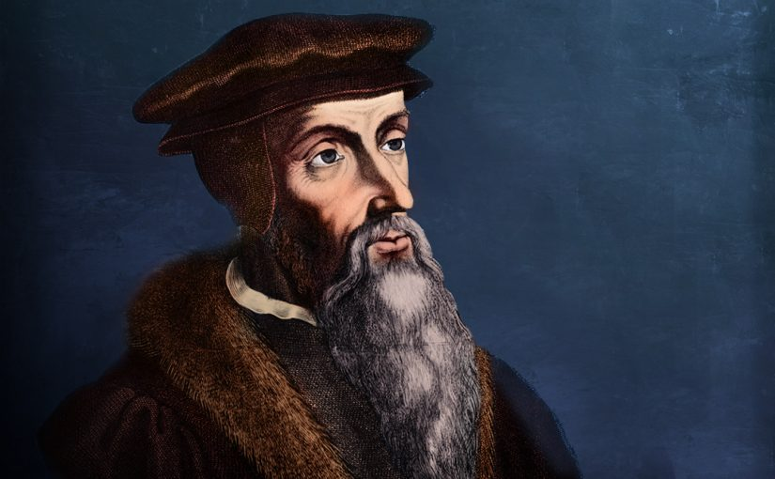
John Calvin
https://www.ets.ac.uk/engage/17-john-calvin/

Slide 22
Class Discussion Time
https://www.weareteachers.com/moving-beyond-classroom-discussions/

Slide 23
*Class Discussion Time
Do you feel a debt of gratitude to the Anabaptists, despite some of their extreme views, for having pulled away from the Magisterial Reformation in some key areas, namely:
Credo-Baptism
Separation of Church and State
Do you agree with Zwingli that Christ’s flesh and blood were in no sense physically present in the bread and wine or do you lean towards the idea put forth by Bucer and others that Christ is somehow “mystically” present in the elements of the Lord’s Supper?
Do you share Bucer’s vision of the ideal society as a “Christian commonwealth” in which Church and state cooperate to establish the Lordship of Christ over all society’s affairs?
Or, put in another way, do you believe that in a perfect world magistrates would (voluntarily) consult Church leaders for their views on the moral principles which underlie social and political life?
Do you have a topic or question that you would like to see us to discuss?

