Slide 2
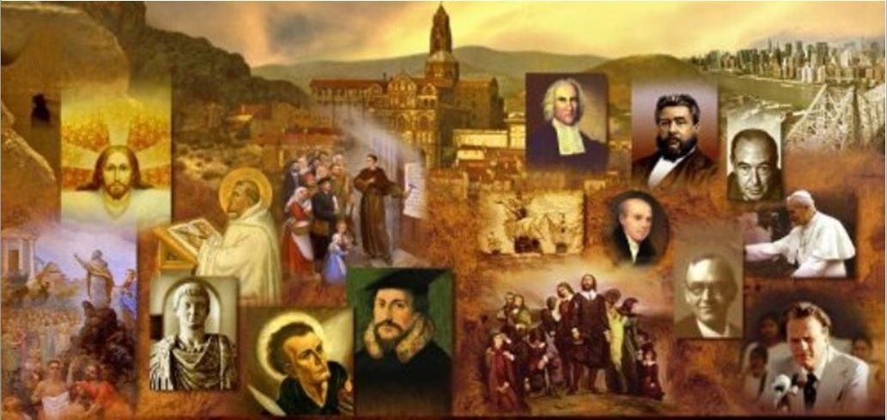
Review
What practice are the Hutterites known for in terms of their handling of their physical possessions?
The Hutterites pooled their money and possessions in a common treasury, in keeping with what they believed to be the early Christian practice (from Acts 2).
What area of belief makes the Anabaptists the forerunners of practically all modern Protestants?
Their belief in the separation of church and state
What city did Bucer minister in for nearly 25 years?
Strasbourg, France
Bucer disagreed with the idea that the state controlled the Church – an idea that had characterized the Reformation up to that point. Who did Bucer believe should rule over the church?
Christ, through special offices of ministry which were set down in Scripture – Pastor, elder, deacon, etc.

Slide 3
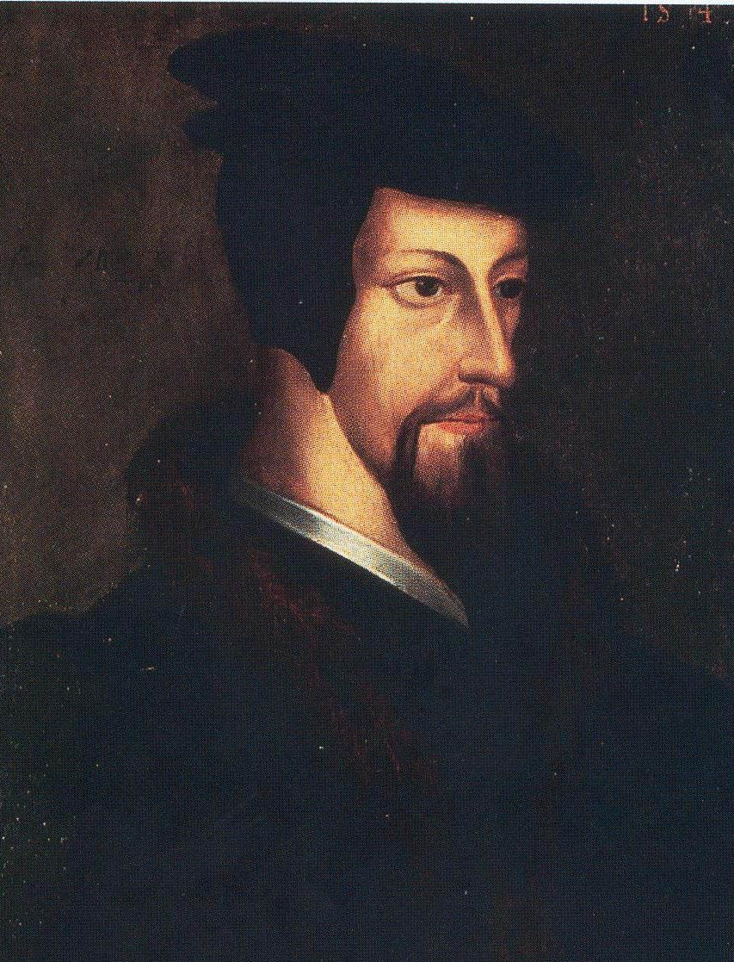
The Young John Calvin 1509-1535
http://www.religionfacts.com/john-calvin/image/9850

Slide 4
The Young John Calvin
Martin Bucer was a theological giant by any standard, and the fact that his present-day reputation is almost totally eclipsed by the more celebrated John Calvin must not blind us to his significance as a founding father of the Reformed faith, nor cause us to give an undue prominence to Calvin.
Calvin never was to Reformed Protestantism the dominating figure that Luther was to Lutheranism.
Nonetheless, it remains true that if any single person among the Reformed pioneers had ultimately the most far-reaching influence on the Church and the world, it was surely Calvin.
Needham, Nick. 2,000 Years of Christ's Power Vol. 3: Renaissance and Reformation

Slide 5
The Young John Calvin
John Calvin was born at Noyon in Picardy, north-eastern France, in 1509, the son of a Church lawyer attached to Noyon Cathedral.
His social background was more “upper class” than Luther’s, something that helps to account for the mature Calvin’s rather aloof, aristocratic personality.
When a Protestant refugee met Calvin after the latter had become the Reformer of Geneva, he addressed him as “brother Calvin”, only to be told that the correct form of address was “Monsieur Calvin”.
Calvin’s father Gérard intended him to enter the Roman Catholic priesthood, so the youthful Calvin prepared himself by studying at Paris University from 1523 to 1528, first at the College de la Marche where he learned Latin from one of its greatest teachers of the day, Mathurin Cordier.
Needham, Nick. 2,000 Years of Christ's Power Vol. 3: Renaissance and Reformation

Slide 6
The Young John Calvin
Cordier must have made an impression on young Calvin; many years later, the Reformer dedicated to his old Latin teacher his commentary on 1 Thessalonians. It is worth quoting:
It is only right that you should come in for a share in my labors, since under your patronage, having entered on a course of study, I gained a proficiency which prepared me to be useful, in some degree, to the Church of God. When my father sent me, while yet a boy, to Paris, after I had simply tasted the first elements of the Latin tongue, providence arranged that I had, for a short time, the privilege of having you as my instructor. I was taught by you the true method of learning, in such a way that I might be prepared afterwards to acquire a somewhat better competence… I gained so much help afterwards from your training, that it is with good reason that I confess myself indebted to you for whatever progress I have since made. And this I desired to testify to posterity, so that, if any advantage is added to them from my writings, they will know that it has in some degree originated with you.
Needham, Nick. 2,000 Years of Christ's Power Vol. 3: Renaissance and Reformation

Slide 7
The Young John Calvin
The mature Calvin’s Latin was unusually pure and beautiful; we can see in his time at the College de la Marche under Cordier the beginnings of the Reformer’s future brilliant style.
Calvin then moved to the College de Montaigu in Paris where Calvin formed a close friendship with Nicholas Cop, a zealous Christian humanist whose father was physician to the French king, Francis I. This friendship was to have important consequences.
In 1527, Calvin’s father got into a dispute with the leaders of the Noyon Cathedral and decided that his son should not become a priest after all, but a lawyer.
Needham, Nick. 2,000 Years of Christ's Power Vol. 3: Renaissance and Reformation

Slide 8
The Young John Calvin
So Calvin now terminated his theology studies and became a law student.
Here he also took pains to acquire the riches of the new humanist culture, learning Greek.
When his father died unexpectedly in 1531, this left Calvin free to abandon law and dedicate himself to Christian humanism at the College de France in Paris.
At the College, Calvin mastered Hebrew as well as Greek, and also wrote his first book, a commentary on a moral treatise called De Clementia (“Concerning Mercy”) by Seneca, the ancient Roman Stoic philosopher.
It was published in 1532, and Calvin sent a copy to Erasmus.
The book clinched Calvin’s reputation as a budding humanist scholar; but there was no hint in it that he had yet embraced the Protestant faith.
Needham, Nick. 2,000 Years of Christ's Power Vol. 3: Renaissance and Reformation

Slide 9
The Young John Calvin
However, some time between 1532 and 1534, Calvin passed over (like so many others) from Christian humanism into avowed Protestantism.
We do not know exactly when or how it happened.
One important influence may have been a Waldensian merchant, Etienne de la Forge, in whose house in Paris Calvin lodged.
De la Forge and Calvin were good friends, and the Waldensian had embraced the Reformation with enthusiasm
He used his house and his wealth to give shelter to Protestant refugees from the Netherlands.
Needham, Nick. 2,000 Years of Christ's Power Vol. 3: Renaissance and Reformation

Slide 10
The Young John Calvin
Calvin later described his conversion in the preface to his commentary on the Psalms:
Since I was more stubbornly addicted to the superstitions of the papacy than to be easily pulled out of that deep swamp, by a sudden conversion God subdued my heart (too hardened for one so young) to a teachable spirit. Thus, having gained some taste of true godliness, I burned with great zeal to make progress. Although I did not give up my former studies, I pursued them with less enthusiasm; and a year had not passed when all who desired this purer doctrine flocked to me, newcomer and beginner though I was, in order to learn it.
Needham, Nick. 2,000 Years of Christ's Power Vol. 3: Renaissance and Reformation

Slide 11
The Young John Calvin
In November, 1533 Calvin’s friend, Nicholas Cop, gave a speech as the newly appointed rector of Paris University.
Cop used the occasion to issue a humanist call for reformation in the Church, attacking scholastic theology and quoting Erasmus and Luther with approval.
The speech caused an uproar among traditional Catholics, and it provoked King Francis I into adopting a more repressive policy towards Protestants and their sympathizers.
Cop fled to the Swiss Protestant city of Basel; Calvin escaped from Paris disguised as a gardener and went into hiding in western France.
Needham, Nick. 2,000 Years of Christ's Power Vol. 3: Renaissance and Reformation

Slide 12
The Young John Calvin
France became an even more dangerous country for Protestant sympathizers in 1534, after the citizens of Paris woke up on the morning of October 19th and found the city covered with posters condemning the Roman Catholic mass as blasphemy and the Roman clergy as servants of Antichrist.
The posters were the work of an extreme Protestant, Antoine Marcourt.
The result was an outbreak of violent government persecution of French Protestants; in Paris, the authorities burnt twenty-four Protestants at the stake (including Calvin’s Waldensian friend, Etienne de la Forge), and imprisoned and tortured many others.
Now clearly a Protestant himself, Calvin followed in Nicholas Cop’s footsteps and fled to Basel, arriving there in January 1535.
Needham, Nick. 2,000 Years of Christ's Power Vol. 3: Renaissance and Reformation

Slide 13
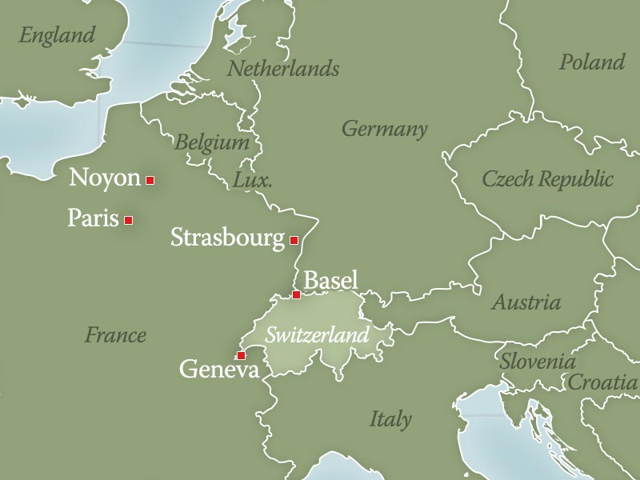
16th Century Europe
https://landmarkevents.org/assets/email/2019/09-02-history-highlight/

Slide 14
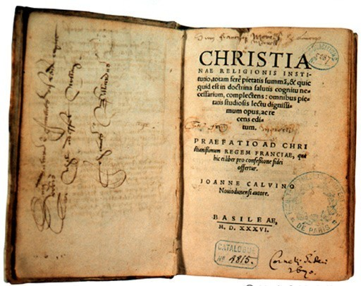
Institutes of the Christian Religion 1536
https://www.museeprotestant.org/en/notice/the-institutes-of-the-christian-faith/

Slide 15
Institutes of the Christian Religion
To justify his burning of Protestants, Francis I of France issued a public letter in 1535 accusing French Protestants of being political rebels intent on overthrowing the government (perhaps not surprising in the aftermath of Münster).
Calvin felt he must defend his persecuted brothers and sisters against this slander, and in March 1536 he published a short book which he had begun writing in when he was in hiding in Western France, called the Institutes of the Christian Religion, prefaced by an open letter to Francis I.
The letter was a masterpiece; with dignity and passion, Calvin set forth the essence of the Protestant position and vindicated French Protestants from Francis I’s false accusations.
From that moment, the world began to regard 26-year-old Calvin as the foremost champion of French Protestantism.
Needham, Nick. 2,000 Years of Christ's Power Vol. 3: Renaissance and Reformation

Slide 16
Institutes of the Christian Religion
The book to which Calvin attached the letter, the Institutes, was an orderly summary of Christian doctrine and the Christian life as understood by Protestants.
It was the clearest, most elegant, and best-organized presentation of Reformation theology and spirituality which had yet appeared.
Institutes is the English form of the book’s Latin title Institutio, which has a range of meanings – “instruction”, “manual”, “summary”.
A great success, the book sold well, and a second edition (greatly enlarged) came out three years later in 1539.
Needham, Nick. 2,000 Years of Christ's Power Vol. 3: Renaissance and Reformation

Slide 17
Institutes of the Christian Religion
Throughout his life, Calvin continued to expand and revise the Institutes; the final edition was published in 1559, and it became the standard textbook of Reformed theology.
The Institutes was a work of literary as well as theological brilliance, written in beautiful Latin and French (there were editions in both languages)
The French editions had a notable impact on the future development of the French tongue.
Needham, Nick. 2,000 Years of Christ's Power Vol. 3: Renaissance and Reformation

Slide 18
Institutes of the Christian Religion
The final 1559 edition of the Institutes was divided into four books. Calvin based this fourfold structure on the Apostles’ Creed, with its four central assertions:
Apostles’ Creed | Calvin’s Institutes
“I believe in God the Father almighty, Creator of heaven and earth” | Book One – “The Knowledge of God the Creator”
“And in Jesus Christ, His only Son, our Lord” | Book Two – “The Knowledge of God the Redeemer in Christ”
“I believe in the Holy Spirit” | Book Three – “The Way we Receive the Grace of Christ”
“I believe in the holy Catholic Church” | Book Four – “The External Means or Aids by which God Invites us into the Society of Christ”
Needham, Nick. 2,000 Years of Christ's Power Vol. 3: Renaissance and Reformation

Slide 19
Institutes of the Christian Religion
By setting out the Institutes like this, Calvin was making an important point: Protestants had not invented new doctrines of their own; they were simply rejecting the various errors that had grown up in the Western Catholic Church during the Middle Ages, and returning to the pure apostolic faith of the early Church.
Calvin himself was one of the 16th century’s great students of the early Church fathers; his writings overflowed with patristic quotations, especially from Augustine of Hippo.
Calvin also had some familiarity with the great Catholic theologians of the Middle Ages.
Frequently Calvin referred to the medieval thinkers only to criticize them, but he exempted Bernard of Clairvaux from this general condemnation, quoting the famous Cistercian monk with warm approval.
Needham, Nick. 2,000 Years of Christ's Power Vol. 3: Renaissance and Reformation

Slide 20
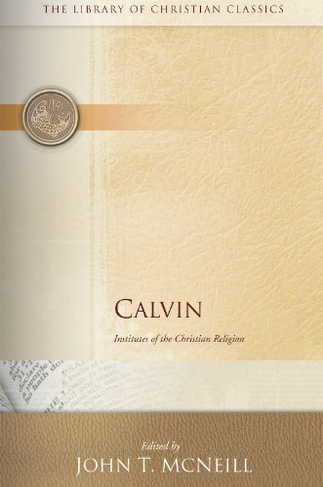
Recommended Translation
Translated by Ford Lewis Battles
https://www.amazon.com/gp/product/B00IYW227A?pf_rd_r=FS2127RZ73Q3T418WNHH&pf_rd_p=edaba0ee-c2fe-4124-9f5d-b31d6b1bfbee

Slide 21
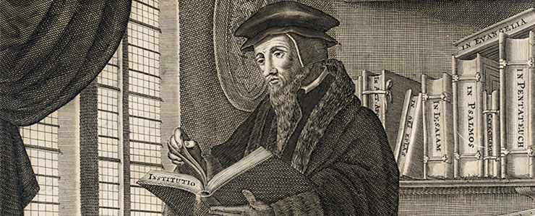
John Calvin’s Theology
https://faculty.wts.edu/posts/why-pastors-should-engage-calvins-institutes-of-the-christian-religion/

Slide 22
Class Discussion Time
https://www.weareteachers.com/moving-beyond-classroom-discussions/

Slide 23
*Class Discussion Time
Part of what prepared Calvin to serve the significant role that did in the Reformation and in church history was the strong education that he received in his youth – much of which he received prior to his conversion.
This raises a question in my mind – Scripture tells us that God uniquely gifts each member of the body with a spiritual gift in order to serve His purposes in the church: Do you think it’s fair to say that some of our gifting is shaped by experiences which God providentially puts us through even prior to our conversion?
Calvin’s education was clearly a significant part of what positioned him to be the effective leader that he was. What, if anything, does this say to us about the value of a good education and theological training in order to prepare men for to server as pastors?
Do you have a topic or question that you would like to see us to discuss?

