Slide 2
Review
Many people today associate the doctrine of predestination with Calvin – as though he somehow invented it.
In reality, what figure in church history were nearly all of the Reformers (including Calvin) most influenced by in their views of predestination and the sovereignty of God in salvation?
Augustine
In Calvin’s thinking, the oversight of the Church was in the hands of presbyters – pastors, teachers, elders; and all the congregations of a particular region were subject to the authority of all their pastors and elders meeting together as a consistory.
This form of Church government came to be called ______.
Presbyterianism

Slide 3
Calvin the Reformer of Geneva 1536-1538
https://www.museeprotestant.org/en/notice/portraits-of-calvin/

Slide 4
Calvin the Reformer of Geneva
Calvin stayed in the Swiss Reformed city of Basel for just over a year, made one last trip to his native town of Noyon in France to put some family business in order, then began making his way to Strasbourg.
As we have seen, Strasbourg was a south German imperial city which had embraced a Reformed variety of Protestantism under the Reformer Martin Bucer.
Calvin hoped to settle there and live a quiet life as a Christian scholar.
However, war between Holy Roman Emperor Charles V and King Francis I of France forced Calvin to make a detour.
In July 1536, he stopped overnight in the independent French-speaking city of Geneva, on the western tip of Switzerland.
It has been called the most fateful detour in history.
Needham, Nick. 2,000 Years of Christ's Power Vol. 3: Renaissance and Reformation

Slide 5
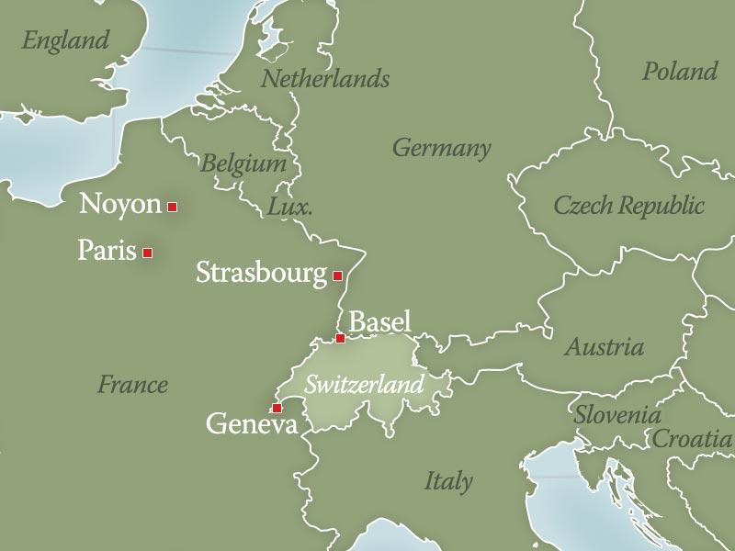
Cities Visited by Calvin
https://landmarkevents.org/assets/email/2019/09-02-history-highlight/

Slide 6
Calvin the Reformer of Geneva
Geneva was a strategically important city, standing on the crossroads between France, Switzerland and Italy.
The Swiss Reformed canton of Berne had only just introduced the Reformation into Geneva two months previously.
Geneva – not a member of the Swiss Confederacy – was struggling to maintain its independence from Savoy (north-western Italy), and relied heavily on Bernese support.
However, Berne itself had ambitions to control Geneva; and so, to bring Geneva more closely under Bernese influence, Berne attempted to propagate the Swiss Reformed faith among the Genevans.
Needham, Nick. 2,000 Years of Christ's Power Vol. 3: Renaissance and Reformation

Slide 7
The Reformation – Calvin’s Switzerland
https://slideplayer.com/slide/15667073/

Slide 8
Calvin the Reformer of Geneva
The Bernese agent in this endeavor was the French Protestant Reformer, William Farel (1489-1565), who was like some fiery Old Testament prophet in his booming denunciations of Rome and sin, and heart-piercing demands for repentance and Reformation.
Before fleeing to Switzerland from persecution in France, Farel had belonged to a reform-minded humanist circle led by Jacques Lefevre d’Étaples.
Calvin had also been linked with the same group, so Farel knew about Calvin.
And he knew that Calvin had recently produced that masterpiece of Reformation theology, the Institutes.
So when Farel heard that Calvin was staying overnight in Geneva, he immediately went to see him and asked Calvin to remain in the city and help him reform its moral and religious life.
Needham, Nick. 2,000 Years of Christ's Power Vol. 3: Renaissance and Reformation

Slide 9
Calvin the Reformer of Geneva
Calvin refused. He explained to Farel that he was a shy scholar who only wanted to live a peaceful and retired life among his books, reading, studying, writing.
But Calvin’s talk about what he wanted to do with his life did not impress Farel. Farel became angry and accused Calvin of putting his own desires for personal peace above the urgent spiritual needs of Geneva.
Towering over the terrified Calvin, Farel called down the curse of God on the scholar’s “peaceful life”, if Calvin would not stay and help him.
Struck with awe, seeming to hear the voice of the Lord speaking from heaven through Farel, Calvin obeyed.
So began John Calvin’s career as the Reformer of Geneva, which would last for (almost) the rest of his life.
Needham, Nick. 2,000 Years of Christ's Power Vol. 3: Renaissance and Reformation

Slide 10
Calvin the Reformer of Geneva
Calvin and Farel wanted to make Geneva into an outstanding model of a Christian community.
To lay a basis for this goal, they felt they had to secure the independence of the Church from the state, so that the Church’s officers, not the city council, had the power to excommunicate the unworthy.
However, this attempt to introduce a strong Church discipline into Geneva met with bitter resistance.
So did Calvin and Farel’s desire to impose a doctrinal statement of faith on all Genevans.
Needham, Nick. 2,000 Years of Christ's Power Vol. 3: Renaissance and Reformation

Slide 11
Calvin the Reformer of Geneva
When the Genevan city council voted to adopt the liturgy used in Berne, Calvin and Farel saw this as the state trying to dictate to the Church how it should worship God, and they refused to accept it.
As a result, in April 1538 the council banished them.
Thus, Calvin’s first attempt at reforming Geneva was a dismal failure.
Needham, Nick. 2,000 Years of Christ's Power Vol. 3: Renaissance and Reformation

Slide 12
Calvin at Strasbourg 1538-41
Saint-Nicolas Church, Strasbourg, where Calvin preached in 1538
https://en.wikipedia.org/wiki/John_Calvin#/media/File:Strasbourg_-_%C3%89glise_Saint-Nicolas.jpg

Slide 13
Calvin at Strasbourg
Martin Bucer invited Calvin to settle in Strasbourg.
There, Calvin found himself in the greatest international center of the Reformed faith at that time.
He acted as pastor to a large congregation of French Protestant refugees who had fled the persecution in their native land.
He also lectured on theology and wrote an exposition on the book of Romans, the first of a brilliant series of biblical commentaries.
Calvin’s commentaries were perhaps even more influential than his Institutes; they are the only Reformation commentaries still being reprinted and widely studied today.
Needham, Nick. 2,000 Years of Christ's Power Vol. 3: Renaissance and Reformation

Slide 14
Calvin at Strasbourg
In August 1540, Calvin married. His attitude to marriage was resoundingly unromantic; he wrote:
I, whom you see so hostile to celibacy, have never taken a wife, and I do not know if I shall ever marry. If I did so, it would be in order to devote my time more to the Lord by being relieved from the worries of daily life.
This unromantic approach was in fact fairly common in 16th century Europe; the idea that romantic love is the proper basis for marriage had not yet dawned on most minds.
Needham, Nick. 2,000 Years of Christ's Power Vol. 3: Renaissance and Reformation

Slide 15
Calvin at Strasbourg
Bucer took it upon himself to find a wife for Calvin. The first attempt failed, but the second succeeded, and Calvin agreed to marry a French lady, Idelette de Bure, widow of a convert from Anabaptism to the Reformed faith.
Idelette already had a son and daughter from her previous marriage; she and Calvin had one son who died in his infancy.
Idelette herself, increasingly troubled with illness, died in 1549, after which Calvin consciously embraced a celibate life.
Although their marriage lacked romance, it proved an affectionate union, and Calvin was emotionally stunned by Idelette’s death. “Truly, mine is no common grief. I have been bereaved of the best companion of my life.”
Needham, Nick. 2,000 Years of Christ's Power Vol. 3: Renaissance and Reformation

Slide 16
Calvin at Strasbourg
Together with Bucer, Calvin took part in a number of important conferences between Protestant and Roman Catholic theologians in 1539-41, especially the Colloquy of Regensburg, which tried, unsuccessfully, to heal the divisions in Western Christendom.
Calvin met the Lutheran Reformer Philip Melanchthon at these conferences, and the two became close lifelong friends.
Philip Melanchthon is the golden chain linking the two supreme figures of the Protestant Reformation, Luther and Calvin: he was the intimate personal friend of both men (Luther and Calvin themselves never met).
Indeed, Melanchthon’s friendship with Calvin got him into trouble with strict Lutherans, because he agreed with Calvin’s doctrine of the eucharist rather than Luther’s.
Needham, Nick. 2,000 Years of Christ's Power Vol. 3: Renaissance and Reformation

Slide 17
Calvin at Strasbourg
Calvin himself worked ceaselessly for union between Reformed and Lutherans, but his labors were always dashed to pieces on the rock of the Lord’s Supper.
Calvin did not believe that the differences between Luther’s view and the Reformed view were serious enough to justify a division among Protestants over the issue.
On this point, however, Luther simply would not shift from the ground he had occupied at the Marburg Colloquy in 1529, where he had refused to give Zwingli and Bucer the right hand of fellowship. “I reverence Luther, but I am ashamed of him,” Calvin wrote to Melanchthon.
He also complained to Bucer about Luther’s “craving for victory, haughty manner, abusive language, and insolent fury”. Nonetheless, Calvin’s esteem for Luther as a theologian and a Reformer was almost unbounded.
Needham, Nick. 2,000 Years of Christ's Power Vol. 3: Renaissance and Reformation

Slide 18
Calvin at Strasbourg
Calvin’s three years in Strasbourg were the happiest of his life. This was where he felt most at home, writing and preaching and mingling with other Reformers in a pleasant atmosphere, free from bitter conflicts.
Despite what ill-informed or prejudiced people have said about him, Calvin was basically a gentle, quiet, long-suffering person, who hated controversy and took part in it only when a high sense of duty compelled him – he had none of Luther’s love of a good fight.
If Calvin’s personality seems less colorful and attractive than Luther’s, the reason is partly that Calvin was a very shy and reserved man who hardly ever spoke about himself.
Needham, Nick. 2,000 Years of Christ's Power Vol. 3: Renaissance and Reformation

Slide 19
Calvin at Strasbourg
Still, Calvin was not a harsh or miserable individual. He was a tender husband, stricken by his wife’s early death. He enjoyed many warm and enduring friendships, especially with Melanchthon and Farel.
He rejoiced in the earthly gifts of God. Natural beauty, food, drink, family, friendship, art, music: these things were very good – Calvin had no doubt of that.
Yet the kingly service of Jesus Christ and His gospel was infinitely greater and more glorious. To that service, the soul of Calvin was consecrated. He expected every other believer to be as dedicated as himself.
Needham, Nick. 2,000 Years of Christ's Power Vol. 3: Renaissance and Reformation

Slide 20
Calvin at Strasbourg
Calvin’s happy years in Strasbourg were not to last. Even in Strasbourg, Calvin could not escape from Geneva.
In 1539 the distinguished Roman Catholic cardinal, Jacob Sadoleto, tried to win back the Genevans to Rome by writing them an open letter in which he attacked Protestants for violating the unity of the Church, and even criticized the motives and characters of Calvin and Farel.
What made Sadoleto’s letter attractive to wavering Protestants was the fact that Sadoleto was himself one of the foremost advocates of “evangelical” reform within the Roman Catholic Church.
Stung by the personal criticisms of himself, Calvin produced a highly effective Reply to Sadoleto in September 1539, regarded by many as one of the most persuasive statements of Reformation principles ever written. It impressed the Genevans.
Needham, Nick. 2,000 Years of Christ's Power Vol. 3: Renaissance and Reformation

Slide 21
Calvin at Strasbourg
In October 1540, the citizens of Geneva asked Calvin to return and resume his work there as a Reformer.
Calvin hesitated long, remembering the pathetic failure of his previous efforts at reforming Geneva. “There is no place under heaven that I am more afraid of,” he wrote. “I would rather submit to a hundred other deaths, than to that cross on which I would have to perish a thousand times every day!”
However, he finally yielded to the urgent and repeated invitations of the Genevans, and re-entered the city in September 1541.
He went in fear and trembling: “I offer my heart a slain victim in sacrifice to the Lord.”
But this time he returned for good.
Needham, Nick. 2,000 Years of Christ's Power Vol. 3: Renaissance and Reformation

Slide 22
Calvin Returns to Geneva 1541-64
https://www.museeprotestant.org/en/notice/portraits-of-calvin/

Slide 23
Class Discussion Time
https://www.weareteachers.com/moving-beyond-classroom-discussions/

Slide 24
*Class Discussion Time
Do you think there was anything wrong with a man of Calvin’s talents and abilities wanting to settle down to live a peaceful and retired life among his books, reading, studying, and writing in Strasbourg?
Was Farel in the right when he became angry and accused Calvin of putting his own desires for personal peace above the urgent spiritual needs of Geneva?
Calvin believed he heard the voice of the Lord speaking from heaven through Farel. Do you think Calvin was right? Does God sometimes speak to us through others in this way?
We saw where Calvin dreaded leaving his peaceful and spiritually productive life in Strasbourg to return to Geneva – and yet he did so anyway. Do you admire Calvin for being willing to do this? Would you be willing to share with the class a time when you might have faced with a similar decision?
Do you have a topic or question that you would like to see us to discuss?

