Slide 2
Review
What were Calvin’s original plans when he first passed through Geneva?
He was on his way to Strasbourg where he hoped to live a peaceful and retired life among his books, reading, studying, and writing.
What caused Calvin to change his plans?
William Farel accused Calvin of putting his own desires for personal peace above the urgent spiritual needs of Geneva and convinced Calvin that God would have him to stay and help him.
What was the results of Calvin (and Farel’s) first attempt to reform Geneva?
The Geneva city council banished them from the city, which lead Calvin to believe that his efforts had been a dismal failure.

Slide 3
Review
Where did Calvin go after being banished from Geneva?
He went on to Strasburg as he had originally intended.
How did things go for Calvin in Strasburg?
Calvin’s three years in Strasbourg were the happiest of his life. This was where he felt most at home, writing and preaching and mingling with other Reformers in a pleasant atmosphere, free from bitter conflicts.
What made Calvin decide to go back to Geneva?
The citizens of Geneva, recognizing their mistake in expelling Calvin, asked him to return and resume his work there as a Reformer.
How did Calvin feel about returning to Geneva?
He went in fear and trembling.

Slide 4
Calvin Returns to Geneva 1541-64
https://www.museeprotestant.org/en/notice/portraits-of-calvin/

Slide 5
Calvin Returns to Geneva
The invitation of the Genevans to Calvin to return to them did not mean that Calvin had an easy ride in his second period as the city’s Reformer.
Indeed, he struggled for many years, against all kinds of opposition, to try to make Geneva into a Christian community which he believed would embody God’s will for human society.
Calvin never achieved all he wanted.
For example, although he won for the Genevan Church a large measure of independence from state control, he had to compromise by agreeing that the elders would be chosen by the city magistrates from among their own number.
Needham, Nick. 2,000 Years of Christ's Power Vol. 3: Renaissance and Reformation

Slide 6
Calvin Returns to Geneva
However in 1555 (fourteen years after coming back to Geneva), Calvin did finally secure the power of Church discipline and excommunication for the consistory (pastors and elders), not the city council.
Calvin was more than a religious reformer; he was a moral, social, and political reformer too.
His great vision was not only to build up a true Christian Church in Geneva, but also to make Geneva itself into a true Christian city.
Calvin therefore strove to purify the moral life of Genevan society, persuading the city council to enforce severe laws against adultery, prostitution, pornography, drunkenness, dancing, gambling, swearing, disobedience of children to parents, and so on.
Needham, Nick. 2,000 Years of Christ's Power Vol. 3: Renaissance and Reformation

Slide 7
Calvin Returns to Geneva
Calvin also took strong positive measures to improve the social, economic, and cultural life of the community.
For instance, the authorities:
Created an outstanding system of free public education;
Stimulated business by helping to establish a highly successful cloth and silk industry, which provided much-needed employment;
Made the sale of food subject to strict health and hygiene laws;
Supplied latrines free of charge for all houses that lacked them (a very real need in most 16th century European homes);
Built a high-quality hospital, and a place of residence for the homeless;
Set up an agency to find work for the unemployed;
Organized a noble system of social care for the poor and aged.
Needham, Nick. 2,000 Years of Christ's Power Vol. 3: Renaissance and Reformation

Slide 8
Calvin Returns to Geneva
In these and other ways, the Genevan government carried out a wide-ranging program of social planning and reform which, alongside the moral and spiritual influence of the Genevan Church, transformed the life of the city.
Out of the purifying fire of internal conflicts, Calvin’s Geneva eventually became a near-perfect pattern of a Reformed community.
Reformed refugees from all over Western Europe (especially France) flocked to the city of Calvin; Geneva rather than Strasbourg now became the great international headquarters of Reformed Protestantism.
The Reformed refugees helped Calvin to make Geneva into a model Reformed city, and at the same time the Genevan example inspired them to take the Reformed faith back to their own homelands.
Needham, Nick. 2,000 Years of Christ's Power Vol. 3: Renaissance and Reformation

Slide 9
Calvin Returns to Geneva
John Knox, the Reformer of Scotland, who pastored a congregation of English Protestant refugees in Geneva from 1556 to 1559, famously referred to Calvin’s Geneva in these words in a letter to a friend:
I cannot cease to wish, that it might please God to guide and bring you to this place; where [there] is the most perfect school of Christ that ever was on the earth since the days of the apostles. In other places, I confess Christ to be truly preached; but behavior and religion to be so sincerely reformed, I have not yet seen in any other place beside.
Needham, Nick. 2,000 Years of Christ's Power Vol. 3: Renaissance and Reformation

Slide 10
Calvin Returns to Geneva
More striking than Knox’s praise was the testimony of a German Lutheran pastor, when he visited Geneva in 1610, some forty-six years after Calvin’s death; he was utterly astonished by the living monument which the Genevan Reformer had left behind him:
There is in Geneva the perfect system of a perfect government; … All cursing, swearing, gambling, luxury, strife, hatred, and deceit are forbidden, while greater sins are hardly even heard of. What a glorious beauty of the Christian faith shines forth in such purity of moral conduct! …Indeed, if it were not for the religious difference between me and the Genevans, I would for ever have been bound to that city by our agreement in morality, and I have ever since tried to introduce something like it into our churches.
Needham, Nick. 2,000 Years of Christ's Power Vol. 3: Renaissance and Reformation

Slide 11
Calvin Returns to Geneva
Calvin himself never held any position of public authority in Geneva, other than the simple office of pastor of Saint Peter’s Church, one of the three city churches.
Calvin ruled Geneva through the persuasive power of the spoken word.
He preached not only on Sundays but on three weekdays too, lectured on theology twice a week, attended the weekly meeting of the consistory every Thursday, and expounded the Bible every Friday at a special spiritual conference called the “assembly”.
Needham, Nick. 2,000 Years of Christ's Power Vol. 3: Renaissance and Reformation

Slide 12
Calvin Returns to Geneva
Calvin had no political power, and the council did not even grant him citizenship in Geneva until nearly twenty years after his return; he reformed the city by preaching, not by force or decree.
The city council would follow Calvin’s reforming ideas only if Calvin’s arguments convinced enough of the council members. He did not always convince them.
Especially in the years 1548-55, there was bitter conflict between Calvin’s supporters and opponents.
His opponents dominated the city council during this period; they were mostly native Genevans from long-established families, who resented the influx of 6,000 foreign religious refugees into the small city (it had a native population of only 13,000).
Needham, Nick. 2,000 Years of Christ's Power Vol. 3: Renaissance and Reformation

Slide 13
Calvin Returns to Geneva
Calvin’s foes were sometimes called the “Libertines” because of their opposition to the moral discipline he wished the city to embrace.
A number of them led somewhat loose lives, and some held heretical views, e.g. denying the inspiration of Scripture, and maintaining that God and the universe were identical (“pantheism” – the view that everything is God).
The Reformer had to endure many insults and even threats against his life from the Libertines, and sometimes he fell into deep depression; “I wish God would let me leave this place,” he wrote in 1547.
Yet by 1555, Calvin and his supporters had completely triumphed over the Libertine party.
Needham, Nick. 2,000 Years of Christ's Power Vol. 3: Renaissance and Reformation

Slide 14
Calvin and Servetus
https://www.youtube.com/watch?v=rmFxUMrrEEM

Slide 15
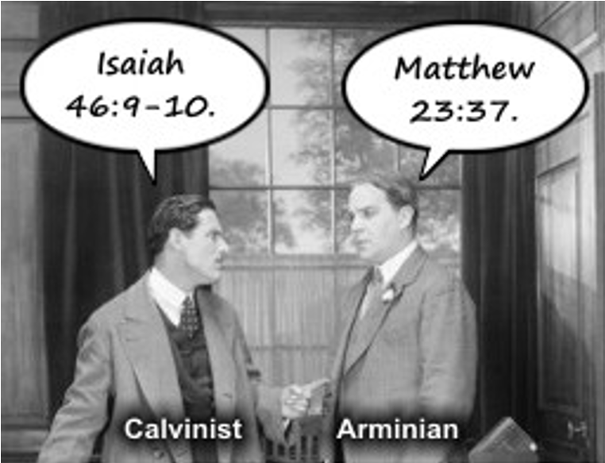
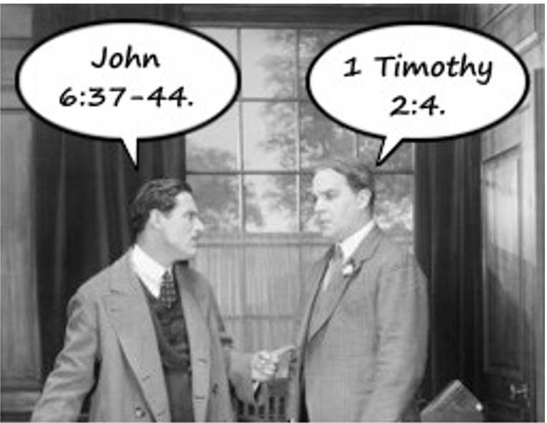
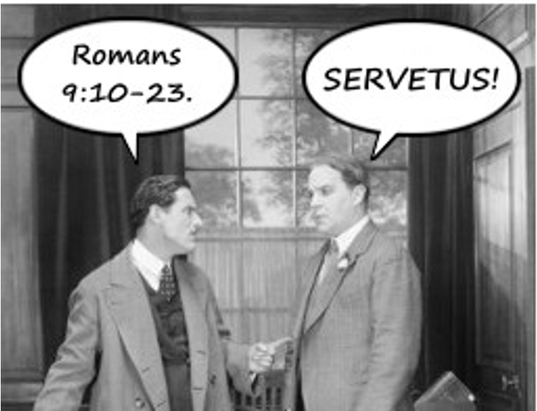
A Calvinist Arguing with an Arminian
https://derekzrishmawy.com/2013/01/29/responses-to-calvin-killed-servetus-by-denomination-or-dealing-with-theological-moral-hubris/

Slide 16
Calvin and Servetus
Calvin’s ultimate victory in Geneva was partly brought about by a tragic episode involving a Spanish Radical called Michael Servetus.
Servetus was a physician gifted with a brilliant if erratic mind, who had shocked Roman Catholics and Protestants alike by his writings in which he denied and mocked the doctrine of the Trinity, which he called “a three-headed monster”.
Servetus corresponded with Calvin in the 1540s; Calvin at first replied to his letters, trying to reason with him from the Scriptures, but he finally washed his hands of Servetus as a “desperately obstinate heretic”.
Arrested and condemned to death for heresy by the Roman Catholic inquisition in Vienne (southern France), Servetus escaped from prison and – for whatever reason – went to Geneva in August 1553 where he was recognized and arrested by the Genevan authorities.
Needham, Nick. 2,000 Years of Christ's Power Vol. 3: Renaissance and Reformation

Slide 17
Calvin and Servetus
Servetus’s trial for heresy before the Genevan city council became a trial of strength between Calvin and the Libertines, who then controlled the council.
Like almost all Christians in his day, Calvin accepted that the state was under moral obligation to God to punish heretics (ironically, even Servetus himself taught that Christian magistrates should put heretics to death).
The crucial difference between Servetus and his Roman Catholic and Protestant opponents was that they believed there was no greater heresy than denying the Trinity.
If the Genevan city council convicted Servetus, then, he would face the death penalty for his anti-Trinitarian faith.
Needham, Nick. 2,000 Years of Christ's Power Vol. 3: Renaissance and Reformation

Slide 18
Calvin and Servetus
The Libertines placed every possible difficulty in the way of Servetus’s conviction – not out of any compassion for Servetus, but just to harass Calvin.
However, they could not afford to acquit Servetus when all Western Christendom was demanding his execution.
They showed their lack of principle when, after encouraging Servetus for so long by their delaying tactics, the Libertine-dominated council (by a unanimous vote) finally condemned the unfortunate Radical to death by burning.
Calvin was glad that Servetus had been sentenced to death, but horrified at the cruel method of execution; he tried to get it changed to something swift and merciful, and was rebuked by his old friend William Farel for being soft.
Needham, Nick. 2,000 Years of Christ's Power Vol. 3: Renaissance and Reformation

Slide 19
Calvin and Servetus
The council, however, refused to listen to Calvin, and Servetus was burnt at the stake on October 17, 1553.
Farel attended Servetus pastorally in his last hours, but, in spite of Farel’s efforts, Servetus died with an unshaken faith in his anti-Trinitarian convictions.
His cry amid the flames was, “Jesus, Son of the eternal God, have mercy on me!”
It has been pointed out that if only Servetus had said, prior to his conviction, “Jesus, the eternal Son of God, have mercy on me!” his life would have been spared.
Needham, Nick. 2,000 Years of Christ's Power Vol. 3: Renaissance and Reformation

Slide 20
Calvin and Servetus
At the time, Servetus’s trial and execution greatly magnified Calvin’s reputation: he had purged Europe of its most hated heretic.
The other Magisterial Reformers showered the highest praise on Calvin.
Peter Martyr’s (a well known Reformer and friend of Martin Bucer) response was typical:
Regarding Servetus, I have nothing to say but that he was the devil’s own son, whose evil and detestable doctrine must everywhere be banished. Nor is the magistrate who executed him to be blamed, since there could be found in Servetus no sign of repentance, and his blasphemies simply could not be tolerated.
Needham, Nick. 2,000 Years of Christ's Power Vol. 3: Renaissance and Reformation

Slide 21
Calvin and Servetus
By contrast, the Libertines had destroyed their credibility by putting so many obstacles in the path of Servetus’s punishment.
The Genevan elections of 1554 and 1555 went decisively in Calvin’s favor.
The Libertines foolishly staged a minor riot one night in May 1555; the city council responded by executing the ringleaders for treason and banishing others.
From that moment, Calvin was the undisputed moral and spiritual leader of Geneva until his death in 1564.
Needham, Nick. 2,000 Years of Christ's Power Vol. 3: Renaissance and Reformation

Slide 22
Summary of Calvin’s Achievements
https://www.ets.ac.uk/engage/17-john-calvin/

Slide 23
Class Discussion Time
https://www.weareteachers.com/moving-beyond-classroom-discussions/

Slide 24
*Class Discussion Time
Calvin strove to purify the moral life of Genevan society, persuading the city council to enforce severe laws against adultery, prostitution, pornography, drunkenness, dancing, gambling, swearing, disobedience of children to parents, and so on.
Were it in your power to do so, would you want to see these things prohibited by government in our day? Go through each item listed and explain why or why not.
The authorities in Geneva:
Created an outstanding system of free public education;
Stimulated business by helping to establish a highly successful cloth and silk industry, which provided much-needed employment;
Made the sale of food subject to strict health and hygiene laws;
Supplied latrines free of charge for all houses that lacked them (a very real need in most 16th century European homes);
Built a high-quality hospital, and a place of residence for the homeless;
Set up an agency to find work for the unemployed;
Organized a noble system of social care for the poor and aged.
Go through each item in this list and tell whether you are in favor of authorities in our day setting up such things.
Should we view Geneva as a model for how cities (ideally) should work in our day?
Do you have a topic or question that you would like to see us to discuss?

