Slide 2
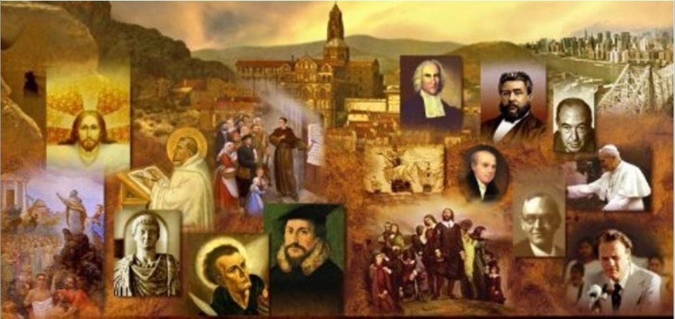
Review
In the New Testament who is the primary group that we see persecuting Christians, and who is it that often steps in to protect the Christians from that persecution?
In most of the New Testament it is the Jews who persecute Christians, who in turn seek refuge under the wing of Roman authorities.
In New Testament times, how did the Romans, Jews, and Christians all view the conflict that was taking place between Jews and Christians?
They understood it as an internal conflict within Judaism.

Slide 3
Review
Acts 18:2 tells us that Priscilla and Aquila had recently left Rome to live in Corinth because Claudius had commanded all the Jews to leave Rome.
According to Suetonius, a Roman historian, why did the emperor Claudius expel the Jews from Rome in AD 51?
Jews were expelled from the Rome for their disorderly conduct “because of Chrestus.” Most historians agree that “Chrestus” refers to Christ, and that what actually took place in Rome was that the Christian proclamation caused so many riots among Jews that the emperor decided to expel them all from Rome.

Slide 4
Review
What historical circumstances caused the Roman authorities to begin recognizing Christianity as separate from Judaism and, as a result, began to persecute them as an unauthorized religion?
The church gained more converts from the Gentile population, and the ratio of Jews in its ranks diminished.
As Jewish nationalism increased and eventually led to rebellion against Rome, Christians—particularly the Gentiles among them—sought to put as much distance as possible between themselves and the Jewish rebellion against Rome.

Slide 5
Review
Through his mother’s manipulation, Nero became emperor in AD 54 – How old was Nero at that time?
16 years old
What kind of a ruler was Nero at first and how did that change later?
At first he was a reasonable ruler, whose laws in favor of the dispossessed were well received by the Roman populace.
But Nero became increasingly infatuated by his dreams of grandeur and his lust for pleasure, to a point where ten years after his accession to the throne (AD 64), he was despised by the general population and thought by many to be insane.

Slide 6
Review
At the point where Nero had become extremely unpopular and thought by some to be insane, a great fire broke out in Rome that lasted six days and seven nights, destroying ten of the fourteen sections of the city.
What was Nero’s first response to the fire?
As soon as he heard the news he hurried to Rome, where he tried to organize the fight against the fire. He opened the gardens of his palace, as well as other public buildings, to those made homeless by the fire.

Slide 7
Review
In spite of his initial response, more and more Romans came to believe that Nero had started the fire.
What did Nero finally end up doing in order to get the Romans to quit blaming him for the fire?
He blamed it on the Christians.
What did Nero begin doing to the Christians in order to “punish” them for having started the fire.
He began to persecute them, throwing parties where he “entertained” his guests by torturing Christians and putting them to death.

Slide 8
Review
A controversial question to provoke thought – I have heard many preachers say something like this:
Scripture says earthly governments are ordained by God to administer justice, and believers are to be subject to their authority. The civil magistrate is “a minister of God to you for good . . . an avenger who brings wrath on the one who practices evil” (Romans 13:1–4). But … when Paul wrote that command, the Roman Emperor was Nero, one of the most grossly unjust, unprincipled, cruel-hearted men ever to wield power on the world stage. (https://www.gty.org/library/blog/B180813)
Nero became emperor in AD 54 and for the first few years was decent and fairly well liked as a ruler.
The Roman letter was written in AD 57
Nero did not begin persecuting Christians until AD 64.
Does anyone see a problem here?

Slide 9
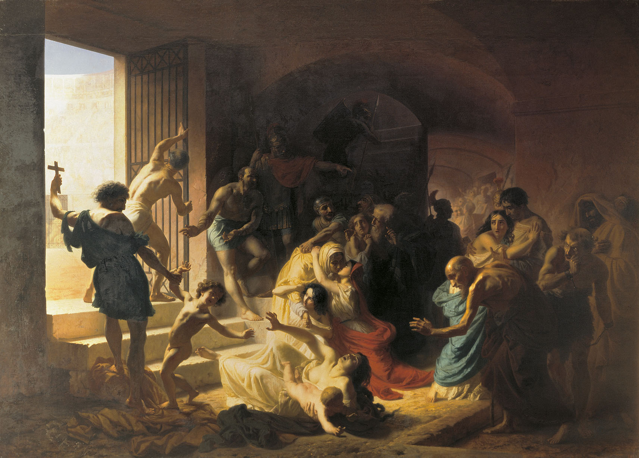
Reasons for Christian Persecution
If you were of the world, the world would love you as its own; but because you are not of the world, but I chose you out of the world, therefore the world hates you.
(John 15:19)
https://upload.wikimedia.org/wikipedia/commons/0/0a/Konstantin_Flavitsky_-_Christian_Martyrs_in_Colosseum.jpg

Slide 10
*Reasons for Christian Persecution
Most people know that the Roman Empire persecuted Christians. But why were the early Christians persecuted?
The Roman state assumed the right to control the religious life of its subjects. It classified religions into two simple categories, licita (“permitted”) and illicita (“not permitted”).
Once it had become clear to Roman magistrates that Christians were not a Jewish sect, Christianity ceased to enjoy the “permitted” status of Judaism.
Rome was normally tolerant in religious matters; but if it felt that a particular religion was a threat to public morality or political stability, the authorities would suppress it.
* Needham, Nick. 2,000 Years of Christ's Power Vol. 1: The Age of the Early Church Fathers

Slide 11
*Reasons for Christian Persecution
So why did Rome decide that the Christians were a threat to the well-being of the Empire?
In part, the answer lies in the fact that Christians made exclusive truth-claims for their faith.
The other religions of the Empire were syncretistic – that is, they did not make any claim to be the one and only truth. A person could “mix” his religions and follow more than one.
Christianity, and of course Judaism, stood out against this idea. The Christians and the Jews insisted that they alone had the one true faith and the only way of salvation.
The Roman world could tolerate such a view in the Jews, because Jews were simply following the traditional religion of their nation and ancestors, and did not go around trying to make everyone else into Jews.
* Needham, Nick. 2,000 Years of Christ's Power Vol. 1: The Age of the Early Church Fathers

Slide 12
*Reasons for Christian Persecution
Christians, on the other hand, did not keep their beliefs to themselves, but were passionate about sharing the Gospel with their Pagan neighbors in hopes of seeing them saved.
To their Pagan neighbors, this evangelistic devotion to Christ as the only Savior seemed highly arrogant and dangerously anti-social.
The moral and social values of the early Christians also brought them into sharp conflict with the Pagan society in which they lived.
In part, this was because of the way that Pagan religion was present in so many of the Empire’s social practices and institutions.
* Needham, Nick. 2,000 Years of Christ's Power Vol. 1: The Age of the Early Church Fathers

Slide 13
*Reasons for Christian Persecution
For the pagan every meal began with a liquid offering and a prayer to the pagan gods. A Christian could not share in that.
Most heathen feasts and social parties were held in the precincts of a temple after sacrifice had been made, and the invitation was usually to dine “at the table” of some god. A Christian could not go to such a feast.
Inevitably, when he refused the invitation to some social occasion, the Christian seemed rude, boorish, and discourteous.
*Shelley, Dr. Bruce L.. Church History in Plain Language: Fourth Edition (p.42)

Slide 14
*Reasons for Christian Persecution
Christians rejected other social events because they found them to be wrong in themselves.
For example, Christians condemned the most popular form of Roman entertainment, the gladiatorial arena, where men were forced to fight each other to the death before a crowd of cheering, bloodthirsty spectators.
The excitement of watching the gladiators fight was very seductive.
As late as the early fifth century, Augustine tells the story of his friend Alypius, who agreed to attend the games in order to please a friend, but resolved to keep his eyes shut. When the shouting began, his eyes popped open, and before long he was yelling above the rest.
The Church rejected such violence, and the enjoyment of watching it, as utterly contrary to Christ who came to give life, not to destroy it.
*Shelley, Dr. Bruce L.. Church History in Plain Language: Fourth Edition (p.42)

Slide 15
*Reasons for Christian Persecution
The Christian fear of idolatry also led to difficulties in making a living:
A mason might be involved in building the walls of a heathen temple, a tailor in making robes for a heathen priest, an incense maker in making incense for the heathen sacrifices.
Tertullian even forbade a Christian to be a schoolteacher, because such teaching involved using textbooks that told the ancient stories of the gods and called for observing the religious festivals of the pagan year.
We might think that working with the sick would be a simple act of kindness. But even here early Christians found the pagan hospitals under the protection of the heathen god Aesculapius, and while a sick friend lay in his bed, the priest went down the aisle chanting to the god.
*Shelley, Dr. Bruce L.. Church History in Plain Language: Fourth Edition (pp. 42-43)

Slide 16
*Reasons for Christian Persecution
Almost everywhere the Christian turned, his life and faith were at odds with the practices of the Roman society around him.
For example, a Roman slave, whether male or female, was always at the disposal of his master for the most menial tasks. And if he failed to satisfy his owner he could be discarded, even slaughtered like a worthless animal.
Christians who owned slaves treated them kindly and allowed them to have the same rights within the church as anyone else.
At least one former slave, Callistus, became the bishop of Rome in AD 217.
*Shelley, Dr. Bruce L.. Church History in Plain Language: Fourth Edition (pp. 42-43)

Slide 17
*Reasons for Christian Persecution
Christians also rejected the widespread Roman custom of abortion and infanticide.
Unlike his pagan neighbor the Christian refused to take his weak and unwanted children out in the woods and leave them to die or be picked up by robbers.
If a Christian woman was married to a pagan and a girl baby was born, the father might say, “Throw her out,” but the mother would usually refuse.
*Shelley, Dr. Bruce L.. Church History in Plain Language: Fourth Edition (pp. 42-43)

Slide 18
*Reasons for Christian Persecution
Christians opposed easy divorce, which was, at that time, the normal Roman practice.
Tertullian once remarked that Roman women “long for divorce as if it were the natural consequence of marriage”.
The Christian view was that the only causes which could justify a divorce were adultery and the desertion of a believer by an unbelieving partner.
* Needham, Nick. 2,000 Years of Christ's Power Vol. 1: The Age of the Early Church Fathers

Slide 19
*Reasons for Christian Persecution
Many Christian leaders opposed the idea of Christians being soldiers, not just because it involved Pagan worship, but also because they did not think Christians should ever kill a human being for any reason.
However, many Christians did in fact serve in the Roman army; they managed to avoid committing idolatry, and could often live the life of a soldier without having to kill anyone, since in the Roman Empire the army acted as a police, prison and fire service, as well as a strictly military force.
* Needham, Nick. 2,000 Years of Christ's Power Vol. 1: The Age of the Early Church Fathers

Slide 20
*Reasons for Christian Persecution
It was not until the 4th century, when the emperors became Christians, that Christian leaders began to accept that Christians could take part in actual warfare.
The first Christian to write in defense of war was Athanasius, the great 4th century bishop of Alexandria, who wrote that “it is lawful and praiseworthy to destroy an enemy” in a “just war” (usually a war of national self-defense against invasion).
* Needham, Nick. 2,000 Years of Christ's Power Vol. 1: The Age of the Early Church Fathers

Slide 21
*Reasons for Christian Persecution
And of course, Christians refused to worship the emperor.
The authorities saw this as a serious political offence. Worshipping the emperor was a sign of loyalty to the Empire; to refuse was to be a traitor.
The chief test of whether someone accused of being a Christian was a real Christian, was for the magistrates to order him to worship a statue of the emperor and say, “Caesar is Lord” – that is, Caesar is a divine figure, a god.
A faithful Christian would refuse, because for him or her, “Jesus is Lord”, not Caesar. One could not worship both Caesar and Christ.
* Needham, Nick. 2,000 Years of Christ's Power Vol. 1: The Age of the Early Church Fathers

Slide 22
*Reasons for Christian Persecution
Another reason for the great unpopularity of Christians was that most people believed them to be guilty of all kinds of evil practices.
Pagans often accused Christians of cannibalism, incest and black magic.
Some of these accusations arose through a misunderstanding of genuine Christian practices.
The accusation of cannibalism, for example, was probably based on the Lord’s supper, where Christians spoke of eating Christ’s flesh and drinking His blood.
The accusation of incest arose partly from the fact that Christians called each other “brother” and “sister” and “loved each other” and greeted one another with a “holy kiss”.
* Needham, Nick. 2,000 Years of Christ's Power Vol. 1: The Age of the Early Church Fathers

Slide 23
*Reasons for Christian Persecution
People were highly suspicious of Christians anyway, because Christians met in secret through fear of persecution.
It was a vicious circle: because the authorities were likely to persecute them, Christians met in secret – but the more they met in secret, the more likely the authorities were to persecute them!
* Needham, Nick. 2,000 Years of Christ's Power Vol. 1: The Age of the Early Church Fathers

Slide 24
*Reasons for Christian Persecution
Pagans often blamed and victimized Christians for any local calamity or disaster
In the words of Tertullian: “When the Tiber floods, or the Nile fails to flood, up goes the cry: Christians to the lion!”
Many in Pagan Roman society believed that the gods were angry because Christians were drawing people away from worshipping them.
So Pagans blamed all local catastrophes on the Church. It became a common saying, “No rain, because of the Christians.”
Since Christians did not worship the Roman gods, people even regarded them as atheists. “Away with the atheists!” was a popular anti-Christian cry.
* Needham, Nick. 2,000 Years of Christ's Power Vol. 1: The Age of the Early Church Fathers

Slide 25
*Reasons for Christian Persecution
The decision to punish or not punish Christians was generally left to the provincial governors since they were the only judges who could order the death penalty.
Their decisions were often guided more by expediency than by moral principle.
Often the only question they would ask was, “Will persecuting the Christians please the general population and calm them down?”
So persecution of Christians by authorities in any particular part of the Empire depended on the ups and downs of popular anti-Christian feeling.
When anti-Christian feeling was high, governors would yield to it and persecute the Church.
* Needham, Nick. 2,000 Years of Christ's Power Vol. 1: The Age of the Early Church Fathers

Slide 26
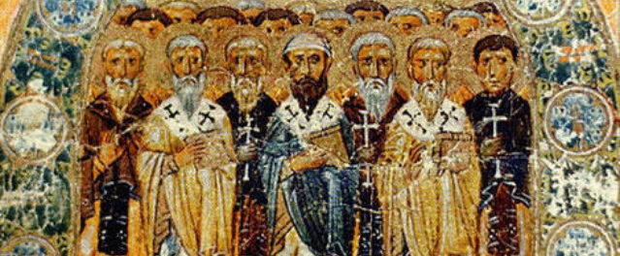
The Apostolic Fathers
I write to you, fathers, because you know him who is from the beginning…
(1 John 2:14)
https://seanmcdowell.org/blog/what-can-christians-learn-from-the-apostolic-fathers-interview-with-author-ken-berding

