Slide 2
Review
Where was William Tyndale born?
Gloucestershire
What percent of the words and phrases in the King James Bible originate from Tyndale?
84% of the New Testament
75.8% of the Old Testament books that he translated
How changes did William Tyndale make to the prior traditional English translation of the following words:
Prior Traditional Translation | Tyndale’s Translation
church | ?

Slide 3
Review
Where was William Tyndale born?
Gloucestershire
What percent of the words and phrases in the King James Bible originate from Tyndale?
84% of the New Testament
75.8% of the Old Testament books that he translated
How changes did William Tyndale make to the prior traditional English translation of the following words:
Prior Traditional Translation | Tyndale’s Translation
church | congregation

Slide 4
Review
Where was William Tyndale born?
Gloucestershire
What percent of the words and phrases in the King James Bible originate from Tyndale?
84% of the New Testament
75.8% of the Old Testament books that he translated
How changes did William Tyndale make to the prior traditional English translation of the following words:
Prior Traditional Translation | Tyndale’s Translation
church | congregation
priest (NT) | ?

Slide 5
Review
Where was William Tyndale born?
Gloucestershire
What percent of the words and phrases in the King James Bible originate from Tyndale?
84% of the New Testament
75.8% of the Old Testament books that he translated
How changes did William Tyndale make to the prior traditional English translation of the following words:
Prior Traditional Translation | Tyndale’s Translation
church | congregation
priest (NT) | elder

Slide 6
Review
Where was William Tyndale born?
Gloucestershire
What percent of the words and phrases in the King James Bible originate from Tyndale?
84% of the New Testament
75.8% of the Old Testament books that he translated
How changes did William Tyndale make to the prior traditional English translation of the following words:
Prior Traditional Translation | Tyndale’s Translation
church | congregation
priest | elder
do penance | ?

Slide 7
Review
Where was William Tyndale born?
Gloucestershire
What percent of the words and phrases in the King James Bible originate from Tyndale?
84% of the New Testament
75.8% of the Old Testament books that he translated
How changes did William Tyndale make to the prior traditional English translation of the following words:
Prior Traditional Translation | Tyndale’s Translation
church | congregation
priest | elder
do penance | repent

Slide 8
Thomas Cromwell
https://www.wikiwand.com/en/Thomas_Cromwell

Slide 9
Thomas Cromwell
Thomas Cromwell (1485-1540) became Henry’s prime minister from 1534, as a reward for having successfully guided through parliament the legislative revolution which had made the “English empire” independent of the papacy.
Cromwell had strong personal leanings towards Protestantism, and encouraged Protestants as far as he could, despite Henry’s traditional Catholic beliefs.
In 1536-40 Cromwell oversaw the suppression (“dissolution”) of the monasteries throughout England.
As a prelude to this, Cromwell and his civil servants compiled a comprehensive register of the English Church’s wealth which revealed that the income of the monasteries was three or four times greater than that of the crown.
Needham, Nick. 2,000 Years of Christ's Power Vol. 3: Renaissance and Reformation

Slide 10
Thomas Cromwell
As the monasteries were suppressed over the four-year period, most of the monks were given a pension or a parish appointment, while their property was taken over by the monarchy and sold to the English nobility.
This was nothing less than an economic revolution, a redistribution of land and wealth on a scale unsurpassed in English history.
The disappearance of monasticism was also a severe psychological blow against medieval Catholicism.
In northern England it was a critical element in provoking a popular uprising against Henry VIII in 1536-37 known as “the Pilgrimage of Grace”, which the king suppressed with great savagery.
Profound economic and religious grievances against the government were mixed together in the rebellion.
Needham, Nick. 2,000 Years of Christ's Power Vol. 3: Renaissance and Reformation

Slide 11
Thomas Cromwell
But we should not minimize the religious element. It demonstrates that the “old (Catholic) religion” was still capable of inspiring great loyalty in the hearts of ordinary English people.
The Reformation in England was not a conflict between sincere, vibrant Protestants and a dead Catholic Church which nobody loved.
Each side could appeal to deep wellsprings of popular support.
Even within Henry VIII’s court there was a constant struggle between conservative and reformist groups, with the balance of power tipping first one way, and then the other.
Needham, Nick. 2,000 Years of Christ's Power Vol. 3: Renaissance and Reformation

Slide 12
Thomas Cromwell
Cromwell was also instrumental in promoting the English Bible.
He and Cranmer prevailed on the Anglican clergy to petition Henry for an official English translation of Scripture.
In 1535, Miles Coverdale, who had stepped into the martyred Tyndale’s place, published the first complete English Bible (probably at Zurich) with an unauthorized dedication to Henry.
In 1537, Henry sanctioned a London printing of Coverdale’s Bible
In that same year Henry issued by royal license a different translation by John Rogers (under the pseudonym "Thomas Matthew"), known as “Matthew’s Bible”.
In 1538 Cromwell, acting as Henry’s vicegerent, commanded every parish church in England to obtain an English Bible, for all to read (or have read to them).
Needham, Nick. 2,000 Years of Christ's Power Vol. 3: Renaissance and Reformation

Slide 13
Thomas Cromwell
In 1539 the long awaited official version appeared, the “Great Bible”, Coverdale’s masterpiece.
The driving force behind the Great Bible was Cromwell, who helped finance it personally.
It was illustrated by a picture of Henry delivering the Word to Cranmer and Cromwell, with Christ surveying the scene favorably.
Needham, Nick. 2,000 Years of Christ's Power Vol. 3: Renaissance and Reformation

Slide 14
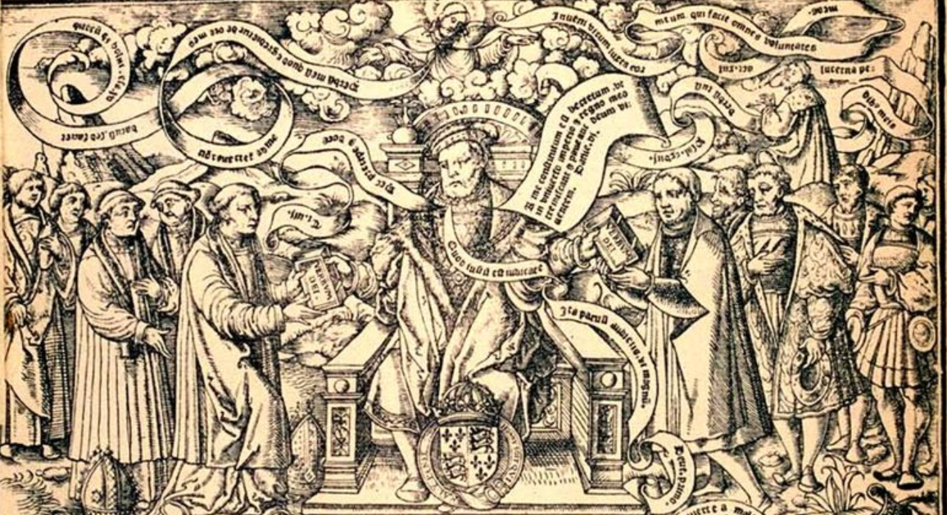
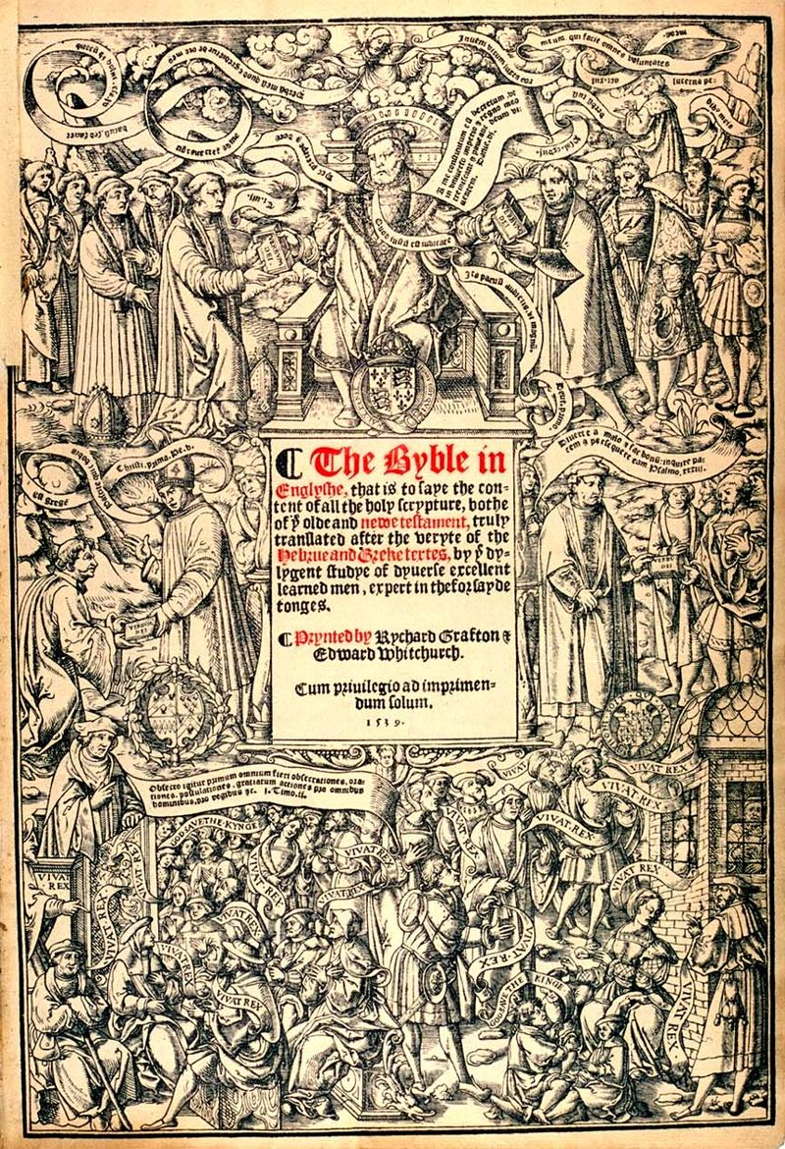
The Great Bible
https://www.wikiwand.com/en/Great_Bible

Slide 15
Thomas Cromwell
Political factors brought about Cromwell’s downfall and execution in 1540, but he had done much to move England in a more Protestant direction.
The availability of the English Bible was part of what caused the wider progress of English Protestantism in the period 1530-47.
The greatest phenomenon of the 1530s and 1540s, however, was the huge growth of lay Bible reading.
Ordinary people were discussing the Bible in ale-houses.
Needham, Nick. 2,000 Years of Christ's Power Vol. 3: Renaissance and Reformation

Slide 16
Thomas Cromwell
The illiterate learned to read so that they could study Scripture.
Women dared to argue with priests about what the Bible taught.
By 1537, Edward Fox could say to his fellow bishops:
Make not yourselves the laughing-stock of the world; light is sprung up and is scattering all the clouds. The lay people know the Scriptures better than many of us!
By Henry’s death in 1547, Protestantism was firmly established in southern England, especially in London.
Much of it was the product of the spiritual Reformation which had been going on alongside Henry’s political Reformation and owed little to the king’s break with Rome.
Needham, Nick. 2,000 Years of Christ's Power Vol. 3: Renaissance and Reformation

Slide 17
Thomas Cromwell
English Protestantism was also unique in being neither fully Lutheran nor fully Reformed; it developed an individual character of its own, marked by:
An intense love of the Bible
An emphasis on vital personal godliness
A swelling English nationalism which saw England as God’s chosen nation, always at the forefront of His purposes in history, especially His quarrel with the Roman Antichrist.
Needham, Nick. 2,000 Years of Christ's Power Vol. 3: Renaissance and Reformation

Slide 18
Thomas Cromwell
Henry VIII, however, never embraced Protestantism himself, remaining a traditional Catholic in most of his beliefs (apart from his rejection of the papacy), and he continued to inflict periodic persecution on outspoken Protestants as well as on stubborn supporters of the pope.
Things turned especially bleak for Protestants in 1539 when Henry decreed a new test of orthodoxy, the “Six Articles”, which reaffirmed transubstantiation, a celibate priesthood, and other medieval dogmas.
Needham, Nick. 2,000 Years of Christ's Power Vol. 3: Renaissance and Reformation

Slide 19
Edward VI: The Young Josiah
https://www.royal.uk/edward-vi

Slide 20
Edward VI
The spiritual and political Reformations came into close harmony in the reign of Edward VI (1547-53), Henry VIII’s young son by his third wife Jane Seymour.
Henry – perhaps sensing the direction the English mind was taking – had ensured that Edward had been raised by Protestant tutors, and the youthful new monarch was sincerely and ardently devoted to the Protestant faith.
Archbishop Cranmer too had by now fully accepted Protestantism.
Since Edward was only nine when he became king, two nobles ruled on his behalf:
The duke of Somerset (1547-49), a moderate but honest Protestant
The duke of Northumberland (1549-53), a more militant Protestant but also a reckless self-interested adventurer.
Needham, Nick. 2,000 Years of Christ's Power Vol. 3: Renaissance and Reformation

Slide 21
Edward VI
Under Somerset and Northumberland, Cranmer and other leading Reformers progressively transformed the Anglican Church into a fully Protestant body.
Adding to the increasingly Protestant complexion of England was an influx of distinguished Protestant refugees from Continental Europe, which had become an unfriendly place for committed Protestants after the military victories of Holy Roman Emperor Charles V over the German Protestant princes.
It was significant for the future of English Protestantism that no Lutheran theologians took refuge in England, although Cranmer did invite Melanchthon.
Needham, Nick. 2,000 Years of Christ's Power Vol. 3: Renaissance and Reformation

Slide 22
Edward VI
Leading Reformed Churchmen, however, such as Martin Bucer did settle and work in England during Edward VI’s reign, helping to inject a strong dose of the Reformed ethos into English Protestantism.
Martin Bucer worked with Cranmer in preparing the second edition of the Book of Common Prayer; Cranmer included many of Bucer’s suggestions in the final text.
Edward VI’s Church combined a Lutheran attitude to Church government (state control through king, parliament, and royally appointed bishops), with a Reformed perspective on other doctrinal issues, notably the Reformed view of the Lord’s Supper.
These ideas were set out in the second edition of the Book of Common Prayer in 1552 and in an aggressively Protestant confession of faith, the Forty-Two Articles, which was promoted as the Anglican Creed in 1553.
Needham, Nick. 2,000 Years of Christ's Power Vol. 3: Renaissance and Reformation

Slide 23
Edward VI
A less militant work was the Book of Homilies published in 1547; these were intended as popular summaries of official Church doctrine to be read out from the pulpit by clergy unable to preach.
Even so, homily number three on “the salvation of all mankind” by Cranmer was clearly a Protestant treatise on justification by faith.
In 1549, the marriage of the clergy was made legal.
It was, however, in the realm of public worship that the deepest impact was made.
There was a massive wave of government-sponsored iconoclasm (the rejection or destruction of religious images as heretical), with images of the saints being removed from churches or destroyed, and church walls being whitewashed to cover over pictures.
Stone altars were also replaced by wooden tables.
Needham, Nick. 2,000 Years of Christ's Power Vol. 3: Renaissance and Reformation

Slide 24
Edward VI
No Roman Catholic was put to death for his religion during the reign of Edward VI, and indeed some parts of England remained hotbeds of open loyalty to the old religion. ¹
This was especially true of Oxford, where the great majority of teachers and students in the university were convinced and committed Roman Catholics. ¹
Although Edward reigned for only six years and died at the age of 15, his reign made a lasting contribution to the English Reformation and the structure of the Church of England. ²
¹ Needham, Nick. 2,000 Years of Christ's Power Vol. 3: Renaissance and Reformation
² https://www.wikiwand.com/en/Edward_VI_of_England

Slide 25
Bloody Mary
https://www.royal.uk/edward-vi

Slide 26
Class Discussion Time
https://www.weareteachers.com/moving-beyond-classroom-discussions/

Slide 27
*Class Discussion Time
What do you think about the way the English government shut down all of the Roman Catholic monasteries and confiscated all their wealth?
Henry VIII personally was in many ways a very pompous, immoral king, and yet God in His sovereignty used Henry (along with other events at the time) to spread the Protestant Reformation throughout England. What does this say about God’s ability to use imperfect rulers to bring about his purposes?
Can bad rulers have a negative effect on the people of a nation?
Should we care about the personal character of our rulers?
Do you have a topic or question that you would like to see us to discuss?

