Slide 2
Review
To which OT king is Edward VI sometimes compared and why?
Josiah – Because he became king at a very young age (9) and was a good king.
How did the English Reformation fare under Edward VI’s short reign?
The spiritual and political Reformations came into close harmony in the reign of Edward VI. Edward ‘s father (Henry VIII) had saw to it that Edward was raised by Protestant tutors, and the youthful new monarch was sincerely and ardently devoted to the Protestant faith.
How many Roman Catholics were put to death during Edward VI’s reign?
None

Slide 3
Bloody Mary
https://www.royal.uk/edward-vi

Slide 4
Bloody Mary
When Edward VI died, the crown went to his half-sister Mary, the daughter of Henry VIII and Catherine of Aragon.
Mary had always been a Catholic, for in her experience the movement of reformation had begun with her own dishonor in her youth, when she had been declared an illegitimate child.
Furthermore, if Henry had been correct in proclaiming himself head of the church and his marriage to Catherine null and void, Mary was a bastard, and her right to succession could be cast into doubt.
Therefore, for reasons both of conviction and of political necessity, Mary was committed to the goal of restoring Roman Catholicism in England.
González, Justo L. . The Story of Christianity: Volume 2: The Reformation to the Present Day (pp. 94-95)

Slide 5
Bloody Mary
In this task she had the powerful support of her cousin Charles V, and also of a number of conservative English bishops who had been deposed during the two previous reigns.
But she knew that she must move with caution, so during the first months of her reign she took the time to consolidate her position within England, while she strengthened her ties with the Catholic house of Hapsburg by marrying her cousin Philip of Spain—later Philip II.
As soon as she felt herself secure on the throne, however, Mary began a series of increasingly repressive measures against Protestants.
González, Justo L. . The Story of Christianity: Volume 2: The Reformation to the Present Day (pp. 94-95)

Slide 6
Bloody Mary
Late in 1554, England officially returned to obedience to the pope.
Most of what had been done during the reigns of Henry and Edward was now undone.
The feast days of the saints were restored.
Married clergy were ordered to set their wives aside.
Finally, open persecution of Protestant leaders became the policy of the kingdom.
For this reason, the queen acquired the name by which she is known to this day: Bloody Mary.
González, Justo L. . The Story of Christianity: Volume 2: The Reformation to the Present Day (pp. 94-95)

Slide 7
Bloody Mary
Between 1555 and 1558, some 300 English Protestants were burnt at the stake, and another 100 died of maltreatment in prison.
England had never known such a concentrated burst of religious persecution in its entire history. Most of the martyrs were obscure, ordinary men and women, whose often joyful and triumphant deaths revealed an unsuspected depth of grass-roots Protestant faith.
Some of England’s famous Protestant leaders, however, were also burnt, including Cranmer, Ridley, Latimer, and Hooper.
Ridley and Latimer were burnt together at Oxford, and Latimer made the most oft-quoted remark of the English Reformation as they were led to the stake: “Be of good comfort, Master Ridley, and play the man; for we shall this day light such a candle, by God’s grace, in England, as I trust shall never be put out.”
Needham, Nick. 2,000 Years of Christ's Power Vol. 3: Renaissance and Reformation

Slide 8
Bloody Mary
Cranmer’s martyrdom made an even greater impression.
He had been subjected to unceasing psychological pressure in prison to renounce Protestantism, and had eventually succumbed (driven partly by his extreme, almost abject reverence for monarchy: how could he defy his lawful sovereign?).
Despite his submission, Mary decided to make an example of Cranmer and burn him anyway, as the foremost figure of the Anglican Reformation (and perhaps as the man who had declared her mother’s marriage to Henry VIII unlawful back in 1533, thus stigmatizing Mary as a bastard).
Needham, Nick. 2,000 Years of Christ's Power Vol. 3: Renaissance and Reformation

Slide 9
Bloody Mary
At the place of execution in Oxford, however, Cranmer unexpectedly refused to read out his recantation, and stunned everyone by vigorously reaffirming his Protestant faith, blaming himself for his cowardice in ever having renounced it, and denouncing the pope as Antichrist.
As the flames rose around him at the stake, the old archbishop held out the hand which had signed the document of recantation, so that it was the first part of his body to be burnt away.
By this final act in death, Cranmer may have done more to sanctify the Protestant cause in English eyes than anything he had accomplished in his life.
Needham, Nick. 2,000 Years of Christ's Power Vol. 3: Renaissance and Reformation

Slide 10
Bloody Mary
In 1563, five years after Mary’s death, the suffering of Protestants under her reign was highlighted in John Foxe’s Book of Martyrs.
Foxe had begun writing his book long before Mary’s reign, and originally conceived his work as a tribute to martyrs of all time.
But as news of what was taking place in England under Queen Mary reached him in exile in Strasbourg, the focus of the book shifted, giving much more emphasis to the more recent English Protestant martyrs.
This new focus may be seen in the full title of the book, Acts and Monuments of these Latter and Perilous Days, Touching Matters of the Church.
The book soon became standard fare in the education of children, particularly among Puritans, and thus contributed to a long-lasting animosity against Catholics and their faith.
González, Justo L. . The Story of Christianity: Volume 2: The Reformation to the Present Day (pp. 94-95)

Slide 11
Queen Elizabeth I
https://www.wikiwand.com/en/Elizabeth_I

Slide 12
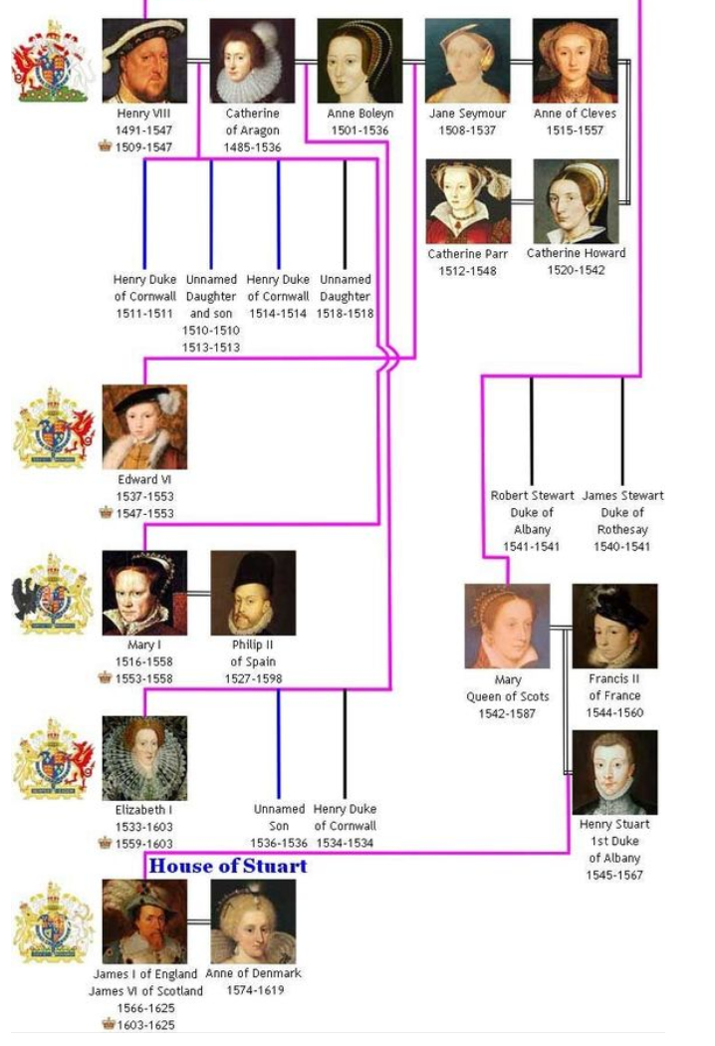

Slide 13
Queen Elizabeth I
Mary died late in 1558, and was succeeded by her half-sister Elizabeth, the daughter of Henry VIII and Anne Boleyn.
Charles V had repeatedly suggested that Mary have her half-sister executed, but the Bloody Queen had not dared go that far, and now her policies were undone by her successor.
This was also the time when many who had left the kingdom for religious reasons returned to their homeland, bringing with them Zwinglian and Calvinist ideas they had learned on the Continent.
González, Justo L. . The Story of Christianity: Volume 2: The Reformation to the Present Day (pp. 96-97)

Slide 14
Queen Elizabeth I
Just as Mary had been a Catholic both out of conviction and out of political necessity, Elizabeth was a Protestant for similar reasons.
If the head of the church in England was the pope, and not the king, it followed that the marriage of Henry VIII with Catherine of Aragon was valid, and that Elizabeth, born from Anne Boleyn while Catherine still lived, was illegitimate.
Paul IV, who was then pope, indicated that he was ready to declare Elizabeth a legitimate daughter of Henry, as long as she continued in the Roman communion.
But Elizabeth did not even notify him of her elevation to the throne, and recalled the English ambassador to Rome.
González, Justo L. . The Story of Christianity: Volume 2: The Reformation to the Present Day (pp. 96-97)

Slide 15
Queen Elizabeth I
Although much more politically inclined than Mary, she had been brought up to believe that her father had done right in proclaiming himself head of the Church of England, and she would not waver in that conviction.
Elizabeth was not a Protestant extremist.
Her ideal was a church whose practices were uniform, thus uniting the kingdom in common worship, but in which there would also be great latitude for varying opinions.
Within that church, there would be no place for either Roman Catholicism or extreme Protestantism.
But any moderate form of Protestantism would be acceptable, as long as it participated in the common worship of the Church of England.
González, Justo L. . The Story of Christianity: Volume 2: The Reformation to the Present Day (pp. 96-97)

Slide 16
Queen Elizabeth I
Elizabeth’s religious policy found expression and support in a new edition of the Book of Common Prayer.
As an indication of her policy of theological inclusiveness, the new book combined the two different formulas that the earlier versions ordered ministers to use in the distribution of the bread. The new text read as follows:
The body of our Lord Jesus Christ which was given for thee, preserve thy body and soul unto everlasting life. Take and eat this in remembrance that Christ died for thee and feed on Him in thy heart by faith with thanksgiving.
Naturally, the purpose of this double formula was to accommodate the divergent opinions of those who believed that communion was simply an act of remembrance, and those who insisted that in it one really partook of the body of Christ.
González, Justo L. . The Story of Christianity: Volume 2: The Reformation to the Present Day (pp. 96-97)

Slide 17
Queen Elizabeth I
The same policy may be seen in the Thirty-nine Articles, promulgated in 1562 in order to serve as doctrinal foundation for the Church of England.
In them several Catholic doctrines and practices are explicitly rejected, but there is no attempt to choose among the various Protestant views.
On the contrary, the articles seek to achieve a broad theology in which all but Roman Catholics and the most doctrinaire Protestants could participate.
Ever since that time, this has been one of the main characteristics of the Anglican Communion—that is, the Church of England and those religions derived from it.
González, Justo L. . The Story of Christianity: Volume 2: The Reformation to the Present Day (pp. 96-97)

Slide 18
Queen Elizabeth I
During Elizabeth’s reign Catholicism continued a precarious existence in England.
Some Catholics took up the cause of Mary Stuart, the queen of Scotland who had been forced into exile in England.
Were Elizabeth to be declared illegitimate, Mary Stuart would gain the English throne.
Therefore, she was the focal point of several conspiracies by Catholics, whom the pope had declared free from any obligation of obedience to Elizabeth.
Exiled Catholic leaders declared that Elizabeth was a heretical usurper, and plotted her downfall and the elevation of Mary Stuart to the throne of England.
Whether or not Mary herself inspired such conspiracies is not clear. But in the end she was involved in them and Elizabeth, after much hesitation, ordered that her cousin be put to death.
González, Justo L. . The Story of Christianity: Volume 2: The Reformation to the Present Day (pp. 96-97)

Slide 19
Queen Elizabeth I
The total number of those executed for religious reasons during Elizabeth’s reign was approximately equal to those who died under her half-sister Mary Tudor—although it should be remembered that Elizabeth’s reign was almost ten times as long as Mary’s.
In any case, toward the end of Elizabeth’s life, Catholics were indicating that they were ready to distinguish between their religious obedience to the pope and their political and civil loyalty to the queen. It was on the basis of this distinction that they would eventually be allowed to practice their religion openly.
It was also toward the end of Elizabeth’s reign that the Puritans began to grow in number.
They were called Puritans because, inspired by Calvinist ideas, they insisted on the need to restore the pure practices and doctrines of the New Testament.
González, Justo L. . The Story of Christianity: Volume 2: The Reformation to the Present Day (pp. 96-97)

Slide 20
The Scottish Reformation
https://www.wikiwand.com/en/Scottish_Reformation

Slide 21
Class Discussion Time
https://www.weareteachers.com/moving-beyond-classroom-discussions/

Slide 22
*Class Discussion Time
Latimer’s admonition to his fellow martyr (Ridley) to “play the man” (be brave) is reminiscent of the Biblical admonition to “Be watchful, stand firm in the faith, act like men, be strong.” (1Cor 16:13b). Why do you think bravery is often associated with manhood? Aren’t women brave?
What does it mean for a martyr to be brave? Is it important for a martyr to be brave? Why or why not?
We have become accustomed to Christians never being under the threat of martyrdom. Do you think that could change in our lifetime? If so, are you prepared to be brave if faced with martyrdom?
Do you have a topic or question that you would like to see us to discuss?

