Slide 2
Review
How did Mary I get the nickname “Bloody Mary”?
Between 1555 and 1558, some 300 English Protestants were burnt at the stake, and another 100 died of maltreatment in prison.
In what religious direction did Mary I take England?
Late in 1554, England officially returned to obedience to the pope and Roman Catholicism.
What well-known book was written five years after Mary’s death that focused on the suffering of Protestants under her reign.
John Foxe’s Book of Martyrs
What were Queen Elizabeth I’s religious convictions?
Elizabeth was Protestant
Her ideal was a church whose practices were uniform, thus uniting the kingdom in common worship, but in which there would also be great latitude for varying opinions.
Within that church, there would be no place for either Roman Catholicism or extreme Protestantism.

Slide 3
The Scottish Reformation
https://www.wikiwand.com/en/Scottish_Reformation

Slide 4
The Scottish Reformation
The kingdom of Scotland, to the north of England, had traditionally followed the policy of seeking the support of France against the English, who frequently invaded its territories.
But in the sixteenth century the country was divided between Francophiles who supported that traditional policy, and Anglophiles who held that circumstances had changed, and that it was in the nation’s best interest to establish closer ties with England.
The advocates of the new policy gained a major victory in 1502, when James IV of Scotland married Margaret Tudor, a daughter of Henry VII of England.
Therefore, when Henry VIII became king of England, there was hope that the two kingdoms could finally live in peace with each other.
González, Justo L. . The Story of Christianity: Volume 2: The Reformation to the Present Day (pp. 96-97)

Slide 5
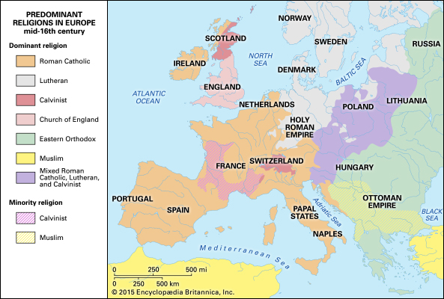
Europe mid-16th century
https://kids.britannica.com/students/assembly/view/193178

Slide 6
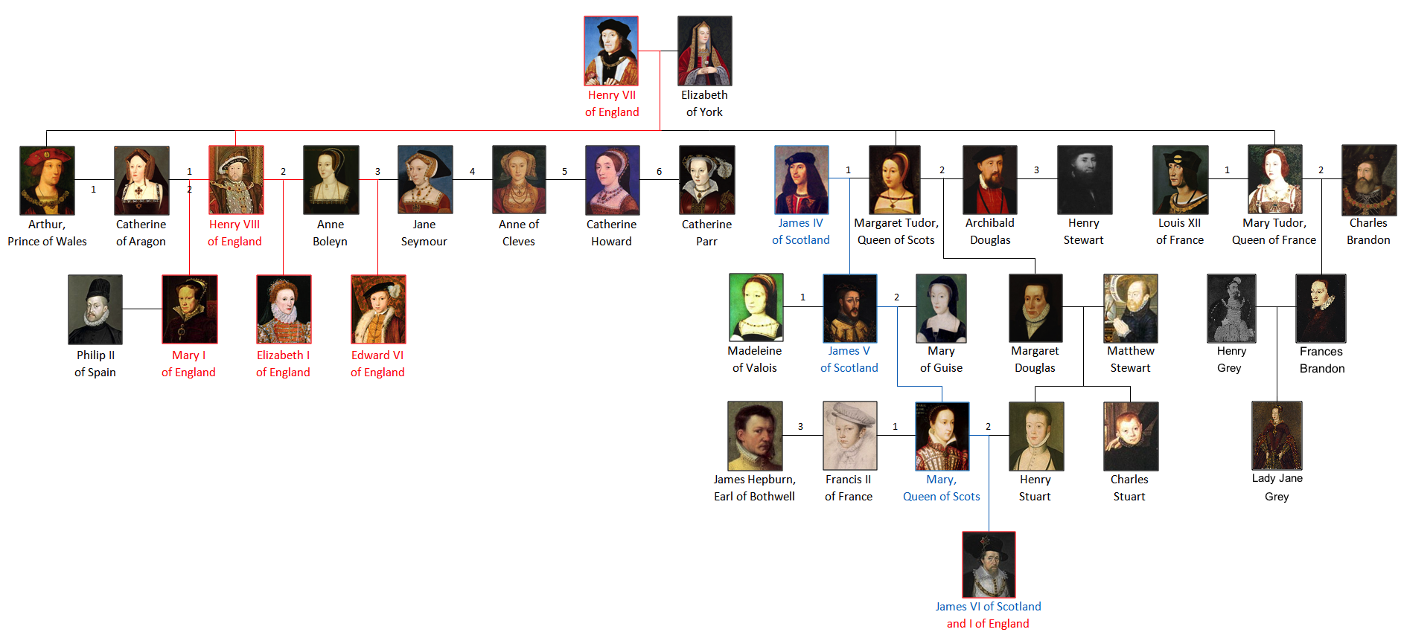
House of Tudor
https://www.wikiwand.com/en/House_of_Tudor

Slide 7
The Scottish Reformation
James V, the son of James IV and Margaret Tudor, was Henry VIII’s nephew, and Henry sought even closer ties by offering James the hand of his daughter Mary.
But Scotland decided to return to its traditional alliance with France, and to that end James married the French Mary of Guise.
From that point on, the two British kingdoms began to follow opposite courses, particularly in matters affecting the reformation of the church and relations with the papacy.
González, Justo L. . The Story of Christianity: Volume 2: The Reformation to the Present Day (pp. 96-97)

Slide 8
The Scottish Reformation
While these events were taking place, Protestantism had been making its way into Scotland.
Since a much earlier date, the doctrines of the Lollards and the Hussites had found followers in the country, and it had been impossible to uproot them.
Now Protestantism found fertile soil among those who held to such doctrines.
Many Scots who had studied in Germany returned to their homeland, taking with them the ideas and writings of Luther and other reformers.
The Scottish Parliament issued laws against those writings, and against those who sought to spread Protestant teachings.
González, Justo L. . The Story of Christianity: Volume 2: The Reformation to the Present Day (pp. 96-97)

Slide 9
The Scottish Reformation
The year 1528 saw the first martyrdom of one of these itinerant preachers (Patrick Hamilton), and after that time ever-increasing numbers were executed.
But it was all in vain. In spite of persecution, the new doctrines continued gaining adherents.
The spread of Protestantism was particularly noticeable among:
The nobility, who resented the growing power of the crown and the loss of many of their ancient privileges
The university students, who constantly read and circulated the smuggled books of Protestant authors
González, Justo L. . The Story of Christianity: Volume 2: The Reformation to the Present Day (pp. 96-97)

Slide 10
The Scottish Reformation
When James V died in 1542, the heir to the throne was his infant daughter Mary Stuart (aka Mary Queen of Scotts), and this led to a power struggle.
Henry VIII sought to marry the infant queen to his son and heir, Edward—a plan supported by the Protestant Scottish nobles, who were also Anglophiles.
The Catholics, who were Francophiles, wished to see Mary sent to France for her education and married to a French prince.
In this they succeeded, thus foiling Henry’s plans.
González, Justo L. . The Story of Christianity: Volume 2: The Reformation to the Present Day (pp. 96-97)

Slide 11
House of Tudor
https://www.wikiwand.com/en/House_of_Tudor

Slide 12
The Scottish Reformation
A short time later (1546), a group of Protestant conspirators took the castle of St. Andrew, and killed the archbishop (Cardinal Beaton),
The government, torn by inner conflict, could do little about it at the time.
An army was sent to capture and punish the rebels, but after a short siege the troops were withdrawn, and Protestants throughout the kingdom began considering St. Andrew’s the bastion of their faith.
It was then that John Knox entered the scene.
González, Justo L. . The Story of Christianity: Volume 2: The Reformation to the Present Day (pp. 96-97)

Slide 13
The Scottish Reformation
John Knox would soon become to Scotland what Luther was to Germany, and Calvin was to Geneva. ¹
Little is known of the early years of this fiery reformer. ²
Born in or about 1515, he studied theology, and was ordained a priest before 1540. ²
He then became a tutor to the sons of two noblemen who conspired to take St. Andrew’s, and he had also been in contact with George Wishart—a famous Protestant preacher who had died for his faith. ²
¹ Needham, Nick. 2,000 Years of Christ's Power Vol. 3: Renaissance and Reformation
² González, Justo L. . The Story of Christianity: Volume 2: The Reformation to the Present Day (pp. 96-97)

Slide 14
The Scottish Reformation
When the conspirators took possession of St. Andrew’s, Knox was ordered to take his young charges to the castle.
Although he planned to leave for Germany after delivering the young boys and to devote some time to the study of Protestant theology, once he arrived at St. Andrew’s, he found himself inextricably involved in the events that were shaking the nation.
Against his own will, he was made preacher of the Protestant community, and from that time he was the main spokesman for the cause of reformation in Scotland.
González, Justo L. . The Story of Christianity: Volume 2: The Reformation to the Present Day (pp. 96-97)

Slide 15
The Scottish Reformation
The Protestants holed up in St. Andrew’s were able to hold out for a time because both England and France were going through difficult times and could not intervene in Scottish affairs.
But as soon as France found itself free to send reinforcements to Scotland, the government sent a strong army to storm the castle, and the Protestants had to surrender.
Eventually the Protestants were bombed into submission by a French fleet and taken as captives to France, where Knox became a galley slave in the French navy for nineteen months, a grueling experience during which he was sometimes so ill that his friends despaired of his life.
González, Justo L. . The Story of Christianity: Volume 2: The Reformation to the Present Day (pp. 96-97)

Slide 16
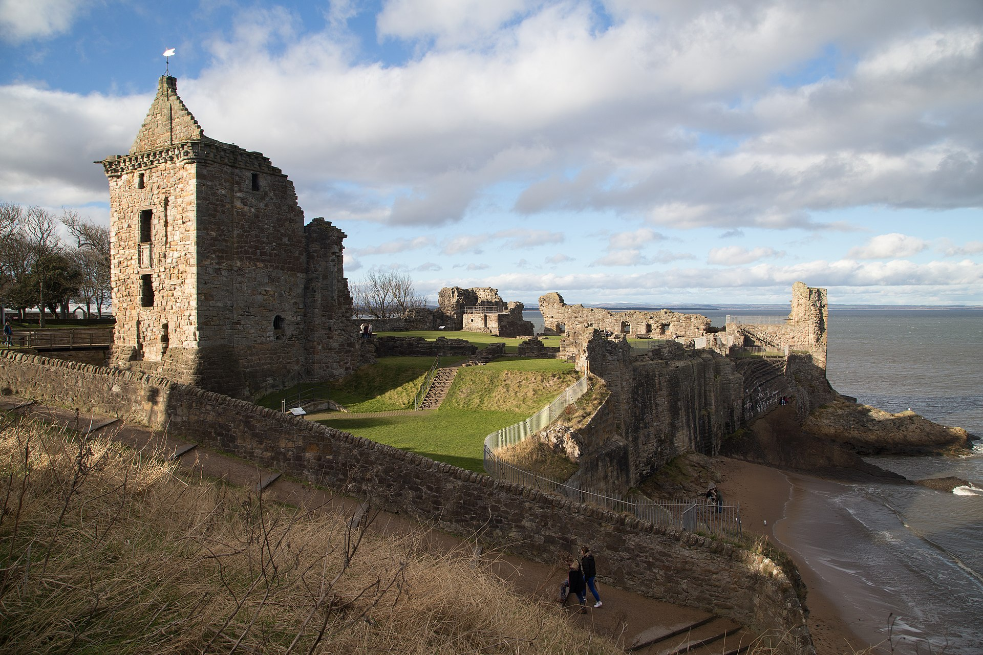
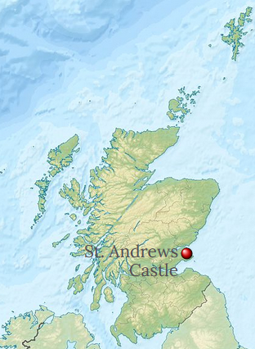
Saint Andrews Castle
https://www.wikiwand.com/en/St_Andrews_Castle

Slide 17
The Scottish Reformation
But Knox, though at times severely ill, kept up the spirits of his fellow prisoners by the fearless and audacious quality of his faith.
To give just one example – early on, when the Roman Catholic captors tried to force the Protestant galley slaves to worship the Roman way, Knox took the image of the Virgin Mary that they thrust into his face to kiss, and calmly threw it overboard.
That was the end of any attempt to impose Roman Catholic worship on the Protestant prisoners.
Knox also emboldened his fellow captives by making confident predictions that God would liberate him to preach again in Scotland: Knox always had a touch of the “charismatic prophet” about him.
Needham, Nick. 2,000 Years of Christ's Power Vol. 3: Renaissance and Reformation

Slide 18
The Scottish Reformation
After nineteen months, the prediction was fulfilled as Knox was finally released thanks to the intervention of England, where Edward VI now ruled, and where Knox later became a pastor.
When the Roman Catholic Mary Tudor (aka “Bloody Mary”) became queen of England in 1553, Knox fled to the Continent, becoming one of the many Protestant refugees.
Knox eventually ended up as co-pastor of the English refugee congregation in Calvin’s Geneva, alongside Christopher Goodman, who had been professor of divinity at Oxford University under Edward VI.
Needham, Nick. 2,000 Years of Christ's Power Vol. 3: Renaissance and Reformation

Slide 19
The Scottish Reformation
Knox looked on his time as co-pastor of the English church in Geneva as the happiest period of his life.
The fellowship had 186 members, and worshipped according to a Continental-style Reformed liturgy which had been drawn up by Knox and others.
The Knoxian liturgy in Geneva was to have a long life; it was used in private services by many English Puritans during Elizabeth I’s reign, and it became the official liturgy of the Scottish Reformed Church in 1560.
Needham, Nick. 2,000 Years of Christ's Power Vol. 3: Renaissance and Reformation

Slide 20
The Scottish Reformation
It was as pastor in Geneva that Knox wrote his most revolutionary writings.
His first work was entitled: The First Blast of the Trumpet Against the Monstrous Regiment of Women in 1558. By “regiment” Knox meant “government”, and by “monstrous” he meant “unnatural”.
Female rule, he argued, contradicted both the law of nature and God’s revealed law in Scripture, and therefore female rulers must be deposed.
The treatise was aimed chiefly against Bloody Mary, “that horrible monster Jezebel of England”, whose regime Protestants had good reason to consider monstrous.
Unfortunately, soon after the book’s publication, Bloody Mary died and was succeeded by a female Protestant sovereign, Elizabeth.
Needham, Nick. 2,000 Years of Christ's Power Vol. 3: Renaissance and Reformation

Slide 21
The Scottish Reformation
Knox’s book alienated Elizabeth badly, and made Protestant Anglo-Scottish relations more difficult than they should have been.
The book also outraged the majority of Protestants, who thought its conclusions were extreme and subversive of good order in society.
Calvin was so opposed to the First Blast of the Trumpet that he had its sale in Geneva banned.
So Knox’s first political treatise was not a great success.
Needham, Nick. 2,000 Years of Christ's Power Vol. 3: Renaissance and Reformation

Slide 22
The Scottish Reformation
Knox’s next work was The Appellation (also written in 1558).
In this work, Knox appealed to the Scottish nobility to enact reformation, and to the Scottish common people to put pressure on the government in favor of Protestantism.
The nobility, Knox maintained, had the right to depose an idolatrous monarch and the common people had the right to establish their own Reformed Church if the government would not establish one.
Knox’s thinking was dominated by the question of how the true believer confronted idolatry and persecution by idolatrous governments.
The mainstream Protestant position held that Christians must refuse religious obedience to idolatrous governments, and then peacefully suffer the consequences.
Needham, Nick. 2,000 Years of Christ's Power Vol. 3: Renaissance and Reformation

Slide 23
The Scottish Reformation
However, a number of radical Protestants were questioning this.
They argued that Christians could move beyond passive resistance to righteous rebellion and forcibly topple an idolatrous government.
Knox took this more radical approach. This too proved distasteful to many Protestants, but in fact Knox’s basic position in the Appellation was acted on by the Huguenots, the Dutch Sea Beggars, and eventually by Scottish Covenanters and English Puritans in the British Civil Wars of the 17th century.
It was akin to Calvin’s view that a monarch’s authority was not absolute, but must be held in check by the lesser political authorities (such as parliaments) whose duty it was to call a wicked ruler to account for his or her misdeeds.
Needham, Nick. 2,000 Years of Christ's Power Vol. 3: Renaissance and Reformation

Slide 24
John Knox Returns to Scotland
https://www.artwarefineart.com/gallery/john-knox-preaching-lords-congregation-parish-church-st-andrews-10th-june-1559

Slide 25
Class Discussion Time
https://www.weareteachers.com/moving-beyond-classroom-discussions/

Slide 26
*Class Discussion Time
In his first work, John Knox argued that female rule contradicted both the law of nature and God’s revealed law in Scripture, and therefore female rulers must be deposed – an idea that even many in his day took issue with.
Scripture does teach that “I [Paul] do not permit a woman to teach or to exercise authority over a man; rather, she is to remain quiet. ¹³ For Adam was formed first, then Eve; ¹⁴ and Adam was not deceived, but the woman was deceived and became a transgressor.” (1Tim. 2:12-14). So are there limits to women having authority over men? And if so, what are they?
The mainstream Protestant position held that Christians in John Knox’s day was that we, as Christians, must refuse religious obedience to idolatrous governments, and then peacefully suffer the consequences.
John Knox and others argued that Christians could move beyond passive resistance to righteous rebellion and forcibly topple an idolatrous government. What are your thoughts on this issue?
Do you have a topic or question that you would like to see us to discuss?

