Slide 1


Slide 2

Review
What was the Council of Trent originally supposed to be?
  The ecumenical Council of the whole Western Church for which Luther had called before his break with Rome, and which others had been demanding for years.
What did it actually end up being?
  A vigorous stance against everything the Protestant Reformation stood for.
The Spanish and Portuguese arrived in the Americas as conquering armies first, with the ______ coming afterwards in their wake.
  “missionaries”

Slide 3
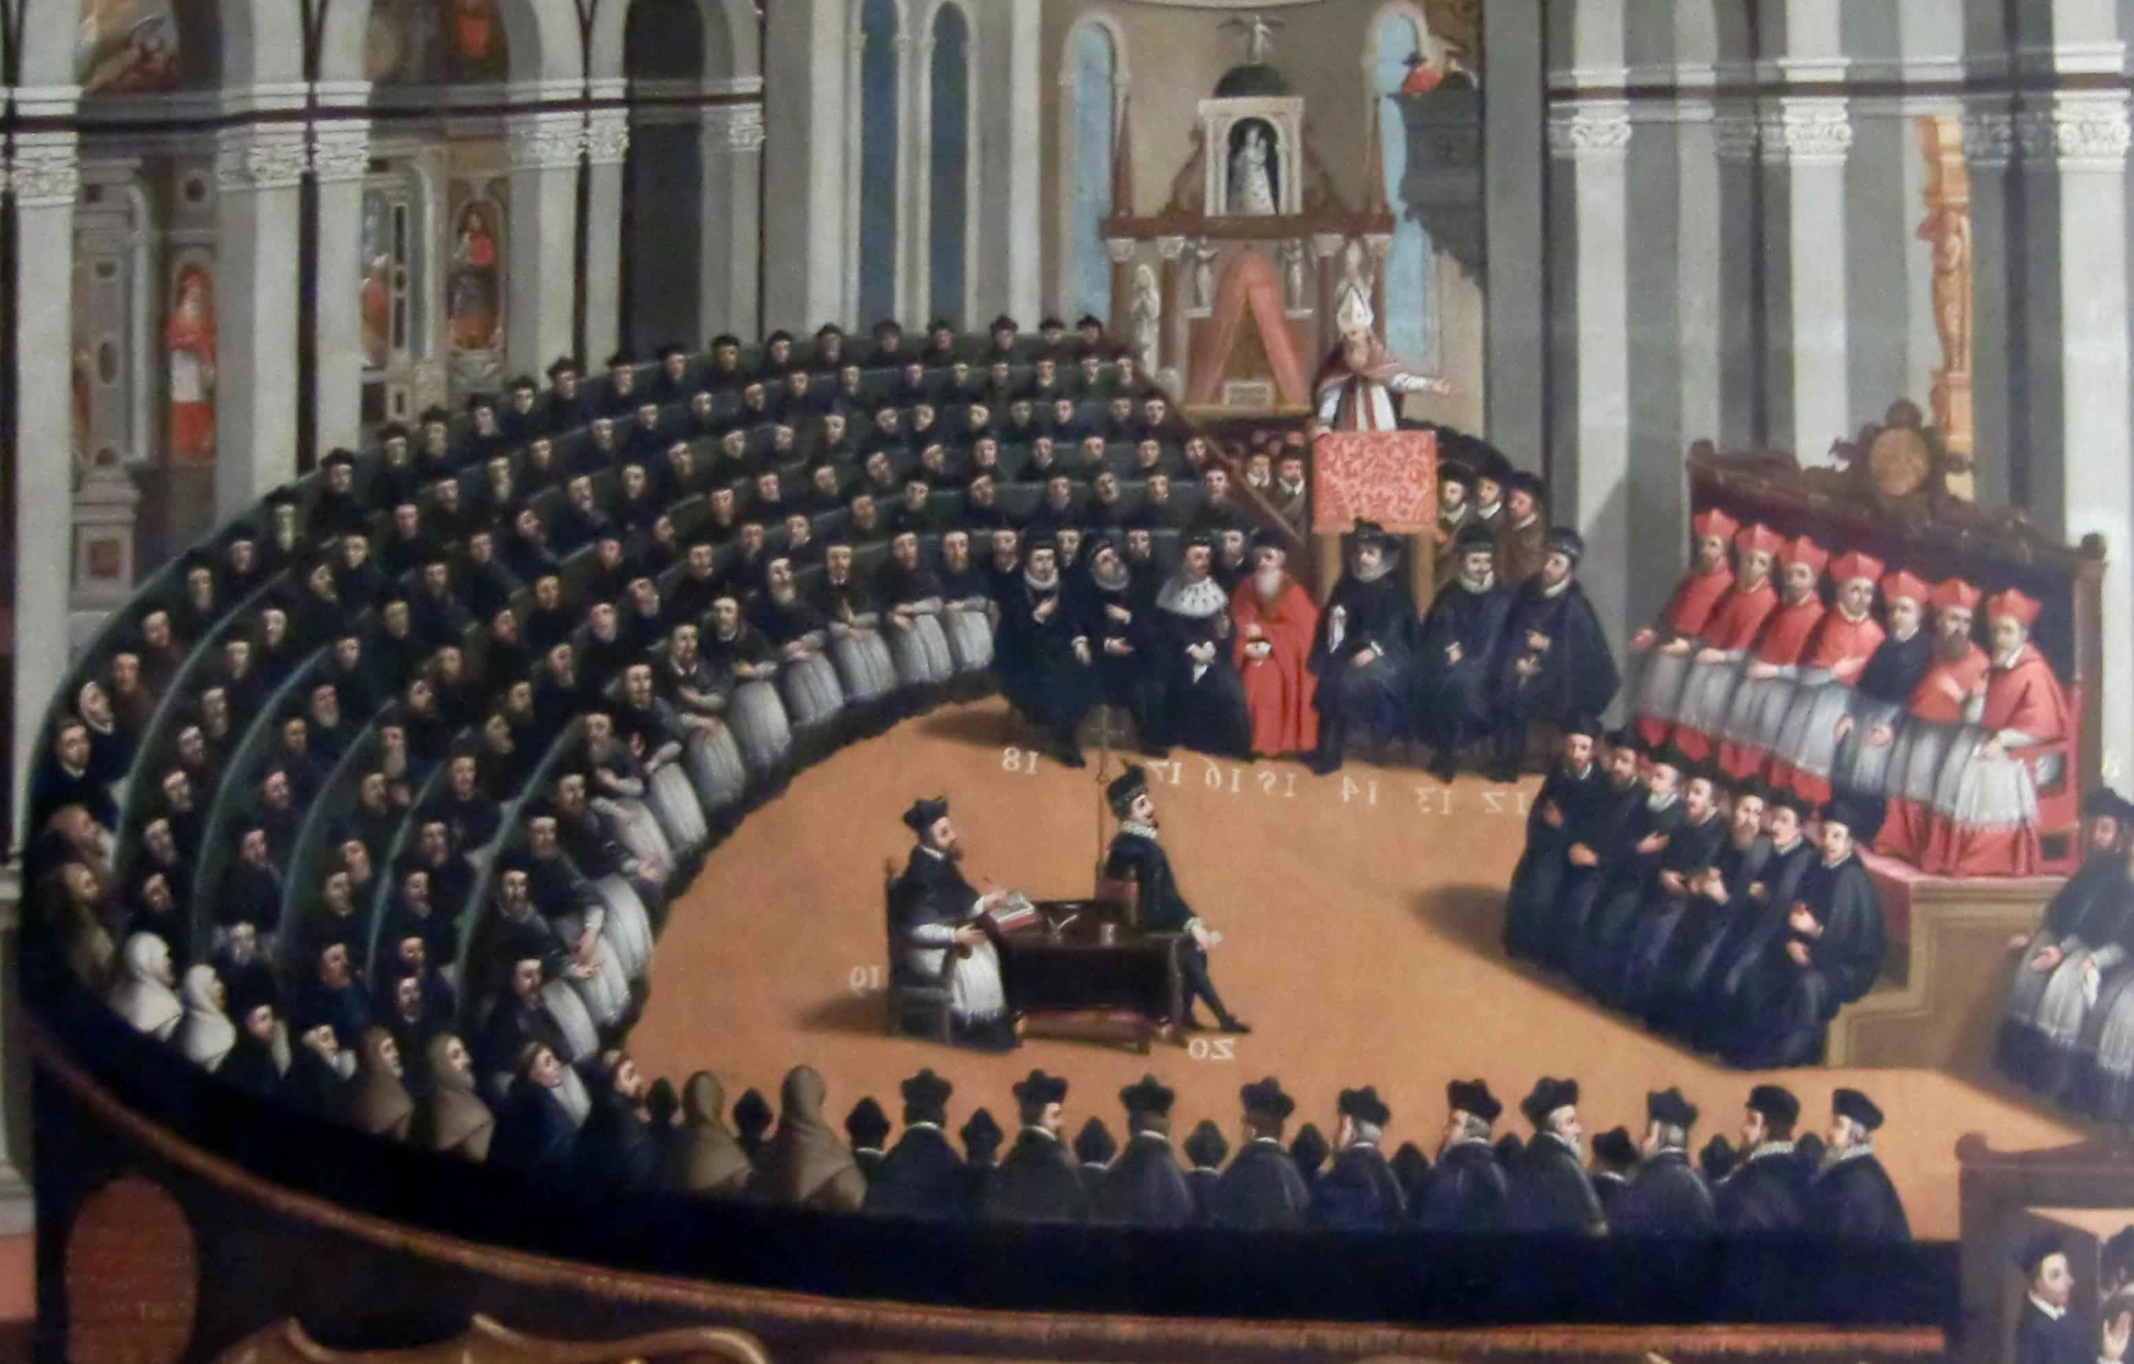
Effects of the Catholic Counter-Reformation
https://christianreformedink.wordpress.com/reformed-theology-2/ecclesiology/reformation-events/nine-things-you-should-know-about-the-council-of-trent/

Slide 4
Effects of the Catholic Counter-Reformation
The Triumph of the Papacy - The popes had managed the Council of Trent masterfully. This helped in restoring the public reputation of the papacy (among Catholics) from the depths of scandal which it had been in mired as the 16th century began its course.
The Definition of Doctrine – The Council of Trent had authoritatively clarified the teaching of Rome. Roman Catholic theologians now had a standard of doctrine to use, promote, and defend against Protestants.
The Recovery of Zeal – A fresh enthusiasm returned to the Roman Catholic Church. In the first shock-waves of the Protestant Reformation, the question had been: Can Rome survive? As a result of the Catholic Counter-Reformation, a new question arose: Can Protestantism survive?
Needham, Nick. 2,000 Years of Christ's Power Vol. 3: Renaissance and Reformation

Slide 5
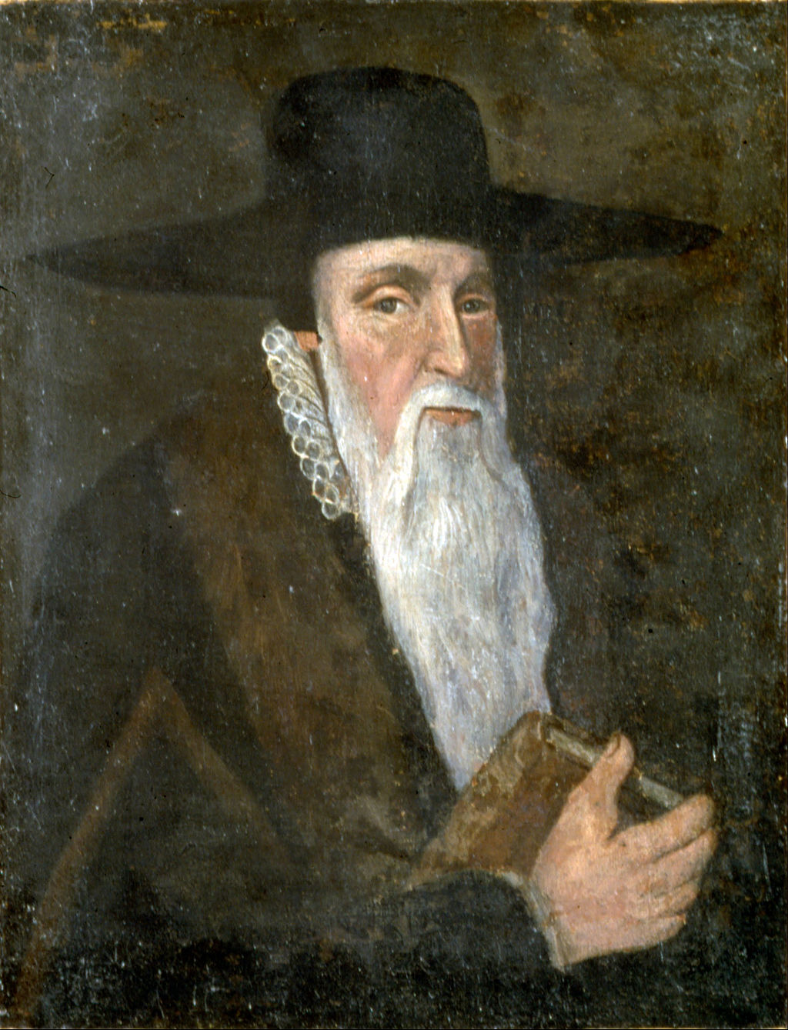
Theodore Beza
https://www.wikiwand.com/en/Theodore_Beza

Slide 6
Theodore Beza
Theodore Beza (1519–1605) was John Calvin’s most distinguished disciple, and indeed Calvin’s successor as spiritual leader of Geneva.
Born to an aristocratic family in Burgundy, France, he received a first class education from the German humanist Melchior Wolmar, one of the foremost Greek scholars of that time (Wolmar had also taught Greek to Calvin, who in turn had dedicated his commentary on 2 Corinthians to Wolmar).
Wolmar had embraced Reformation views, and these deeply influenced the young Beza.
However, Beza remained outwardly a Roman Catholic for many years, living in Paris as a carefree noble with a private income, and dedicating his energies to classical literature.
Needham, Nick. 2,000 Years of Christ's Power Vol. 4: The Age of Religious Conflict

Slide 7
Theodore Beza
It was not until recovering from a near-death experience through illness in 1548 that Beza became serious about being a Protestant.
He now fled from Paris to the Swiss Reformed city of Lausanne, where he taught Greek for the next nine years at its university.
In 1558, the rulers of the powerful Swiss canton of Berne imposed a new religious settlement on Lausanne.
Although the Bernese were Reformed, Beza objected to the state dictating doctrine and worship to a Reformed Church.
So he left in protest, relocating to Calvin’s Geneva.
Needham, Nick. 2,000 Years of Christ's Power Vol. 4: The Age of Religious Conflict

Slide 8
Theodore Beza
Beza soon became Calvin’s closest friend and co-worker; Calvin put him in charge of the Genevan academy in 1559, a position he held for the rest of his life.
Along with his general duties running the academy, Beza also taught systematic theology there.
His devotion to the academy made it one of the most successful Reformed educational bodies of the 16th century, with distinguished lecturers and a huge international student body.
From the academy a steady flow of Reformed pastors, evangelists, and church-planters streamed out into the rest of Europe.
On Calvin’s death in 1564, Geneva naturally looked to Beza for continued leadership, which he provided for the next 40 years.
Needham, Nick. 2,000 Years of Christ's Power Vol. 4: The Age of Religious Conflict

Slide 9
Theodore Beza
Beza not only supervised the academy; he was also, after Calvin died, Geneva’s chief pastor and chairman of the “company of pastors”, which supervised ministerial training and ordination.
Much of Beza’s energy as a church leader was given to the roller-coaster fortunes of the French Calvinists or Huguenots during France’s “wars of religion” (1562–98).
He advised the Huguenot nobles; he gave guidance to Huguenot pastors and theologians, especially over matters of church government, where he upheld Presbyterianism.
Needham, Nick. 2,000 Years of Christ's Power Vol. 4: The Age of Religious Conflict

Slide 10
Theodore Beza
His political philosophy evolved in a more radical direction under the impact of the massacre of Saint Bartholomew’s day in 1572, when some 20,000 Huguenots were slaughtered by the French Roman Catholics.
The French crown’s participation in the massacre (through the young King Charles IX’s domineering mother, Catherine de Medici), inspired Beza to write Concerning the Power of Magistrates (1574).
Here, Beza argued that if monarchs behaved tyrannically, the lesser political authorities of the realm could lawfully restrain them, by force if necessary.
This became the standard Reformed view, acted on not just by Huguenots in France, but also by Dutch Calvinists in revolt against King Philip II of Spain, and by Scottish Covenanters and English Puritans in revolt against King Charles I.
Needham, Nick. 2,000 Years of Christ's Power Vol. 4: The Age of Religious Conflict

Slide 11
Theodore Beza
Beza’s contribution to Reformed worship was notable.
In 1562, he published a complete French metrical psalter.
It had been translated in part by Clement Marot – Beza finished it.
He was poetically talented, and the new psalter instantly captured the affections of French-speaking Calvinists across Europe.
It formed the basis for English, German, and Dutch Reformed psalters.
Needham, Nick. 2,000 Years of Christ's Power Vol. 4: The Age of Religious Conflict

Slide 12
Theodore Beza
Beza was also a notable textual scholar.
He published his own critical edition of the Greek New Testament in 1565, intended as a replacement for Erasmus’ text which Beza considered inadequate.
Beza’s version made use of other Greek manuscripts unknown to Erasmus, including one named after Beza, the codex Bezae; of French origin, it was given to Beza for safekeeping during the French wars of religion, and he in turn donated it to England’s Cambridge University.
Beza’s edition of the Greek New Testament went through five editions in his lifetime, and had widespread influence on Protestant textual scholarship; it would be a key text used by the translators of the King James Bible.
Needham, Nick. 2,000 Years of Christ's Power Vol. 4: The Age of Religious Conflict

Slide 13
Theodore Beza
Beza’s deepest impact was the way he helped consolidate a distinctive Reformed theological identity post-Calvin.
Through his writings, went a long ways towards creating a clear distinction between the Reformed faith and its competitors in the latter half of the 16th century, engaging with Roman Catholics, Lutherans, Socinians, and even his fellow-Reformed Zwinglians.
On the Lord’s Supper, Beza rejected the Zwinglian “memorialism” still favored by a few. Instead Beza favored the “spiritual real presence” view that Martin Bucer, Peter Martyr, and John Calvin had championed.
Beza articulated his theology most fully in his Confession of the Christian Faith, originally published in French (1559), then translated into Latin (1560) and other languages (e.g. English in 1563). It was a Europe-wide best-seller.
Needham, Nick. 2,000 Years of Christ's Power Vol. 4: The Age of Religious Conflict

Slide 14
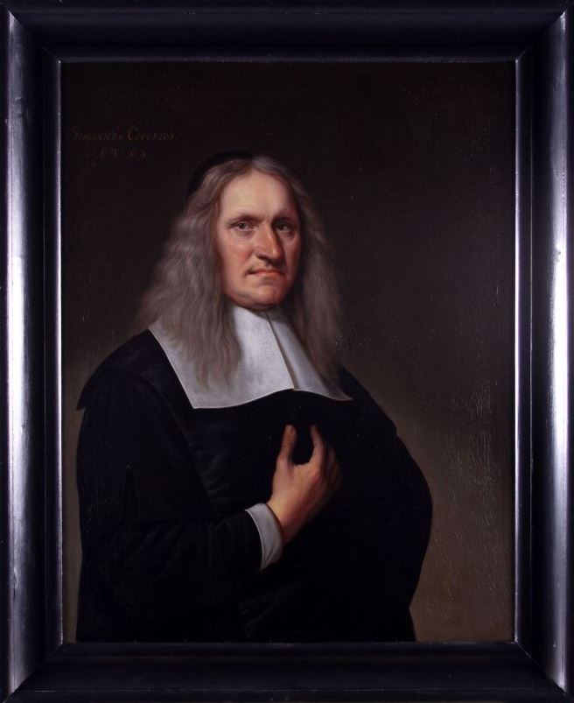
Johannes Cocceius
https://www.wikiwand.com/en/Johannes_Cocceius

Slide 15
Johannes Cocceius
Johannes Cocceius (1603–69) (pronounced Cock-say-uss) was born at Bremen, in north-western Germany.
He studied in Bremen University under the early “covenant” theologians Matthias Martini and Ludwig Crocius.
Then in 1626 he went to Franeker University in the Dutch Republic, where he sat under the teaching of the English Puritan theologian, William Ames.
The extent of Cocceius’ learning was astonishing: he was well versed in Biblical Hebrew and Greek, and Christian theology from a Reformed perspective, he had a thorough knowledge of the Jewish Talmud, and of the Qur’an which he read in the original Arabic.
Needham, Nick. 2,000 Years of Christ's Power Vol. 4: The Age of Religious Conflict

Slide 16
Johannes Cocceius
By all accounts, Cocceius was also distinguished by a warm, earnest piety; we know that one reason why he left Germany for the Dutch Republic was (according to his own testimony) his discomfort over poor standards of personal godliness that he found in the German universities.
Cocceius’ most famous, influential, and controversial work was his Doctrine of the Covenant and Testament of God, first published in 1648, with revised editions in 1653 and 1660.
This eloquently presented his “covenant theology” (or “federal theology”).
In the process he managed to divide the Dutch Reformed Church into ardent admirers and fierce critics.
Needham, Nick. 2,000 Years of Christ's Power Vol. 4: The Age of Religious Conflict

Slide 17
Johannes Cocceius
Understanding God’s dealings with humanity in terms of successive covenants (e.g. “covenant theology”) was not in itself a novelty coined by Cocceius. It goes back at least as far as Augustine.
However, covenant theology was given a whole new lease on life by Reformed theologians in the 16th century.
There is debate about how early it appeared in the Reformed tradition, and what exactly counts as “covenant theology”.
A key point would probably be whether a particular theologian interpreted God’s original relationship with humanity in Adam in covenant terms.
Needham, Nick. 2,000 Years of Christ's Power Vol. 4: The Age of Religious Conflict

Slide 18
Johannes Cocceius
The basic idea of covenant (or federal) theology was that human history revolved around two covenants:
  An original covenant between God and the human race in Adam (known as the “covenant of works”)
  The “covenant of grace” in which Christ played the role of a Second Adam.
Through these covenants, God bound Himself to the communities represented by Adam and Christ as heads—all humankind in Adam, the new humanity in Christ.
Life and blessedness flowed through the covenant-keeping of the two federal heads; their communities participated in the consequences of their actions.
Through union with Adam, humanity fell, because Adam broke the covenant; through union with Christ, the new humanity is redeemed, because Christ kept the covenant.
Needham, Nick. 2,000 Years of Christ's Power Vol. 4: The Age of Religious Conflict

Slide 19
Johannes Cocceius
Cocceius didn’t invent any of this. But in his Doctrine of the Covenant and Testament of God, he magnified covenant thinking to intense new levels of meaning for the Bible and theology.
Federal theology had put the spotlight on the historical outworking of God’s purposes, and has often been interpreted as a corrective to forms of Reformed Orthodoxy where the emphasis had been on God’s eternal decrees.
Cocceius carried this “historicizing” impulse into the covenant of grace itself. It could not be seen as a static entity, he insisted; it was progressive within history, developing from a primitive Old Testament seed into a mature New Testament organism.
For Cocceius, the overriding reality in the Bible was the unfolding history of God’s saving acts in Israel and the Church.
Needham, Nick. 2,000 Years of Christ's Power Vol. 4: The Age of Religious Conflict

Slide 20
Johannes Cocceius
The controversial aspect of Cocceius’ federalism was the way it highlighted differences between the Old and New Testaments. Two such differences in Cocceius’ thinking became particular storm-centers of contention:
First, Cocceius saw the Sabbath as a distinctively Old Testament ordinance, rooted not in creation but in God’s covenant with Israel at Sinai.
It was a sign of the coming Messianic kingdom, he argued, just like other ceremonial ordinances; it foreshadowed the spiritual rest that Christ would procure from the laborious existence of sin.
In the New Testament church, he maintained, a day of rest and worship was observed, not from obedience to an obsolete Sabbath command, but simply because Christ’s people had always found it edifying to have such a day.
Needham, Nick. 2,000 Years of Christ's Power Vol. 4: The Age of Religious Conflict

Slide 21
Johannes Cocceius
Second, Cocceius made a distinction between the salvation enjoyed by believers under the Old and New Testaments.
Before Christ actually atoned for sin by His death, he argued, God “passed over” sin rather than forgave it.
So the justification of the Old Testament saints was inferior that of the New; prior to Christ, justification was by way of “promise”, whereas now in Christ it is by way of “fulfilment”.
Part of Cocceius’ exegetical foundation for this idea was Romans 3:25b-26a – People are made right with God when they believe that Jesus sacrificed his life, shedding his blood. This sacrifice shows that God was being fair when he held back and did not punish those who sinned in times past, ²⁶ for he was looking ahead and including them in what he would do in this present time. (NLT).
He accused his opponents of flattening out justification into a single unchanging fact, ignoring its historical development between the Testaments.
Needham, Nick. 2,000 Years of Christ's Power Vol. 4: The Age of Religious Conflict

Slide 22
Johannes Cocceius
The opposition to Cocceius was spearheaded by the Dutch Calvinist theologian, Gisbet Voetius.
So fierce did the theological warfare become, it threatened to rip apart the Dutch Reformed Church into two mutually exclusive factions, the Cocceians and the Voetians.
Where one party gained the ascendancy in a university, the other party was expelled.
The Dutch state had to intervene to tell the theologians to calm down and practice a little more Christian forbearance
In fact, to make sure they did, the government coerced the universities into appointing equal numbers of Cocceians and Voetians, so that neither could vote the other out of their places.
Needham, Nick. 2,000 Years of Christ's Power Vol. 4: The Age of Religious Conflict

Slide 23
Johannes Cocceius
The dispute between the factions continued for many years – even after both Cocceius and Voetius had died.
It dissipated at last through a combination of sheer exhaustion and the marginalizing of both sides by a new, more liberal Enlightenment theology, which regarded Cocceians and Voetians as equally old-fashioned and irrelevant.
Fortunately both parties had their share of men who valued piety as well as doctrine, and the “pious” Cocceians and Voetians coalesced in the 18th century to fight together against the new liberalism.
Needham, Nick. 2,000 Years of Christ's Power Vol. 4: The Age of Religious Conflict

Slide 24
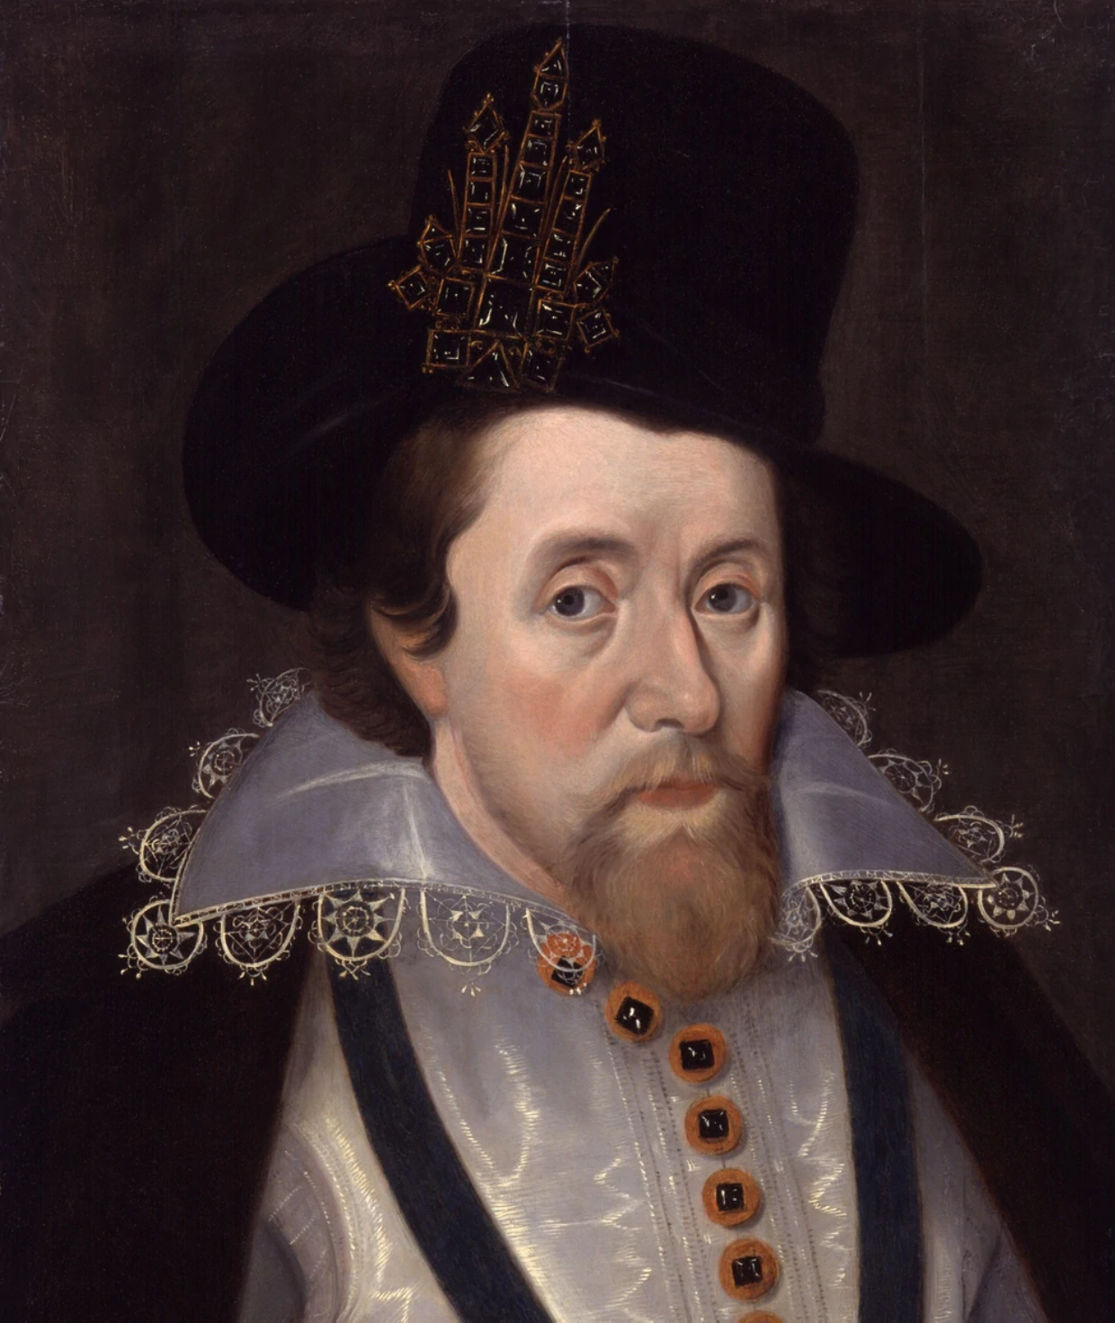
King James
https://reign.fandom.com/wiki/History%27s_King_James_VI_and_I?file=King_James_VI_and_I.jpg

Slide 25

Class Discussion Time
https://www.weareteachers.com/moving-beyond-classroom-discussions/

Slide 26
*Class Discussion Time
Cocceius saw the Sabbath as a distinctively Old Testament ordinance, rooted not in creation but in God’s covenant with Israel at Sinai, and like other ceremonial ordinances; it foreshadowed the spiritual rest that Christ would bring.
In the New Testament church, he maintained, a day of rest and worship was observed, not from obedience to an obsolete Sabbath command, but simply because Christ’s people had always found it edifying to have such a day. What are your thoughts on this?
Cocceius made a distinction between the salvation enjoyed by believers under the Old and New Testaments. Before Christ actually atoned for sin by His death, he argued, God “passed over” sin rather than forgave it. So the justification of the Old Testament saints was inferior that of the New; prior to Christ, justification was by way of “promise”, whereas now in Christ it is by way of “fulfilment”. What are your thoughts on this?
Do you have a topic or question that you would like to see us to discuss?
Notes:
Acts 10:34-35 - So Peter opened his mouth and said: "Truly I understand that God shows no partiality, but in every nation anyone who fears him and does what is right is acceptable to him. (Act 10:34-35)
Acts 17:26 And [God] made from one man every nation of mankind to live on all the face of the earth, having determined allotted periods and the boundaries of their dwelling place (Act 17:26)
James 3:8-9 - no human being can tame the tongue. It is a restless evil, full of deadly poison. With it we bless our Lord and Father, and with it we curse people who are made in the likeness of God. (Jam 3:8-9)

