Slide 2
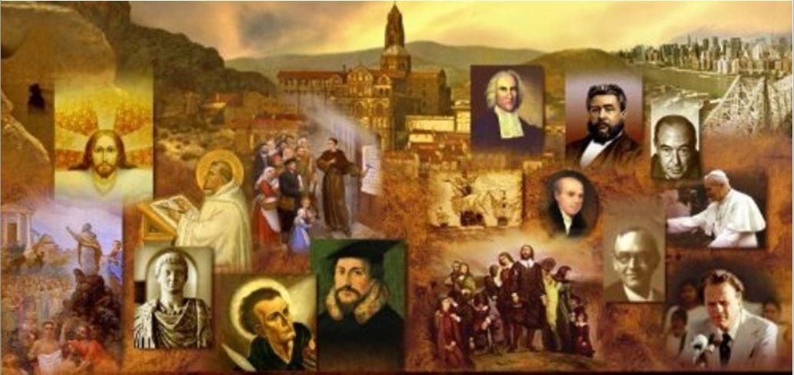
Review
We saw last time that Rome classified religions into two simple categories – based mostly on whether or not a religion was in place at the time that a people were conquered by Rome. What were those two categories?
licita (“permitted”)
illicita (“not permitted”)
Which category did Christianity fall into and why?
In the early years it was viewed as a part of Judaism and therefore considered licita (“permitted”)
Once it had become clear to Roman magistrates that Christians were not a Jewish sect, Christianity ceased to enjoy the “permitted” status of Judaism.

Slide 3
Review
Rome was normally tolerant in religious matters; but if it felt that a particular religion was a threat to public morality or political stability, the authorities would suppress it.
Why would Rome have considered Christianity a threat?
Christians made exclusive truth-claims for their faith
The other religions of the Empire (except Judaism) were syncretistic – that is, they did not make any claim to be the one and only truth. A person could “mix” his religions and follow more than one.

Slide 4
Review
Both Christianity and Judaism believed that there is only one true God. So, what made Christianity more of a threat than Judaism to the Roman religious systems?
Though the Jews might welcome Roman proselytes, they tended to follow the traditional religion of their nation and ancestors, and did not go around trying to make everyone else into Jews.
Christians, on the other hand, did not keep their beliefs to themselves, but were passionate about sharing the Gospel with their Pagan neighbors in hopes of seeing them saved.

Slide 5
Review
The moral and social values of the early Christians also brought them into sharp conflict with the Pagan society in which they lived. What were some of those areas of conflict that we talked about last time?
Romans meals and feasts usually involved offerings and prayers to the pagan gods.
Christians condemned the most popular form of Roman entertainment, the gladiatorial arena, where men were forced to fight each other to the death before a crowd of cheering, bloodthirsty spectators.
Christians had difficulty finding an occupation that did not in some way involve them in supporting pagan beliefs and worship.
Christians rejected the widespread Roman customs of abortion and infanticide.
Christians opposed easy divorce, which was, at that time, the normal Roman practice.
Christians refused to worship the emperor which the Romans viewed as a sign of disloyalty to Rome itself.

Slide 6
Review
Another reason for the great unpopularity of Christians was that most people (wrongly) believed them to be guilty of all kinds of evil practices.
What were some of the misconceptions that unbelieving Romans had about Christians, and what Christian practices might have given rise to those misconceptions?
They thought Christians practiced cannibalism, probably based on the Lord’s supper, where Christians spoke of eating Christ’s flesh and drinking His blood.
They thought Christians practiced incest perhaps from the fact that Christians called each other “brother” and “sister” and “loved each other” and greeted one another with a “holy kiss”.
They viewed the Christians as atheists because they did not worship the Roman gods.

Slide 7
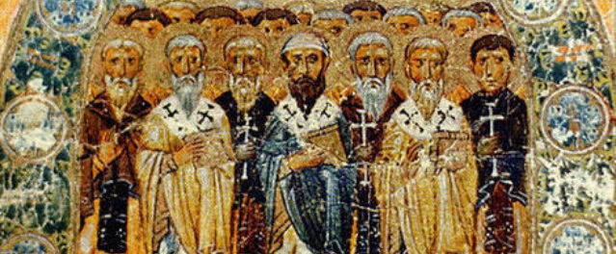
The Apostolic Fathers
I write to you, fathers, because you know him who is from the beginning…
(1 John 2:14)
https://seanmcdowell.org/blog/what-can-christians-learn-from-the-apostolic-fathers-interview-with-author-ken-berding

Slide 8
*The Apostolic Fathers
Christian writers and teachers who lived after the apostles in the first five or six centuries of Church history are generally known as the early Church fathers.
The name we give to the authors of the earliest Christian writings, the period in just after the death of the apostles (from about AD 95 to 140), is known as the age of the apostolic fathers.
This name (“apostolic fathers”), was invented in the 17th century, when scholars believed that these early Christian writers all had direct personal contact with the apostles; most historians today think that only a few of them did.
* Needham, Nick. 2,000 Years of Christ's Power Vol. 1: The Age of the Early Church Fathers

Slide 9
*The Apostolic Fathers
We often expect the apostolic fathers to have the best theology. And yet even in the NT itself, we see individuals who “knew” the apostles, but were nonetheless guilty of erroneous beliefs.
Just because someone says they knew an apostle doesn’t mean they really know and believe what that apostle believes and just because you heard an apostle preach one time, doesn’t mean you know everything they believe.
Many of these early writings were very sub-biblical. One thing to keep in mind is that most of these early writers did not have the entire NT available to them.
Also, communication didn’t travel as quickly in those days.
* Based on notes taken from James White’s 2016 Church History Series; Lesson 6 – Clement of Rome

Slide 10
*The Apostolic Fathers
There are two questions we always have to ask ourselves as we study early church history, especially:
What do I know that they didn’t?
What did they know that I don’t know?
What is the first writing we have from a Christian that is not in the NT? This is disputed. The two most likely documents would be:
Clement of Rome (AD 95–97)
The Didache (AD 80–120)
* Based on notes taken from James White’s 2016 Church History Series; Lesson 6 – Clement of Rome

Slide 11
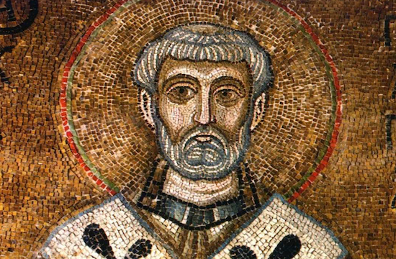
Clement of Rome Letter to the Corinthians
Yes, I ask you also, true companion, help these women, who have labored side by side with me in the gospel together with Clement and the rest of my fellow workers, whose names are in the book of life. (Philippians 4:3)
https://international.la-croix.com/news/possible-bone-fragment-of-st-clement-of-rome-gifted-to-westminster-abbey/7875#

Slide 12
*Clement of Rome’s Letter to the Corinthians
Eusebius and others believe that the “Clement” mentioned by the Apostle Paul in Philippians 4:3 wrote this letter while serving as an elder in the church of Rome.
The (Roman) Catholic Encyclopedia actually claims that Clement was the fourth pope!
http://www.newadvent.org/cathen/04012c.htm
* Based on notes taken from James White’s 2016 Church History Series; Lesson 6 – Clement of Rome

Slide 13
* Clement of Rome’s Letter to the Corinthians
Some things we need to keep in mind:
The name Clement does not appear anywhere in the letter.
The letter itself says it is from: “The Church of God which sojourns at Rome”.
The church at Rome is known to have had a plurality of elders until at least AD 140–150 (cf. Shepherd of Hermas Chapter 4).
Therefore, at the time this letter was written, the church at Rome would still have had a plurality of elders.
It could be that Clement was one of the elders in the church of Rome and had been given the task of writing this letter on behalf of the church.
* Based on notes taken from James White’s 2016 Church History Series; Lesson 6 – Clement of Rome

Slide 14
Overview of the Purpose and Content of the Letter
The letter was written to try to settle a dispute in the Corinthian church.
In a conflict between the older and younger generations, the Corinthian Christians had dismissed all their elders and replaced them by new youthful leaders.
The Roman church’s response was to emphasize the need for good order in the Church.
*Needham, Nick. 2,000 Years of Christ's Power Vol. 1: The Age of the Early Church Fathers

Slide 15
Overview of the Purpose and Content of the Letter
The letter argues that God’s purpose of salvation revealed a sort of “chain of command”: God the Father sent the Lord Jesus Christ, Christ sent the apostles, the apostles appointed the original elders and deacons in the churches, and the churches, in turn, were to appoint their successors.
A church must not disturb this chain of command by dismissing its officers without just cause.
Apparently, in the case of the Corinthian presbyters, they did not have just cause for getting rid of their elders
The Roman church therefore entreated the Corinthians to restore their deposed leaders back into office.
*Needham, Nick. 2,000 Years of Christ's Power Vol. 1: The Age of the Early Church Fathers

