Slide 2
Corrections/Clarifications From Last Week
[As a youth, King James fell] under the influence of the duke of Lennox, a Roman Catholic who schemed to win back Scotland for the imprisoned Queen Mary…
In class I erroneously identified Queen Mary as “Bloody Mary”. It is actually referring to Mary Queen of Scotts – James’ mother. Bloody Mary died in 1558 – eight years before King James was even born, and as far as I can tell, she was never imprisoned.
[The Puritans] were also very critical of all that they considered licentious—and this included the theater, not only because immorality was often depicted, but also because of the apparent duplicity implicit in acting.
Their chief complaint was that secular entertainments distracted people from worshipping God, though they also felt that the theater’s increasing popularity symbolized the moral iniquity of city life. For instance, they regarded the convention of boy actors playing women’s roles as immoral, and some Puritan preachers even felt that the sinfulness of play-acting either contributed to or else directly caused London’s frequent outbreaks of plague. (https://www.sparknotes.com/shakespeare/life-and-times/historical-context/religious/puritans/ )

Slide 3
Other Significant Events in the Reign of King James
https://reign.fandom.com/wiki/History%27s_King_James_VI_and_I?file=King_James_VI_and_I.jpg

Slide 4
The Gunpowder Plot
https://pinupmagazine.org/articles/article-guy-fawkes-mask-v-for-vendetta

Slide 5
The Gunpowder Plot
There were multiple conspiracies and efforts to depose James during the early years of his reign in England.
In 1605, what became known as the “Gunpowder Plot” was organized by Robert Catesby, an English Catholic whose father had been persecuted by Queen Elizabeth I for refusing to conform to the Church of England.
Catesby and the handful of other plotters rented a cellar that extended under the House of Lords building, and Guy Fawkes, one of the conspirators, planted thirty-six barrels of gunpowder there.
https://www.history.com/topics/british-history/gunpowder-plot

Slide 6
The Gunpowder Plot
As the November 5 opening meeting of Parliament approached, Lord Monteagle, the brother-in-law of one of the conspirators, received an anonymous letter warning him not to attend Parliament on November 5.
Monteagle alerted the government hours before the attack was to have taken place.
At about midnight on the night of November 4, Sir Thomas Knyvet, a justice of the peace, found Guy Fawkes lurking in a cellar under the Parliament building and ordered the premises searched.
https://www.history.com/topics/british-history/gunpowder-plot

Slide 7
The Gunpowder Plot
The thirty-six barrels of gunpowder were found, and Fawkes was taken into custody.
After being tortured, Fawkes revealed he was a participant in an English Catholic conspiracy to annihilate England’s Protestant government and replace it with Catholic leadership.
By torturing Fawkes, King James’ government learned the identities of his co-conspirators.
During the next few weeks, English authorities killed or captured all the plotters and put the survivors on trial.
Fawkes and the other surviving chief conspirators were sentenced to be hanged, drawn and quartered in London.
Moments before the start of his execution, on January 31, 1606, Fawkes jumped from a ladder while climbing to the gallows, breaking his neck and dying.
https://www.history.com/topics/british-history/gunpowder-plot

Slide 8
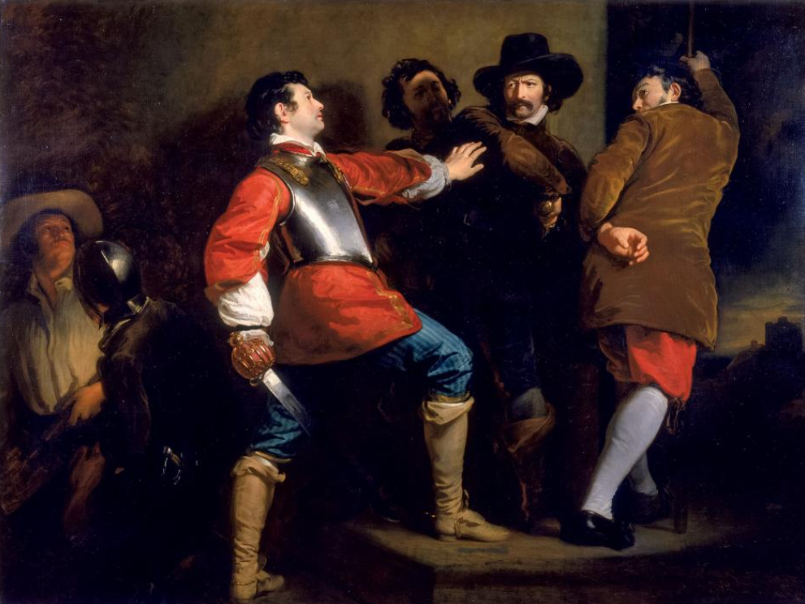
The Discovery of the Gunpowder Plot and the Taking of Guy Fawkes
The 1823 painting by Henry Perronet Briggs depicts the arrest.
https://www.nationalgeographic.com/history/magazine/2017/11-12/history-the-explosive-truth-about-guy-fawkes/

Slide 9
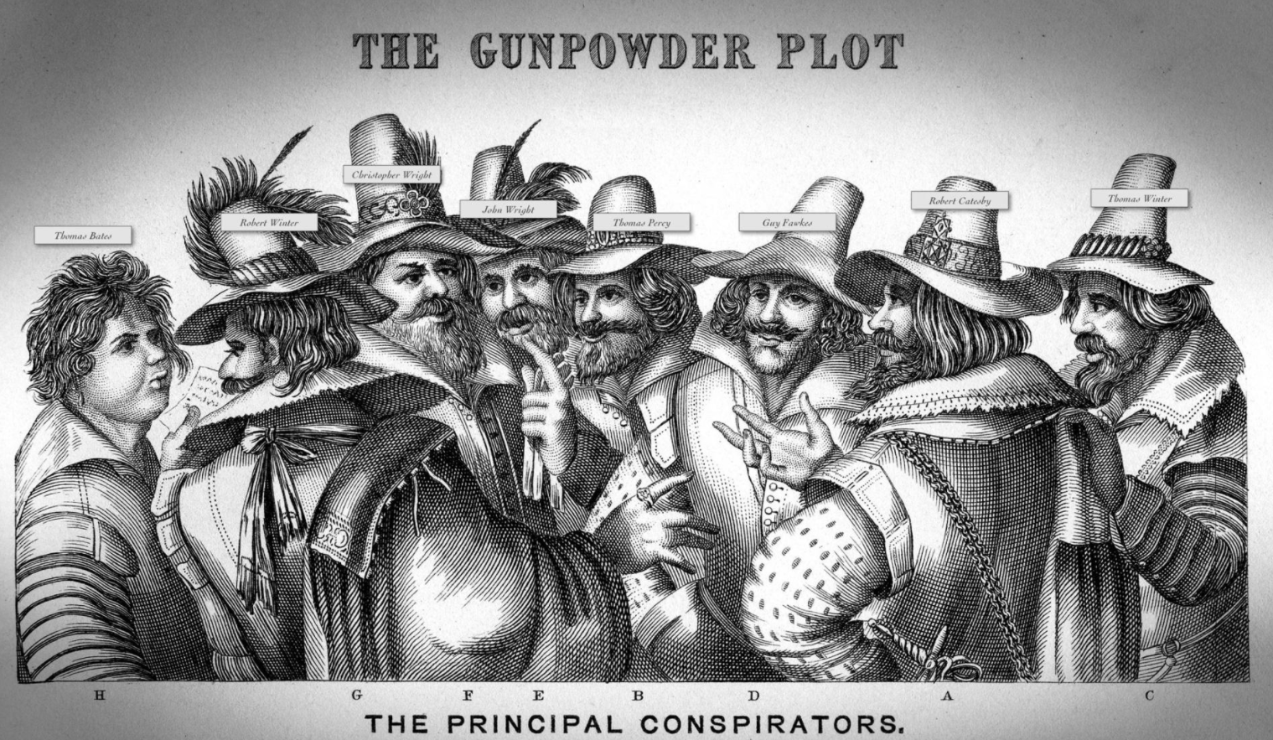
Gunpowder Plot Conspirators
https://www.nationalgeographic.com/history/magazine/2017/11-12/history-the-explosive-truth-about-guy-fawkes/

Slide 10
The Gunpowder Plot
Following the failed Gunpowder Plot, new laws were instituted in England that, among other restrictions, eliminated the right of Catholics to vote.
In 1606, Parliament established November 5 as a day of public thanksgiving.
Guy Fawkes Night (or Guy Fawkes Day), also referred to as and Bonfire Night, now is celebrated annually across Great Britain on November 5 in remembrance of the Gunpowder Plot.
As dusk falls, villagers and city dwellers across Britain light bonfires, set off fireworks and burn effigies of Fawkes.
https://www.history.com/topics/british-history/gunpowder-plot

Slide 11
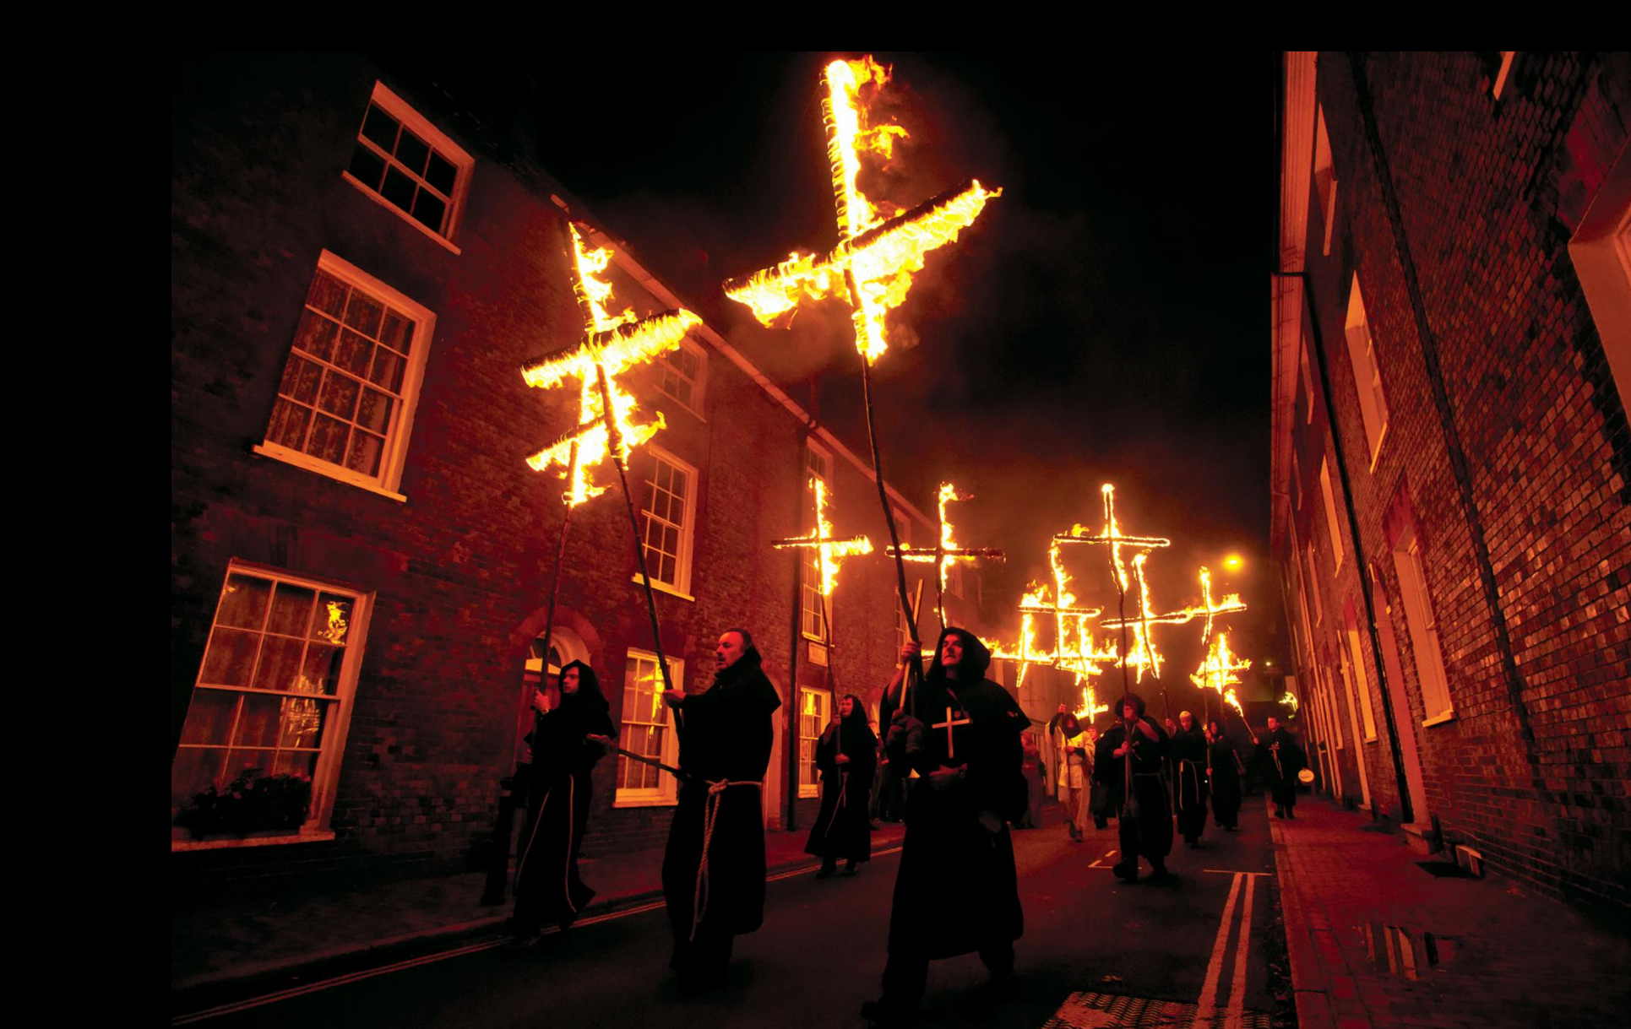
Guy Fawkes Night
Bonfire Night celebration in Lewes, England
https://www.nationalgeographic.com/history/magazine/2017/11-12/history-the-explosive-truth-about-guy-fawkes/

Slide 12
Explosive Impact
Scholars have wondered just what the impact of the Gunpowder Plot would have been if the plotters had been able to carry it out.
In 2003 a study by the Centre for Explosion Studies at the University of Aberystwyth in Wales sought to find out.
If Fawkes had been able to ignite the barrels of gunpowder, there would have been total destruction within a 40-yard radius, walls and roofs destroyed at 100 yards, and windows broken as far away as 900 yards.
The Houses of Parliament and Westminster Abbey would have been completely destroyed, while structures in Whitehall, about a third of a mile away, would have been damaged as well.
https://www.history.com/topics/british-history/gunpowder-plot

Slide 13
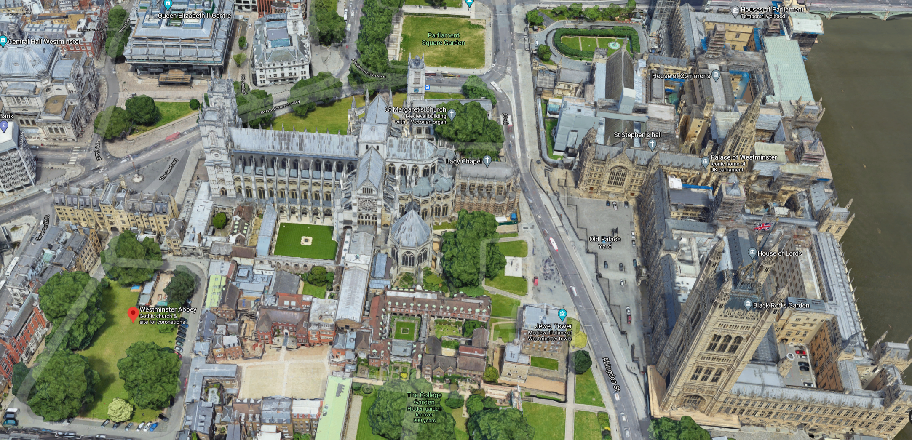
Palace of Westminster
https://www.google.com/maps/place/Westminster+Abbey/@51.4965863,-0.1273055,343a,35y,39.4t/data=!3m1!1e3!4m5!3m4!1s0x487604c4ba43352f:0xda8effa2059b537a!8m2!3d51.4986769!4d-0.1289446?hl=en&authuser=0

Slide 14
Guy Fawkes Masks
https://www.nationalgeographic.com/history/magazine/2017/11-12/history-the-explosive-truth-about-guy-fawkes/

Slide 15
Guy Fawkes Masks
Over the past decade or so, dissidents across the globe have appropriated the visage of Guy Fawkes, warping the once-reviled fringe rebel into a widespread symbol of resistance.
The iconic version of the Guy Fawkes mask owes its popularity to the graphic novel and 2005 dystopian political action film V for Vendetta, which centers on a vigilante's efforts to destroy an authoritarian government in a dystopian future United Kingdom.
Although he didn't predict the mask's role in popular protest, David Lloyd, the artist who illustrated the comic, told The New York Times, "It's a great symbol of protest for anyone who sees tyranny."
https://www.mentalfloss.com/article/70807/brief-history-guy-fawkes-mask

Slide 16
Guy Fawkes Masks
In recent years the stylized mask has evolved into a global symbol of dissent, employed by everyone from shadowy computer hackers to Turkish airline workers.
And although the masks are often used in anti-establishment demonstrations, one of the largest media corporations in the country gains the most from the masks' rising popularity.
Time Warner owns the rights to the image, and at over 100,000 masks made each year, it is by far the company's best-selling facial costume.
https://www.mentalfloss.com/article/70807/brief-history-guy-fawkes-mask

Slide 17
The Virginia Company
https://www.britannica.com/topic/Virginia-Company

Slide 18
The Virginia Company
King James I granted a charter to The Virginia Company in 1606 to support England’s goals of finding a northwest passage to the Orient, competing with the expansion of other European nations, and bringing the Anglican religion to the Indians.
Its shareholders were Londoners, and it was distinguished from the Plymouth Company, which was chartered at the same time and composed largely of men from Plymouth.
In December 1606 the Virginia Company sent out three ships carrying approximately 105 colonists led by Christopher Newport.
https://www.britannica.com/topic/Virginia-Company

Slide 19
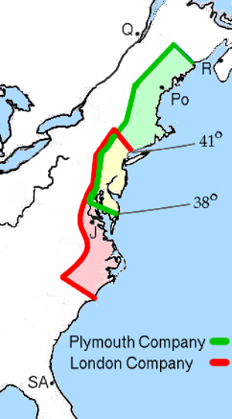
The Virginia Company
https://www.wikiwand.com/en/Virginia_Company

Slide 20
The Virginia Company
In May 1607 the colonists reached Virginia and founded the Jamestown Colony at the mouth of the James River.
After some initial hardships, the colony took root, and the Virginia Company itself was reconstituted on a broader legal basis.
A new charter in 1609 reorganized its governing structure.
In 1619 the company established continental America’s first true legislature, the General Assembly, which was organized into two chambers.
It consisted of the governor and his council, named by the company in England, and the House of Burgesses, made up of two burgesses from each of the four boroughs and seven plantations.
https://www.britannica.com/topic/Virginia-Company

Slide 21
The Virginia Company
Despite increasing prosperity in Virginia over the following years, the company’s role came under attack as disputes among the shareholders grew and as the king himself became offended both by the trend toward popular government in Virginia and by the colony’s efforts to raise tobacco, a “noisome” (having an extremely offensive smell) product of which he disapproved.
A petition submitted to the king, calling for an investigation of conditions in the colony, led to a trial before the King’s Bench in May 1624.
The court ruled against the Virginia Company, which was then dissolved, with the result that Virginia was transformed into a royal colony.
https://www.britannica.com/topic/Virginia-Company

Slide 22
Other Accomplishments of King James
https://reign.fandom.com/wiki/History%27s_King_James_VI_and_I?file=King_James_VI_and_I.jpg

Slide 23
Other Accomplishments
King James I died in 1625, at age 58.
In addition to expanding lands overseas and Britain’s influence in the world, his achievements included:
Peace with Spain in 1604 after decades of fighting;
A new Banqueting House in Whitehall Palace in London, designed by the noted architect Inigo Jones;
Nine children by his wife, Anne of Denmark — including his second son, the next King of England, Charles I.
Five years before his death, the Pilgrims sailed to America (New England) on the Mayflower.
https://www.historyisfun.org/sites/jamestown-chronicles/james_more1.html

Slide 24
Pilgrims Come to America
https://www.history.com/topics/colonial-america/pilgrims

Slide 25
Class Discussion Time
https://www.weareteachers.com/moving-beyond-classroom-discussions/

Slide 26
*Class Discussion Time
The Puritans’ chief complaint about the theater in their day was that:
Secular entertainments distracted people from worshipping God (or from engaging in productive work)
They regarded the convention of boy actors playing women’s roles as immoral based on Deuteronomy 22:5 – A woman shall not wear a man's garment, nor shall a man put on a woman's cloak, for whoever does these things is an abomination to the LORD your God
Some Puritan preachers even felt that the sinfulness of play-acting either contributed to or else directly caused London’s frequent outbreaks of plague.
Do you think there is any merit in any of the Puritans’ arguments against theater in their day?
Does God’s providential intervention in saving the English king and houses of parliament from the Gunpowder plot give you a greater appreciation for God’s intervention in history?
Can you think of a more modern example of what you believe to be providential intervention on God’s part?
Do you have a topic or question that you would like to see us to discuss?
Notes:
Acts 10:34-35 - So Peter opened his mouth and said: "Truly I understand that God shows no partiality, but in every nation anyone who fears him and does what is right is acceptable to him. (Act 10:34-35)
Acts 17:26 And [God] made from one man every nation of mankind to live on all the face of the earth, having determined allotted periods and the boundaries of their dwelling place (Act 17:26)
James 3:8-9 - no human being can tame the tongue. It is a restless evil, full of deadly poison. With it we bless our Lord and Father, and with it we curse people who are made in the likeness of God. (Jam 3:8-9)

