Slide 2
The Thirty Years War
https://www.wikiwand.com/en/Thirty_Years%27_War

Slide 3
The Thirty Years War
The Thirty Years’ War (1618–48) ranks as one of the most devastating conflicts ever to ravage the soil of Europe.
Unfortunately for Germany, the war was fought on German soil. ¹
Virtually all the major European powers became involved in the clash at one time or another, so that Germany became an international battleground where marauding armies inflicted destruction on each other, on the civilian population, and on the land. ¹
The Thirty Years’ War is thought to have claimed between 4 and 12 million lives. ²
Around 450,000 people died in combat.
Disease and famine took the lion’s share of the death toll.
Estimates suggest that 20% of Europe’s people perished, with some areas seeing their population fall by as much as 60%.
¹ Needham, Nick. 2,000 Years of Christ's Power Vol. 4: The Age of Religious Conflict
² https://blogs.icrc.org/law-and-policy/2017/05/23/thirty-years-war-first-modern-war/

Slide 4
The Thirty Years War
The war was religious in origin.
We could regard it in many ways as part two of the religious civil war between Protestants and Roman Catholics that had flared across Germany from 1547 to 1552.
That war had culminated in the Peace of Augsburg, ratified by the German imperial diet in 1555.
The Peace generally accomplished its objective; it really did bring peace to most of Germany, most of the time, for the following 60 years.
Its fatal defect was that it gave legal recognition to only two forms of Christianity: Roman Catholicism and Lutheranism.
The Reformed faith, which at that point had almost no presence in Germany, was not covered by the Peace.
Needham, Nick. 2,000 Years of Christ's Power Vol. 4: The Age of Religious Conflict

Slide 5
The Thirty Years War
Calvinism, however, enjoyed major growth in Germany after the Peace was signed.
Numerous German territories embraced or extended toleration to the Reformed faith after 1555.
Yet technically they were violating imperial law, since the Peace of Augsburg had outlawed any faith but Catholicism and Lutheranism.
It was not Calvinism alone, however, that provoked friction in Germany.
Lutherans and Catholics, although legally protected by the Peace of Augsburg, did not necessarily live at peace with each other.
Needham, Nick. 2,000 Years of Christ's Power Vol. 4: The Age of Religious Conflict

Slide 6
The Thirty Years War
There were also Lutherans and Calvinists in Bohemia, and indeed in 1575 they and the Hussites had signed a joint Protestant confession of faith, the Bohemian Confession, as a way of acting together politically to secure freedom of worship.
Their king was none other than the Holy Roman Emperor, the Catholic Habsburg Rudolf II.
The Habsburgs had added Bohemia to their Europe-wide dynastic empire in 1526.
Despite Rudolf’s animosity toward the Reformation, the Bohemian Protestant nobility forced him in 1609 to recognize their liberty in a document known as the “Letter of Majesty”.
Needham, Nick. 2,000 Years of Christ's Power Vol. 4: The Age of Religious Conflict

Slide 7
The Thirty Years War
The next emperor, Matthias, who was childless, had his cousin, Archduke Ferdinand of Styria (Lower Austria) presented to the Bohemian nobility in 1617 as their crown prince and future king.
A shiver of dread ran through the country.
Ferdinand was an aggressive Counter-Reformation Catholic; having received a brilliant Jesuit training, he had brutally suppressed Protestantism in his land of Styria.
Already the 1609 Letter of Majesty was proving ineffective at stopping Emperor Matthias’ agents in Bohemia from harassing its Protestants.
Needham, Nick. 2,000 Years of Christ's Power Vol. 4: The Age of Religious Conflict

Slide 8
The Thirty Years War
The fear of what so intolerant a Catholic as Ferdinand might do as their new king drove the Bohemian nobility to outright rebellion.
A band of nobles bribed their way into Prague castle, where four of Ferdinand’s representatives were meeting, and the nobles threw two of the unfortunate men (well-known inflexible Catholics) out of the third floor window—they landed unharmed in a pile of horse dung.
It was May 18th 1618, and it was known as the Defenestration of Prague. (Defenestration is the act of throwing someone out of a window: a bizarre word, but throwing unpopular politicians out of windows was a Bohemian tradition, almost a sport!)
It is this melodramatic event that marks the outbreak of the Thirty Years’ War.
Needham, Nick. 2,000 Years of Christ's Power Vol. 4: The Age of Religious Conflict

Slide 9
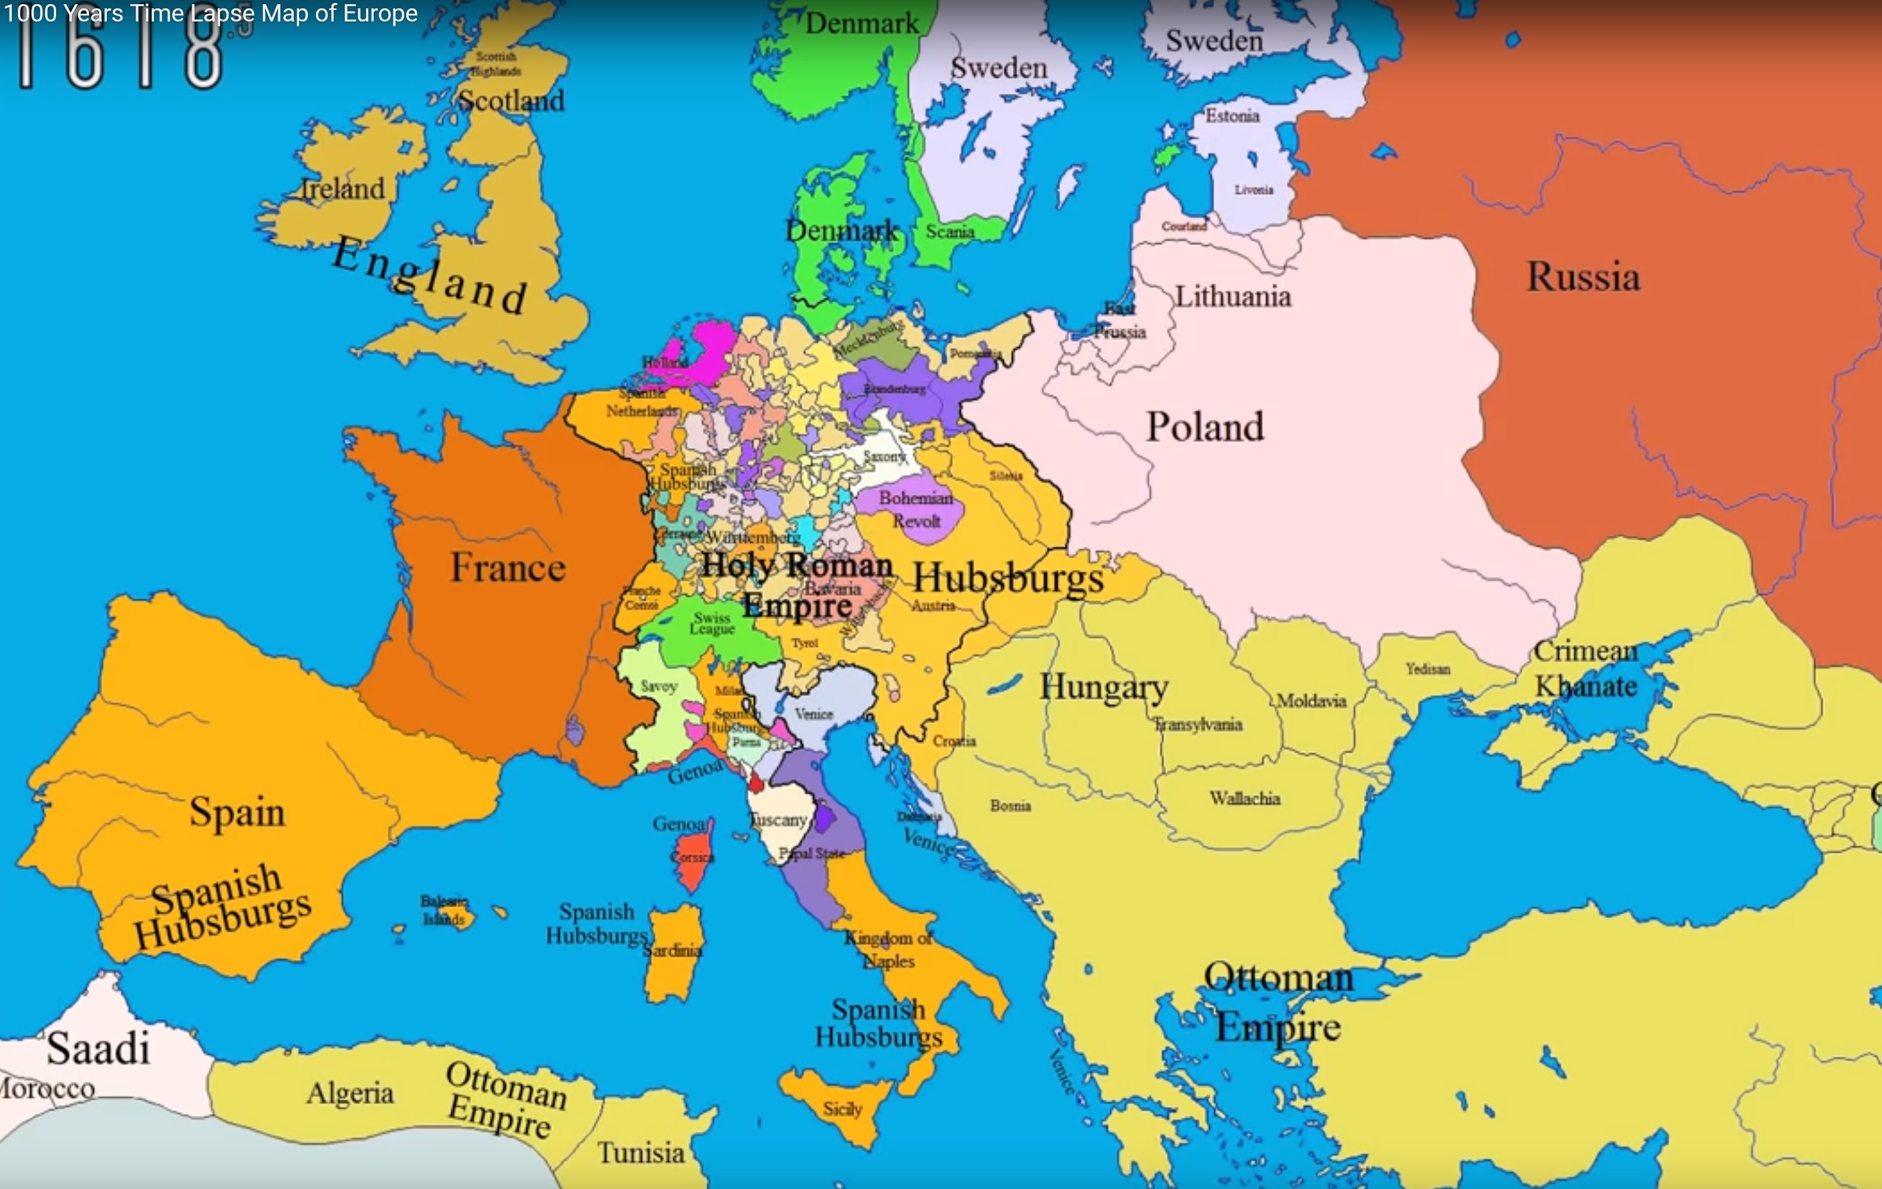
Europe 1618
https://www.youtube.com/watch?v=vjWVFZ5e_vo&t=48s

Slide 10
The Thirty Years War
By November 1618, the Bohemian rebels had quelled internal resistance to their revolution and were in full military control of the country.
This initial success of the Bohemian revolt led to serious Protestant uprisings against Catholic rulers throughout the entire region: Moravia, Silesia, Upper Austria, Transylvania, even Archduke Ferdinand’s Styria.
In August 1619, the Bohemians elected a new king—the Calvinist Prince Frederick V of the Palatinate, leader of the Protestant Union.
Needham, Nick. 2,000 Years of Christ's Power Vol. 4: The Age of Religious Conflict

Slide 11
The Thirty Years War
Frederick’s acceptance touched off the fighting between Catholics and Calvinists.
In 1620 near Prague the Catholic Imperial forces, surging forward to the cry, “For the Virgin Mary,” crushed the Bohemians and confiscated most of the estates of the insurgents.
The victors added salt to the wounds by awarding the Jesuits control of the University of Prague, the old haunt of John Hus.
Shelley, Dr. Bruce L.. Church History in Plain Language: Fourth Edition

Slide 12
The Thirty Years War
Appalled by this Catholic victory and eager to annex German territory, King Christian IV of Lutheran Denmark entered the war against Ferdinand and the Catholic forces.
Without adequate support, however, his venture was doomed from the start.
In 1626 the Danes were completely routed in the Harz Mountains and forced to withdraw to Denmark like a pack of whipped pups.
Shelley, Dr. Bruce L.. Church History in Plain Language: Fourth Edition

Slide 13
The Thirty Years War
Then help arrived from another quarter.
In 1611, when he was only seventeen years of age, Gustavus Adolphus had inherited the Swedish throne.
Since Gustavus Adolphus was also a staunch Lutheran who bewailed the events that were taking place in Bohemia and Germany, he felt compelled to intervene with the double purpose of:
Defending the Protestants
Defeating the ambitions of the Hapsburgs.
González, Justo L. . The Story of Christianity: Volume 2: The Reformation to the Present Day

Slide 14
The Thirty Years War
In 1630, Gustavus Adolphus invaded Germany.
At first the Swedes found little support among German Protestants, who feared the emperor’s wrath and in any case did not trust the Swedish invader.
But Gustavus Adolphus was a very able general whose repeated victories soon became legendary.
His soldiers, in contrast to all the armies that had marched in this protracted war, treated the native population with kindness and respect.
While the Swedes were clearly Protestant, they did not force the conversion of Catholics in the areas they conquered.
González, Justo L. . The Story of Christianity: Volume 2: The Reformation to the Present Day

Slide 15
The Thirty Years War
Repeatedly, Gustavus Adolphus made it clear that he did not seek to dismember Germany for Swedish profit.
When France offered him financial support in his campaign against the Hapsburgs, he accepted it on the condition that it be understood that not a single village in German territory would become French.
Eventually, several powerful German Protestant princes came to his support.
Gustavus Adolphus then sent some of his German allies to invade Bohemia.
By then several Catholic leaders were suing for peace, and many were willing to agree to the terms imposed by the Swedish king:
Religious tolerance for both Catholics and Protestants
The restoration of its ancient rights to the kingdom of Bohemia
The expulsion of the Jesuits from the empire.
González, Justo L. . The Story of Christianity: Volume 2: The Reformation to the Present Day

Slide 16
The Thirty Years War
But then the Spanish Hapsburgs sent an army to support their cousins in Germany.
In the meantime, the French then joined in support of the Protestants, even though France was then ruled by a cardinal of the Roman Catholic Church.
But eventually, even the most bloodthirsty tired of war and destruction.
Ferdinand II had died in 1637, and his son and successor Ferdinand III, although a sincere Catholic, did not share his father’s intolerance.
Germans bemoaned seeing their land invaded by foreign troops in support of both sides.
Sweden was ready to withdraw its army.
France knew that the time had come when the greatest concessions could be obtained.
González, Justo L. . The Story of Christianity: Volume 2: The Reformation to the Present Day

Slide 17
The Thirty Years War
When the contending powers finally met in the German province of Westphalia in 1648 in order to end the bloodshed, the balance of power in Europe had been radically changed:
Spain had lost not only the Netherlands but its dominant position in western Europe.
France was now the chief Western power.
Sweden had control of the Baltic.
The United Netherlands was recognized as an independent republic.
The German member states of the Holy Roman Empire were granted full sovereignty.
https://www.britannica.com/event/Thirty-Years-War

Slide 18
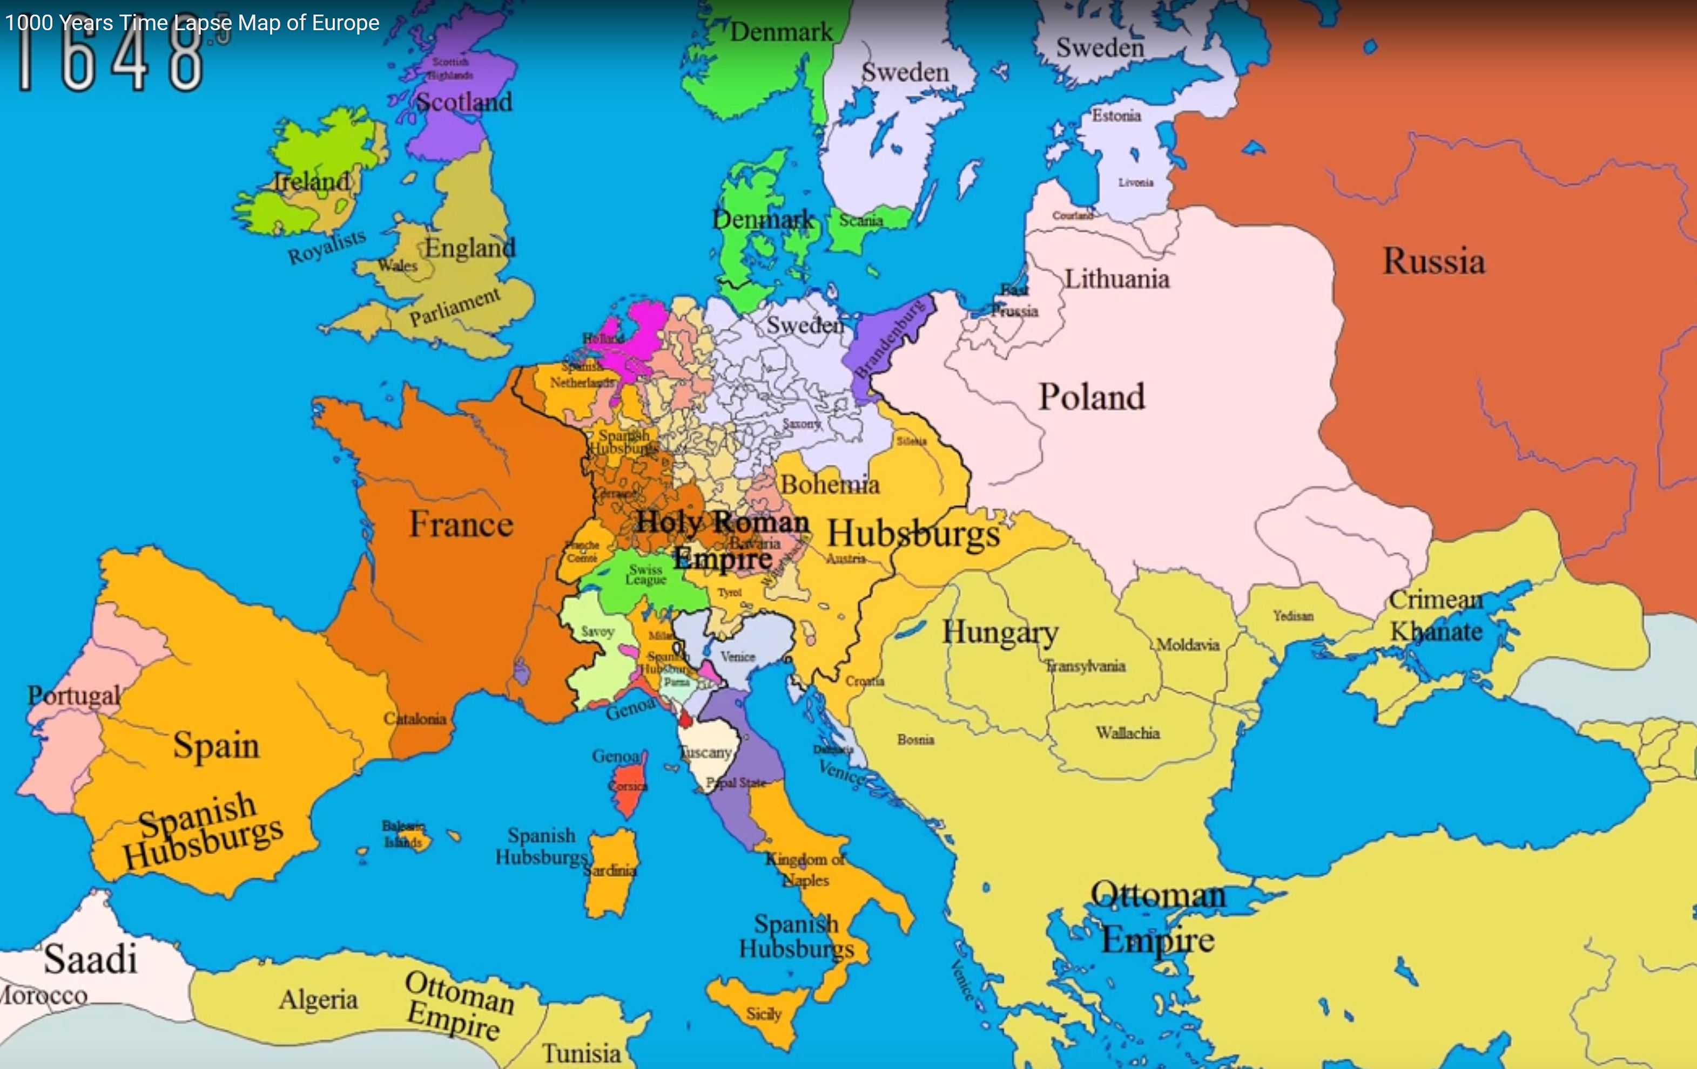
Europe 1648
https://www.youtube.com/watch?v=vjWVFZ5e_vo&t=48s

Slide 19
The Thirty Years War
The terms of peace, called the Peace of Westphalia (1648), reflect the passing of an age.
Calvinism joined Lutheranism and Catholicism as a recognized expression of the Christian faith (though the Anabaptists were still excluded).
Princes, if they chose, could, for the first time, allow Protestants and Catholics to exist within their territories.
And the pope was excluded from any interference in the religious affairs of Germany.
Naturally Pope Innocent X condemned the treaty, but both Catholics and Protestants ignored his protests.
The state was now free to transact its business as though the pope did not exist.
Shelley, Dr. Bruce L.. Church History in Plain Language: Fourth Edition

Slide 20
The Thirty Years War
Christianity’s alliance with civil power was changing.
Christians in the West would now live in nation-states, the real victor in the Thirty Years’ War.
The emerging nation-states would require Christians to live under a government whose citizens belonged to a variety denominations and faiths.
In time, some of these nation-states required citizens to affirm a generic version of God in order to hold office or attend college; but distinctive beliefs and practices, such as being Catholic or Presbyterian, were strictly a private, individual matter.
Shelley, Dr. Bruce L.. Church History in Plain Language: Fourth Edition

Slide 21
The Thirty Years War
Because of these developments in the Thirty Years’ War, it is considered to be the last great religious war in Europe.
The way its nature had been secularized by Catholic France fighting alongside Protestants against the Catholic Habsburgs, meant that a new, more pragmatic era had dawned in European history.
Nations would now be much more ready to fight for their own interests and glory, without a convincing religious motive.
Needham, Nick. 2,000 Years of Christ's Power Vol. 4: The Age of Religious Conflict

Slide 22
Major Periods of Church History
Early Church
Medieval Church
Reformation
Modern Church
AD 33
600
1517
1648

Slide 23
Class Discussion Time
https://www.weareteachers.com/moving-beyond-classroom-discussions/

Slide 24
*Class Discussion Time
Do you see any parallels between some of the events leading up to the Thirty Years War and recent events in our country? If so, what are they?
In this war, perhaps more than in previous wars, you see the emergence of pluralistic religious beliefs within the population of a single country – something that has been the hallmark of our own nation. Is this a good thing? Is there a point at which such pluralism begins to undermine the ability of a nation to hold together? If so, what is it, and how do you stop it?
We are told that some of these nation-states required citizens to affirm a generic version of God in order to hold office or attend college; but distinctive beliefs and practices, such as being Catholic or Presbyterian, were strictly a private, individual matter.
This could still be a pretty accurate description of our nation today. Do you think it’s enough for an office holder to affirm a “generic” belief in God? Should we expect more? If so, what?
Do you have a topic or question that you would like to see us to discuss?
Notes:
Acts 10:34-35 - So Peter opened his mouth and said: "Truly I understand that God shows no partiality, but in every nation anyone who fears him and does what is right is acceptable to him. (Act 10:34-35)
Acts 17:26 And [God] made from one man every nation of mankind to live on all the face of the earth, having determined allotted periods and the boundaries of their dwelling place (Act 17:26)
James 3:8-9 - no human being can tame the tongue. It is a restless evil, full of deadly poison. With it we bless our Lord and Father, and with it we curse people who are made in the likeness of God. (Jam 3:8-9)

