Slide 1


Slide 2
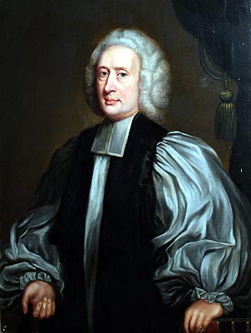
Joseph Butler
Countering the Claims of Deism
https://www.wikiwand.com/en/Joseph_Butler

Slide 3
Countering the Claims of Deism
The Enlightenment intellectuals were thoroughly aware that they were fomenting a revolution in the fundamental beliefs of Europeans.
Voltaire reported on each new triumph of reason over the church with the exultation of a commander winning battles.
These attacks upon Christian convictions demanded a vigorous and well-reasoned response from orthodox Christians.
Unfortunately in Catholic countries, like France, the reaction was woefully inadequate.
Church leaders were not indifferent to the rising tide of infidelity, but they tried to check it by traditional means.
They appealed to secular authorities to censor the “dangerous” books, but they were usually unfamiliar with the primary issues the scoffers raised.
Shelley, Dr. Bruce L.. Church History in Plain Language: Fourth Edition

Slide 4
Countering the Claims of Deism
In England it was different. Several men wrote effectively against deism, none more so than Bishop Joseph Butler (1692–1752).
His monumental work, The Analogy of Religion, virtually ended the debate for thinking people.
Skirmishes continued for years, but after Butler it was clear the fundamental issues had been settled.
The deists, with their confident optimism, assumed that they knew all about God’s wisdom and purpose. They read it all in the “pattern of nature”.
Butler, however, saw with disarming clarity that life is filled with perplexities and enigmas.
Shelley, Dr. Bruce L.. Church History in Plain Language: Fourth Edition

Slide 5
Countering the Claims of Deism
Butler did not try to prove the existence of God. Deists never denied this premise.
Nor did he reject reason; he accepted it as man’s natural light.
But he did challenge reason’s sovereignty. Reason, said Butler, provides no complete system of knowledge, and in ordinary life it can offer us only probabilities.
Thus Butler undermined deism’s fortress, its confidence in reason.
Nature, he said, is not a realm in which reason is supreme. It is filled with obscurities and unexplained mysteries. We meet perplexity at every turn.
And if we meet problems in nature, should we be surprised if we encounter difficulties in religion?
Shelley, Dr. Bruce L.. Church History in Plain Language: Fourth Edition

Slide 6
Countering the Claims of Deism
In the end, however, deism collapsed from its own weaknesses. It was based on a false optimism. It had no explanation for the evils and disasters of life.
Because the laws of nature were clear and unalterable, deists assumed that man’s moral choices drawn from nature were also simple and unchanging.
If asked, “Why don’t men always see clearly the religious truths in nature?” the deist could only respond with, “the lies of religious leaders.”
But that was too simplistic to be true, and few were convinced.
Unfortunately, the eventual rejection of deism did not restore Christianity to a central place in Western culture.
The negative work of the Age of Reason endured.
Shelley, Dr. Bruce L.. Church History in Plain Language: Fourth Edition

Slide 7
Countering the Claims of Deism
Almost all formal Christian influence was lost in modern culture—its art, its education, its politics.
In it’s place, men made a deliberate attempt to organize a religiously “neutral” civilization.
This meant that faith now had to function in the private realms confined to church, home, and heart. And that is what we still find today in modern secular societies.
This leaves Christians with a basic problem in the modern era: How far can believers go in trying, as citizens, to get the state to enforce Christian standards of conduct?
Or if Christians give up the idea of enforcing Christian behavior, then what norm of conduct should they, as citizens, try to make an obligation for everyone?
Shelley, Dr. Bruce L.. Church History in Plain Language: Fourth Edition

Slide 8
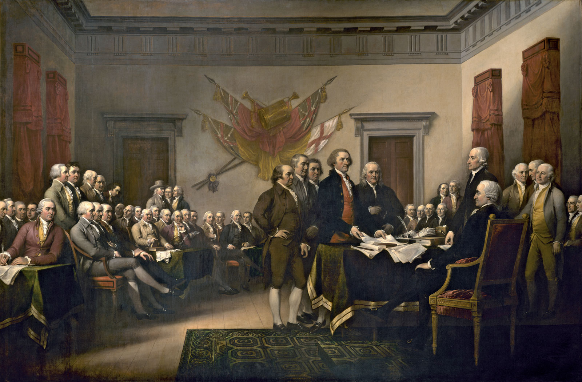
Enlightenment Influence on Politics
https://www.britannica.com/topic/Declaration-of-Independence

Slide 9
Enlightenment Influence on Politics
The Enlightenment has long been hailed as the foundation of modern Western political and intellectual culture.¹
The era is marked by three political revolutions, which together lay the basis for modern, republican, constitutional democracies:²
  The English Revolution (1688)
  The American Revolution (1775–83)
  The French Revolution (1789–99)
Enlightenment philosophers believed that the existing political and social authorities of their day were shrouded in religious myth and mystery and founded on obscure traditions and they sought through Enlightenment style reasoning to rethink them. ²
¹ https://www.wikiwand.com/en/Age_of_Enlightenment
² https://plato.stanford.edu/entries/enlightenment/#GooPolTheEthTheRelEnl

Slide 10
Enlightenment Influence on Politics
Many of the ideals of modern Western governments were developed and articulated during the Enlightenment period. For example:
  The idea that governments “derive their just powers by the consent of the governed”
  The articulation of the political ideals of freedom and equality
  The articulation of a list of basic individual human rights to be respected and realized by any legitimate political system
  The articulation and promotion of religious liberty as a virtue to be respected in a well ordered society
  The concept that political powers should be organized in a system of checks and balances
The political ideals of the Enlightenment were informed and guided to a significant extent by the political philosophers of that the period.
We are going to examine the views of two of them: Thomas Hobbes and John Locke
https://plato.stanford.edu/entries/enlightenment/#GooPolTheEthTheRelEnl

Slide 11
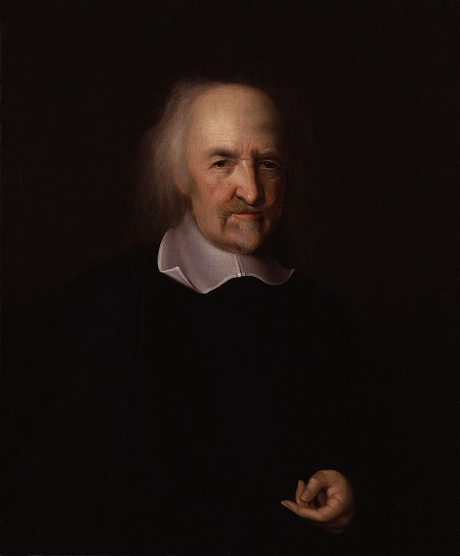
Thomas Hobbs
https://www.wikiwand.com/en/Thomas_Hobbes

Slide 12
Thomas Hobbs
One of the classical sources of Enlightenment political theory is Thomas Hobbs (1588–1679)
In his work Leviathan Hobbs argues for the necessity of a powerful sovereign governing authority.
Hobbes argues for this by imagining men in their natural state, or what he calls, the State of Nature.
In the State of Nature, which is purely hypothetical according to Hobbes, men are naturally and exclusively self-interested, they are more or less equal to one another, (even the strongest man can be killed in his sleep), there are limited resources, and yet there is no power able to force men to cooperate.
^{https://iep.utm.edu/soc-cont/}

Slide 13
Thomas Hobbs
Given these conditions in the State of Nature, Hobbes concludes that the State of Nature would be unbearably brutal – that the “life of man [in the State of Nature would be], solitary, poor, nasty, brutish, and short.”
In the State of Nature, every person is always in fear of losing his life to another. No long-term or complex cooperation is possible because the State of Nature can be aptly described as a state of utter distrust.
Given Hobbes’ reasonable assumption that most people want first and foremost to avoid their own deaths, he concludes that the State of Nature is the worst possible situation in which men can find themselves.
It is the state of perpetual and unavoidable war.
^{https://iep.utm.edu/soc-cont/}

Slide 14
Thomas Hobbs
The situation is not, however, hopeless. Being reasonable, men can be expected to construct a Social Contract that will afford them a life other than that available to them in the State of Nature.
First, they must agree to establish society by collectively and reciprocally renouncing the rights they had against one another in the State of Nature.
Second, they must imbue some one person or assembly of persons with the authority and power to enforce the initial contract.
In other words, to ensure their escape from the State of Nature, they must both agree to live together under common laws, and create an enforcement mechanism for the social contract and the laws that constitute it.
^{https://iep.utm.edu/soc-cont/}

Slide 15
Thomas Hobbs
Since the sovereign is invested with the authority and power to mete out punishments for breaches of the contract which are worse than not being able to act as one pleases, men have good, albeit self-interested, reason to treat others fairly.
Society becomes possible because now there is a more powerful person who can force men to cooperate.
While living under the authority of a Sovereign can be harsh it is at least better than living in the State of Nature.
And so Hobbs argues that no matter how poorly a Sovereign manages the affairs of the state and regulates our own lives, we are never justified in resisting his power because it is the only thing which stands between us and what we most want to avoid, the State of Nature.
^{https://iep.utm.edu/soc-cont/}

Slide 16
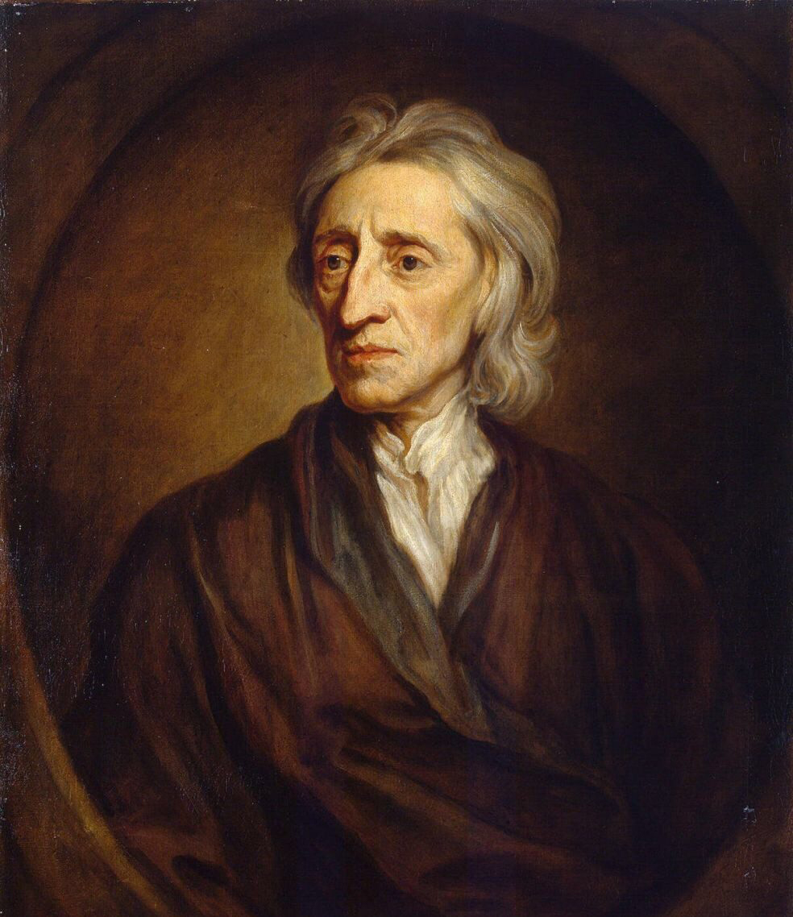
John Locke
https://www.wikiwand.com/en/John_Locke

Slide 17
John Locke
The works of John Locke (1632–1704) are another classical source of Enlightenment political theory.
Like Hobbs, Locke began his reasoning about the need for government by examining how man might function in the State of Nature, i.e. without a human government.
But unlike Hobbs, Locke sees the State of Nature as a state of perfect liberty where one can conduct his life as he best sees fit, free from the interference of others.
The State of Nature, although a state where there is no civil authority or government to punish people for transgressions against laws, is not a state without morality.
The Law of Nature, which is in Locke’s view the basis of all morality, and given to us by God, commands that we not harm others with regards to their “life, health, liberty, or possessions”.
^{https://iep.utm.edu/soc-cont/}

Slide 18
John Locke
So, in a perfect world, because of the Law of Nature and the restrictions that it imposes upon people, a State of Nature where persons are free to pursue their own interests and plans, free from interference should (theoretically) result in a relatively peaceful existence.
Unfortunately the State of Nature can [and, in the real world, will] devolve into a state of war.
The state of war begins between two or more men once one man declares war on another, by stealing from him, or by trying to make him his slave.
Since in the State of Nature there is no civil power to whom men can appeal, and since the Law of Nature allows them to defend their own lives, they may then rightfully kill those who would bring force against them.
^{https://iep.utm.edu/soc-cont/}

Slide 19
John Locke
Since the State of Nature lacks civil authority, once war begins it is likely to continue. And this is one of the strongest reasons that men have to abandon the State of Nature by contracting together to form civil government.
Civil government comes into being when individual men, representing their families, come together in the State of Nature and agree to each give up the executive power to punish those who transgress the Law of Nature, and hand over that power to the public power of a government.
Having done this, they then become subject to the will of the majority.
In other words, by making a compact to leave the State of Nature and form society, they make a civil government and submit themselves to the will of that society and that civil government .
^{https://iep.utm.edu/soc-cont/}

Slide 20
John Locke
One joins such a society, either from its beginnings, or after it has already been established by others, only by explicit consent.
Having created a political society and government through their consent, men then gain three things which they lacked in the State of Nature:
  Laws
  Judges to Adjudicate Laws
  The Executive Power Necessary to Enforce these Laws
Each man therefore gives over the power to protect himself and punish transgressors of the Law of Nature to the government that he has created through the compact.
^{https://iep.utm.edu/soc-cont/}

Slide 21
John Locke
Given that the purpose in forming a civil government is the preservation of their wealth, and preserving their lives, liberty, and well-being in general, Locke argues that there are conditions under which the compact with government might be destroyed, and men would be justified in resisting the authority of a civil government, such as a King.
When the executive power of a government devolves into tyranny, by (for example) dissolving the legislature and therefore denying the people the ability to make laws for their own preservation, then the resulting tyrant puts himself into a state of war with the people, and they then have the same right to self-defense as they had before making a compact to establish society in the first place.
^{https://iep.utm.edu/soc-cont/}

Slide 22
John Locke
In other words, the justification of the authority of the executive component of government is the protection of the people’s property and well-being, so when such protection is no longer present, or when the king becomes a tyrant and acts against the interests of the people, the people have a right, if not an outright obligation, to resist his authority.
Under those circumstances, the social compact can be dissolved and the process to create political society begun anew.
^{https://iep.utm.edu/soc-cont/}

Slide 23
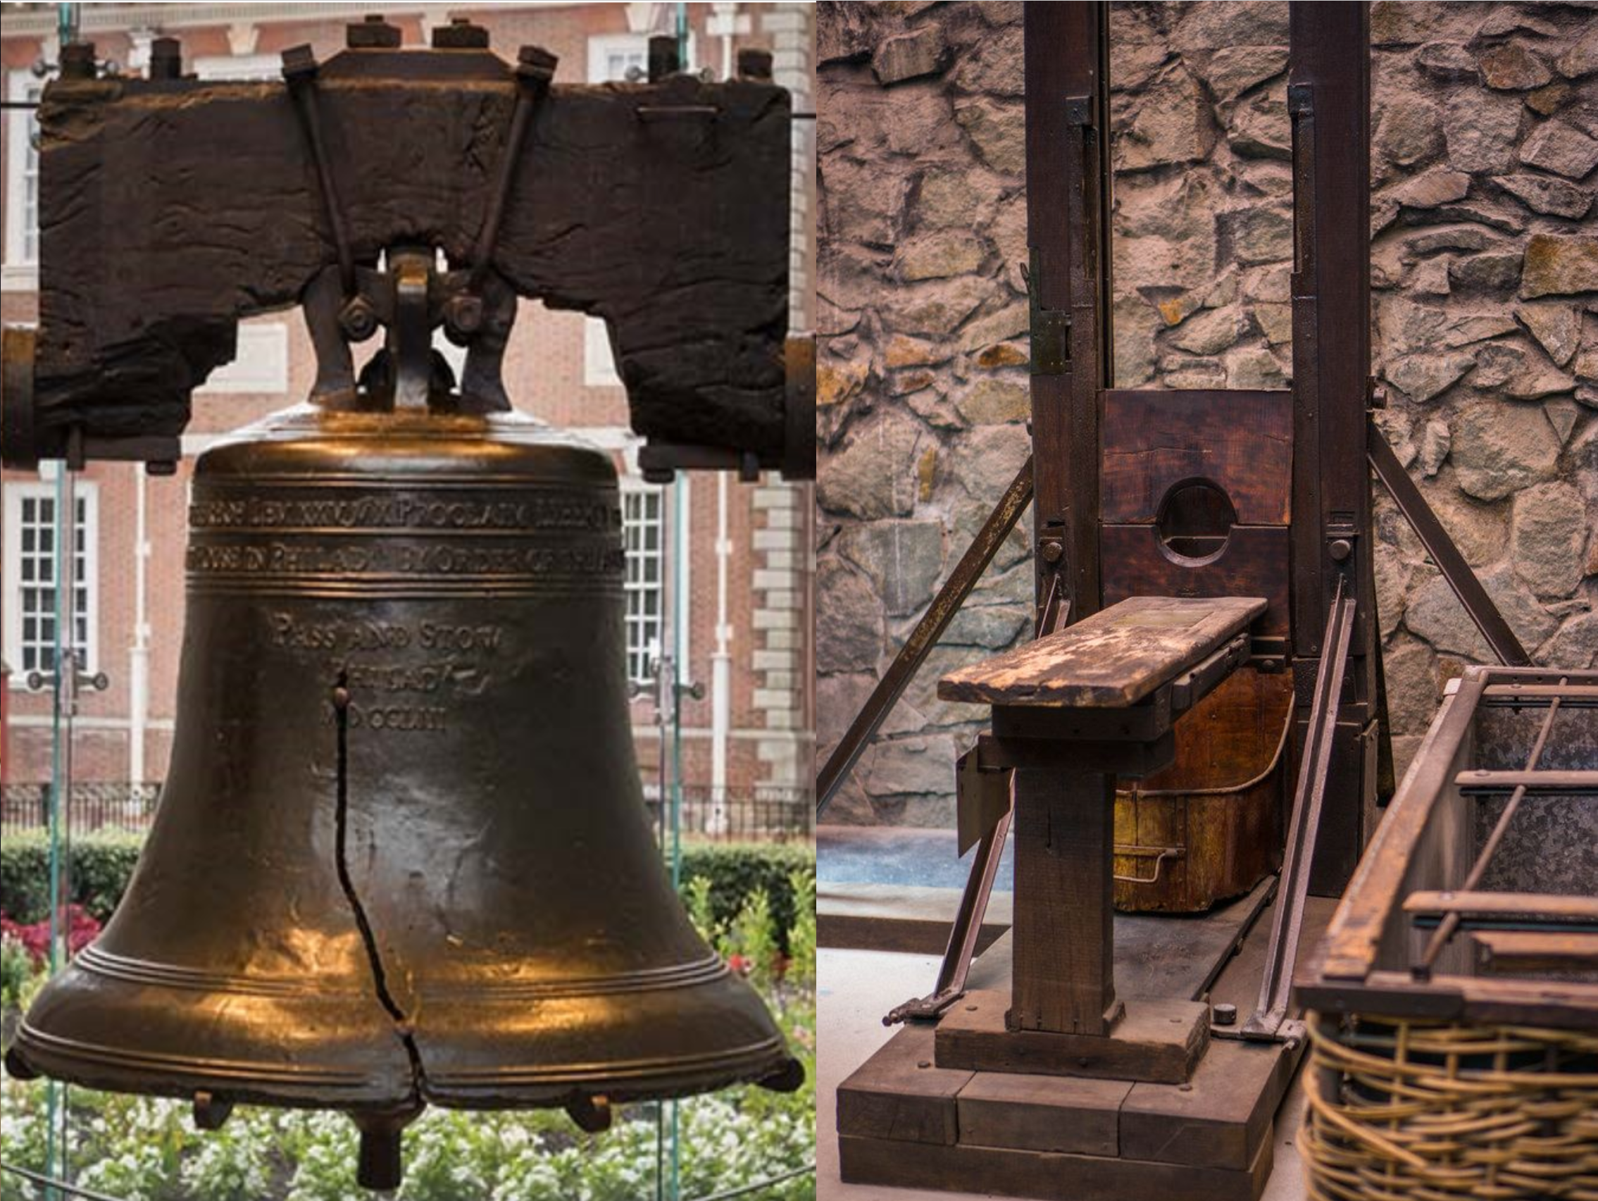
A Comparison of the American and French Revolutions
https://www.nps.gov/inde/planyourvisit/libertybellcenter.htm
https://www.pinterest.com/pin/661184789021236935/

Slide 24

Class Discussion Time
https://www.weareteachers.com/moving-beyond-classroom-discussions/

Slide 25
*Class Discussion Time
How good a job are Christians doing in responding to and refuting the secularists in our day? In what ways should we be doing better?
How far can believers go in trying, as citizens, to get the state to enforce Christian standards of conduct? Or if Christians give up the idea of enforcing Christian behavior, then what norm of conduct should they, as citizens, try to make an obligation for everyone?
What do you think of Enlightenment idea that governing authorities “derive their just powers by the consent of the governed”?
Hobbs argues that no matter how poorly a Sovereign manages the affairs of the state and regulates our own lives, we are never justified in resisting his power because it is the only thing which stands between us and what we most want to avoid, the State of Nature. Locke, on the other hand, argues that there are conditions under which the compact with government might be destroyed, and men would be justified in resisting the authority of a civil government. Who got it right? Why do you think that?
Do you have a topic or question that you would like to see us to discuss?

