Slide 1


Slide 2
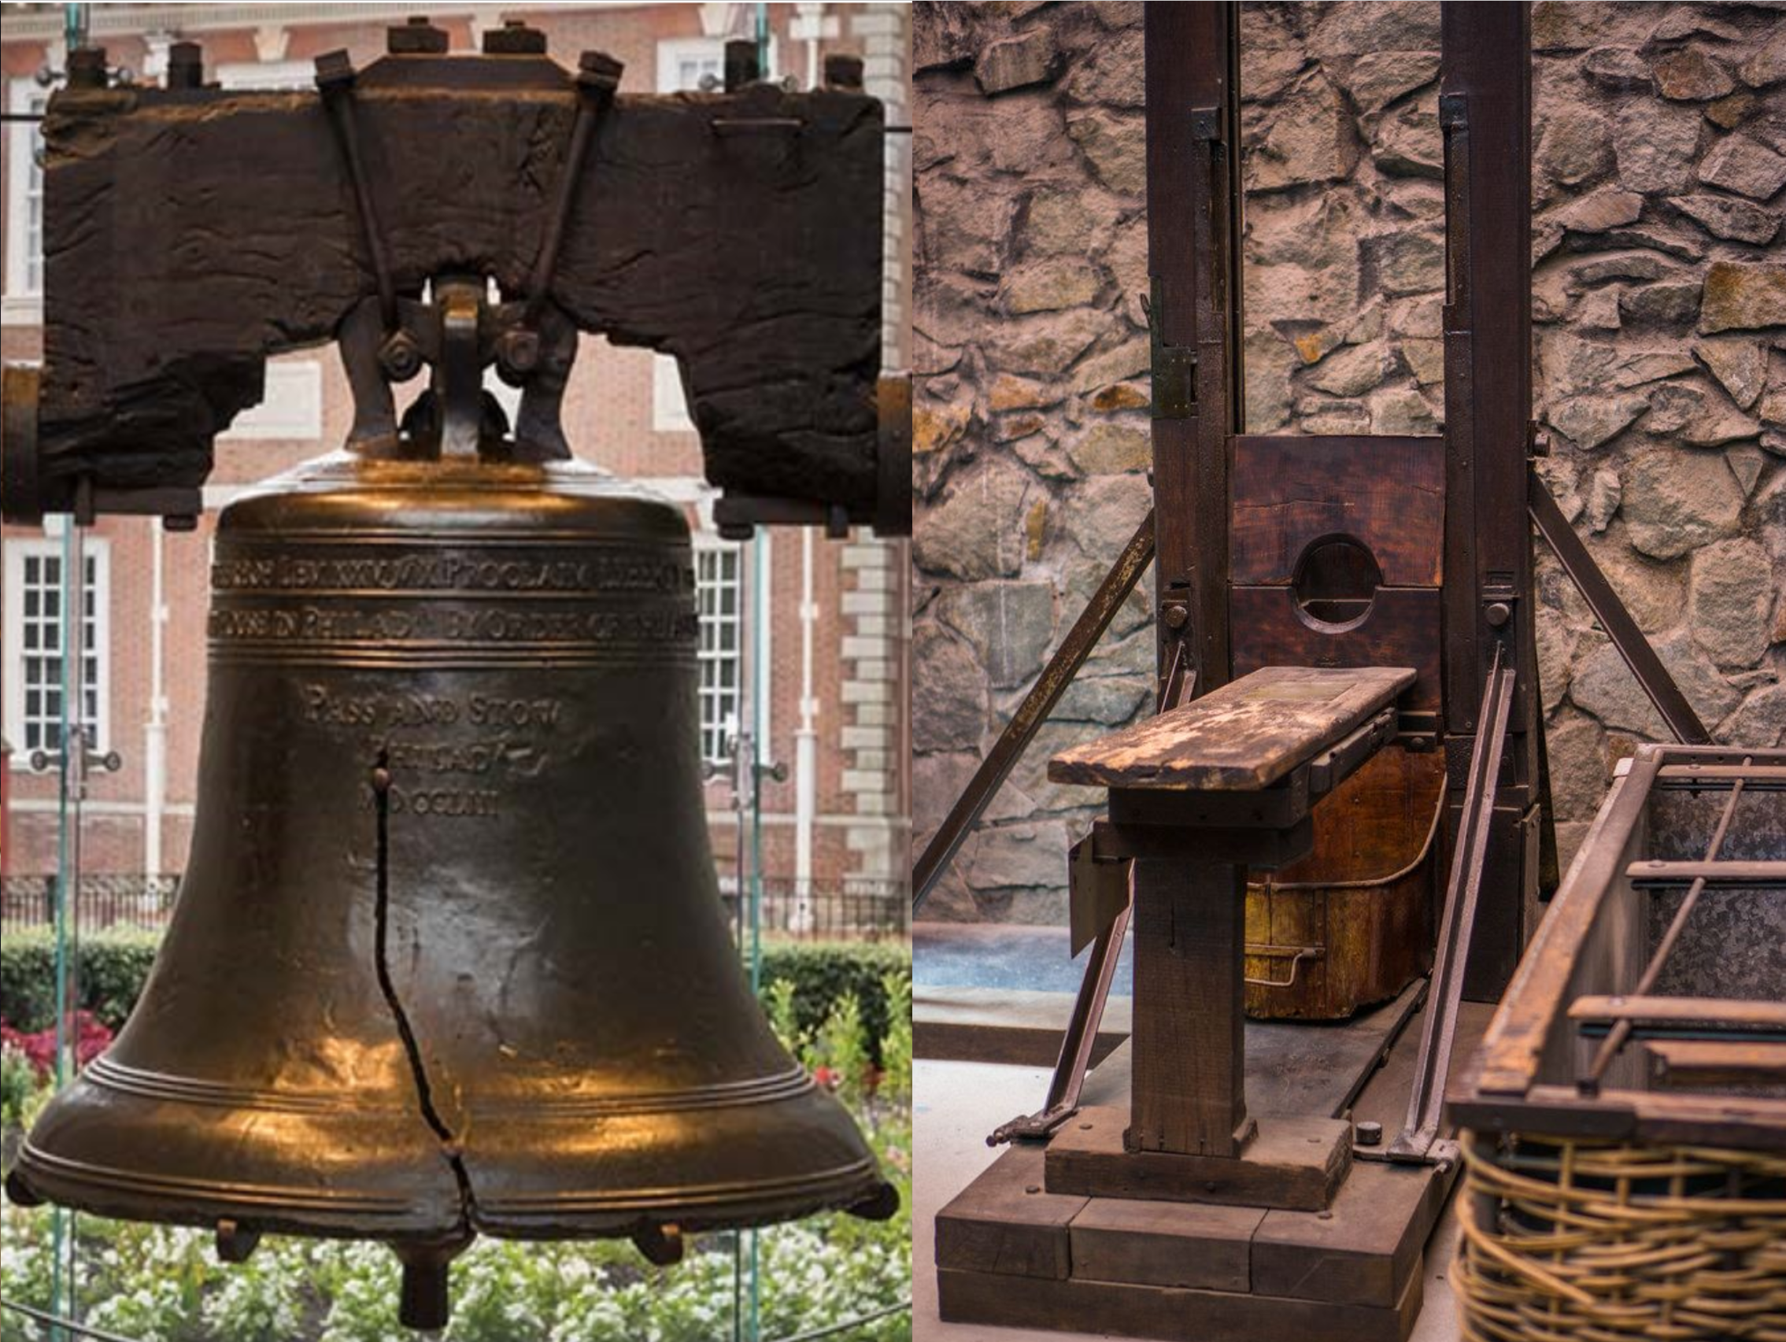
A Comparison of the American and French Revolutions
https://www.nps.gov/inde/planyourvisit/libertybellcenter.htm
https://www.pinterest.com/pin/661184789021236935/

Slide 3
American Versus French Revolution
Today we will be looking at the radical difference between the American and French revolutions, and will be doing so with the aid of Friedrich von Gentz (1764-1832), a German writer, thinker, publicist, and man of public affairs.
He wrote a short little booklet comparing the two revolutions, and it was published in 1800, the same year Jefferson was elected to the presidency.
The booklet was translated for the English-speaking world soon after publication and it provides us with a good glimpse of the early struggle to control the narrative of America’s founding.
Everyone knew that America was independent now, but what did that mean exactly?
https://dougwils.com/books-and-culture/s7-engaging-the-culture/the-american-and-french-revolutions-compared.html

Slide 4
American Versus French Revolution
Some saw it as the first in a series of inevitable revolutions, and so they naturally welcomed the French Revolution as the obvious next step.
Others (e.g. Edmund Burke, Friedrich Gentz, or John Quincy Adams), saw the revolutions as strikingly different, as different as night and day.
From the very beginning, we have had men like Patrick Henry, wanting America to take her place among the nations of Christendom.
And also from the very beginning, we have had men like Thomas Paine, who wanted something much more like the French Revolution.
https://dougwils.com/books-and-culture/s7-engaging-the-culture/the-american-and-french-revolutions-compared.html

Slide 5
American Versus French Revolution
The fighting that we now call the American War for Independence actually started in 1775, and independence was not openly declared until July of the next year.
The war lasted for 8 years, until 1783.
When the Treaty of Paris was signed, the new nation operated for six years under the Articles of Confederation, after which a consensus arose about the need for a more robust Constitution.
John Quincy Adams’ who wrote the preface to Gentz’s booklet, says there that Gentz did a fine job, because his booklet “rescues that revolution from the disgraceful imputation of having proceeded from the same principles as that of France” (p. 3).
He goes on to say that the revolutions of America and France were as different as “right and wrong” (p.4).
https://dougwils.com/books-and-culture/s7-engaging-the-culture/the-american-and-french-revolutions-compared.html

Slide 6
American Versus French Revolution
At the time of the American Revolution, the word revolution did not have the connotations it came to have after the French Revolution.
When we use the word revolutionary today, we mean some kind of radical.
At this time, the meaning of the word was closer to its cognate word revolve.
A revolution simply meant that there had been a change in the government, that things had “turned over.”
An example of this usage would be the Glorious Revolution of 1688 in England.
While the basic structures of English society remained what they had been, one king was removed and another one installed.
https://dougwils.com/books-and-culture/s7-engaging-the-culture/the-american-and-french-revolutions-compared.html

Slide 7
American Versus French Revolution
But starting with the French Revolution, a more sinister and radical meaning took root.
A revolution still means a turnover in the government, but now we have the extra connotations that guillotines bring to the situation.
When the American Revolution was first undertaken, revolution was a reasonable noun to use.
But now, in the aftermath of numerous other revolutions, almost all of them nasty, it would perhaps be better to use the alternative name for our war—which is the American War for Independence.
https://dougwils.com/books-and-culture/s7-engaging-the-culture/the-american-and-french-revolutions-compared.html

Slide 8
American Versus French Revolution
Edmund Burke, that great and insightful enemy of the wrong kind of revolution, the man who predicted the Reign of Terror before it happened in France, was an English parliamentarian statesman who took the side of the Americans.
When the Stamp Act was passed in 1765, the American reaction was hot.
But the problem was not the tax per se, but rather the constitutional authority to tax.
What would you do, as a resident of Arkansas, if one day you received a tax bill authorized by the legislature of Rhode Island?
https://dougwils.com/books-and-culture/s7-engaging-the-culture/the-american-and-french-revolutions-compared.html

Slide 9
American Versus French Revolution
Take a step further. Suppose the bill was only for five dollars, and your friends tried to quiet you down by pointing out that it was only five dollars.
You would hopefully point out that the amount was not the point. The point would be that Rhode Island had no lawful jurisdiction. That would be the point, right?
Parliament was the legislative body for England.
The colonies all had their own lawfully constituted legislatures. This is what was meant by the phrase “no taxation without representation.”
Because the colonists had no representatives in the Parliament (but did have representatives in their own legislatures), it was therefore completely out of line for Parliament to levy a tax on Virginians, Marylanders, or Pennsylvanians.
https://dougwils.com/books-and-culture/s7-engaging-the-culture/the-american-and-french-revolutions-compared.html

Slide 10
American Versus French Revolution
But how had Parliament come to think that it did have such a right?
The answer requires us to go back one more century.
In the previous century, the English Civil War had resulted in Charles I being executed in 1649. As a consequence, Oliver Cromwell ruled (not as king, but Lord Protector) during a period known as the Interregnum (1649–1660).
After Cromwell died, his son Richard did not demonstrate the competence of his father, and so Charles II was brought back to the throne in the Restoration (1660).
He ruled for a while, and when he died, he left no legitimate heir, which meant his brother, James II, took over.
https://dougwils.com/books-and-culture/s7-engaging-the-culture/the-american-and-french-revolutions-compared.html

Slide 11
American Versus French Revolution
Unfortunately, James was a Catholic with a bigoted streak.
He also mismanaged his rule rather badly, and so in 1688, he was evicted from the throne, and replaced by William and Mary.
Naturally enough, after 1688, Parliament assumed, with some justification, that the relationship between themselves and the monarch had been greatly altered.
And so it had been altered in England. But in the colonies, nothing had changed.
https://dougwils.com/books-and-culture/s7-engaging-the-culture/the-american-and-french-revolutions-compared.html

Slide 12
American Versus French Revolution
So the problem was that the colonies had all been planted, and their political constitutions fixed and established, prior to this turmoil in England.
They were across the ocean, quietly growing up into a significant power, both economic and political. And their constitutions had been settled under the old system.
Here is Gentz on this crucial detail:
  “Most of the colonies were founded before the middle of the seventeenth century; all before the revolution of 1688. The province of Georgia, the most southern of the colonies, and which was originally part of South Carolina, was the only one which received her separate constitution since the beginning of the century; (in 1732)” (pp. 37–38).
https://dougwils.com/books-and-culture/s7-engaging-the-culture/the-american-and-french-revolutions-compared.html

Slide 13
American Versus French Revolution
The settlements were varied. Maryland, for example, had been a grant to a private individual.
Others were royal provinces, which meant that the king was the immediate sovereign over them.
Yet others (Massachusetts and Connecticut, for example) had the authority of the king strictly limited in their charters.
According to their founding documents, they had various degrees of relationship to the king, but not one of them had any relationship to the Parliament whatever.
Each legislature had authority over its own laws, period, end, stop.
The Charter of Maryland, to take one example, said they had the right to “free, full and absolute Power . . . to ordain, Make, and Enact LAWS of what kind soever, according to their sound discretion.”
https://dougwils.com/books-and-culture/s7-engaging-the-culture/the-american-and-french-revolutions-compared.html

Slide 14
American Versus French Revolution
Now the colonists were Englishmen, and this meant they were under the English Constitution. And this meant, in turn, that the power to tax was resident in those legislatures where they, the colonists, were represented. And only there.
So with regard to their taxation, English Parliament was an alien body.
Gentz explains: “In no single colony, however its constitution in respect to its dependence upon the crown was organized, was there a trace of a constitutional and legal authority, vested in the British parliament” (p. 39).
After 1688, the authority of Parliament in England ascended. During that same period of time, the colonies were prospering.
https://dougwils.com/books-and-culture/s7-engaging-the-culture/the-american-and-french-revolutions-compared.html

Slide 15
American Versus French Revolution
The average standard of living for the average American grew past the standard of living of the average European by 1740.
America had become an economic force to be reckoned with very early on. Parliament had becoming a political force (over against the king) at the same time. Conflict was inevitable.
Parliament’s mistake was a natural one. Now that they were in charge of the king, why wouldn’t they also be in charge of anything the king had been in charge of? This included all those prosperous, fat, untaxed colonies “over there.”
But all the constitutional power shifts had been occurring in England, not in America.
https://dougwils.com/books-and-culture/s7-engaging-the-culture/the-american-and-french-revolutions-compared.html

Slide 16
American Versus French Revolution
This meant that when the Americans took their stand, it was on the basis of their rights as Englishmen.
This is why a conservative like Burke could support them. The Americans were in the right, constitutionally speaking.
Each colony had an executive head, which was the crown.
Each legislature was defined according to its respective charter.
Not one of those definitions had any room for Parliament.
Parliament was not listed anywhere on the flow chart.
https://dougwils.com/books-and-culture/s7-engaging-the-culture/the-american-and-french-revolutions-compared.html

Slide 17
American Versus French Revolution
This is why the Declaration of Independence is a series of complaints against the king.
They didn’t complain against Parliament because they had nothing to do with Parliament.
At the same time, the king had a constitutional responsibility to protect them from all such unconstitutional usurpations of Parliament.
Now this brings up another point that might seem to be an arcane bit of law, but it is really quite important.
https://dougwils.com/books-and-culture/s7-engaging-the-culture/the-american-and-french-revolutions-compared.html

Slide 18
American Versus French Revolution
In British feudalism, the king or lord owed his subjects or vassals protection.
In return, those subjects owed him allegiance. That was how feudalism worked.
In December of 1775, the British Parliament passed the Prohibitory Act, which stripped the colonies of the king’s protection, and determined that they were to be treated as foreign enemies.
The king did not step in to protect the colonies from this tyrannical force, and so, in the Declaration, the colonies declared themselves free of any allegiance to the king.
They did not have to declare themselves free of any allegiance to Parliament, for they had never had any.
https://dougwils.com/books-and-culture/s7-engaging-the-culture/the-american-and-french-revolutions-compared.html

Slide 19
American Versus French Revolution
Compare all this to what happened in France.
In terms of violent behavior, the American Revolution can’t hold a candle to the French Revolution.
The French Revolution was one of the most senseless bloodlettings ever to occur in the name of freedom.
From the time the revolutionaries stormed the Bastille until the rise of Napoleon, thousands in France were senselessly murdered, including France’s hapless king, Louis XVI and his wife, Marie Antoinette.
https://owlcation.com/humanities/american-revolution-french-revolution

Slide 20
American Versus French Revolution
There are many contrasts that can be made between these two revolutions.
The Americans were trying to preserve their traditions of representative government and self-imposed taxation
For the French, everything that had to do with the ancien régime was repugnant and had to be uprooted, even its religion.
The French Revolution was a conflict rooted in envy with desperate peasants whipped into a frenzy.
The Americans, in contrast, did not envy the British; they wanted to be left alone, to chart their own political destiny.
In contrast to the American symbol of liberty, the Liberty Bell, we have the French symbol of liberty, the guillotine.
https://owlcation.com/humanities/american-revolution-french-revolution

Slide 21
American Versus French Revolution
It is true that some of the intellectual currents that were very popular in France were present in America, but not nearly at the same level.
Thomas Paine was the kind of who could really move things in France, but he was pretty lonely in his radicalism over here.
So the revolutionary elements that made the French Revolution so appalling were present here, but those sparks here did not come in contact with the same kind of combustible material as they did over there – because those kinds of materials were largely absent here, thanks to the Great Awakening.
https://dougwils.com/books-and-culture/s7-engaging-the-culture/the-american-and-french-revolutions-compared.html

Slide 22
American Versus French Revolution
Now of course there were some responsible Americans, men like Thomas Jefferson, who were open to the French Revolution initially.
Remember that the French had come to our aid in our War. It was the French fleet that had bottled up Cornwallis at Yorktown.
And George Washington had been greatly helped by Lafayette, who later on became a participant in the French Revolution.
But with all that said and recognized, clear-headed Americans knew that what they had fought for was not at all like what the French Revolution was seeking to establish.
To run them together really is an historical slander, and it is to throw away one of the great achievements of the American founding—a righteous heritage.
https://dougwils.com/books-and-culture/s7-engaging-the-culture/the-american-and-french-revolutions-compared.html

Slide 23
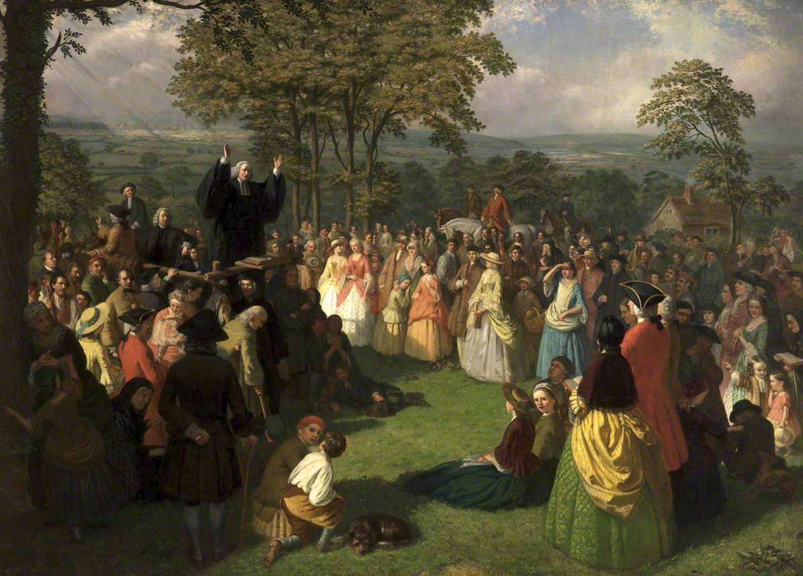
The First Great Awakening
https://allthingsliberty.com/2016/08/great-awakening-american-revolution/

Slide 24

Class Discussion Time
https://www.weareteachers.com/moving-beyond-classroom-discussions/

Slide 25
*Class Discussion Time
Is the American War for Independence a clear violation of Paul’s teaching in Romans 13:1-8? Explain your answer.
  Let every person be subject to the governing authorities. For there is no authority except from God, and those that exist have been instituted by God.
  ² Therefore whoever resists the authorities resists what God has appointed, and those who resist will incur judgment.
  ³ For rulers are not a terror to good conduct, but to bad. Would you have no fear of the one who is in authority? Then do what is good, and you will receive his approval,
  ⁴ for he is God's servant for your good. But if you do wrong, be afraid, for he does not bear the sword in vain. For he is the servant of God, an avenger who carries out God's wrath on the wrongdoer.
  ⁵ Therefore one must be in subjection, not only to avoid God's wrath but also for the sake of conscience.
  ⁶ For because of this you also pay taxes, for the authorities are ministers of God, attending to this very thing.
  ⁷ Pay to all what is owed to them: taxes to whom taxes are owed, revenue to whom revenue is owed, respect to whom respect is owed, honor to whom honor is owed.
  ⁸ Owe no one anything, except to love each other, for the one who loves another has fulfilled the law.
  (Rom 13:1-8 ESV)
Do you have a topic or question that you would like to see us to discuss?

