Slide 2
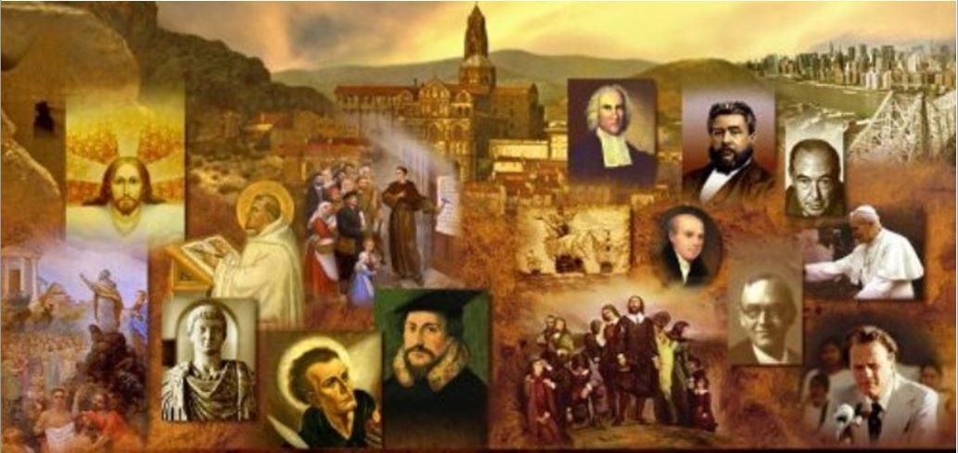
Review
What is the title or phrase that is generally used in referring to the Christian writers and teachers who lived in the first five or six centuries of Church history after the apostles?
The Early Church fathers
What is the title or phrase that is generally used in referring to the authors of the earliest Christian writings in the period in just after the death of the apostles (from about AD 95 to 140)?
The Apostolic Fathers
Why were they originally called the “apostolic fathers?”
Because the 17th century scholars who came up with the term believed that these early Christian writers all had direct personal contact with the apostles; most historians today think that only a few of them did.

Slide 3
Review
People often expect that the apostolic fathers have the best theology. What is the problem with that assumption?
Even if we assume that a given apostolic father really did “know” an apostle, we see many examples in the NT itself of individuals who “knew” the apostles, but were nonetheless guilty of erroneous beliefs and practices.
Just because someone says they knew an apostle doesn’t mean they really know and believe what that apostle believes.
What are the two questions we said last time that we always have to ask ourselves as we study and try to determine the accuracy of what people believed in early church history?
What do I know that they didn’t?
What did they know that I don’t know?

Slide 4
Review
Who wrote the letter that has come to be called the “Letter of Clement to the Corinthians”, or as it is sometimes called, “1 Clement”?
We don’t know for sure.
Eusebius and others believe that the “Clement” mentioned by the Apostle Paul in Philippians 4:3 wrote this letter while serving as an elder in the church of Rome.
But the name Clement does not appear anywhere in the letter.
The letter itself says it is from: “The Church of God which sojourns at Rome”.
It could be that Clement was one of a plurality of elders that existed in the church of Rome at that time, and had been given the task of writing this letter on behalf of the church.
What do the Roman Catholics claim about Clement?
That he was the fourth Pope!

Slide 5
Review
In your own words give a brief summary of the purpose and content of 1 Clement.
The letter was written to take issue with the Corinthian church for having recently removed their elders without having just cause to do so and replacing them with younger leaders.
The Roman church therefore entreated the Corinthians to restore their deposed leaders back into office.

Slide 6
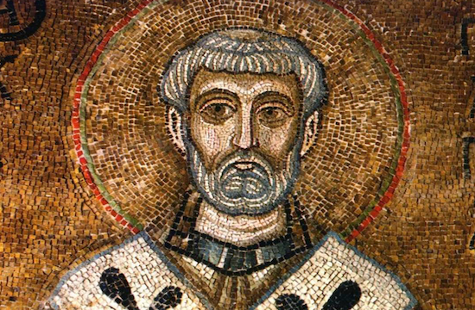
Clement of Rome Letter to the Corinthians
https://international.la-croix.com/news/possible-bone-fragment-of-st-clement-of-rome-gifted-to-westminster-abbey/7875#

Slide 7
*Some Excerpts from the Letter
Chapter 1
The Church of God which sojourns at Rome, to the Church of God sojourning at Corinth, to those who are called and sanctified by the will of God, through our Lord Jesus Christ: Grace to you, and peace, from Almighty God through Jesus Christ, be multiplied.
Owing, dear brethren, to the sudden and successive calamitous events which have happened to ourselves, we feel that we have been somewhat tardy in turning our attention to the points respecting which you consulted us;
and especially to that shameful and detestable sedition, utterly abhorrent to the elect of God, which a few rash and self-confident persons have kindled to such a pitch of frenzy, that your venerable and illustrious name, worthy to be universally loved, has suffered grievous injury.
*Roberts-Donaldson translation - 1867

Slide 8
*Some Excerpts from the Letter
Chapter 1 (continued)
For who ever dwelt even for a short time among you, and did not find your faith to be as fruitful of virtue as it was firmly established?
Who did not admire the sobriety and moderation of your godliness in Christ?
Who did not proclaim the magnificence of your habitual hospitality?
And who did not rejoice over your perfect and well-grounded knowledge?
*Roberts-Donaldson translation - 1867

Slide 9
*Some Excerpts from the Letter
Chapter 1 (continued)
For you did all things without respect of persons, and walked in the commandments of God, being obedient to those who had the rule over you, and giving all fitting honor to the presbyters among you.
You enjoined young men to be of a sober and serious mind… and you taught them that, living in the rule of obedience, they should manage their household affairs becomingly, and be in every respect marked by discretion.
*Roberts-Donaldson translation - 1867

Slide 10
*Some Excerpts from the Letter
Chapter 3
Every kind of honor and happiness was bestowed upon you, and then was fulfilled that which is written, “My beloved ate and drink, and was enlarged and became fat, and kicked.”
This is an allusion to Deut. 32:9-15. For the LORD's allotment is his people, Jacob is his special possession… He continually guarded him and taught him; he continually protected him like the pupil of his eye… He provided honey for him from the cliffs, and olive oil from the hardest of rocks, butter from the herd and milk from the flock, along with the fat of lambs, rams and goats of Bashan, along with the best of the kernels of wheat; and from the juice of grapes you drank wine. But Jeshurun [=Upright One] became fat and kicked, you got fat, thick, and stuffed! Then he deserted the God who made him, and treated the Rock who saved him with contempt. (NET)
Hence flowed emulation and envy, strife and sedition, persecution and disorder, war and captivity. So the worthless rose up against the honored, those of no reputation against such as were renowned, the foolish against the wise, the young against those advanced in years…
*Roberts-Donaldson translation - 1867

Slide 11
*Some Excerpts from the Letter
Chapter 42
The apostles have preached the Gospel to us from the Lord Jesus Christ… And thus preaching through countries and cities, they appointed the first-fruits [of their labors], having first proved them by the Spirit, to be bishops and deacons of those who should afterwards believe.
Compare this with :
And when [Paul and Barnabas] had appointed elders for them in every church, with prayer and fasting they committed them to the Lord in whom they had believed. (Acts 14:23)
Paul and Timothy, servants of Christ Jesus, To all the saints in Christ Jesus who are at Philippi, with the overseers and deacons (Philippians 1:1)
*Roberts-Donaldson translation - 1867

Slide 12
*Some Excerpts from the Letter
Chapter 44
Our apostles also knew, through our Lord Jesus Christ, and there would be strife on account of the office of the episcopate. For this reason, therefore, inasmuch as they had obtained a perfect fore-knowledge of this, they appointed those [ministers] already mentioned, and afterwards gave instructions, that when these should fall asleep, other approved men should succeed them in their ministry.
We are of opinion, therefore, that those appointed by them, or afterwards by other eminent men, with the consent of the whole Church, and who have blamelessly served the flock of Christ in a humble, peaceable, and disinterested spirit, and have for a long time possessed the good opinion of all, cannot be justly dismissed from the ministry.
*Roberts-Donaldson translation - 1867

Slide 13
*Some Excerpts from the Letter
Chapter 44 (continued)
For our sin will not be small, if we eject from the episcopate those who have blamelessly and holily fulfilled its duties.
Blessed are those presbyters who, having finished their course before now, have obtained a fruitful and perfect departure [from this world]; for they have no fear lest any one deprive them of the place now appointed them.
But we see that you have removed some men of excellent behavior from the ministry, which they fulfilled blamelessly and with honor.
*Roberts-Donaldson translation - 1867

Slide 14
*Some Excerpts from the Letter
Chapter 57
Ye therefore, who laid the foundation of this sedition, submit yourselves to the presbyters, and receive correction so as to repent, bending the knees of your hearts.
Learn to be subject, laying aside the proud and arrogant self-confidence of your tongue.
For it is better for you that you should occupy a humble but honorable place in the flock of Christ, than that, being highly exalted, you should be cast out from the hope of His people.
*Roberts-Donaldson translation - 1867

Slide 15
*Some Excerpts from the Letter
Chapter 59
Send back speedily to us in peace and with joy these our messengers to you: Claudius Ephebus and Valerius Bito, with Fortunatus: that they may the sooner announce to us the peace and harmony we so earnestly desire and long for [among you], and that we may the more quickly rejoice over the good order re-established among you.
The grace of our Lord Jesus Christ be with you, and with all everywhere that are the called of God through Him, by whom be to Him glory, honor, power, majesty, and eternal dominion, from everlasting to everlasting. Amen.
*Roberts-Donaldson translation - 1867

Slide 16
*1 Clement is Steeped in Both OT and NT Scripture
Chapter 4, alone, references:
Cain and Abel
Jacob and Esau
Joseph (being sold into bondage)
Moses and Pharaoh
Aaron and Miriam
Dathan and Abiram (cf. Numbers 16)
David and Saul
* Based on notes taken from James White’s 2016 Church History Series; Lesson 6 – Clement of Rome

Slide 17
*1 Clement is Steeped in Both OT and NT Scripture
There are a number of places where scripture is quoted extensively such as in Chapter 28 gives a very close paraphrase of Psalm 139:
For the Scripture says in a certain place, "Whither shall I go, and where shall I be hid from Your presence? If I ascend into heaven, You are there; if I go away even to the uttermost parts of the earth, there is Your right hand; if I make my bed in the abyss, there is Your Spirit." Whither, then, shall any one go, or where shall he escape from Him who comprehends all things?
* Based on notes taken from James White’s 2016 Church History Series; Lesson 6 – Clement of Rome

Slide 18
*1 Clement is Steeped in Both OT and NT Scripture
The letter makes many allusions to the teachings found in the book of Hebrews. For example, in Chapter 36 we see:
This is the way, beloved, in which we found our salvation, Jesus Christ, the high priest of our offerings, the protector and helper of our weakness. (Kenneth J. Howell translation – 2012)
Compare that with:
Therefore he had to be made like his brothers in every respect, so that he might become a merciful and faithful high priest in the service of God, to make propitiation for the sins of the people. (Heb. 2:17)
For we do not have a high priest who is unable to sympathize with our weaknesses, but one who in every respect has been tempted as we are, yet without sin. (Heb. 4:15)
He can deal gently with the ignorant and wayward, since he himself is beset with weakness. (Heb. 5:2)
* Based on notes taken from James White’s 2016 Church History Series; Lesson 6 – Clement of Rome

Slide 19
*1 Clement is Steeped in Both OT and NT Scripture
Just a very small sample of some of the other NT quotations or allusions:
Chapter 2 - giving gladly rather than receiving. (Acts 20:35)
Chapter 2 - ready for every good work. (Eph. 2:10)
Chapter 13 - let him who boasts boast in the Lord. (1 Cor. 1:31; 2 Cor. 10:17)
Chapter 30 - "God resists the proud but gives grace to the humble." (James 4:6; 1 Pet 5:5)
Chapter 35 - "For they that do such things are hateful to God; and not only they that do them, but also those who take pleasure in those who do them.“ (Rom. 1:32)
Chapter 46 - It would be better for him to have a millstone hung about him and to be plunged into the sea than to turn one of my elect away (Luke 17:2)
* Based on notes taken from James White’s 2016 Church History Series; Lesson 6 – Clement of Rome

Slide 20
*1 Clement Shows Rome Had a Sound Ecclesiology
As we have seen, the letter indicates that at this point in church history (AD 96), having a plurality of elders in every church was the norm.
As we have also seen, while a number of interchangeable terms are used to refer to elders (“bishops”, “ministers”, “members of the episcopate”, i.e. oversees), the early church at this point recognizes that Christ through his apostles established only two offices within his church: elders and deacons.
* Based on notes taken from James White’s 2016 Church History Series; Lesson 6 – Clement of Rome

Slide 21
*1 Clement Shows Rome Had a Sound Theology
There are indications of a belief in the trinity as demonstrated by the inclusion of Trinitarian formulas similar to those we see in many places in the NT:
Chapter 46 – Do we not have one God, one Christ, and one Spirit of grace poured out on us, and one calling in Christ? (Kenneth J. Howell translation – 2012)
Chapter 58 – Receive our counsel and you will regret nothing. For God lives and our Lord Jesus Christ lives and the Holy Spirit [lives], the faith and hope of the elect, because the one who has practiced the requirements and commands given by God in humility with an intense virtue will be in good order and enrolled among the number of the saved through Jesus Christ, through whom is glory to him [the Father] forever and ever. Amen. (Ibid.)
* Based on notes taken from James White’s 2016 Church History Series; Lesson 6 – Clement of Rome

Slide 22
*1 Clement Shows Rome Had a Sound Theology
There are numerous references to election and God’s sovereignty in salvation:
Chapter 29 – Let us then draw near to Him with holiness of spirit, lifting up pure and undefiled hands to Him, loving our gracious and merciful Father, who has made us partakers in the blessings of His elect. (Roberts-Donaldson)
Chapter 59 – And we will ask, with instancy of prayer and supplication, that the Creator of the universe may guard intact unto the end the number that hath been numbered of His elect throughout the whole world, through His beloved Son Jesus Christ, through whom He called us from darkness to light, from ignorance to the full knowledge of the glory of His Name. (Lightfoot)
* Based on notes taken from James White’s 2016 Church History Series; Lesson 6 – Clement of Rome

Slide 23
*1 Clement Shows Rome Had a Sound Theology
The letter contains a crystal clear reference to the doctrine if the justification by faith alone:
Chapter 32 – And we, too, being called by His will in Christ Jesus, are not justified by ourselves, nor by our own wisdom, or understanding, or godliness, or works which we have wrought in holiness of heart; but by that faith through which, from the beginning, Almighty God has justified all men; to whom be glory for ever and ever. Amen.(Roberts-Donaldson)
This is particularly ironic since the Roman Catholics believe that the author of this letter written from the Church at Rome is the fourth pope and yet here we see within it a teaching that was anathematized by the Church at Rome some 1400 years later at the Council of Trent!
* Based on notes taken from James White’s 2016 Church History Series; Lesson 6 – Clement of Rome

Slide 24
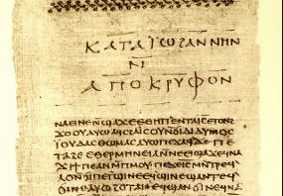
The Didache
https://mymorningmeditations.files.wordpress.com/2013/11/didache_nag_hammadi_codex_ii.jpg

