Slide 2
The Second Great Awakening
Charles Finney Preaching in Rochester New York, 1830
https://vimeo.com/349525075

Slide 3
Introduction
The Second Great Awakening was a Protestant revival movement during the early nineteenth century.
The movement began around 1790 and gained momentum by 1800.
After 1820, membership rose rapidly among Baptist and Methodist congregations, whose preachers led the movement.
The Second Great Awakening began to decline by 1870. It enrolled millions of new members and led to the formation of new denominations.
https://courses.lumenlearning.com/boundless-ushistory/chapter/the-second-great-awakening/

Slide 4
Introduction
Many leaders of the Second Great Awakening held to an Arminian theology, who believed that every person could be saved through revivals, repentance, and conversion.
Revivals were mass religious meetings featuring emotional preaching by evangelists such as the eccentric Lorenzo Dow.
The Second Great Awakening stimulated the establishment of many social reform movements by which many Christians of that era hoped to remedy the evils of society before the Second Coming of Jesus Christ.
https://courses.lumenlearning.com/boundless-ushistory/chapter/the-second-great-awakening/

Slide 5
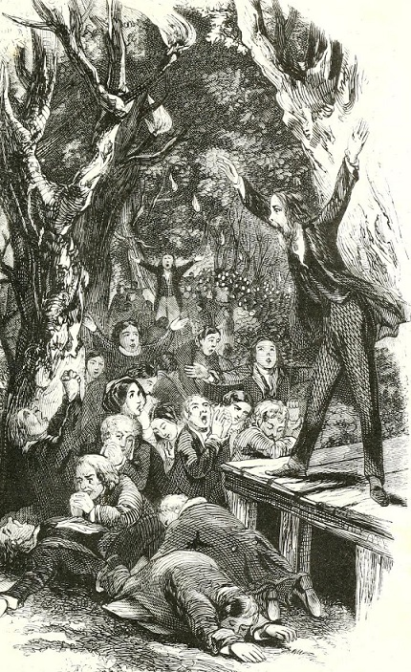
Lorenzo Dow
Said to have preached to more people than any other preacher of his era.
Took what he believed to be a divine call and crossed the Atlantic Ocean to preach as a missionary to the Catholics of Ireland.
Preached in the Albany region of New York, against atheism, deism, Calvinism and Universalism.
He did not practice personal hygiene and his long hair and beard were described as “never having met a comb.” He usually owned one set of clothes: those that were on his back.
Throughout most of his life, what little money he ever collected was either given away to the poor or used to purchase Bibles.
https://www.wikiwand.com/en/Lorenzo_Dow

Slide 6
Revivals on the Frontier
In the newly settled frontier regions, the revivals of the Second Great Awakening took the form of camp meetings.
These meetings were often the first experience settlers had with organized religion.
The camp meeting was a religious service of several days’ length involving multiple preachers.
Settlers in thinly populated areas would gather at the camp meeting for fellowship.
The sheer exhilaration of participating in a religious revival, with crowds of hundreds and perhaps thousands of people, inspired the dancing, shouting, and singing associated with these events.
https://courses.lumenlearning.com/boundless-ushistory/chapter/the-second-great-awakening/

Slide 7
Revivals on the Frontier
The revivals typically involved a great display of emotion and emphasized the individual’s sins and need to turn to Christ, and subsequent personal salvation.
Upon their return home, most converts joined or created small local churches, which resulted in rapid growth for small religious institutions.
With the effort of such leaders as Barton W. Stone (1772–1844) and Alexander Campbell (1788–1866), the camp meeting revival became a major mode of church expansion for denominations such as the Methodists and Baptists.
https://courses.lumenlearning.com/boundless-ushistory/chapter/the-second-great-awakening/

Slide 8
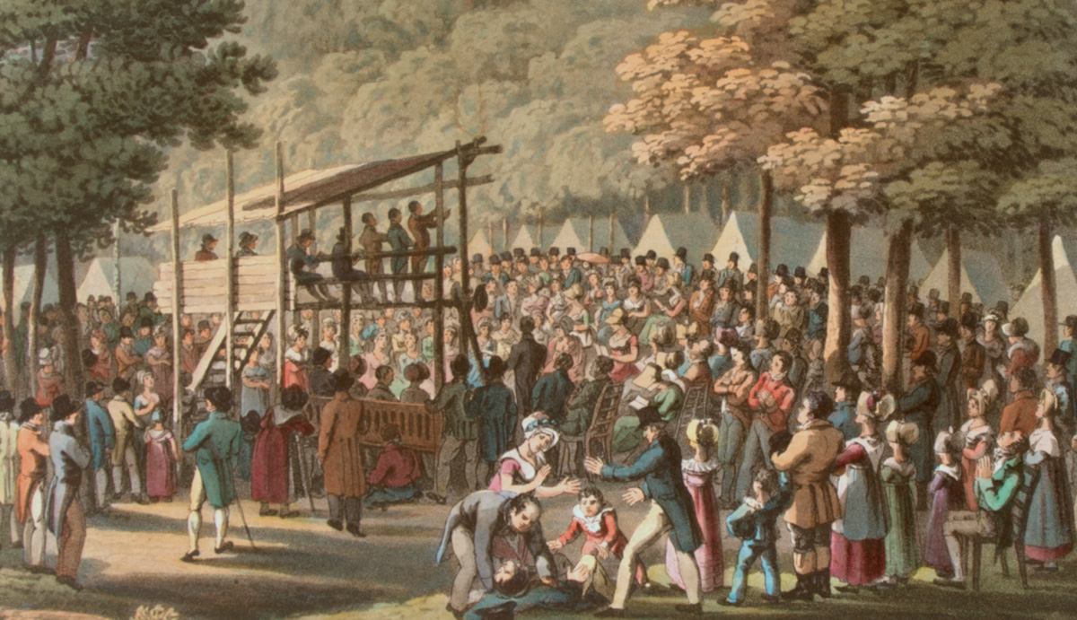
Camp Meeting
https://imagejournal.org/2017/11/10/poetry-friday-camp-meeting/

Slide 9
Social Reform
Social reform prior to the Civil War came largely out of this new devotion to religion during the Second Great Awakening.
Efforts to apply Christian teaching to the resolution of social problems was a forerunner to the social gospel of the late nineteenth century.
Converts were taught that to achieve salvation, they needed not only to repent for personal sin but also work for the moral perfection of society, which meant eradicating sin in all its forms.
Thus, evangelical converts were leading figures in a variety of nineteenth-century reform movements.
https://courses.lumenlearning.com/boundless-ushistory/chapter/the-second-great-awakening/

Slide 10
Social Reform
Reforms took the shape of social movements for temperance, women’s rights, and the abolition of slavery.
Social activists began efforts to reform prisons and care for the handicapped and mentally ill.
They believed in the perfectibility of people and were highly moralistic in their endeavors.
Many participants in the revival meetings believed that reform was a part of God’s plan.
As a result, local churches saw their role in society as purifying the world through the individuals to whom they could bring salvation, as well as through changes in the law and the creation of institutions.
https://courses.lumenlearning.com/boundless-ushistory/chapter/the-second-great-awakening/

Slide 11
Social Reform
The burst of religious enthusiasm for social reform owed much to the uniqueness of the early decades of the republic.
These years saw swift population growth, broad western expansion, and the rise of participatory democracy.
These political and social changes made many people anxious, and the more egalitarian, emotional, and individualistic religious practices of the Second Great Awakening provided relief and comfort for Americans experiencing rapid change.
https://courses.lumenlearning.com/boundless-ushistory/chapter/the-second-great-awakening/

Slide 12
Social Reform
Another factor driving the social reform that grew out of the Second Great Awakening was the Postmillennialist theology that dominated American Protestantism in the first half of the 19th century.
Postmillennialists believe that Christ will return to earth after the “Millennium”, which could entail either a literal 1,000 years or a figurative "long period" of peace and happiness.
Therefore, according to this perspective, Christians have a duty to purify society in preparation for that return.
Interest in transforming the world was applied to political action, as temperance activists, antislavery advocates, and proponents of other variations of reform sought to implement their beliefs into national politics.
https://www.wikiwand.com/en/Second_Great_Awakening

Slide 13
The Influence of Charles Finney
Following the second Great Awakening the professional revivalist immerged as an agent for the perpetuation of revival blessings.
Many of these revivalists used the new methods of evangelism developed by the leading revivalist of this period, Charles Finney.
Converted in 1821, Finney ministered extensively in the North-East from 1824 to 1835 as a Presbyterian missionary, moving from place to place holding intensive evangelistic “campaigns”.
He worked on the basis that revival was something for which churches could pray and prepare, and for which they did not need to wait passively.
Tim Grass. SCM Core Text: Modern Church History

Slide 14
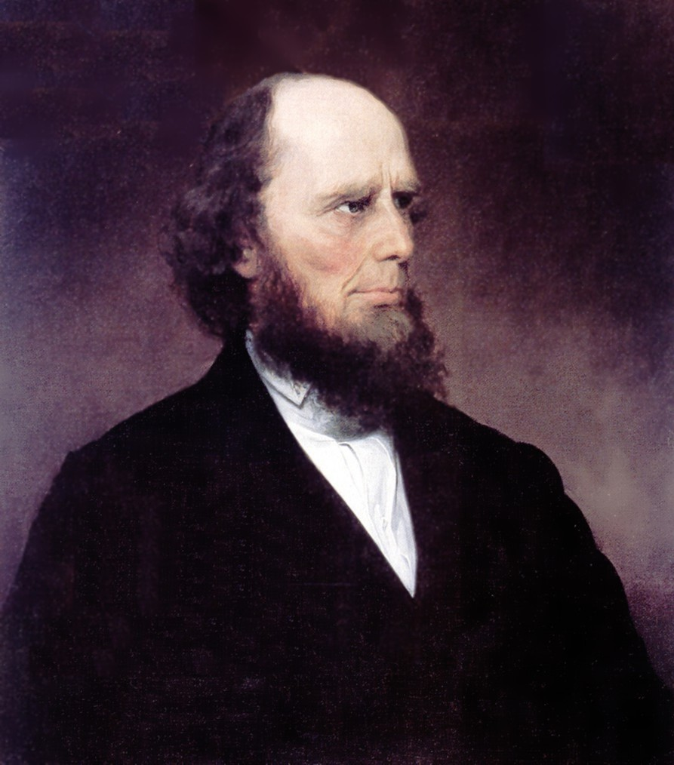
Charles Finney
https://www.wikiwand.com/en/Charles_Grandison_Finney

Slide 15
The Influence of Charles Finney
Finney departed from traditional Calvinist theology by teaching that people have free will to choose salvation.
He argued that original sin was a “selfishness” that people can overcome if they made themselves a “new heart.”
He taught that “Sin and holiness are voluntary acts of mind.”
He believed that preachers had important roles in producing revival and wrote in 1835, “A revival is not a miracle, or dependent on a miracle, in any sense. It is a purely philosophical result of the right use of the constituted means.”
https://www.wikiwand.com/en/Charles_Grandison_Finney

Slide 16
The Influence of Charles Finney
Finney’s methods became known as the “New Measures”, and included
Daily meetings over a sustained period
Large choirs
Preaching which called for an immediate response
“Altar calls” for those wishing to respond to go to the “Anxious bench” at the front of the congregation
The deployment of counsellors to assist those responding
Prayer meetings in which sinners were prayed for by name
None of these were necessarily new in themselves, but their combination as a systematic evangelistic methodology was.
Tim Grass. SCM Core Text: Modern Church History

Slide 17
The Influence of Charles Finney
From the late 1830s Finney’s approach became influential in Britain and Ireland as well as in North America, and its legacy was carried on in the work of Billy Graham and other practitioners of “mass evangelism”.
Baptists and Presbyterians tended to make greatest use of the “New Measures” – series of revivalist meetings became annual features of the life of many congregations.
Methodists, however, persisted with the camp meeting format, although it became institutionalized in the form of permanent camp grounds where believers could go each summer for such gatherings.
A few continue today in Holiness and Fundamentalist circles.
Tim Grass. SCM Core Text: Modern Church History

Slide 18
The Influence of Charles Finney
Not all approved of these developments.
Conservative Calvinists such as Nettleton challenged the view of human freedom to respond underlying Finney’s approach (in this, they had the tradition of Whitefield and Edwards behind them).
Unitarians and others of a liberal outlook despised what they saw as the irrationalism and enthusiasm of religion, often failing to distinguish between its various forms.
Tim Grass. SCM Core Text: Modern Church History

Slide 19
Women and the Second Great Awakening
Women made up the majority of the converts during the Second Great Awakening and therefore played a crucial role in its development and focus.
It is not clear why women converted in larger numbers than men.
Some women, especially in the South, encountered opposition to their conversion from their husbands and had to choose between submission to God or to the head of the household.
While there is no single reason women joined the revival movement, the revival provided many women with shared experiences.
Church membership and religious activity gave women peer support and a place for meaningful activity outside of the home.
https://courses.lumenlearning.com/boundless-ushistory/chapter/the-second-great-awakening/

Slide 20
Women and the Second Great Awakening
While they constituted the majority of converts and participants, women were not formally indoctrinated and did not hold leading ministerial positions.
They did occasionally take on public roles during revivals.
They preached or prayed aloud on rare occasions, but they were more likely to give testimonials of their conversion experience or work through the conversion process directly with sinners (who could be male or female).
Women’s prayer was seen by leaders such as Charles Finney as a crucial aspect in preparing a community for revival and improving the revival’s efficacy.
https://courses.lumenlearning.com/boundless-ushistory/chapter/the-second-great-awakening/

Slide 21
Women and the Second Great Awakening
Though they typically held no formal leadership roles, women became very important informally in the process of conversion and in the religious upbringing of their children through family structure and through their maternal roles.
During the period of the revivals, mothers—who were seen as the moral and spiritual foundation of the family—used their teaching and influence to pass religion to their children.
The rising number of women congregants influenced the doctrine preached by ministers as well.
In an effort to give sermons that would resonate with the congregation, ministers stressed Christ's humility and forgiveness, in what the historian Barbara Welter calls a "feminization" of Christianity.
https://courses.lumenlearning.com/boundless-ushistory/chapter/the-second-great-awakening/

Slide 22
Mormonism
https://washingtonmonthly.com/magazine/november-december-2019/was-i-too-hard-on-the-mormons-nope/

Slide 23
Class Discussion Time
https://www.weareteachers.com/moving-beyond-classroom-discussions/

Slide 24
*Class Discussion Time
What do you see as some of the positive results of the Second Great Awakening? What do you see as the negative results?
What do you make of a character like Lorenzo Dow? Do you think he was truly called of God? Or was he just a nut case?
What do you think of Finney’s approach to revivals? In particular what do you think of his idea that “A revival is not a miracle, or dependent on a miracle, in any sense. It is a purely philosophical result of the right use of the constituted means”? Is there any truth to this statement?
What do you think of his idea of having a “alter call” at the end of a revival service where people come forward to an “Anxious bench” at the front of the congregation where counsellors come to pray with them?
What are your thoughts on some of the social movements that grew out of the Second Great Awakening?
Do you have a topic or question that you would like to see us to discuss?

