Slide 1


Slide 2
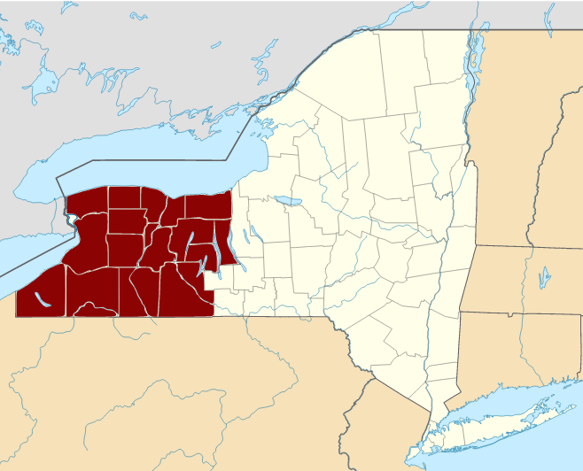
“Burned Over” District in New York
https://courses.lumenlearning.com/boundless-ushistory/chapter/the-second-great-awakening/

Slide 3
“Burned Over” District in New York
Some of the more offbeat nonconformist sects from this area included:
  The Fox sisters of Hydesville, New York, conducted the first table-rapping séances in the area around 1848, leading to the American movement of Spiritualism which taught communion with the dead.
  The Shakers were very active in the area, establishing their communal farm in central New York in 1826, and a major revival in 1837.
  The Oneida Society was a large utopian group that established a successful community in central New York, founded in 1848.
https://www.wikiwand.com/en/Burned-over_district

Slide 4
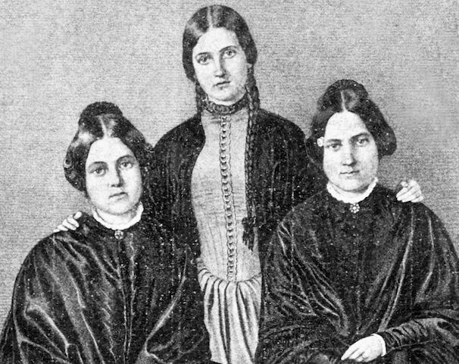
The Fox Sisters and Spiritism
https://www.atlasobscura.com/places/the-fox-sisters-rochester-new-york

Slide 5
The Fox Sisters and Spiritism
Spiritualism, the belief that the living can talk with the dead, became an American phenomenon in the mid-19th century. At the forefront of this phenomenon were the Fox sisters.
There were three Fox sisters, Kate, Leah, and Margaret, and they were raised in Hydesville, New York (20 miles from Rochester, but the town is no longer in existence) in a house that the sisters claimed was haunted by a spirit.
They claimed to communicate with this spirit by asking it questions which it would answer with rappings, or knockings.
Through these “rappings,” they claimed to “discover” that this spirit was a peddler named Charles Rossum who had been murdered five years before and was now buried in the cellar.
https://www.atlasobscura.com/places/the-fox-sisters-rochester-new-york

Slide 6
The Fox Sisters and Spiritism
Neighbors and family members were astonished! Could these girls really talk to spirits? They went into the cellar to see if these young girls were telling the truth and, lo and behold, they found bones in the walls.
Despite this “evidence,” persistent rumors exist that these bones had been, in fact, planted.
With their newfound fame, the Fox sisters moved to the big city – Rochester, New York – to begin their new careers as mediums.
They routinely put on seances attended by some of the biggest names of the day, like poet William Cullen Bryant, showman PT Barnum, and newspaper editor Horace Greeley.
https://www.atlasobscura.com/places/the-fox-sisters-rochester-new-york

Slide 7
The Fox Sisters and Spiritism
The Fox Sisters’ ability to communicate with the dead was eventually shown to be a hoax.
A table the Fox sisters used for their seances is now located at the Rochester Historical Society.
Much as they did when they were girls, the Fox sisters relied on mysterious “rappings” as proof that spirits were present.
A close examination of this table shows that it was specifically made to produce these rappings.
Within the enclosed top of the table lies a spring connected to a long metal rod. When pushed, the rod hits the inside of the table creating the rapping sound.
The sisters were also known to create unusual sounds by cracking their feet and knuckles, which they used as further “evidence” that the dead were present.
https://www.atlasobscura.com/places/the-fox-sisters-rochester-new-york

Slide 8
The Fox Sisters and Spiritism
The Fox Sisters continued to perform seances and other matters of spirit communication until the late 1800s when skeptics and nonbelievers forced them to admit it was all a fraud.
Chief among these skeptics was the magician Harry Houdini, who took it personally that these sisters were defrauding vulnerable people.
With their livelihood ruined, the Fox sisters faded into alcoholism and obscurity.
By the turn of the century, all of the sisters had died in poverty and shame.
https://www.atlasobscura.com/places/the-fox-sisters-rochester-new-york

Slide 9
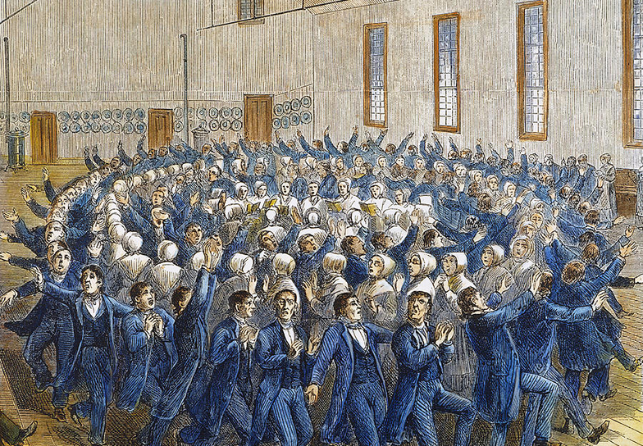
The Shakers
A Shaker congregation worshiping in a highly synchronised dance and prayer routine
https://academytravel.com.au/blog/on-the-trail-of-the-shakers-in-new-england/

Slide 10
The Shakers
Another interesting movement was that of the Shakers, led by Ann Lee Stanley—Mother Ann Lee. ¹
Mother Ann Lee claimed that she was the Second Coming of Christ who had now appeared in feminine form as he had appeared earlier in masculine form. ¹
Shaker theology is based on the idea of the dualism of God as male and female: “So God created man in his own image, in the image of God he created him; male and female he created them.” (Genesis 1:27). This passage was interpreted as showing the dual nature of the Creator. ²
Shaker religion valued women and men equally in religious leadership. The church was hierarchical, and at each level women and men shared authority. ²
¹ González, Justo L. . The Story of Christianity: Volume 2: The Reformation to the Present Day
² https://www.wikiwand.com/en/Shakers

Slide 11
The Shakers
Adam's sin was understood to be sex, which was considered to be an act of impurity.
Therefore, marriage was done away within the body of the Believers in the Second Appearance (another name for the Shakers), which they claim was patterned after the Kingdom of God, in which there would be “no marriage or giving in marriage”.
Shakers were celibate; procreation was forbidden after they joined the society (except for women who were already pregnant at admission).
Children were added to their communities through indenture, adoption, or conversion.
When Shaker youngsters, girls and boys, reached the age of 21, they were free to leave or to remain with the Shakers.
https://www.wikiwand.com/en/Shakers

Slide 12
The Shakers
As pacifists, the Shakers did not believe that it was acceptable to kill or harm others, even in time of war.
Shakers tended to sympathize with the Union but they did feed and care for both Union and Confederate soldiers.
President Lincoln exempted Shaker males from military service, and they became some of the first conscientious objectors in American history.
The Shakers' dedication to hard work and perfection has resulted in a unique range of architecture, furniture and handicraft styles.
They designed their furniture with care, believing that making something well was in itself, "an act of prayer".
https://www.wikiwand.com/en/Shakers

Slide 13
The Shakers
One of the characteristics of Shaker worship was the important role played by dance.
For a few decades, the movement flourished, and several Shaker communities were founded.
As experiments in communal living, they were quite successful, for conditions in Shaker communities were usually better than in neighboring areas.
But eventually the movement dwindled, lacking in both converts and in new generations and today there are only a few surviving members.
González, Justo L. . The Story of Christianity: Volume 2: The Reformation to the Present Day (p. 326).

Slide 14
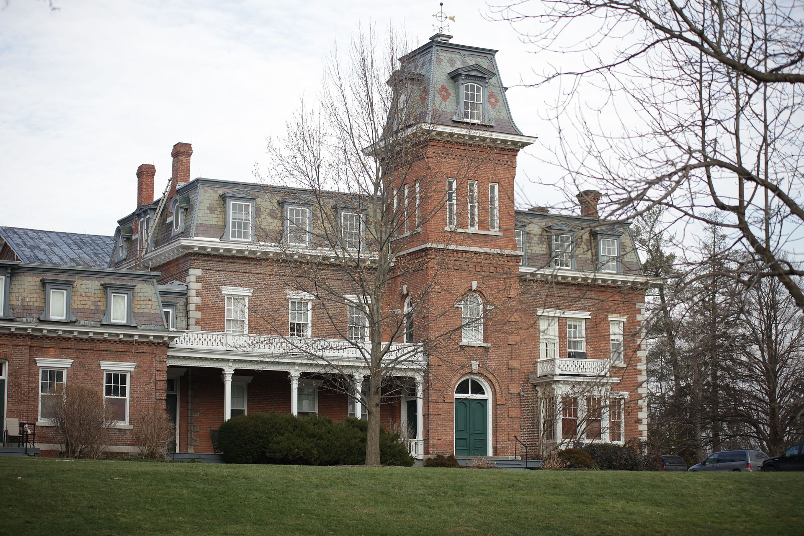
The Oneida Community
The South Wing of the Oneida Community Mansion House
https://www.wikiwand.com/en/Oneida_Community_Mansion_House

Slide 15
The Oneida Community
The Oneida Community was a perfectionist religious communal society founded by John Humphrey Noyes and his followers in 1848 near Oneida, New York.¹
Noyes was a deeply religious graduate of Dartmouth College, who was inspired by the teachings of Charles Finney and the Shaker Society. ²
The Oneida Community believed that Jesus had already returned in AD 70, making it possible for them to bring about Jesus's millennial kingdom themselves, and be perfect and free of sin in this world, not just in Heaven (a belief known as perfectionism). ¹
The Oneida Community practiced communalism (in the sense of communal property and possessions), complex marriage, male sexual continence, and mutual criticism.¹
¹ https://www.wikiwand.com/en/Oneida_Community
² http://www.cloverleaflocal.org/Downloads/The%20Oneida%20Community.pptx

Slide 16
The Oneida Community
“Complex Marriage” was a system in which all the members of a community are married to every other member of the community.
Noyes believed that marriage was stopping people from reaching perfection, and he preached that it did not exist in heaven, so it was unnecessary on earth.
Noyes’ main goal was to create an equal society for women:
  Women would be free from being the property of their husbands
  Limited childbirth by encouraging coitus interruptus
  Children that were born were placed in community nurseries to lessen the burden of or raising children and give women more opportunity.
  Women began to wear pantaloons under their dresses and cut their hair short to symbolize their equality with men.
http://www.cloverleaflocal.org/Downloads/The%20Oneida%20Community.pptx

Slide 17
The Oneida Community
Every member of the community was subject to criticism by committee or the community as a whole, during a general meeting.
The goal was to eliminate undesirable character traits.
The community lasted until John Humphrey Noyes attempted to pass leadership to his son, Theodore Noyes.
This move was unsuccessful because Theodore was an agnostic and lacked his father's talent for leadership.
After the Noyes’ departure, the community abandoned complex marriage.
A number of years later, they created their own silverware company, Oneida Community, Ltd. The joint-stock corporation still exists and is a major producer of cutlery under the brand name “Oneida Limited”. https://www.oneida.com/
https://www.wikiwand.com/en/Oneida_Community

Slide 18
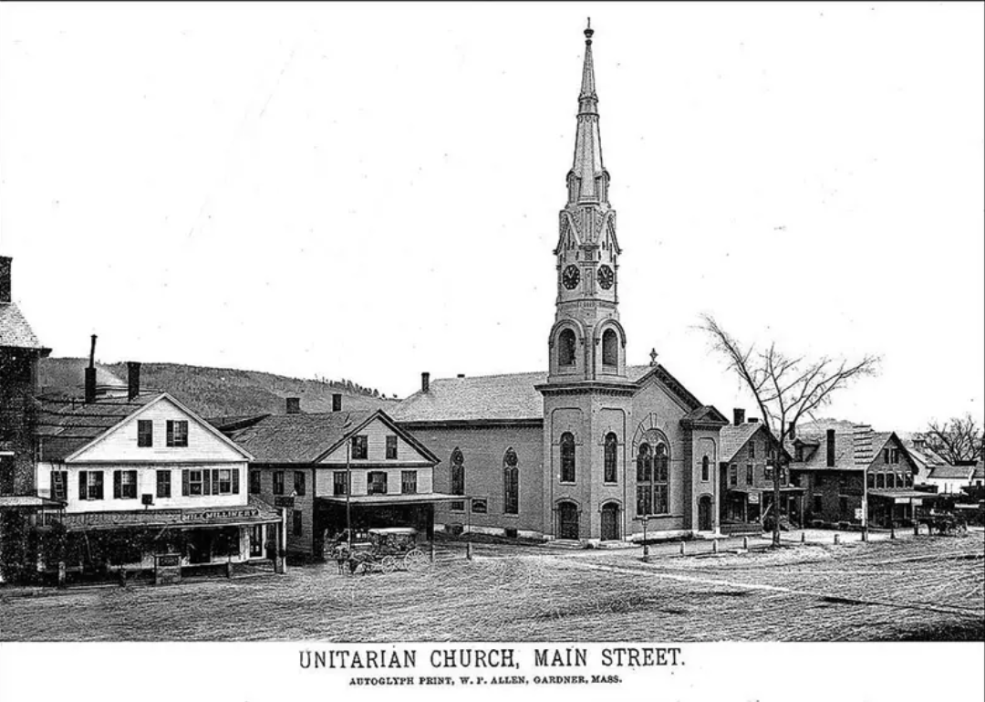
Unitarianism
https://www.christianity.com/church/denominations/what-is-unitarianism-discover-the-history-and-beliefs-of-the-unitarian-church.html

Slide 19
Unitarianism
Unitarianism is a Christian theological movement named for its understanding of God as one person (in direct contrast to Trinitarianism, which defines God as three persons coexisting as one in being).
Thus, Unitarians adhere to strict monotheism, maintaining that Jesus was a great man and a prophet of God but not God himself.
Unitarianism began in Poland and Transylvania in the late sixteenth century and had reached England by the mid-seventeenth century.
As early as the middle of the eighteenth century, a number of clergymen in New England preached what was essentially Unitarianism.
https://courses.lumenlearning.com/boundless-ushistory/chapter/the-second-great-awakening/

Slide 20
Unitarianism
From 1725 to 1825, Unitarianism gained ground in New England and other areas.
The first official acceptance of the Unitarian faith on the part of a congregation was by King’s Chapel in Boston, which revised the prayer book into a mild Unitarian liturgy in 1785.
At the beginning of the nineteenth century, with one exception, all of the churches of Boston were occupied by Unitarian preachers, and various periodicals and organizations expressed Unitarian opinions.
Churches were established in New York, Baltimore, Washington, Charleston, and elsewhere during this period.
https://courses.lumenlearning.com/boundless-ushistory/chapter/the-second-great-awakening/

Slide 21
Unitarianism
Unitarian Henry Ware was appointed as the Hollis professor of divinity at Harvard College in 1805, and Harvard Divinity school then shifted from its conservative roots to teach Unitarian theology.
The period of American Unitarianism from about 1800 to 1835 can be thought of as formative, mainly influenced by English philosophy, semi-supernatural, imperfectly rationalistic, and devoted to philanthropy and “practical” Christianity.
The association published books, supported poor churches, sent out missionaries, and established new churches in nearly every state.
https://courses.lumenlearning.com/boundless-ushistory/chapter/the-second-great-awakening/

Slide 22
Unitarianism
Although there is no specific authority on convictions of Unitarian belief aside from rejection of the Trinity, the following beliefs are generally accepted:
  One God and the oneness or unity of God.
  The life and teachings of Jesus Christ constitute the exemplar model for living one's own life.
  Reason, rational thought, science, and philosophy coexist with faith in God.
  Humans have the ability to exercise free will in a responsible, constructive and ethical manner with the assistance of religion.
  Human nature in its present condition is neither inherently corrupt nor depraved but capable of both good and evil, as God intended.
  No religion can claim an absolute monopoly on the Holy Spirit or theological truth.
  Though the authors of the Bible were inspired by God, they were humans and therefore subject to human error.
  The traditional doctrines of predestination, eternal damnation, and the vicarious sacrifice and satisfaction theories of the Atonement are invalid because they malign God's character and veil the true nature and mission of Jesus Christ.
https://courses.lumenlearning.com/boundless-ushistory/chapter/the-second-great-awakening/

Slide 23
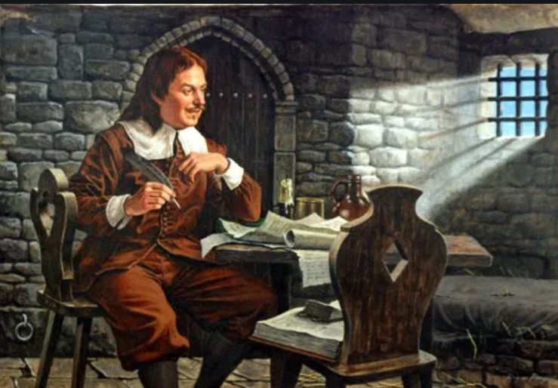
John Bunyan
https://www.pastorjack.org/?tag=john-bunyan-trial

Slide 24

Class Discussion Time
https://www.weareteachers.com/moving-beyond-classroom-discussions/

Slide 25
*Class Discussion Time
Why do you think that people who are otherwise rational and sensible people fall for a hoax like that perpetrated by the Fox sisters?
The Shakers argued that because Genesis says that man was made in God’s image as male and female that God must have both a masculine and feminine side. What’s wrong with this understanding of Genesis 1:27?
Both the Shakers and the Oneida Society believed that man and women should no longer be married because in the kingdom men neither marry nor are given in marriage, but are like angels in heaven. (Mat 22:30) What is wrong with this interpretation of Jesus’ teaching?
Do you have a topic or question that you would like to see us to discuss?

