Slide 2
John Bunyan
PILGRIM WHO MADE PROGRESS IN PRISON
https://www.pastorjack.org/?tag=john-bunyan-trial

Slide 3
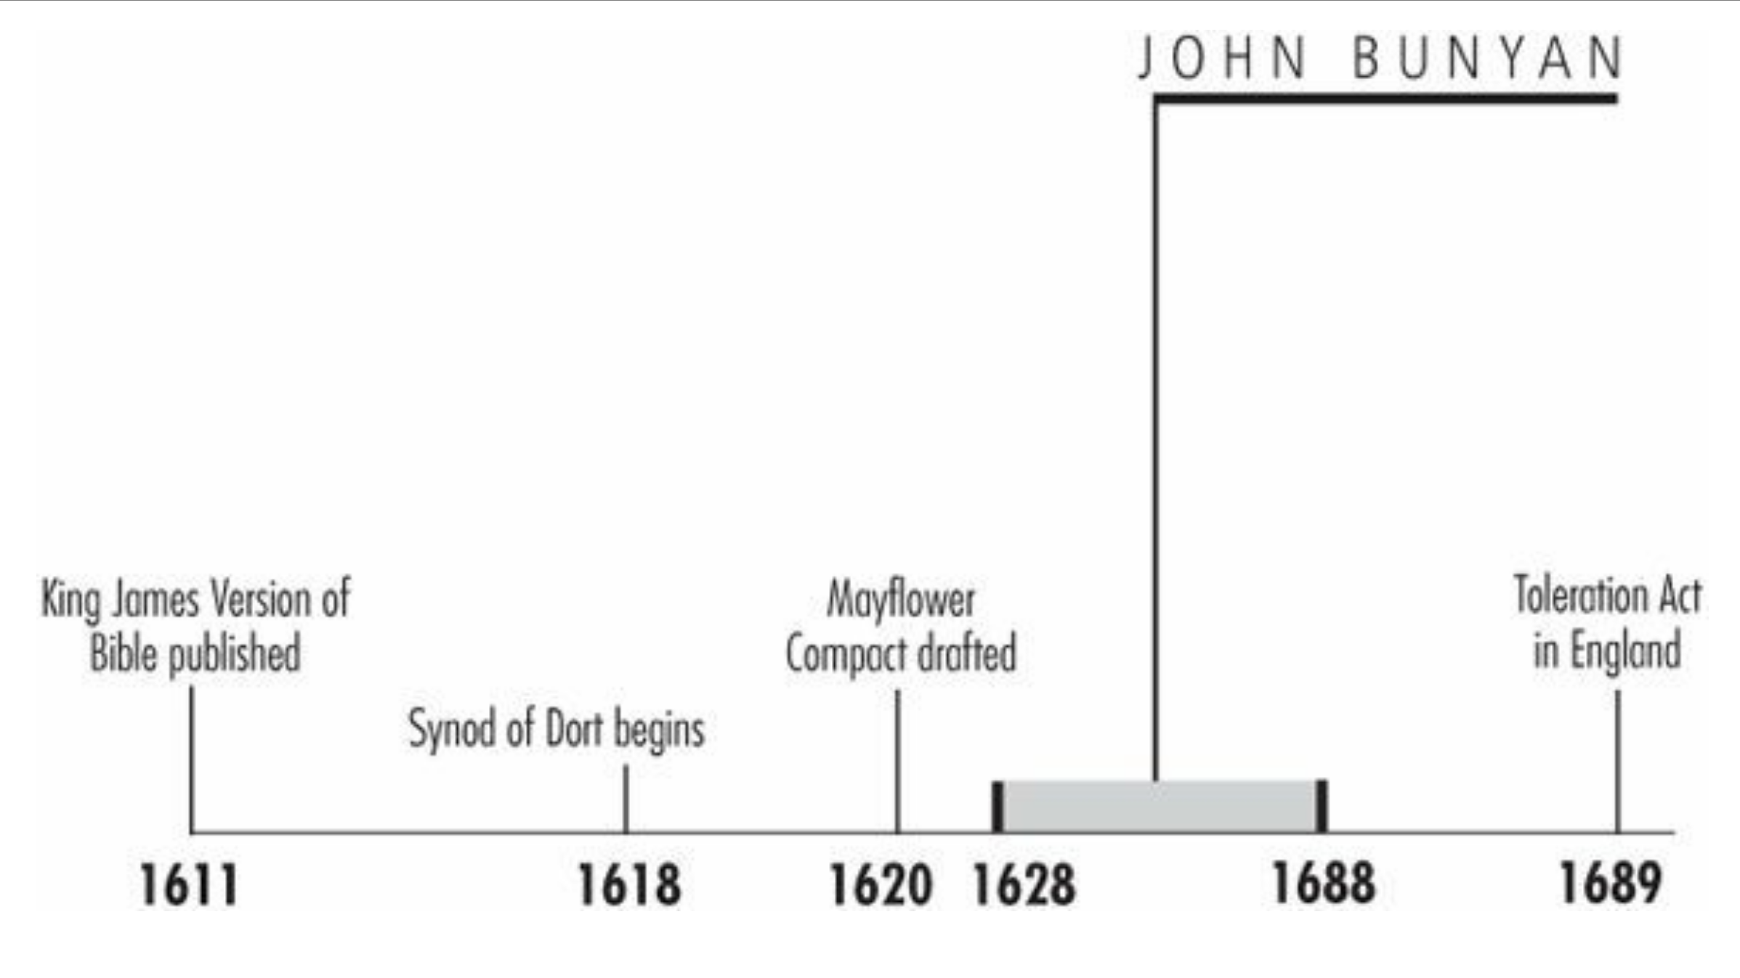
Timeline
Galli, Mark. 131 Christians Everyone Should Know (p. 115).

Slide 4
“I saw a man clothed with rags … a book in his hand and a great burden upon his back.”
Successful English writers were, in John Bunyan's day, nearly synonymous with wealth.
Men like Richard Baxter and John Milton could afford to write because they didn't need to earn a living.
But Bunyan, a traveling tinker like his father, was nearly penniless before becoming England's most famous author.
His wife was also destitute, bringing only two Puritan books as a dowry. “We came together as poor as poor might be,” Bunyan wrote, “not having so much household-stuff as a dish or spoon betwixt us both.”
What allowed Bunyan to become the bestselling author of one of the most beloved books in the English language was when things actually got worse: an imprisonment of 12 years.
Galli, Mark. 131 Christians Everyone Should Know (p. 115).

Slide 5
Early Temptations
Born in Elstow, Bedfordshire, Bunyan married at age 21.
Those books his wife brought to the marriage began a process of conversion.
Gradually, he gave up recreations like dancing, bell ringing, and sports; he began attending church and fought off temptations.
Bunyan wrote in his autobiography:
One morning as I did lie in bed, I was, as at other times, most fiercely assaulted with this temptation, to sell and part with Christ; the wicked suggestion still running in my mind, Sell him, sell him, sell him, sell him, sell him, as fast as a man could speak.
Galli, Mark. 131 Christians Everyone Should Know (p. 115-116).

Slide 6
Early Temptations
Bunyan was drawn to a Christian fellowship where he saw “three or four poor women sitting at a door…talking about the things of God.”
He was also befriended by John Gifford, minister at a Separatist church in Bedford.
The tinker joined the church and within four years was drawing crowds “from all parts” as a lay minister.
“I went myself in chains to preach to them in chains,” he said, “and carried that fire in my own conscience that I persuaded them to beware of.”
Galli, Mark. 131 Christians Everyone Should Know (p. 115-116).

Slide 7
Prison – A Mixed Blessing
Bunyan's rise as a popular preacher coincided with the Restoration of Charles II.
The freedom of worship Separatists had enjoyed for 20 years was quickly ended; those not conforming with the Church of England would be arrested.
By January 1661, Bunyan sat imprisoned in the county jail.
The worst punishment, for Bunyan, was being separated from his second wife (his first had died in 1658) and four children.
“The parting…hath oft been to me in this place as the pulling the flesh from my bones,” he wrote.
He tried to support his family making “many hundred gross [= a dozen dozen] of long tagg'd [shoe] laces” while imprisoned, but he mainly depended on “the charity of good people” for their well-being.
Galli, Mark. 131 Christians Everyone Should Know (p. 116-117).

Slide 8
Prison – A Mixed Blessing
Bunyan could have freed himself by promising not to preach but refused.
He told local magistrates he would rather remain in prison until moss grew on his eyelids than fail to do what God commanded.
Still, the imprisonment wasn't as bad as some have imagined. He was permitted visitors, spent some nights at home, and even traveled once to London.
The jailer allowed him occasionally to preach to “unlawful assemblies” gathered in secret.
Galli, Mark. 131 Christians Everyone Should Know (p. 116-117).

Slide 9
Prison – A Mixed Blessing
More importantly, the imprisonment gave him the incentive and opportunity to write.
Before his arrest he wrote three books—two against Quakers and the other an expository work
He penned at least nine books between 1660 and 1672 (the years of his imprisonment) including:
Profitable Mediations
Christian Behavior (a manual on good relationships)
The Holy City (an interpretation of Revelation)
Grace Abounding to the Chief of Sinners, considered the greatest Puritan autobiography.
But during the last five years of his imprisonment (from 1667 to 1672), Bunyan probably spent most of his time on his greatest legacy, The Pilgrim's Progress.
Galli, Mark. 131 Christians Everyone Should Know (p. 116-117).

Slide 10
Pilgrim’s Success
Charles II eventually relented in 1672, issuing the Declaration of Indulgence.
Bunyan was freed, licensed as a Congregational minister, and called to be pastor of the Bedford church.
When persecution was renewed, Bunyan was again imprisoned for six months.
After his second release, Pilgrim's Progress was published. “I saw a man clothed with rags…a book in his hand and a great burden upon his back.” So begins the allegorical tale that describes Bunyan's own conversion process.
Pilgrim, like Bunyan, is a tinker. He wanders from the City of Destruction to the Celestial City, a pilgrimage made difficult by the burden of sin (an anvil on his back), the Slough of Despond, Vanity Fair, and other such allegorical waystations.
Galli, Mark. 131 Christians Everyone Should Know (p. 117).

Slide 11
Pilgrim’s Success
The book was instantly popular with every social class.
His first editor, Charles Doe, noted that 100,000 copies were already in print by 1692.
Samuel Taylor Coleridge called it, “the best Summa Theologicae Evangelicae ever produced by a writer not miraculously inspired.”
Every English household that owned a Bible also owned the famous allegory.
Eventually, it became the bestselling book (apart from the Bible) in publishing history.
Galli, Mark. 131 Christians Everyone Should Know (p. 117).

Slide 12
Pilgrim’s Success
The book brought Bunyan great fame, and though he continued to pastor the Bedford church, he also regularly preached in London.
He continued to write. The Life and Death of Mr. Badman (1680) has been called the first English novel (since it is less of an allegory than Pilgrim's Progress), and was followed by another allegory, The Holy War.
He also published several doctrinal and controversial works, a book of verse, and a children's book.
By age 59 Bunyan was one of England's most famous writers.
He carried out his pastoring duties and was nicknamed “Bishop Bunyan.”
In August 1688, he rode through heavy rain to reconcile a father and son, became ill, and died.
Galli, Mark. 131 Christians Everyone Should Know (p. 117).

Slide 13
Jonathan Edwards
AMERICA'S GREATEST THEOLOGIAN
https://www.wikiwand.com/en/Jonathan_Edwards_(theologian)

Slide 14
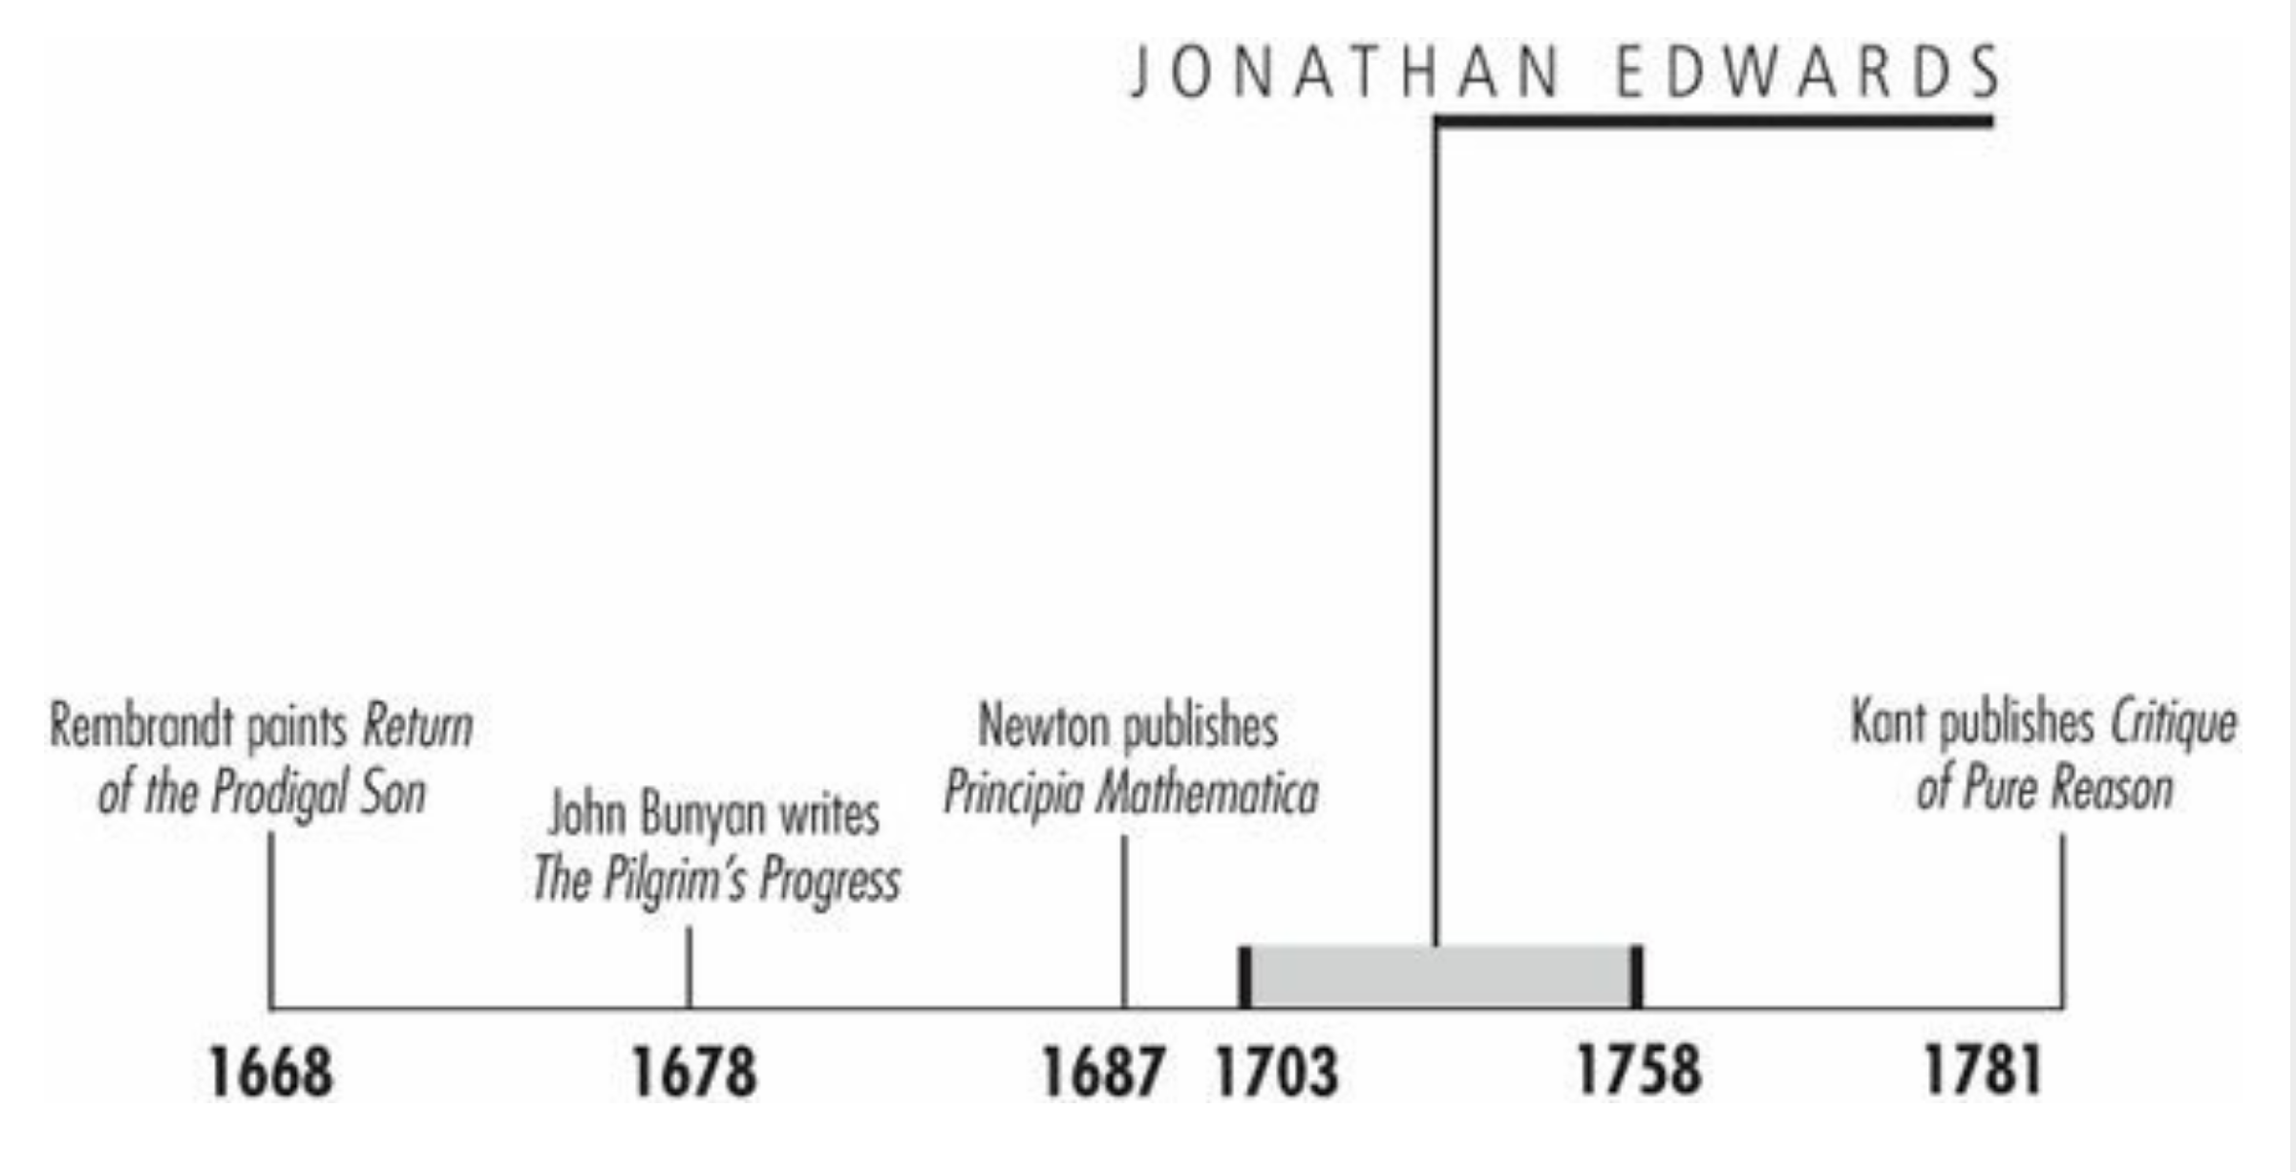
Timeline
Galli, Mark. 131 Christians Everyone Should Know (p. 43).

Slide 15
““[I wish] to lie low before God, as in the dust; that I might be nothing, and that God might be all, that I might become as a little child.”
At age 14, Jonathan Edwards, already a student at Yale, read philosopher John Locke with more delight “than the most greedy miser finds when gathering up handfuls of silver and gold, from some newly discovered treasure.”
He also was a young man with profound spiritual sensitivities.
At age 17, after a period of distress, he said holiness was revealed to him as a ravishing, divine beauty. His heart panted “to lie low before God, as in the dust; that I might be nothing, and that God might be all, that I might become as a little child.”
This combination of intellect and piety characterized Edward's whole life.
Galli, Mark. 131 Christians Everyone Should Know (p. 43).

Slide 16
Dispassionate Revivalist
Edwards was born in East Windsor, Connecticut, and he received his master's degree from Yale in 1722.
He apprenticed for his grandfather, Solomon Stoddard, for two years before he became, in 1729, the sole preacher of the Northampton, Massachusetts, parish.
In the meantime, when he was 20, he had met Sarah Pierrepont.
Their wedding followed four years of often agonizing courtship for the gawky and intense Edwards, but in the end, their marriage proved deeply satisfying to both.
Edwards described it as an “uncommon union,” and in a sermon on Genesis 2:21–25, he said, “When Adam rose from his deep sleep, God brought woman to him from near his heart.”
They eventually had 11 children.
Galli, Mark. 131 Christians Everyone Should Know (pp. 43-44).

Slide 17
Dispassionate Revivalist
In 1734 Edwards's preaching on justification by faith sparked a different sort of devotion: a spiritual revival broke out in his parish.
In December there were six sudden conversions.
By spring there were about thirty a week.
It was not due to theatrics. One observer wrote, “He scarcely gestured or even moved, and he made no attempt by the elegance of his style or the beauty of his pictures to gratify the taste and fascinate the imagination.”
Instead he convinced “with overwhelming weight of argument and with such intenseness of feeling.”
Galli, Mark. 131 Christians Everyone Should Know (pp. 43-44).

Slide 18
Dispassionate Revivalist
Edwards kept a careful written account of his observations and noted them in A Faithful Narrative of the Surprising Work of God (1737), and his most effective sermons were published as Justification by Faith (1738), which were widely read in America and England.
These works helped fuel the Great Awakening a few years later (1739–1741), during which thousands were moved by the preaching of Britain's George Whitefield.
Whitefield had read Edwards's book and made it a point to visit him when he came to America.
Edwards invited Whitefield to preach at his church and reported, “The congregation was extraordinarily melted…almost the whole assembly being in tears for a great part of the time.”
The “whole assembly” included Edwards himself.
Galli, Mark. 131 Christians Everyone Should Know (pp. 44-45).

Slide 19
Dispassionate Revivalist
During the Great Awakening, Edwards contributed perhaps the most famous sermon in American history, “Sinners in the Hands of an Angry God.”
Unfortunately it has since cast Edwards as an emotional and judgmental revivalist, when in fact he preached it as dispassionately as any of his sermons.
In spite of his dispassionate style, Edwards insisted that true religion is rooted in the affections, not in reason.
He defended the emotional outbursts of the Great Awakening, especially in Treatise on Religious Affections (1746), a masterpiece of psychological and spiritual discernment, and in Some Thoughts Concerning the Present Revival of Religion in New England (in which he included an account of his wife's spiritual awakening).
And in a day when psalm-singing was almost the only music to be heard in congregational churches, Edwards encouraged the singing of new Christian hymns, notably those of Isaac Watts.
Galli, Mark. 131 Christians Everyone Should Know (pp. 44-45).

Slide 20
Newton and the Bible
Edwards regarded personal conversion as critical, so he insisted that only persons who had made a profession of faith, which included a description of their conversion experience, could receive Communion.
This reversed the policy of his grandfather and alienated his congregation, which ousted him in 1750.
For the next few years, he was a missionary pastor to Native Americans in Stockbridge, Massachusetts, and wrote, among other theological treatises, Freedom of the Will (1754), a brilliant defense of divine sovereignty.
In it he argued that we are free to do whatever we want, but we will never want to do God's will without a vision of his divine nature imparted by the Spirit.
Galli, Mark. 131 Christians Everyone Should Know (pp. 45).

Slide 21
Newton and the Bible
Fascinated by Newtonian physics and enlightened by Scripture, Edwards believed that God's providence was literally the binding force of atoms—that the universe would collapse and disappear unless God sustained its existence from one moment to the next.
Scripture affirmed his view that Christ is “upholding all things by his word of power” (Heb. 1:3 RSV).
Such were the fruits of his lifelong habit of rising at 4:00 a.m. and studying 13 hours a day.
The College of New Jersey (later Princeton) called him as president in 1758.
But soon after his arrival, Edwards died of the new smallpox vaccination. He was 55.
He left no small legacy: Edwards is considered (some would say with Reinhold Niebuhr) America's greatest theologian.
Galli, Mark. 131 Christians Everyone Should Know (pp. 45).

Slide 22
John Newton
https://www.ouramericannetwork.org/story?title=John-Newton-From-Disgrace-to-Amazing-Grace

Slide 23
Class Discussion Time
https://www.weareteachers.com/moving-beyond-classroom-discussions/

Slide 24
*Class Discussion Time
John Bunyan was imprisoned for 12 years and yet could have gotten free at any time if he had only been willing to agree to stop preaching. Do you think we may someday face such a choice as Christians? If so, do you think you will have the kind of convictions John Bunyan did?
What, on the surface, seemed to be John Bunyan’s greatest curse (imprisonment), proved to be a great blessing. Can you think of a time in your life when God used a bad situation to bring about great blessing?
Jonathan Edwards, sometimes referred to as America’s greatest theologian, in addition to his deep understanding and interest in theology also had a deep and passionate interest in science and in the works of the not-so-orthodox philosophers of his day (e.g. John Locke). How do you suppose he was able to be so strongly committed to sound theology and yet still enjoy the philosophers of his day?
When Bunyan married his second wife, he was 31 and she was 17. Edwards began courting Sarah when she was 13 and married her when she was 17. Marriage at such an early age was not uncommon in those days. Why do you suppose couples in our culture tend to marry so much later in life? Is that a good thing?
Do you have a topic or question that you would like to see us to discuss?

