Slide 2
John Nelson Darby
Father of Dispensationalism
https://www.plymouthbrethrenchristianchurch.org/beliefs/authors/#john-nelson-darby-(1800%E2%80%931882)

Slide 3
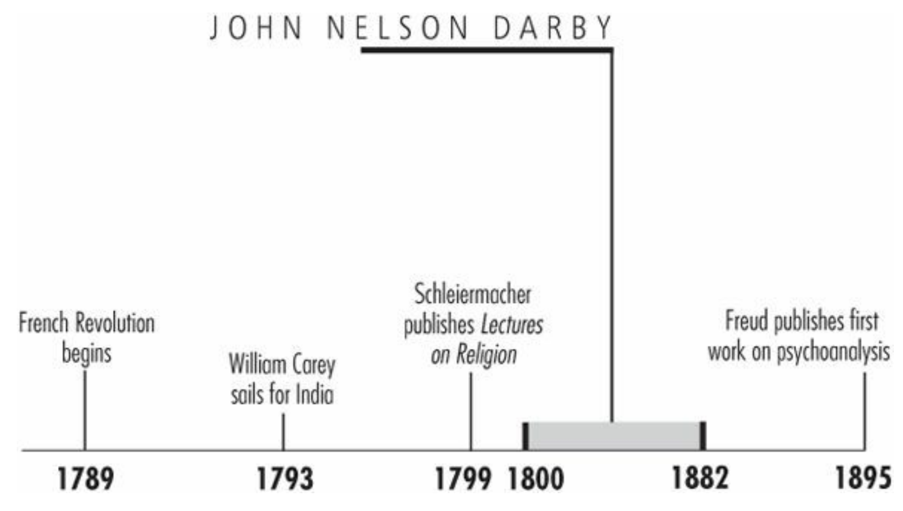
Timeline
Galli, Mark. 131 Christians Everyone Should Know (p. 98).

Slide 4
“The Christian is directed to turn away from evil and turn to the Scriptures.”
“The church is in ruins,” wrote John Darby, then a successful Anglican priest in Ireland.
Echoing the lamentations of Protestant reformers three centuries earlier, he believed that the Church of England had lost any notion of salvation by grace and that it had forsaken biblical ideas of what church should be.
For Darby it was time to start afresh with a new church and prepare for Jesus' imminent Second Coming.
What resulted from Darby's departure was a new way of viewing the church and history that still pervades much of evangelical Christian thought.
Galli, Mark. 131 Christians Everyone Should Know (p. 98).

Slide 5
Ever-Changing Vocation
Born in London into a prominent Anglo-Irish family, Darby received the best education possible.
He attended London's Westminster School until his parents moved to an ancestral castle in Ireland.
He graduated from Dublin's Trinity College as a Classical Gold Medalist and continued his studies in law, being admitted to the Irish Chancery Bar in 1822.
But Darby's law career was to be short-lived. Within four years, largely due to his desire to help poor Irish Catholics, he was made a priest as a curate of the Church of Ireland.
“I owed myself entirely to [God],” he explained of his career switch. “I longed for complete devotedness to the work of God.”
Galli, Mark. 131 Christians Everyone Should Know (pp. 98-99).

Slide 6
Ever-Changing Vocation
Darby was assigned to a parish in the mountainous regions south of Dublin, and he quickly became an excellent pastor; rarely would he return to his cottage from pastoral visits before midnight.
Still, as he read his Bible, he became frustrated with how “established” the church had become. The formalized Anglican church, so associated with the State, was lifeless beyond repair.
“It is positively stated (2 Tim. 3) that the church would fail and become as bad as heathenism,” he wrote. “The Christian is directed to turn away from evil and turn to the Scriptures, and Christ (Rev. 2 and 3) is revealed as judging the state of the churches.”
Galli, Mark. 131 Christians Everyone Should Know (pp. 98-99).

Slide 7
Ever-Changing Vocation
And so Darby resigned his position a mere two years and three months after receiving it. He joined a group of similarly disillusioned Christians who called themselves simply “Brethren.”
Committed to operate by strict biblical methods, the group had no professional ministers.
Rejecting denominationalism, they believed the Holy Spirit would lead worship, so they focused their meetings on simple Communion services, served by a different individual each week.
Galli, Mark. 131 Christians Everyone Should Know (pp. 98-99).

Slide 8
Ever-Changing Vocation
Though officially no more a leader than anyone else in the group (now called the Plymouth Brethren because of their gathering in Plymouth, England), Darby quickly became its most prominent voice.
His pamphlet The Nature and Unity of the Church of Christ (1828), which described their beliefs and practices, quickly spread throughout the West.
The former priest traveled to churches in Western Europe, North America, Australia, and New Zealand condemning denominationalism and calling believers to his new ecclesiology.
Galli, Mark. 131 Christians Everyone Should Know (pp. 98-99).

Slide 9
The End of the World
Believers were drawn not only to Darby's view of the church but also to his view of history, especially the end of it.
Premillennialism, the belief that the world will get worse until Christ returns to set up a visible, thousand-year reign of peace, had fallen out of favor for 1,500 years.
Some occasional premillennialist movements had appeared over the centuries, but usually ended in disappointment after predicting Jesus' imminent return.
Darby, on the other hand, developed a new premillennialism, which he called “dispensationalism” after the division of history into eras or dispensations.
Though later dispensationalists quibbled over the number and names of these periods, most agreed with Darby that there were seven, like the seven days of creation.
Galli, Mark. 131 Christians Everyone Should Know (pp. 99-100).

Slide 10
The End of the World
Darby listed the ages as:
Paradise
Noah
Abraham
Israel
Gentiles
the Spirit
the Millennium
Darby saw history as a “progressive revelation,” and his system sought to explain the stages in God's redemptive plan for the universe.
Galli, Mark. 131 Christians Everyone Should Know (pp. 99-100).

Slide 11
The End of the World
There was nothing especially radical about dividing history into periods.
What separated Darby's dispensationalism was his novel method of biblical interpretation, which consisted of:
A strict literalism
The absolute separation of Israel and the church into two distinct peoples of God
The separation of the rapture (the “catching away” of the church) from Christ's Second Coming.
At the rapture, he said, Christ will come for his saints; and at the Second Coming, he will come with his saints.
Darby's teachings became increasingly popular and became more popular still after his death when C.I. Scofield published Darby's ideas in the annotated Scofield Reference Bible in 1909.
Galli, Mark. 131 Christians Everyone Should Know (pp. 99-100).

Slide 12
Harsh Critic
Historians have criticized Darby's tendency to treat opponents harshly.
For example, Darby condemned Dwight Moody (they disagreed on free will), who made efforts to befriend his British colleague.
Eventually, Darby's followers created a tight group of churches known as Exclusive Brethren (also called Darbyites), while the others, maintaining a more congregational church government with less stringent membership standards, were called Open Brethren.
Though Darby may have burned his bridges, his message gained a larger and larger following. Today his dispensational premillennialism is the view of many modern fundamentalists and conservative evangelicals.
Galli, Mark. 131 Christians Everyone Should Know (pp. 100-101).

Slide 13
Charles Haddon Spurgeon
The Prince of Preachers
https://www.freechristianresources.org/2008-01/free-spurgeon-devotionals-however-you-want-them

Slide 14
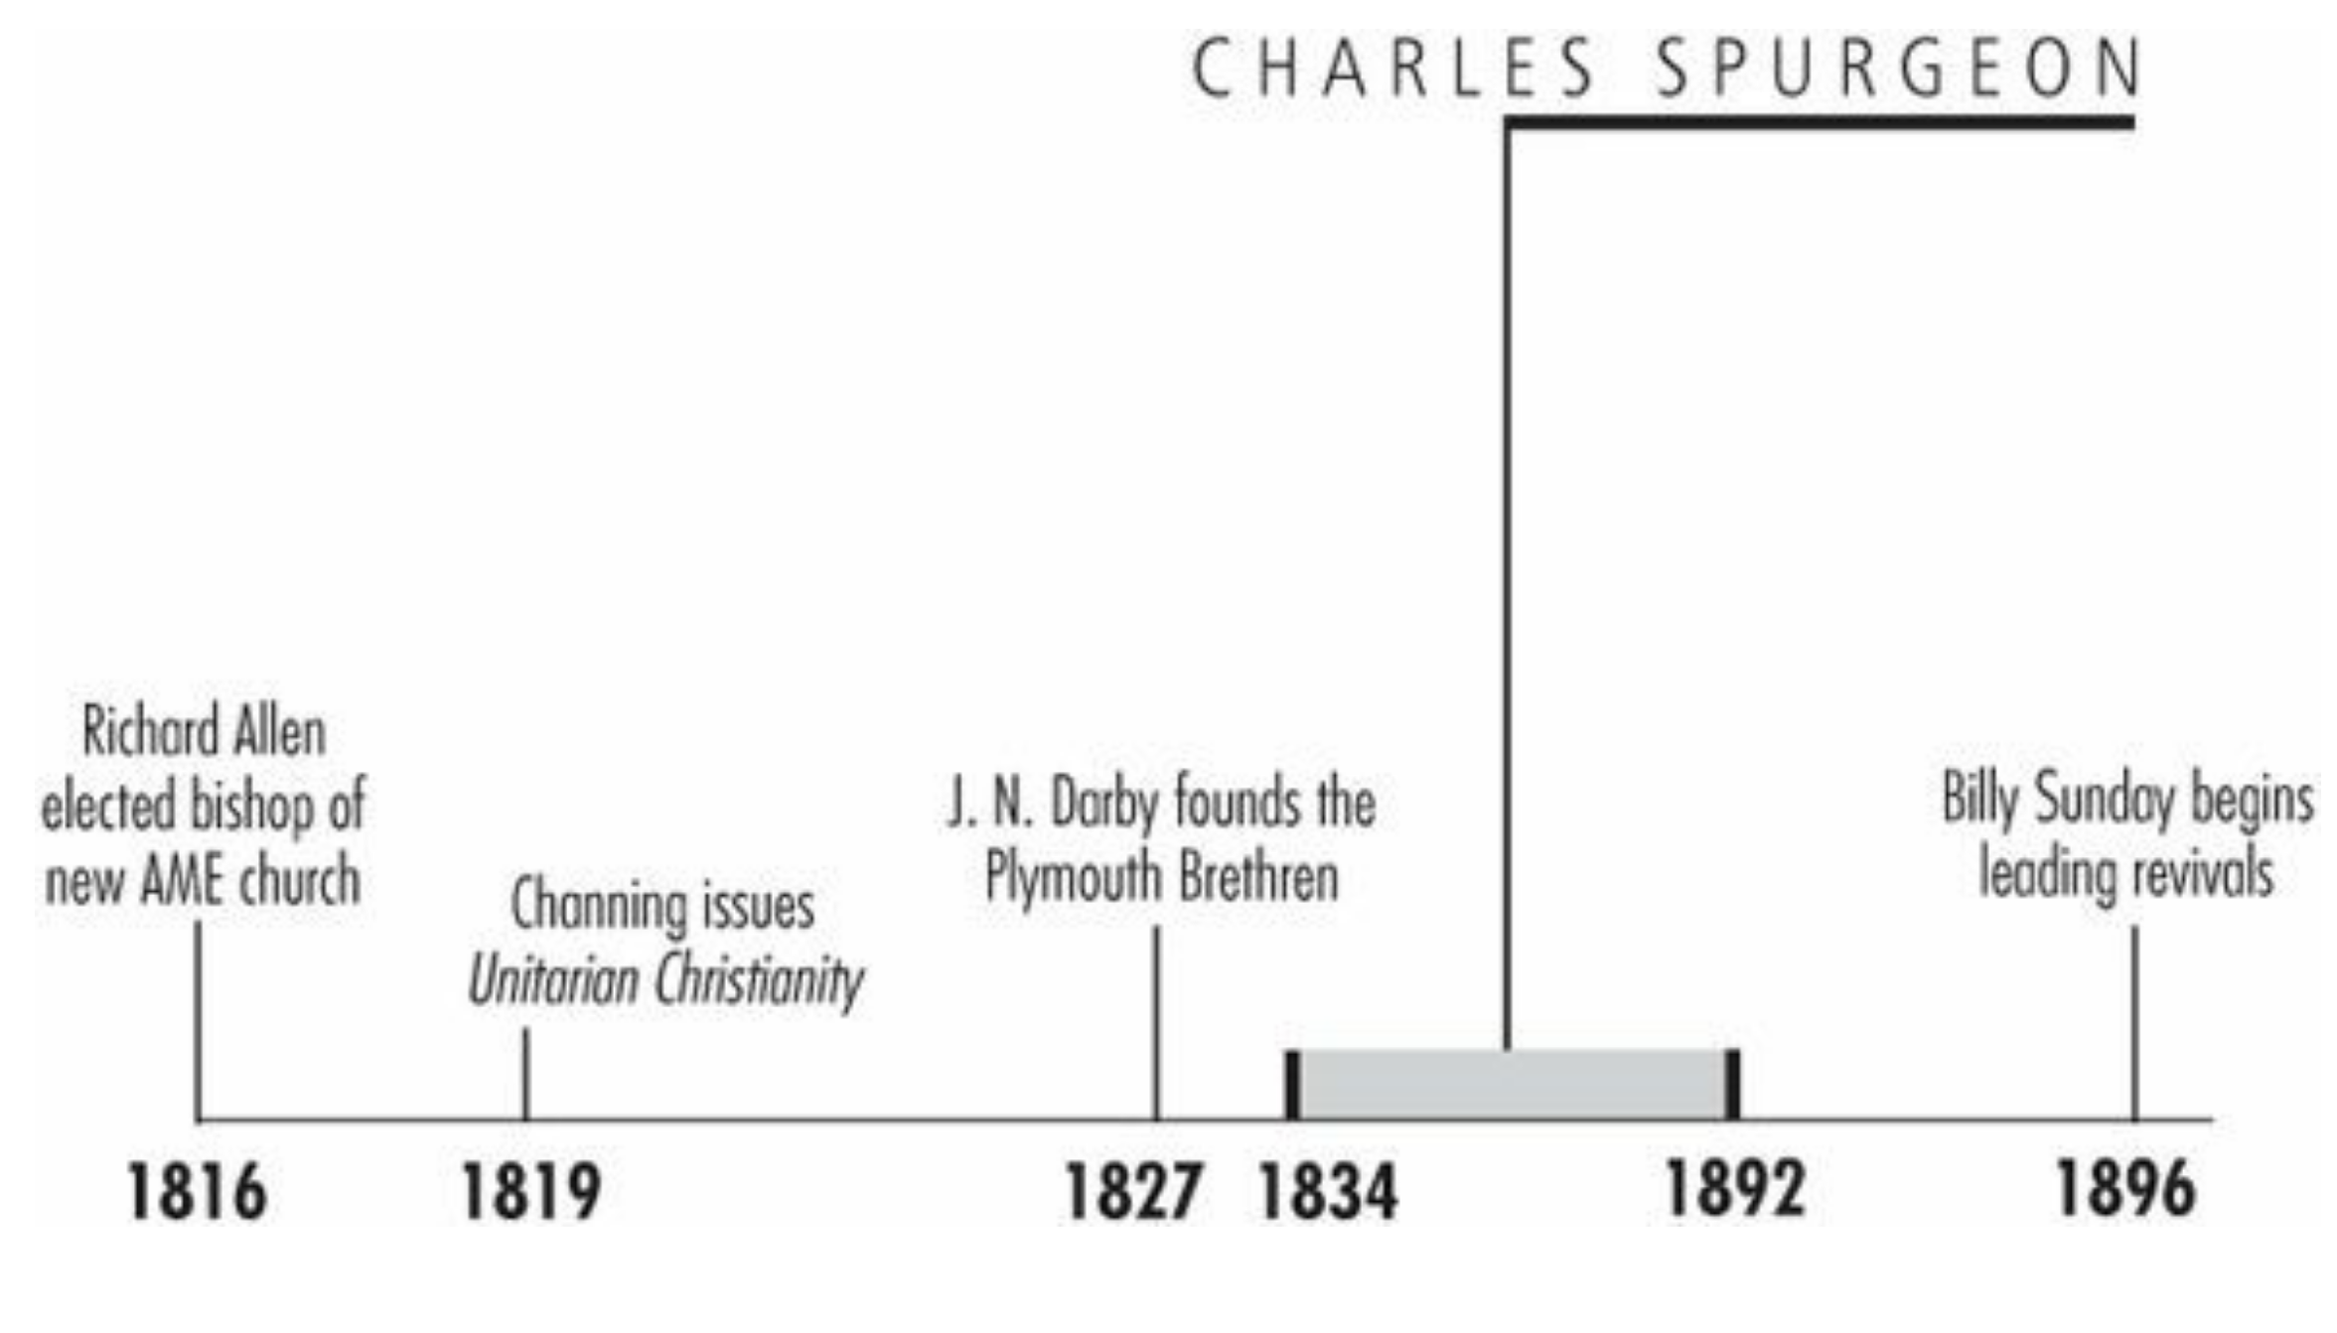
Timeline
Galli, Mark. 131 Christians Everyone Should Know (p. 101).

Slide 15
“I am perhaps vulgar, but it is not intentional, save that I must and will make people listen.”
When Charles Spurgeon died in January 1892, London went into mourning.
Nearly 60,000 people came to pay homage during the three days his body lay in state at the Metropolitan Tabernacle.
Some 100,000 lined the streets as a funeral parade two miles long followed his hearse from the Tabernacle to the cemetery.
Flags flew at half-staff and shops and pubs were closed. All this for a Victorian minister—who also happened to be the most extraordinary preacher of his day.
Galli, Mark. 131 Christians Everyone Should Know (p. 101).

Slide 16
Calvinist Baptist
Spurgeon was born in Kelvedon, Essex, to a family of clerics.
His father and grandfather were Nonconformist ministers (meaning they weren't Anglicans), and Spurgeon's earliest memories were of looking at the pictures in Pilgrim's Progress and Foxe's Book of Martyrs.
His formal education was limited, even by nineteenth-century standards: he attended local schools for a few years but never earned a university degree.
He lived in Cambridge for a time, where he combined the roles of scholar and teaching assistant and was briefly tutored in Greek.
Galli, Mark. 131 Christians Everyone Should Know (pp. 101-102).

Slide 17
Calvinist Baptist
Though he stayed away from formal education, all his life Spurgeon valued learning and books—especially those by Puritan divines—and his personal library eventually exceeded 12,000 volumes.
At age 15, Spurgeon broke with family tradition by becoming a Baptist.
He attributed this conversion to a sermon heard by “chance"—when a snowstorm blew him away from his destination into a Primitive Methodist chapel.
The experience forced Spurgeon to re-evaluate his idea on, among other things, infant baptism.
Within four months he was baptized and joined a Baptist church.
Galli, Mark. 131 Christians Everyone Should Know (pp. 101-102).

Slide 18
Calvinist Baptist
Spurgeon’s theology, however, remained more or less Calvinist, though he liked to think of himself as a “mere Christian.”
He once said:
I am never ashamed to avow myself a Calvinist, I do not hesitate to take the name of Baptist, but if I am asked what is my creed, I reply, “It is Jesus Christ.”
Galli, Mark. 131 Christians Everyone Should Know (pp. 101-102).

Slide 19
Preaching Sensation
Still a teen, Spurgeon began preaching in rural Cambridgeshire.
He quickly filled the pews in his first pastorate in the village of Waterbeach.
He had a boyish appearance that contrasted sharply with the maturity of his sermons.
He had a good memory and always spoke extemporaneously from an outline.
His energy and oratorical skills and harmonious voice earned him such a reputation that within a year and a half, he was invited to preach in London, at the historic New Park Street Chapel.
The congregation of 232 was so impressed, it voted for him to preach an additional six months.
He moved to the city and never left.
Galli, Mark. 131 Christians Everyone Should Know (p. 102).

Slide 20
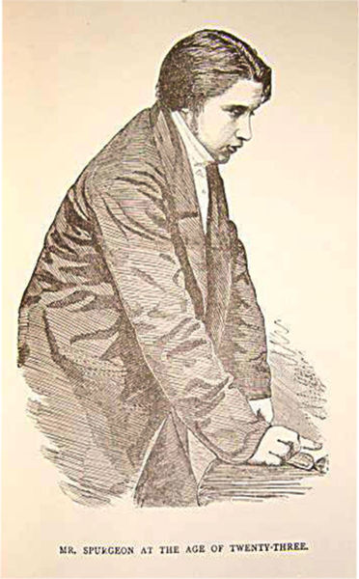
Spurgeon at Age 23
https://www.wikiwand.com/en/Charles_Spurgeon

Slide 21
Preaching Sensation
As word spread of Spurgeon’s abilities, he was invited to preach throughout London and the nation.
No chapel seemed large enough to hold those who wanted to hear the “the preaching sensation of London.”
He preached to tens of thousands in London's greatest halls—Exeter, Surry Gardens, Agricultural.
In 1861 his congregation, which kept extending his call, moved to the new Metropolitan Tabernacle, which seated 5,600.
Galli, Mark. 131 Christians Everyone Should Know (p. 102).

Slide 22
At the Center of Controversy
Spurgeon did not go unnoticed in the secular press.
On the one hand, his sermons were published in the Monday edition of the London Times, and even the New York Times.
On the other hand, he was severely criticized by more traditional Protestants.
His dramatic flair—he would pace the platform, acting out biblical stories, and fill his sermons with sentimental tales of dying children, grieving parents, and repentant harlots—offended many, and he was called “the Exeter Hall demagogue” and “the pulpit buffoon.”
Spurgeon replied, “I am perhaps vulgar, but it is not intentional, save that I must and will make people listen. My firm conviction is that we have had enough polite preachers.”
Galli, Mark. 131 Christians Everyone Should Know (pp. 102-103).

Slide 23
At the Center of Controversy
Not only his style, but his convictions created controversy as well.
He never flinched from strong preaching: in a sermon on Acts 26:28, he said, “Almost persuaded to be a Christian is like the man who was almost pardoned, but he was hanged; like the man who was almost rescued, but he was burned in the house. A man that is almost saved is damned.”
On certain subjects, he was incapable of moderation: Rome, ritualism, hypocrisy, and modernism—the last of which became the center of a controversy that would mark his last years in ministry.
Galli, Mark. 131 Christians Everyone Should Know (pp. 102-103).

Slide 24
At the Center of Controversy
The “Down-Grade Controversy,” as it came to be known, was started in 1887 when Spurgeon began publicly claiming that some of his fellow Baptist ministers were “down grading” the faith.
This was the late-nineteenth century, when Darwinism and critical biblical scholarship were compelling many Christians to re-evaluate their understanding of the Bible.
Spurgeon believed the issue was not one of interpretation but of the essentials of the faith.
Galli, Mark. 131 Christians Everyone Should Know (pp. 102-103).

Slide 25
At the Center of Controversy
He proclaimed in his monthly, The Sword and the Trowel, “Our warfare is with men who are giving up the atoning sacrifice, denying the inspiration of Holy Scripture, and casting slurs upon justification by faith.”
The controversy took its toll on the denomination (which censured Spurgeon) and upon Spurgeon, whose already delicate health deteriorated even more during the yearlong affair (he suffered from, among other things, recurring depressions and gout).
Spurgeon's contributions were larger than his pulpit, however. He established alms houses and an orphanage, and his Pastor's College, opened in 1855, continues to this day. He preached his last sermon in June 1891 and died six months later.
Galli, Mark. 131 Christians Everyone Should Know (pp. 102-103).

Slide 26
C.S. Lewis
https://www.britannica.com/biography/C-S-Lewis

Slide 27
Class Discussion Time
https://www.weareteachers.com/moving-beyond-classroom-discussions/

Slide 28
*Class Discussion Time
What do you think of Darby’s approach to church government and worship – the group had no professional ministers and, rejecting denominationalism, they believed the Holy Spirit would lead worship, so they focused their meetings on simple Communion services, served by a different individual each week.
What do you think of Darby’s ideas on Eschatology? Do you have any sympathies towards his dispensational views? Does it surprise you that these popular ideas were developed so recently in church history?
In your opinion, what is it about Spurgeon that made him so well-loved by the people?
What do you think about Spurgeon’s statement: “I am perhaps vulgar, but it is not intentional, save that I must and will make people listen. My firm conviction is that we have had enough polite preachers”?
Do you have a topic or question that you would like to see us to discuss?

