Slide 2
Spurgeon’s Wit and Wisdom
The Prince of Preachers
https://www.freechristianresources.org/2008-01/free-spurgeon-devotionals-however-you-want-them

Slide 3
C.S. Lewis
https://www.britannica.com/biography/C-S-Lewis

Slide 4
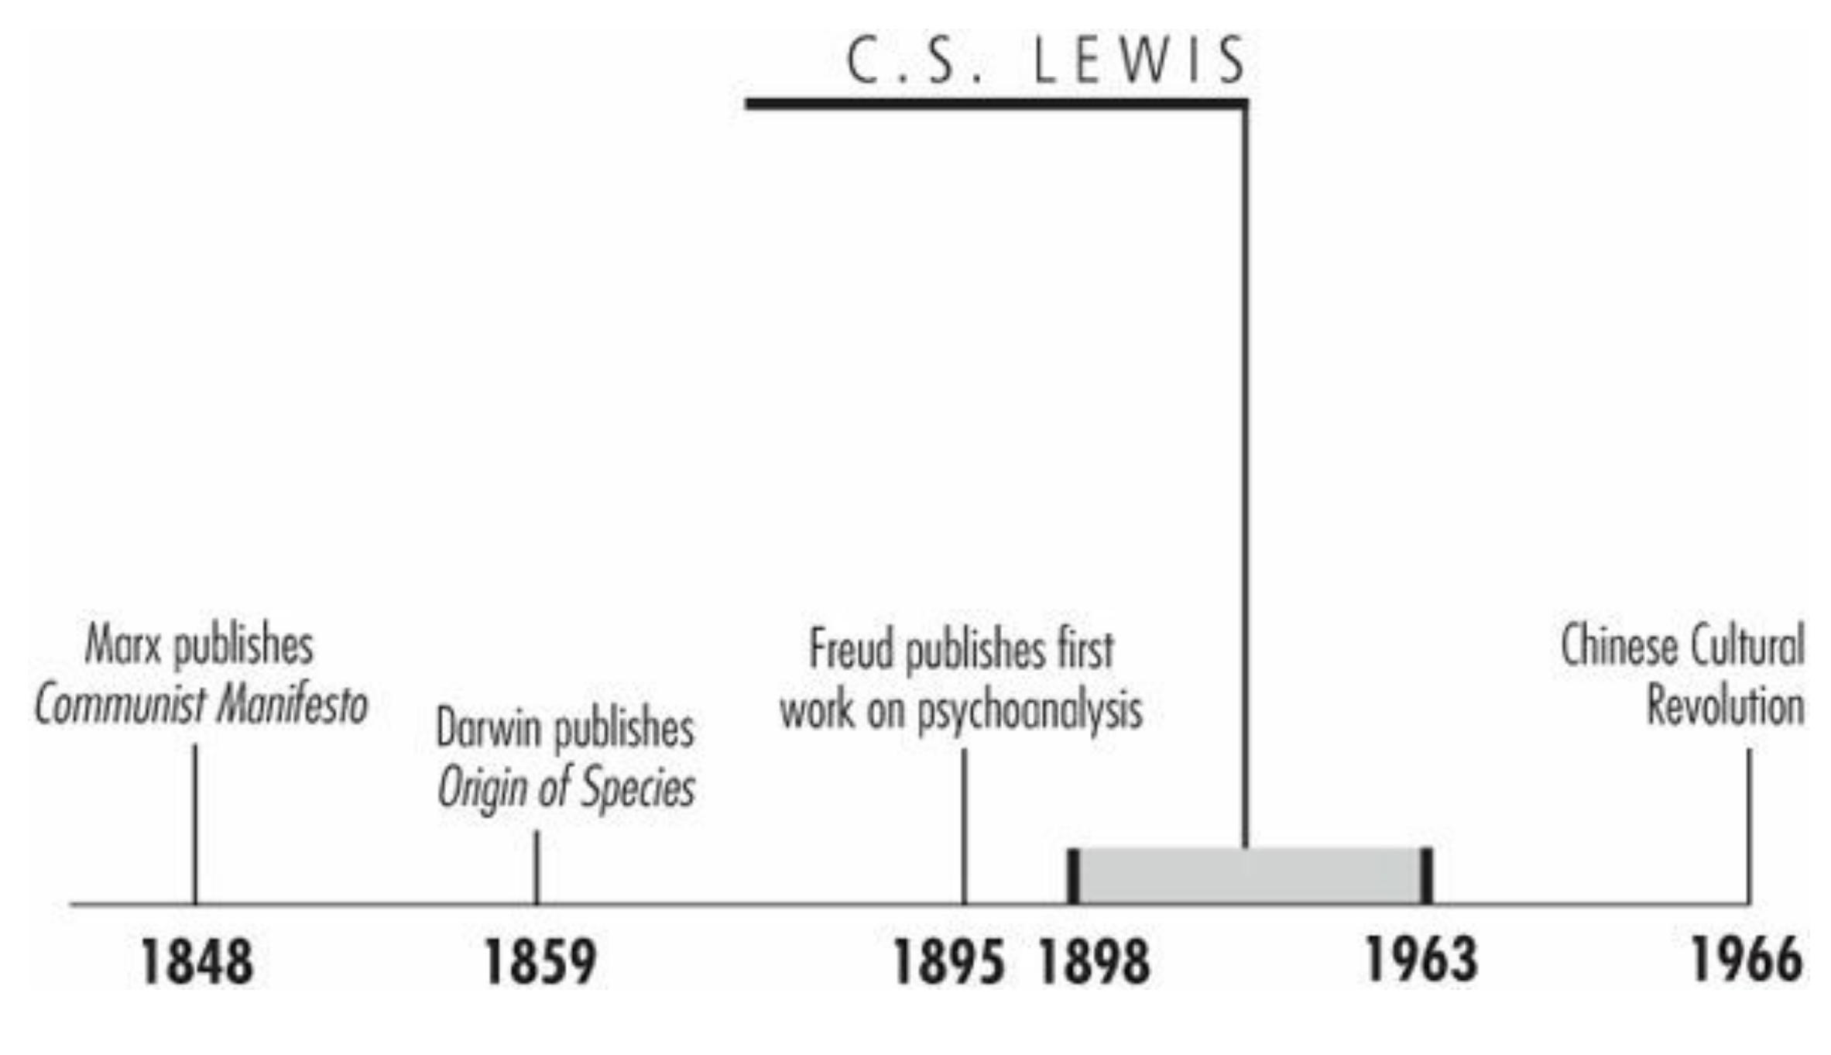
Timeline
Galli, Mark. 131 Christians Everyone Should Know (p. 132).

Slide 5
C.S. Lewis
Clive Staples Lewis wrote to a young admirer in 1954: “I'm tall, fat, rather bald, red-faced, double-chinned, black-haired, have a deep voice, and wear glasses for reading”.
If the famous author had been prone to notice clothing, he might have added that his trousers were usually in dire need of pressing, his jackets threadbare and blemished by snags and food spots, and his shoes scuffed and worn at the heels.
Galli, Mark. 131 Christians Everyone Should Know (pp. 132-133).

Slide 6
C.S. Lewis
But “Jack,” as C.S. Lewis's friends knew him, was not bothered by fashion.
He was meticulous about the precise use of words, the quality of evidence presented in arguments, and meter in verse.
And it is for his books and ideas that the Oxford scholar is remembered as one of the great Christian writers of the twentieth century.
Galli, Mark. 131 Christians Everyone Should Know (pp. 132-133).

Slide 7
Raised in a Library
Lewis was born into a bookish family of Protestants in Belfast, Ireland.
Eclectic in their reading tastes, they purchased and read “endless” books.
“There were books in the study, books in the dining room, books in the cloakroom, books (two deep) in the great bookcase on the landing, books in a bedroom, books piled as high as my shoulder in the cistern attic, books of all kinds,” Lewis remembered, and none were off-limits to him.
On rainy days—and there were many in northern Ireland—he pulled volumes off the shelves and entered into worlds created by authors such as Conan Doyle, E. Nesbit, Mark Twain, and Henry Wadsworth Longfellow.
Galli, Mark. 131 Christians Everyone Should Know (p. 133).

Slide 8
Raised in a Library
After his only brother, Warren, was sent off to English boarding school in 1905, Jack became somewhat reclusive as he spent more time in books and an imaginary world of “dressed animals” and “knights in armor.”
But he did more than read books, he wrote and illustrated his own stories as well.
His mother's death from cancer in 1908 made him even more withdrawn.
Mrs. Lewis's death came just three months before Jack's tenth birthday, and the young man was hurt deeply by her passing.
Not only did he lose a mother, his father never fully recovered from her death.
Galli, Mark. 131 Christians Everyone Should Know (p. 133).

Slide 9
Raised in a Library
Both boys felt estranged from their father, and home life was never warm and satisfying again.
The death of Mrs. Lewis convinced young Jack that the God he encountered in the Bible his mother gave him was, if not cruel, at least a vague abstraction.
By 1911 or 1912, with the additional influence of a spiritually unorthodox boarding school matron, Lewis rejected Christianity and became an avowed atheist.
Galli, Mark. 131 Christians Everyone Should Know (p. 133).

Slide 10
University and Military Service
In 1916, Lewis was offered a scholarship at University College, Oxford University, but in 1917, his university life was interrupted as he volunteered to join the British army in the First World War.
He was transferred to the Somme valley where he took part in trench warfare.
In the last months of the war, he was injured by a shell and was sent home to recuperate from his injuries.
During his period of convalescence, he became increasingly friendly with Mrs. Moore – the mother of a close army friend Edward ‘Paddy’ Moore.
He remained very close to Mrs. Moore, often referring to her as his mother until her death in the 1940s.
https://www.biographyonline.net/writers/c-s-lewis.html

Slide 11
University and Military Service
On returning to Oxford, Lewis completed his degrees before taking up a post teaching English at Magdalen College, Oxford from 1925 to 1954.
He was a prolific writer and formed a close friendship with other Oxford fellows such as J. R. R. Tolkien, Charles Williams, and Owen Barfield.
They formed an informal group known as the ‘Inklings’.
They would meet at pubs in Oxford where they would read parts of their novels.
He encouraged Tolkien as he wrote his epic “The Lord of the Rings.”
https://www.biographyonline.net/writers/c-s-lewis.html

Slide 12
Spiritual Awakening
As Lewis continued to read, he especially enjoyed Christian author George MacDonald. One volume, Phantastes, powerfully challenged his atheism. “What it actually did to me,” wrote Lewis, “was to convert, even to baptize…my imagination.”
G.K. Chesterton's books worked much the same way, especially The Everlasting Man, which raised serious questions about the young intellectual's materialism.
While MacDonald and Chesterton were stirring Lewis's thoughts, close friend Owen Barfield pounced on the logic of Lewis's atheism.
Barfield had converted from atheism to theism, then finally Christianity, and frequently badgered Lewis about his materialism.
Galli, Mark. 131 Christians Everyone Should Know (pp. 133-134).

Slide 13
Spiritual Awakening
After many evening chats with these and other friends such as J.R.R. Tolkien and Hugo Dyson, Lewis began to realize that most of his friends, like his favorite authors—MacDonald, Chesterton, Johnson, Spenser, and Milton—held to this Christianity.
In 1929 these roads met, and C.S. Lewis surrendered, admitting “God was God, and knelt and prayed.”
Within two years the reluctant convert also moved from theism to Christianity and joined the Church of England.
Galli, Mark. 131 Christians Everyone Should Know (pp. 133-134).

Slide 14
Spiritual Awakening
Lewis later wrote he was a reluctant and unwilling convert. But, felt compelled to accept the evidence of faith. ¹
In his book, “Surprised by Joy” he writes that he came to Christianity: “kicking, struggling, resentful, and darting his eyes in every direction for a chance to escape.” ¹
Almost immediately, Lewis set out in a new direction, most demonstrably in his writing. Earlier efforts to become a poet were laid to rest. ²
The new Christian devoted his talent and energy to writing prose that reflected his recently found faith. ²
¹ https://www.biographyonline.net/writers/c-s-lewis.html
² Galli, Mark. 131 Christians Everyone Should Know (pp. 133-134).

Slide 15
Spiritual Awakening
He concentrated on a more universal form of Christianity seeking to avoid the sectarianism that was common in his native Northern Ireland.
He rarely made any specific reference to a particular denomination of Christianity but sought to reinforce the underlying Christian values shared by all Christian faiths.
However, he always remained an Anglican and, to the disappointment of Tolkien, he never converted to Roman Catholicism.
https://www.biographyonline.net/writers/c-s-lewis.html

Slide 16
Spiritual Awakening
Lewis's 25 Christian books sold millions of copies, including
The Screwtape Letters (1942),
Mere Christianity (1952),
The Chronicles of Narnia (1950-56),
The Great Divorce (1946),
The Abolition of Man (1943), which Encyclopedia Britannica included in its collection of Great Books of the World.
Galli, Mark. 131 Christians Everyone Should Know (pp. 133-134).

Slide 17
Fame and Fortune
Preaching sermons, giving talks, and expressing his theological views over the radio throughout the United Kingdom bolstered Lewis's reputation and increased his book sales.
With these new circumstances came other changes—not the least being a marked upswing in annual income.
Throughout the 1920s Lewis had been getting by on little money.
During his student years his father provided an allowance, and Jack supplemented that in various ways.
Nevertheless, money was always scarce.
And when the young academician took on the responsibility for a friend's family, finances were always tight even with the regular tutorial stipend.
Galli, Mark. 131 Christians Everyone Should Know (pp. 134-135).

Slide 18
Fame and Fortune
Now, with money no longer an issue, Lewis refused to upgrade his standard of living, and instead established a charitable fund for his royalty earnings.
He supported numerous impoverished families, underwrote education fees for orphans and poor seminarians, and put monies into scores of charities and church ministries.
During the last decade of his earthly pilgrimage, Lewis's world was invaded by an American woman and her two children. In 1952 Joy Davidman Gresham, who had become a Christian through reading The Great Divorce and The Screwtape Letters, visited her spiritual mentor in England.
Soon thereafter her husband abandoned her for another woman, and she moved to London with her two adolescent boys, David and Douglas.
Galli, Mark. 131 Christians Everyone Should Know (pp. 134-135).

Slide 19
Fame and Fortune
Gresham gradually fell into financial trouble. Her acquaintance with Lewis led to his underwriting the boarding school education of David and Douglas.
From charity and common literary interests grew a deep friendship, and eventually love.
They were married in 1956. Joy was 16 years Lewis's junior, but that did not prevent a happy marriage.
A savage case of cancer, however, cut their marriage short less than four years after the wedding.
She was so ill even before the wedding that he called it a “deathbed marriage.”
Galli, Mark. 131 Christians Everyone Should Know (pp. 134-135).

Slide 20
Fame and Fortune
Still, Joy brought Lewis happiness. As he wrote to one friend soon after their marriage, “It's funny having at 59 the sort of happiness most men have in their twenties … 'Thou hast kept the good wine till now.’”
A writer in her own right, her influence on what Jack considered his best book, Till We Have Faces (1956), was so profound that he told one close friend she was actually its co-author.
Thus her death in 1960, like the death of his mother, dealt Lewis a severe blow.
In his A Grief Observed, he expressed his grief, anger, and doubts that ensued for the next few years.
Galli, Mark. 131 Christians Everyone Should Know (pp. 134-135).

Slide 21
Fame and Fortune
Lewis died a few years later in 1963 from kidney failure. His death occurred on the same date as the assassination of J.F. Kennedy.
Since his death, his books and influence have continued to grow.
He has been rated as one of the top English writers of all time and his books have been translated into numerous languages.
https://www.biographyonline.net/writers/c-s-lewis.html

Slide 22
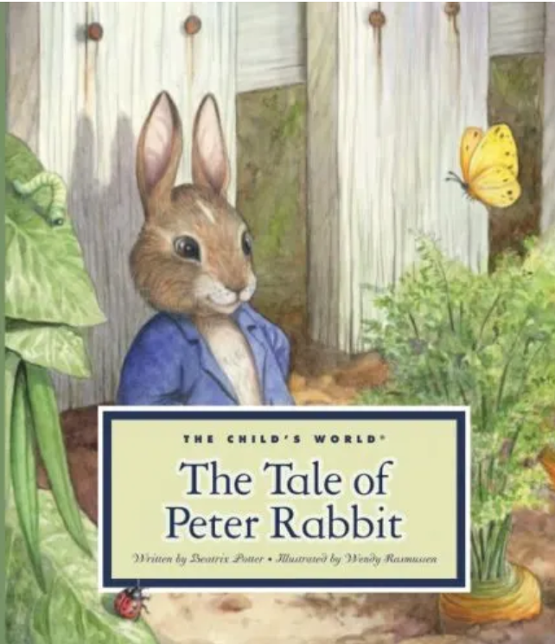
Pictures of C.S. Lewis
Lewis at age four
Lewis’ favorite childhood books were written by Beatrix Potter
https://www.bookbub.com/blog/facts-about-cs-lewis

Slide 23
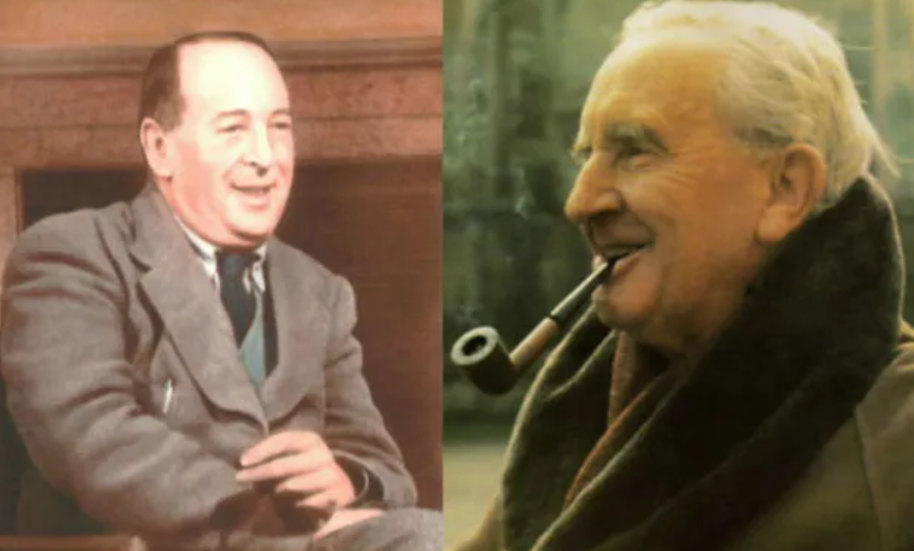
Pictures of C.S. Lewis
Lewis and J.R.R. Tolkien
https://www.bookbub.com/blog/facts-about-cs-lewis

Slide 24
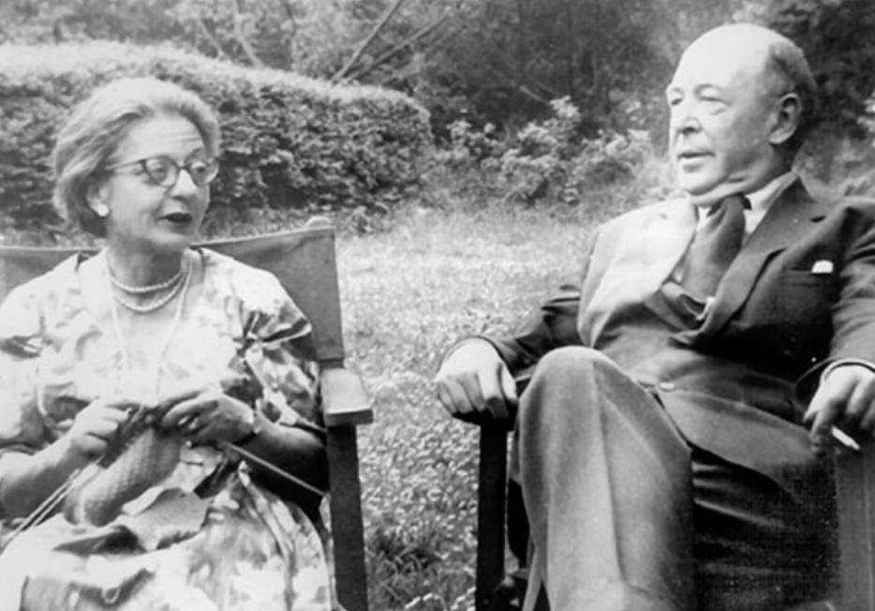
Pictures of C.S. Lewis
Lewis’ and his wife, Joy Davidman Gresham
https://www.bookbub.com/blog/facts-about-cs-lewis

Slide 25
Dietrich Bonhoeffer
https://www.pastortheologians.com/articles/2021/1/9/bonhoeffer-and-the-church-struggle-a-challenge-for-the-church-today

Slide 26
Class Discussion Time
https://www.weareteachers.com/moving-beyond-classroom-discussions/

Slide 27
*Class Discussion Time
Have you read any of C.S Lewis’ books? If so, are there any that you would care to comment on?
When Lewis went from being poor to being well off due to royalties from his writings and speaking engagements, he refused to upgrade his standard of living, and instead established a charitable fund for his royalty earnings. Is this a practice that all Christians who are financially well off should seek to emulate?
Lewis, in his writings, views anyone who holds to broad Christian ideas (belief in God and the Trinity, etc.) as a genuine Christian – even if they hold to a wrong understanding of the Gospel (such as Roman Catholics). Do you find C.S. Lewis’ broadly inclusive view of Christianity troubling?
Do you have a topic or question that you would like to see us to discuss?

