Slide 2
Dietrich Bonhoeffer
https://www.pastortheologians.com/articles/2021/1/9/bonhoeffer-and-the-church-struggle-a-challenge-for-the-church-today

Slide 3
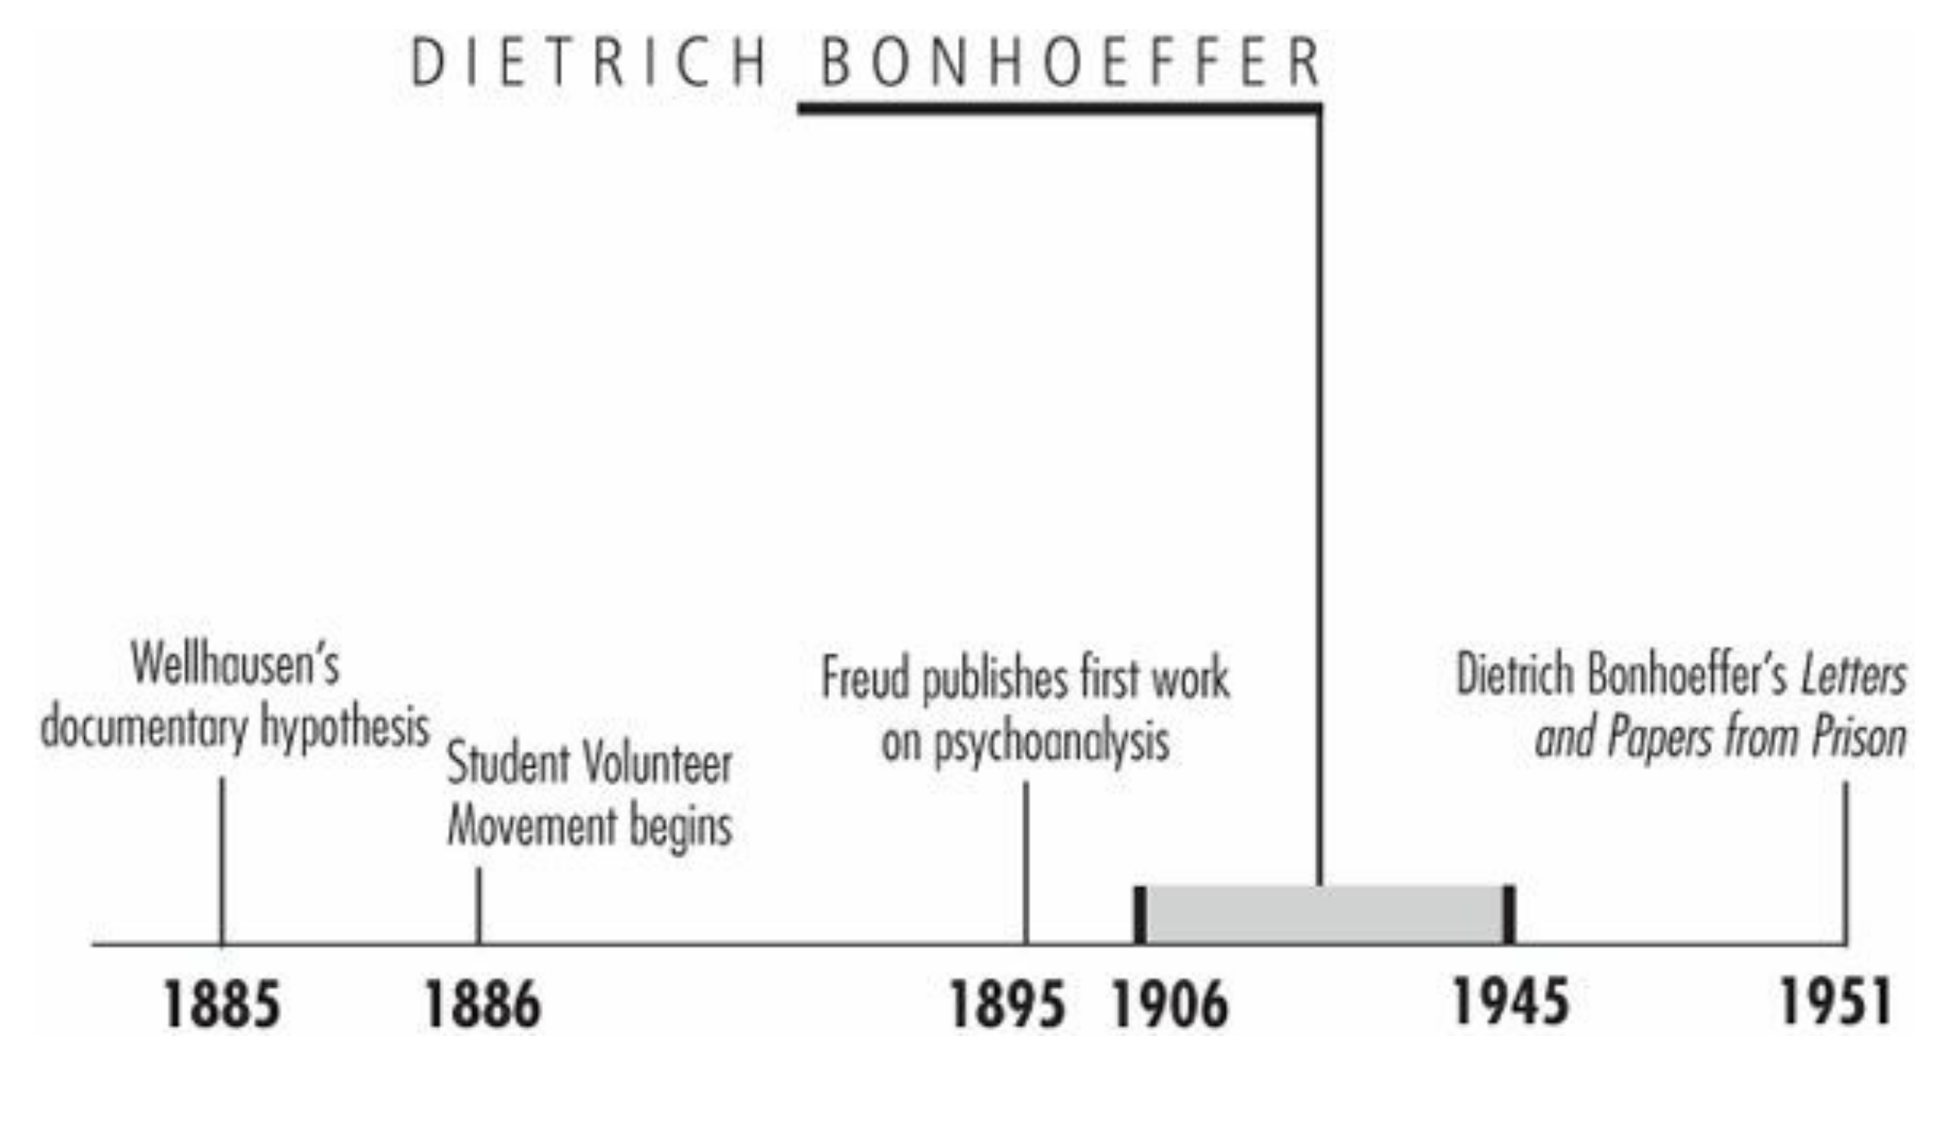
Timeline
Galli, Mark. 131 Christians Everyone Should Know (p. 378).

Slide 4
Dietrich Bonhoeffer
While Hitler was in power, German pastor Hermann Gruner wrote: The time is fulfilled for the German people of Hitler. It is because of Hitler that Christ, God the helper and redeemer, has become effective among us…. Hitler is the way of the Spirit and the will of God for the German people to enter the Church of Christ.
Another pastor put it more succinctly: “Christ has come to us through Adolph Hitler.”
The German people had been so despondent after the defeat of World War I and the subsequent economic depression that the charismatic Hitler appeared to be the nation's answer to prayer—at least to most Germans.
One exception was theologian Dietrich Bonhoeffer, who was determined not only to refute this idea but also to topple Hitler, even if it meant killing him.
Galli, Mark. 131 Christians Everyone Should Know (p. 378).

Slide 5
Dietrich Bonhoeffer
Bonhoeffer was born into an aristocratic family.
His mother was daughter of the preacher at the court of Kaiser Wilhelm II, and his father was a prominent neurologist and professor of psychiatry at the University of Berlin.
In addition to his other siblings, Dietrich had a twin sister, Sabine: he and Sabine were the sixth and seventh children out of eight.
All eight children were raised in a liberal, nominally religious environment and were encouraged to dabble in great literature and the fine arts.
Bonhoeffer's skill at the piano, in fact, led some in his family to believe he was headed for a career in music.
When at age 14, Dietrich announced he intended to become a minister and theologian, the family was not pleased.
Galli, Mark. 131 Christians Everyone Should Know

Slide 6
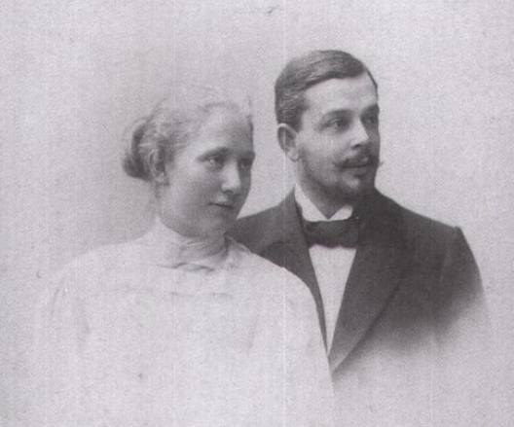
Dietrich Bonhoeffer Parents: Karl and Paula
https://www.amazon.com/Dietrich-Bonhoeffer-Brief-Renate-Bethge/dp/0800636775?asin=0800636775&revisionId=&format=4&depth=1

Slide 7
Dear Mama,
I want you and Papa to know that you are constantly in my thoughts, and I thank God for all you have been to me and the rest of the family. I know you have always lived for us, and have never had a life of your own.
And that is why there is no one else with whom I can share all that I am going through.
(Dietrich Bonhoeffer from prison to his parents December 28, 1944).
https://bonhoefferblog.wordpress.com/2009/06/13/a-letter-from-the-prisoner-dietrich-bonhoeffer-to-his-mother/

Slide 8
Dietrich Bonhoeffer
Bonhoeffer graduated from the University of Berlin in 1927, at age 21, and then spent some months in Spain as an assistant pastor to a German congregation.
Then it was back to Germany to write a dissertation, which would grant him the right to a university appointment.
He then spent a year in America, at New York's Union Theological Seminary, before returning to the post of lecturer at the University of Berlin.
Galli, Mark. 131 Christians Everyone Should Know

Slide 9
Dietrich Bonhoeffer
Although Bonhoeffer found the American seminary not up to his exacting German standards (“There is no theology here.”), he had life-changing experiences and friendships.
He studied under Reinhold Niebuhr and met Frank Fisher, a black fellow-seminarian who introduced him to Abyssinian Baptist Church in Harlem, where Bonhoeffer taught Sunday school and formed a lifelong love for African-American spirituals, a collection of which he took back to Germany.
During this time, he developed a deep sympathy for the state of blacks living in America in that day and he was deeply troubled by the separation that existed between blacks and whites in American churches.
https://www.wikiwand.com/en/Dietrich_Bonhoeffer

Slide 10
Dietrich Bonhoeffer
In 1931, at age 25, he returned to Berlin and was ordained as a pastor in the Evangelical Church.
The early 1930s were a period of great upheaval in Germany, with the instability of Weimar Germany and the mass unemployment of the Great Depression leading to the election of Adolf Hitler in 1933.
While the election of Hitler was widely welcomed by the German population, including significant parts of the Church, Bonhoeffer was a firm opponent of Hitler’s philosophy.
Two days after Hitler’s election as Chancellor in January, 1933, Bonhoeffer delivered a radio address criticizing the concept of “The Fuhrer,” and in particular the danger of an idolatrous cult. His radio broadcast was cut off mid-air.
https://tdbi.org/dietrich-bonhoeffer/biography/

Slide 11
Dietrich Bonhoeffer
In April 1933, Bonhoeffer raised opposition to the persecution of Jews and argued that the Church had a responsibility to act against this kind of policy.
Bonhoeffer sought to organize the Protestant Church to reject Nazi ideology from infiltrating it.
This led to a breakaway branch – The Confessing Church—which Bonhoeffer helped form with the prominent Berlin pastor, Martin Niemoller.
The Confessing Church sought to stand in contrast to the Nazi-supported, “German Christian” movement.
However, in practice, it was difficult to agree on bold initiatives to oppose the Nazification of society and the church.
https://www.wikiwand.com/en/Dietrich_Bonhoeffer

Slide 12
Dietrich Bonhoeffer
Bonhoeffer felt disillusioned by the weakness of the church and the political opposition, and in the autumn of 1933, he took a two-year appointment to a German-speaking Protestant congregation in London.
After two years, Bonhoeffer returned to Berlin.
He felt a call to his native country and to share in its struggles, despite the bleak outlook.
Shortly after his return, one leader of the Confessing Church was arrested and another fled to Switzerland; Bonhoeffer had his authorization to teach revoked in 1936, after being denounced as a pacifist and enemy of the state.
https://tdbi.org/dietrich-bonhoeffer/biography/

Slide 13
Dietrich Bonhoeffer
In the meantime, Bonhoeffer had written The Cost of Discipleship (1937), a call to more faithful and radical obedience to Christ and a severe rebuke of comfortable Christianity:
“Cheap grace is preaching forgiveness without requiring repentance, baptism without church discipline, Communion without confession…. Cheap grace is grace without discipleship, grace without the cross, grace without Jesus Christ, living and incarnate.”
Galli, Mark. 131 Christians Everyone Should Know

Slide 14
Dietrich Bonhoeffer
During this time, Bonhoeffer was teaching pastors in an underground seminary.
But after the seminary was discovered and closed, the Confessing Church became increasingly reluctant to speak out against Hitler, and moral opposition proved increasingly ineffective, so Bonhoeffer began to change his strategy.
To this point he had been a pacifist, and he had tried to oppose the Nazis through religious action and moral persuasion.
Galli, Mark. 131 Christians Everyone Should Know

Slide 15
Dietrich Bonhoeffer
Worried he would be required to swear an oath to Hitler or be arrested, Bonhoeffer left Germany for the United States in June 1939.
After less than two years, he returned again to Germany because he felt guilty for seeking sanctuary and not having the courage to practice what he preached.
He wrote to his American sponsor:
I have come to the conclusion that I made a mistake in coming to America. … Christians in Germany will have to face the terrible alternative of either willing the defeat of their nation in order that Christian civilization may survive or willing the victory of their nation and thereby destroying civilization. I know which of these alternatives I must choose but I cannot make that choice from security.
https://tdbi.org/dietrich-bonhoeffer/biography/

Slide 16
Dietrich Bonhoeffer
Once back in Germany, Bonhoeffer joined the Abwehr, the German military intelligence agency. It was within the Abwehr that the strongest opposition to Hitler was found.
Bonhoeffer was aware of various assassination plots, and it was during the darkest hours of the Second World War that he began to question his pacifism.
He eventually came to see the need for violent opposition to an unprecedented and unparalleled evil:
The great masquerade of evil has played havoc with all our ethical concepts. For evil to appear disguised as light, charity, historical necessity or social justice is quite bewildering to anyone brought up on our traditional ethical concepts, while for the Christian who bases his life on the Bible, it merely confirms the fundamental wickedness of evil.
https://tdbi.org/dietrich-bonhoeffer/biography/

Slide 17
Dietrich Bonhoeffer
When the General Secretary of The World Council of Churches asked Bonhoeffer, “What do you pray for in these days?” Bonhoeffer replied, “If you want to know the truth, I pray for the defeat of my nation.”
Under the cover of the Abwehr, Bonhoeffer served as a messenger for the small German resistance movement. He made contact with associates of the British government – though his outreach was ignored as the Allies pursued a policy of requiring “unconditional surrender.”
Within the Abwehr, efforts were made to help some German Jews escape to neutral Switzerland.
It was Bonhoeffer’s involvement in this activity that led to his arrest in April 1943.
https://tdbi.org/dietrich-bonhoeffer/biography/

Slide 18
Dietrich Bonhoeffer
On January 13, 1943, Bonhoeffer had become engaged to Maria von Wedemeyer, the granddaughter of his close friend and Finkenwalde seminary supporter, Ruth von Kleist Retzow.
Ruth had campaigned for this marriage for several years, although up until late October 1942, Bonhoeffer remained a reluctant suitor despite Ruth being part of his innermost circle.
A large age gap loomed between Bonhoeffer and Maria: he was 36 to her 18.
Bonhoeffer had first met his would-be fiancée Maria when she was his confirmation student at age eleven.
https://www.wikiwand.com/en/Dietrich_Bonhoeffer

Slide 19
Dietrich Bonhoeffer
The two also spent almost no time alone together prior to the engagement and did not see each other between becoming engaged and Bonhoeffer's arrest in April.
Once he was in prison, however, Maria's status as fiancée became invaluable, as it meant she could visit Bonhoeffer and correspond with him.
While their relationship was troubled, she was a source of food and smuggled messages.
Bonhoeffer made Eberhard Bethge his heir, but Maria, in allowing her correspondence with Bonhoeffer to be published after her death, provided an invaluable addition to the scholarship.
https://www.wikiwand.com/en/Dietrich_Bonhoeffer

Slide 20
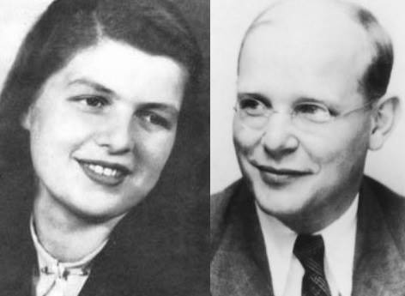
Dietrich Bonhoeffer and his Fiancé Maria Von Wedemayer
https://www.facebook.com/GermanResistance1933.1945/photos/maria-von-wedemayer-engaged-to-dietrich-bonhoeffer-her-fianc%C3%A9-was-executed-on-9-/1664028987096412/

Slide 21
My Dearest Maria,
You can’t possibly imagine what it means to me, in my present predicament, to have you. I’m under God’s special guidance here. I feel sure. To me, the way in which we found each other such a short time before my arrest seems a definite indication of that. Once again, things went according to man’s confusion and God’s providence.
(Dietrich Bonhoeffer from prison to his fiancé August 12, 1943).
http://goingtodamasc.us/a-very-bonhoeffer-valentines-day/

Slide 22
Dietrich Bonhoeffer
Bonhoeffer was confined to Tegel Military prison for a year and a half.
Here he continued his writings, including his magnum opus, Ethics.
Helped by sympathetic guards, his writings were smuggled out.
In his letters from prison, Bonhoeffer reflected on the significance of his imprisonment:
There remains an experience of incomparable value. We have for once learned to see the great events of world history from below, from the perspective of the outcasts, the suspects, the maltreated — in short, from the perspective of those who suffer. Mere waiting and looking on is not Christian behavior. Christians are called to compassion and to action.
https://tdbi.org/dietrich-bonhoeffer/biography/

Slide 23
Dietrich Bonhoeffer
After the failed assassination bomb plot against Hitler of July 20th, 1944, Bonhoeffer was moved to the Gestapo’s high-security prison. He was then transferred to Buchenwald concentration camp and finally Flossenburg.
Even during the privations of the concentration camp, Bonhoeffer retained a deep spirituality which was evident to other prisoners. He continued to minister to his fellow prisoners.
Payne Best, a fellow inmate and officer of the British Army, wrote this observation of Bonhoeffer.
Bonhoeffer was different, just quite calm and normal, seemingly perfectly at his ease… his soul really shone in the dark desperation of our prison. He was one of the very few men I have ever met to whom God was real and ever close to him.
https://tdbi.org/dietrich-bonhoeffer/biography/

Slide 24
Dietrich Bonhoeffer
On April 8th, 1945 (just two weeks prior to the camp being liberated by U.S. forces), Bonhoeffer was given a cursory court martial and sentenced to death by hanging.
Just before his execution, he asked a fellow inmate to relate a message to his English friend, Bishop George Bell of Chichester, “This is the end – for me the beginning of life.”
The camp doctor who witnessed the execution of Bonhoeffer later wrote:
I saw Pastor Bonhoeffer … kneeling on the floor praying fervently to God. I was most deeply moved by the way this lovable man prayed, so devout and so certain that God heard his prayer. At the place of execution, he again said a short prayer and then climbed the few steps to the gallows, brave and composed. His death ensued after a few seconds. In the almost fifty years that I worked as a doctor, I have hardly ever seen a man die so entirely submissive to the will of God.
https://tdbi.org/dietrich-bonhoeffer/biography/

Slide 25
Dietrich Bonhoeffer
Bonhoeffer's prison correspondence was eventually edited and published as Letters and Papers from Prison, which inspired much controversy and the “death of God” movement of the 1960s (though Bonhoeffer's close friend and chief biographer, Eberhard Bethge, said Bonhoeffer implied no such thing).
His Cost of Discipleship, as well as Life Together (about Christian community, based on his teaching at the underground seminary), have remained devotional classics.
Galli, Mark. 131 Christians Everyone Should Know

Slide 26
Isaac Watts
https://creation.com/isaac-watts

Slide 27
Class Discussion Time
https://www.weareteachers.com/moving-beyond-classroom-discussions/

Slide 28
*Class Discussion Time
Bonhoeffer believed that a Christian who had truly experienced the grace of God would show it in the way they lived their lives and even in their response to things going on in the society around them: “Cheap grace is preaching forgiveness without requiring repentance, baptism without church discipline, Communion without confession…. Cheap grace is grace without discipleship, grace without the cross, grace without Jesus Christ, living and incarnate.” Do you agree?
Bonhoeffer could have, on numerous occasions, left Germany and later, escaped from prison, thus saving himself. But he felt it would be wrong to do so. Does God always expect Christians to remain in difficult situations (even when they have a chance to escape)?
Bonhoeffer was a part of a group within Germany that attempted to assassinate Adolf Hitler. Though he did not directly participate in the assassination attempt, he was aware of it and continued to work with and support the group. He believed (contrary to convictions that he held earlier in his life) that such a drastic evil called for drastic counter measures. Do you agree?
Do you have a topic or question that you would like to see us to discuss?

