Slide 2
Isaac Watts
FATHER OF ENGLISH HYMNODY
https://creation.com/isaac-watts

Slide 3
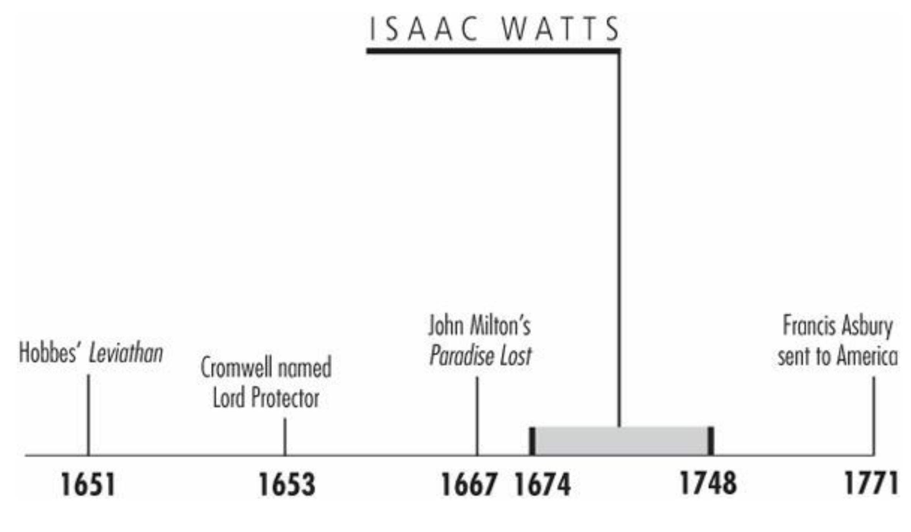
Timeline
Galli, Mark. 131 Christians Everyone Should Know

Slide 4
“Joy to the world, the Lord is come / Let earth receive her King / Let every heart, prepare him room / And heaven and nature sing.”
In his later years, Isaac Watts once complained about hymn singing in church: “To see the dull indifference, the negligent and thoughtless air that sits upon the faces of a whole assembly, while the psalm is upon their lips, might even tempt a charitable observer to suspect the fervency of their inward religion.”
He had been making this complaint since his late teens. His father, tired of his hearing his complaints, challenged him to write something better.
The following week, the adolescent Isaac presented his first hymn to the church, “Behold the Glories of the Lamb,” which received an enthusiastic response.
And so the career of the “Father of English Hymnody” had begun.
Galli, Mark. 131 Christians Everyone Should Know

Slide 5
Head of a Genius
At Isaac's birth in 1674, his father was in prison for his Nonconformist sympathies (that is, he would not embrace the established Church of England).
His father was eventually freed (and fathered seven more children), but Isaac respected his courage and remembered his mother's tales of nursing her children on the jail steps.
Young Isaac showed genius early. He was learning Latin by age 4, Greek at 9, French (which he took up to converse with his refugee neighbors) at 11, and Hebrew at 13.
Several wealthy townspeople offered to pay for his university education at Oxford or Cambridge, which would have led him into Anglican ministry.
Isaac refused and at 16 went to London to study at a leading Nonconformist academy.
Upon graduation, he spent five years as a private tutor.
Galli, Mark. 131 Christians Everyone Should Know

Slide 6
Head of a Genius
In 1702 Isaac became pastor of London's Mark Lane Independent (i.e. Congregational) Chapel, then one of the city's most influential independent churches.
But the following year, he began suffering from psychiatric illness that would plague him for the rest of his life.
He had to pass off more and more of his work to his assistant and eventually resigned in 1712.
His illness and unsightly appearance took its toll on his personal life.
Galli, Mark. 131 Christians Everyone Should Know

Slide 7
Head of a Genius
Isaac's five-foot, pale, skinny frame was topped by a disproportionately oversized head.
Almost every portrait of him depicts him in a large gown with large folds—an apparent attempt by the artists to disguise his homeliness.
This was probably the reason for Elizabeth Singer's rejection of his marriage proposal. As one biographer noted, “Though she loved the jewel, she could not admire the casket [case] which contained it.”
Galli, Mark. 131 Christians Everyone Should Know

Slide 8
Reaching the Ordinary Christian
Though German Lutherans had been singing hymns for 100 years, John Calvin had urged his followers to sing only metrical psalms; English Protestants had followed Calvin's lead.
Watts's 1707 publication of Hymns and Spiritual Songs technically wasn't a collection of hymns or metrical psalms, but it was a collection of consequence.
In fact, it contained what would become some of the most popular English hymns of all time, such as “When I Survey the Wondrous Cross.”
Galli, Mark. 131 Christians Everyone Should Know

Slide 9
Reaching the Ordinary Christian
Watts didn't reject metrical psalms; he simply wanted to see them more impassioned. “They ought to be translated in such a manner as we have reason to believe David would have composed them if he had lived in our day,” he wrote.
Psalms of David Imitated in the Language of the New Testament followed in 1719.
Many of his English colleagues couldn't recognize these translations.
How could “Joy to the World” really be Psalm 98? Or “Jesus Shall Reign Where'er the Sun” be Psalm 72, or “O God Our Help in Ages Past” be Psalm 90?
Watts was unapologetic, arguing that he deliberately omitted several psalms and large parts of others, keeping portions “as might easily and naturally be accommodated to the various occasions of Christian life, or at least might afford us some beautiful allusions to Christian affairs.”
Galli, Mark. 131 Christians Everyone Should Know

Slide 10
Reaching the Ordinary Christian
Furthermore, where the psalmist fought with personal enemies, Watts turned the biblical invective against spiritual adversaries: sin, Satan, and temptation.
Finally, he said, “Where the flights of his faith and love are sublime, I have often sunk the expressions within the reach of an ordinary Christian.”
Such looseness brought criticism. “Christian congregations have shut out divinely inspired psalms and taken in Watts's flights of fancy,” protested one detractor.
Galli, Mark. 131 Christians Everyone Should Know

Slide 11
Reaching the Ordinary Christian
Others dubbed the new songs “Watts's whims.”
But after church splits, pastor firings, and other arguments, Watts's paraphrases won out.
“He was the first who taught the Dissenters to write and speak like other men, by showing them that elegance might consist with piety,” wrote the famed lexicographer (and Watts's contemporary) Samuel Johnson.
Galli, Mark. 131 Christians Everyone Should Know

Slide 12
Reaching the Ordinary Christian
More than a poet, however, Watts was also a scholar of wide reputation, especially in his later years.
He wrote nearly 30 theological treatises; essays on psychology, astronomy, and philosophy; three volumes of sermons; the first children's hymnal; and a textbook on logic that served as a standard work on the subject for generations.
But his poetry remains his lasting legacy and earned him acclaim on both sides of the Atlantic.
Benjamin Franklin published his hymnal, Cotton Mather maintained a long correspondence, and John Wesley acknowledged him as a genius—though Watts maintained that Charles Wesley's “Wrestling Jacob” was worth all of his own hymns.
Galli, Mark. 131 Christians Everyone Should Know

Slide 13
J.S. Bach
“THE FIFTH EVANGELIST”
https://interlude.hk/revealed-the-violent-thuggish-world-of-the-young-js-bach/

Slide 14
Timeline
Galli, Mark. 131 Christians Everyone Should Know

Slide 15
“At a reverent performance of music, God is always at hand with his gracious presence.”
When he was 48, Johann Sebastian Bach acquired a copy of Luther's three-volume translation of the Bible.
He pored over it as if it were a long-lost treasure. He underlined passages, corrected errors in the text and commentary, inserted missing words, and made notes in the margins.
Near 1 Chronicles 25 (a listing of Davidic musicians) he wrote, “This chapter is the true foundation of all God-pleasing music.”
At 2 Chronicles 5:13 (which speaks of temple musicians praising God), he noted, “At a reverent performance of music, God is always at hand with his gracious presence.”
Galli, Mark. 131 Christians Everyone Should Know (p. 98).

Slide 16
“At a reverent performance of music, God is always at hand with his gracious presence.”
As one scholar put it, Bach the musician was indeed “a Christian who lived with the Bible.”
Besides being the baroque era's greatest organist and composer, and one of the most productive geniuses in the history of Western music, Bach was also a theologian who just happened to work with a keyboard.
Galli, Mark. 131 Christians Everyone Should Know (p. 98).

Slide 17
Early Genius
Bach was born and schooled in Eisenach, Thuringia (at the same school Luther had attended), part of a family that in seven generations produced 53 prominent musicians.
Johann Sebastian received his first musical instruction from his father, Johann Ambrosius, a town musician.
By age 10 Bach was orphaned, and he went to live and study with his elder brother, Johann Christoph, an organist in Ohrdruf.
By age 15 Bach was ready to establish himself in the musical world, and he immediately showed immense talent in a variety of areas.
He become a soprano (women weren't permitted to sing in church) in the choir of Lüneburg's Church of Saint Michael.
Galli, Mark. 131 Christians Everyone Should Know

Slide 18
Early Genius
Three years later, he was a violinist in the chamber orchestra of Prince Johann Ernst of Weimar.
After a few months, he moved to Arnstadt to become a church organist.
In October 1705, Bach was invited to study for one month with the renowned Danishborn German organist and composer Dietrich Buxtehude.
Bach was so enamored with his teacher, he stretched the visit to two months. When he returned to his church, he was severely criticized for breach of contract and, in the ensuing weeks, for his new organ flourishes and harmonies that accompanied congregational singing.
But he was already too highly respected to be dismissed.
Galli, Mark. 131 Christians Everyone Should Know

Slide 19
Early Genius
In 1707 he married a second cousin, Maria Barbara Bach, and went to Mülhausen to become organist in the Church of Saint Blasius.
After various moves and prominent jobs, he finally settled down in Leipzig in 1723, where he remained for the rest of his life.
Maria died in 1720, and the next year he married Anna Magdalena Wilcken, an accomplished singer. She bore him 13 children, in addition to the seven he'd had by Maria, and helped copy his music for performers.
Galli, Mark. 131 Christians Everyone Should Know

Slide 20
Bitter Setting, Brilliant Work
Bach's stay in Leipzig, as musical director and choirmaster of Saint Thomas's church and school, wasn't always happy.
He squabbled continually with the town council, and neither the council nor the populace appreciated his musical genius.
They said he was a stuffy old man who clung stubbornly to obsolete forms of music.
Consequently, they paid him a miserable salary, and when he died even contrived to defraud his widow of her meager inheritance.
Ironically, in this setting Bach wrote his most enduring music.
Galli, Mark. 131 Christians Everyone Should Know

Slide 21
Bitter Setting, Brilliant Work
For a time he wrote a cantata each week (today, a composer who writes a cantata a year is highly praised), 202 of which survive.
Most conclude with a chorale based on a simple Lutheran hymn, and the music is at all times closely bound to biblical texts.
Among these works are the Ascension Cantata and the Christmas Oratorio.
Galli, Mark. 131 Christians Everyone Should Know

Slide 22
Bitter Setting, Brilliant Work
In Leipzig he also composed his epic Mass in B Minor, The Passion of St John and The Passion of St Matthew—all for use as worship services.
The latter piece has sometimes been called “the supreme cultural achievement of all Western civilization,” and even the radical skeptic Friedrich Nietzsche (1844–1900) admitted upon hearing it, “One who has completely forgotten Christianity truly hears it here as gospel.”
Galli, Mark. 131 Christians Everyone Should Know

Slide 23
Bach Revival
After Bach's death, people seemed glad to wipe their ears of his music.
He was remembered less as a composer than as an organist and harpsichordist.
Some of his music was sold, and some was reportedly used to wrap garbage.
For the next 80 years his music was neglected by the public, although a few musicians (Mozart and Beethoven, for example) admired it.
Not until 1829, when German composer Felix Mendelssohn arranged a performance of The Passion of St Matthew, did a larger audience appreciate Bach the composer.
Galli, Mark. 131 Christians Everyone Should Know

Slide 24
Bach Revival
In terms of pure music, Bach has become known as one who could combine the rhythm of French dances, the gracefulness of Italian song, and the intricacy of German counterpoint—all in one composition.
In addition, Bach could write musical equivalents of verbal ideas, such as undulating a melody to represent the sea.
But music was never just music to Bach. Nearly three-fourths of his 1,000 compositions were written for use in worship.
Between his musical genius, his devotion to Christ, and the effect of his music, he has come to be known in many circles as “the Fifth Evangelist.”
Galli, Mark. 131 Christians Everyone Should Know

Slide 25
George Frideric Handel
COMPOSER OF MESSIAH
https://www.theguardian.com/music/2020/nov/04/handel-where-to-start-with-his-music

Slide 26
Class Discussion Time
https://www.weareteachers.com/moving-beyond-classroom-discussions/

Slide 27
*Class Discussion Time
In Isaac Watts day, it was considered wrong to sing anything but Psalms, because they were scripture. There are a number of Presbyterian churches that still hold to this idea even in the present day. How would you respond to someone who wanted to argue this way?
Watts furthermore was criticized for deviating too much from the Psalms that he translated them into hymns. Do you see a problem with him doing this?
Watts once complained that “To see the dull indifference, the negligent and thoughtless air that sits upon the faces of a whole assembly, while the psalm is upon their lips, might even tempt a charitable observer to suspect the fervency of their inward religion.” Do you think this criticism could justifiably be made in our own day, where people can sing hymns as well as Psalms? If so, what, if anything, should be about that?
Bach, a musical genius, was unappreciated in his own day. This is reminiscent of Jesus’ words “A prophet is not without honor except in his hometown and in his own household.” (Mat. 13:57). Could this be an encouraging thought to keep in mind when you face opposition in your own day?
Do you have a topic or question that you would like to see us to discuss?

