Slide 2
George Frideric Handel
COMPOSER OF MESSIAH
https://www.theguardian.com/music/2020/nov/04/handel-where-to-start-with-his-music

Slide 3
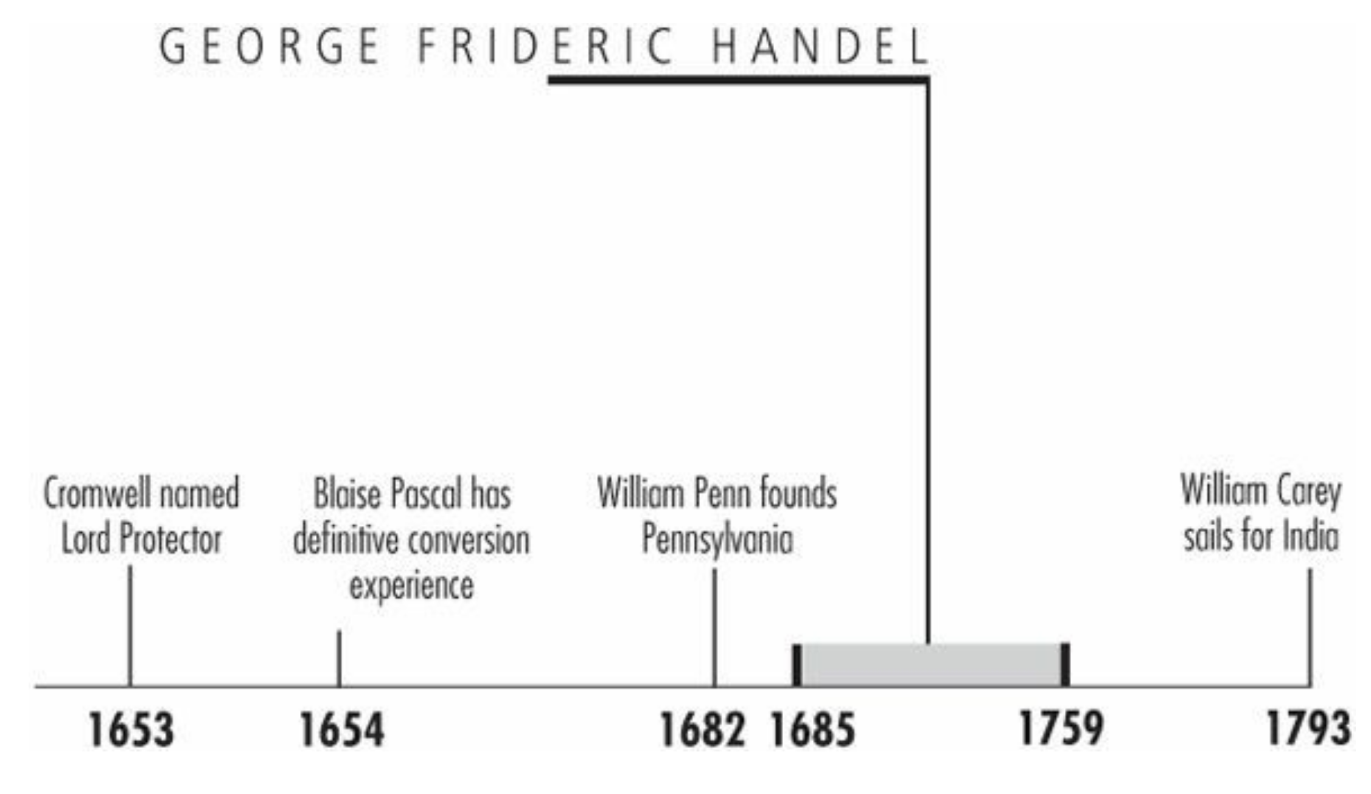
Timeline
Galli, Mark. 131 Christians Everyone Should Know

Slide 4
“He [Handel] would frequently declare the pleasure he felt in setting the Scriptures to music, and how contemplating the many sublime passages in the Psalms had contributed to his edification.” — Sir John Hawkins .”
By 1741 George Frideric Handel was a failure. Bankrupted, in great physical pain, and the victim of plots to sabotage his career, the once-great opera composer scheduled a “farewell” appearance in London in April.
To the London elite, it looked like this “German nincompoop,” as he was once called, was through.
That summer, however, he composed Messiah, which not only brought him back into the spotlight, but is still deemed by some to be “an epitome of Christian faith.”
Galli, Mark. 131 Christians Everyone Should Know (p. 98).

Slide 5
Opposition Begins
Unlike Handel's fellow countryman and contemporary Johann Bach (the two were born the same year but never met), Handel never had a musical family.
George's father was a practical “surgeon-barber” who discouraged his son's musical career at every turn. His son was to be a lawyer.
Indeed, George studied law until 1703, even though his father (who finally allowed his son to take music lessons at age 9) died when he was 11.
By age 12, Handel was substituting for his organ teacher and had written his first composition.
After musical studies in Germany and Italy, Handel moved to England, where he stayed for the rest of his life and became a composer for the Chapel Royal.
Galli, Mark. 131 Christians Everyone Should Know

Slide 6
Opposition Begins
His greatest passion was for the opera—an ill-timed passion, for the form was quickly falling out of fashion in England.
The most popular work in that day was the 1728 Beggar's Opera, which satirized the opera itself.
Still, Handel continued to pen operas into the 1740s, losing more and more money.
Handel's friends expressed concern that the concert hall was nearly empty. Never mind, he joked, an empty venue would mean great acoustics.
He didn't joke for long. In 1737 Handel's opera company went bankrupt, and he suffered what seems to be a mild stroke.
Galli, Mark. 131 Christians Everyone Should Know

Slide 7
Opposition Begins
But to make matters worse, his latest musical fascination—the oratorio (a composition for orchestra and voices telling a sacred story without costumes, scenery, or dramatic action)—was his most controversial yet.
His first oratorio (actually, the first of its kind in English), Esther, was met with outrage by the church.
A Bible story was being told by “common mummers,” and even worse, the words of God were being spoken in the theater! “What are we coming to when the will of Satan is imposed upon us in this fashion?” cried one minister.
The bishop of London apparently agreed and prohibited the oratorio from being performed.
Galli, Mark. 131 Christians Everyone Should Know

Slide 8
Opposition Begins
When Handel proceeded anyway, and the royal family attended, it was met with success—but the church was still angry.
In 1739 advertisements for Israel in Egypt were torn down by devout Christians, who also disrupted its performances.
All of this angered the devoutly Lutheran Handel.
As his friend Sir John Hawkins commented, “Throughout his life, [he] manifested a deep sense of religion. In conversation he would frequently declare the pleasure he felt in setting the Scriptures to music, and how contemplating the many sublime passages in the Psalms had contributed to his edification.”
Galli, Mark. 131 Christians Everyone Should Know

Slide 9
Opposition Begins
Though irritated—and Handel was often irritated, earning a reputation for prolific cursing in five languages—he dismissed the Puritans' concerns: “I have read my Bible very well,” he said, “and will choose for myself.”
In fact, Handel maintained that he knew the Bible as well as any bishop.
Financially, however, it did him little good. Once the composer for royalty, he was now threatened with debtor's prison.
Galli, Mark. 131 Christians Everyone Should Know

Slide 10
Delivered by Messiah
Deeply depressed, Handel was visited by his friend Charles Jennens.
The wealthy, devout Anglican had written a libretto about the life of Christ and the work of redemption, with the text completely taken from the Bible.
A fussy perfectionist, Jennens had written it to challenge the deists who denied the divinity of Jesus. Would Handel compose the music for it? he asked.
Handel answered that he would, and estimated its completion in a year.
Galli, Mark. 131 Christians Everyone Should Know

Slide 11
Delivered by Messiah
Soon thereafter, a group of Dublin charities approached Handel to compose a work for a benefit performance.
The money raised would help free men from debtor's prison, and Handel would receive a generous commission.
Now with a text and a motivation, Handel began composing Messiah on August 22, 1741.
Within six days, Part One was finished. In nine more, Part Two. Six more and Part Three was done.
It took him only an additional two days to finish the orchestration.
Galli, Mark. 131 Christians Everyone Should Know

Slide 12
Delivered by Messiah
Handel composed like a man obsessed. He rarely left his room and rarely touched his meals.
But in 24 days he had composed 260 pages—an immense physical feat.
When he finished writing what would become known as the Hallelujah Chorus, he said, “I did think I did see all Heaven before me, and the great God himself.”
Though the performance of the piece again caused controversy (Jonathan Swift, author of Gulliver's Travels and then the dean of Saint Patrick's Cathedral, was outraged and initially refused to allow his musicians to participate), the premiere on April 13, 1742, at the Fishamble Street Musick Hall was a sensation.
Galli, Mark. 131 Christians Everyone Should Know

Slide 13
Delivered by Messiah
An overcapacity crowd of 700 people attended, raising 400 pounds to release 142 men from prison. (The demand for tickets was so great that men were asked not to wear their swords and women asked not to wear hoops in their skirts, allowing 100 extra people into the audience. Such hoops immediately fell out of fashion for concerts.)
Still it took nearly a year for Messiah to be invited to London.
Religious controversy surrounded it there, too, and Handel compromised a bit by dropping the “blasphemous” title from handbills.
It was instead called “A New Sacred Oratorio.”
Galli, Mark. 131 Christians Everyone Should Know

Slide 14
Delivered by Messiah
But the controversy wasn't strong enough to keep away the king, who stood instantly at the opening notes of the Hallelujah Chorus—(though some historians have suggested it was because he was partially deaf and mistook it for the national anthem) a tradition ever since.
Though it had met rave reviews in Dublin (“the most finished piece of music”), it was not very popular in London after its premiere.
By 1745 Handel was again playing to empty houses and nearing poverty.
Not until his oratorio Judas Maccabeus, which was misunderstood by the English as a veiled nationalistic anthem, did Handel (and with him Messiah) reach the pinnacle of his career.
Galli, Mark. 131 Christians Everyone Should Know

Slide 15
Delivered by Messiah
Until his death, Handel conducted 30 performances of Messiah (none at Christmastime, for Handel deemed it a Lenten piece), only one of which was in a church, Bristol Cathedral. ¹
In that audience sat John Wesley. “I doubt if that congregation was ever so serious at a sermon as they were during this performance,” he remarked. ¹
Over the years, performances of the Messiah have not always been as well received by Christian leaders: for example, John Newton, following a performance of the work in 1784, fired off more than fifty sermons assailing the oratorio as a trivial amusement “no better than a profanation of the name and truths of God” and no less than a second “crucifying of the Son of God.” ²
Handel died on the day before Easter 1759, hoping to “meet his good God, his sweet Lord and Savior, on the day of his Resurrection.” ¹
¹ Galli, Mark. 131 Christians Everyone Should Know
² https://www.praeclara.org/?page_id=641

Slide 16
Charles Wesley
GREATEST HYMN WRITER OF ALL TIME
https://www.wikiwand.com/en/Charles_Wesley

Slide 17
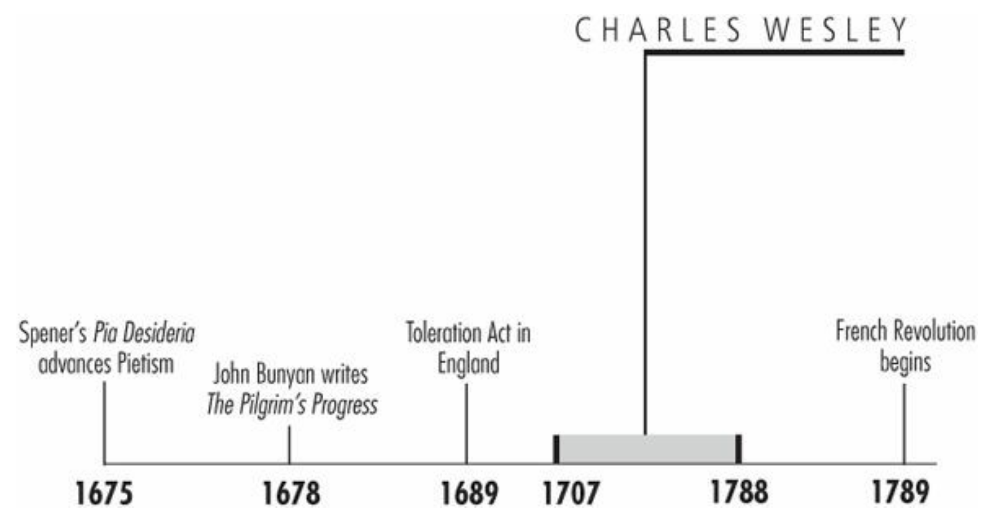
Timeline
Galli, Mark. 131 Christians Everyone Should Know

Slide 18
“O for a thousand tongues to sing / My dear Redeemer's praise / The glories of my God and King, / The triumphs of his grace!”
He was said to have averaged 10 poetic lines a day for 50 years.
He wrote 8,989 hymns, 10 times the volume composed by the only other candidate (Isaac Watts) who could conceivably claim to be the world's greatest hymn writer.
He composed some of the most memorable and lasting hymns of the church:
“Hark! The Herald Angels Sing”
“And Can It Be”
“O for a Thousand Tongues to Sing”
“Love Divine, All Loves Excelling”
“Jesus, Lover of My Soul”
“Christ the Lord Is Risen Today”
“Soldiers of Christ, Arise”
“Rejoice! the Lord Is King!”
Galli, Mark. 131 Christians Everyone Should Know (p. 98).

Slide 19
“O for a thousand tongues to sing / My dear Redeemer's praise / The glories of my God and King, / The triumphs of his grace!”
And yet he is often referred to as the “forgotten Wesley.”
His brother John is considered the organizational genius behind the founding of Methodism.
But without the hymns of Charles, the Methodist movement may have gone nowhere.
As one historian put it, “The early Methodists were taught and led as much through [Charles's] hymns as through sermons and [John] Wesley's pamphlets.”
Galli, Mark. 131 Christians Everyone Should Know (p. 98).

Slide 20
Language Scholar
Charles Wesley was the eighteenth of Samuel and Susannah Wesley's nineteen children (only 10 lived to maturity).
He was born prematurely in December 1707 and appeared dead.
He lay silent, wrapped in wool, for weeks.
When older, Charles joined his siblings as each day his mother, Susannah, who knew Greek, Latin, and French, methodically taught them for six hours.
Galli, Mark. 131 Christians Everyone Should Know

Slide 21
Language Scholar
Charles then spent 13 years at Westminster School, where the only language allowed in public was Latin.
He added nine years at Oxford, where he received his master's degree.
It was said that he could reel off the Latin poet Virgil by the half hour.
It was off to Oxford University next, and to counteract the spiritual tepidity of the school, Charles formed the Holy Club, and with two or three others celebrated Communion weekly and observed a strict regimen of spiritual study.
Because of the group's religious regimen, which later included early rising, Bible study, and prison ministry, members were called “Methodists.”
Galli, Mark. 131 Christians Everyone Should Know

Slide 22
Language Scholar
In 1735 Charles joined his brother John (they were now both ordained), to become a missionary in the colony of Georgia—John as chaplain of the rough outpost and Charles as secretary to Governor Oglethorpe.
Shot at, slandered, suffering sickness, shunned even by Oglethorpe, Charles could have echoed brother John's sentiments as they dejectedly returned to England the following year: “I went to America to convert the Indians, but, oh, who will convert me?”
It turned out to be the Moravians.
Galli, Mark. 131 Christians Everyone Should Know

Slide 23
Language Scholar
After returning to England, Charles taught English to Moravian Peter Böhler, who prompted Charles to look at the state of his soul more deeply.
During May 1738, Charles began reading Martin Luther's volume on Galatians while ill.
He wrote in his diary, “I labored, waited, and prayed to feel ‘who loved me, and gave himself for me.’”
He shortly found himself convinced, and journaled, “I now found myself at peace with God, and rejoice in hope of loving Christ.”
Two days later he began writing a hymn celebrating his conversion.
Galli, Mark. 131 Christians Everyone Should Know

Slide 24
Evangelistic Preacher
At evangelist George Whitefield's instigation, John and Charles eventually submitted to “be more vile” and do the unthinkable: preach outside of church buildings.
In his journal entries from 1739 to 1743, Charles computed the number of those to whom he had preached.
Of only those crowds for whom he stated a figure, the total during these five years comes to 149,400.
From June 24 through July 8, 1738, Charles reported preaching twice to crowds of ten thousand at Moorfields, once called “that Coney Island of the eighteenth century.”
He preached to 20,000 at Kennington Common plus gave a sermon on justification before the University of Oxford.
Galli, Mark. 131 Christians Everyone Should Know

Slide 25
Evangelistic Preacher
On a trip to Wales in 1747, the adventurous evangelist, now 40 years old, met 20-year-old Sally Gwynne, whom he soon married.
By all accounts, their marriage was a happy one.
Charles continued to travel and preach, sometimes creating tension with John, who complained that “I do not even know when and where you intend to go.”
His last nationwide trip was in 1756. After that, his health led him gradually to withdraw from itinerant ministry.
He spent the remainder of his life in Bristol and London, preaching at Methodist chapels.
Galli, Mark. 131 Christians Everyone Should Know

Slide 26
Magnificent Obsession
Throughout his adult life, Charles wrote verse, predominantly hymns for use in Methodist meetings.
He produced 56 volumes of hymns in 53 years, producing in his lyrics what brother John called a “distinct and full account of scriptural Christianity.”
The Methodists became known (and sometimes mocked) for their exuberant singing of Charles's hymns.
A contemporary observer recorded, “The song of the Methodists is the most beautiful I ever heard…. They sing in a proper way, with devotion, serene mind and charm.”
Galli, Mark. 131 Christians Everyone Should Know

Slide 27
Magnificent Obsession
Charles Wesley quickly earned admiration for his ability to capture universal Christian experience in memorable verse.
In the following century, Henry Ward Beecher declared, “I would rather have written that hymn of Wesley's, 'Jesus, Lover of My Soul,' than to have the fame of all the kings that ever sat on the earth.”
The compiler of the massive Dictionary of Hymnology, John Julian, concluded that “perhaps, taking quantity and quality into consideration, [Charles Wesley was] the greatest hymn-writer of all ages.”
Galli, Mark. 131 Christians Everyone Should Know

Slide 28
Fanny J. Crosby
PROLIFIC AND BLIND HYMN WRITER
https://www.wikiwand.com/en/Charles_Wesley

Slide 29
Class Discussion Time
https://www.weareteachers.com/moving-beyond-classroom-discussions/

Slide 30
*Class Discussion Time
During the eighteenth and nineteenth centuries, the Puritans and many Christian leaders that we admire (e.g. John Newton, Charles Spurgeon) strongly condemned theater attendance. Were they right in doing so? What would such leaders think of believers in our day going to theaters?
At evangelist George Whitefield's instigation, John and Charles eventually submitted to “be more vile” and do the unthinkable: preach outside of church buildings. Such preaching met with tremendous success in their day. Do you think that outdoor preaching would be as successful if we were to do it our day? Why or why not?
Do you have a topic or question that you would like to see us to discuss?

