Slide 2
Fanny J. Crosby
PROLIFIC AND BLIND HYMN WRITER
https://vancechristie.com/2017/02/24/facing-death-finding-life-fanny-crosby/

Slide 3
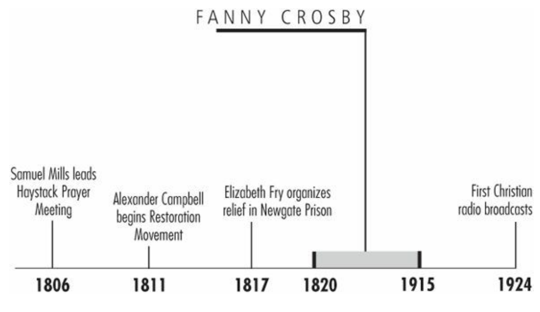
Timeline
Galli, Mark. 131 Christians Everyone Should Know

Slide 4
“Oh, what a happy soul I am, / Although I cannot see! / I am resolved that in this world / Contented I will be.”
Francis Jane Crosby wrote more than 9,000 hymns, some of which are among the most popular in every Christian denomination.
She wrote so many that she was forced to use pen names lest the hymnals be filled with her name above all others.
And, for most people, the most remarkable thing about her was that she had done so in spite of her blindness.
Galli, Mark. 131 Christians Everyone Should Know (p. 98).

Slide 5
“Oh, what a happy soul I am, / Although I cannot see! / I am resolved that in this world / Contented I will be.”
A well-meaning preacher once told Fanny: “I think it is a great pity that the Master did not give you sight when he showered so many other gifts upon you,”
Fanny Crosby responded at once, as she had heard such comments before:
“Do you know that if at birth I had been able to make one petition, it would have been that I was born blind?” said the poet, who had been able to see only for her first six weeks of life. “Because when I get to heaven, the first face that shall ever gladden my sight will be that of my Savior.”
Galli, Mark. 131 Christians Everyone Should Know (p. 98).

Slide 6
Blinded by a Quack
Born in Putnam County, New York, Crosby became ill within two months.
Unfortunately, the family doctor was away, and another man—pretending to be a certified doctor—treated her by prescribing hot mustard poultices to be applied to her eyes.
Her illness eventually relented, but the treatment left her blind. When the doctor was revealed to be a quack, he disappeared.
A few months later, Crosby's father died. Her mother was forced to find work as a maid to support the family, and Fanny was mostly raised by her Christian grandmother.
Galli, Mark. 131 Christians Everyone Should Know

Slide 7
Blinded by a Quack
Her love of poetry began early—her first verse, written at age eight, echoed her lifelong refusal to feel sorry for herself:
Oh, what a happy soul I am,
Although I cannot see!
I am resolved that in this world
Contented I will be.
How many blessings I enjoy
That other people don’t,
To weep and sigh because I'm blind
I cannot, and I won’t!
Galli, Mark. 131 Christians Everyone Should Know

Slide 8
Blinded by a Quack
While she enjoyed her poetry, she zealously memorized the Bible.
Memorizing five chapters a week, even as a child she could recite the Pentateuch, the Gospels, Proverbs, the Song of Solomon, and many psalms chapter and verse.
Her mother's hard work paid off. Shortly before her fifteenth birthday, Crosby was sent to the recently founded New York Institute for the Blind, which would be her home for 23 years: 12 as a student, 11 as a teacher.
She initially indulged in her own poetry and was called upon to pen verses for various occasions.
In time the principal asked her to avoid such “distractions” in favor of her general instruction. “We have no right to be vain in the presence of the Owner and Creator of all things,” he said.
Galli, Mark. 131 Christians Everyone Should Know

Slide 9
Blinded by a Quack
It was the work of a traveling phrenologist (one who studies the shape and irregularities of the skull for insights into character and mental capacity) that changed the school's mind and again ignited her passion.
Though his study is now the ridicule of science, the phrenologist's words were to prove prophetic: “Here is a poetess. Give her every possible encouragement. Read the best books to her and teach her the finest that is in poetry. You will hear from this young lady some day.”
Galli, Mark. 131 Christians Everyone Should Know

Slide 10
Poetry for Presidents
It didn't take long. By age 23 Crosby was addressing Congress and making friendships with presidents.
In fact, she knew all the chief executives of her lifetime, especially Grover Cleveland, who served as secretary for the Institute for the Blind before his election.
Another member of the institute, former pupil Alexander van Alstine, married Crosby in 1858. Considered one of New York's best organists, he wrote the music to many of Crosby's hymns.
Crosby herself put music to only a few of hers, though she played harp, piano, guitar, and other instruments.
Galli, Mark. 131 Christians Everyone Should Know

Slide 11
Poetry for Presidents
More often, musicians came to her for lyrics. For example, one day musician William Doane dropped by her home for a surprise visit, begging her to put some words to a tune he had recently written and which he was to perform at an upcoming Sunday School convention.
The only problem was that his train to the convention was leaving in 35 minutes. He sat at the piano and played the tune. “Your music says, 'Safe in the Arms of Jesus,’” Crosby said, scribbling out the hymn's words immediately. “Read it on the train and hurry. You don't want to be late!”
The hymn became one of Crosby's most famous.
Galli, Mark. 131 Christians Everyone Should Know

Slide 12
Poetry for Presidents
Though she was under contract to submit three hymns a week to her publisher and often wrote six or seven a day (for a dollar or two each), many became incredibly popular.
When Dwight Moody and Ira Sankey began to use them in their crusades, they received even more attention.
Among them are:
“Blessed Assurance”
“All the Way My Savior Leads Me”
“To God Be the Glory”
“Pass Me Not, O Gentle Savior”
“Safe in the Arms of Jesus”
“Rescue the Perishing”
“Jesus Keep Me Near the Cross”
Galli, Mark. 131 Christians Everyone Should Know

Slide 13
Poetry for Presidents
She could write very complex hymns and compose music with a more classical structure (she could even improvise it), but she preferred to write simple, sentimental verses that could be used for evangelism.
She continued to write her poetry up to her death, a month shy of her 95th birthday.
Her last stanza was: “You will reach the river brink, some sweet day, bye and bye”.
Galli, Mark. 131 Christians Everyone Should Know

Slide 14
William Carey
FATHER OF MODERN PROTESTANT MISSIONS
https://missionkaali.org/the-less-told-story-of-william-carey/

Slide 15
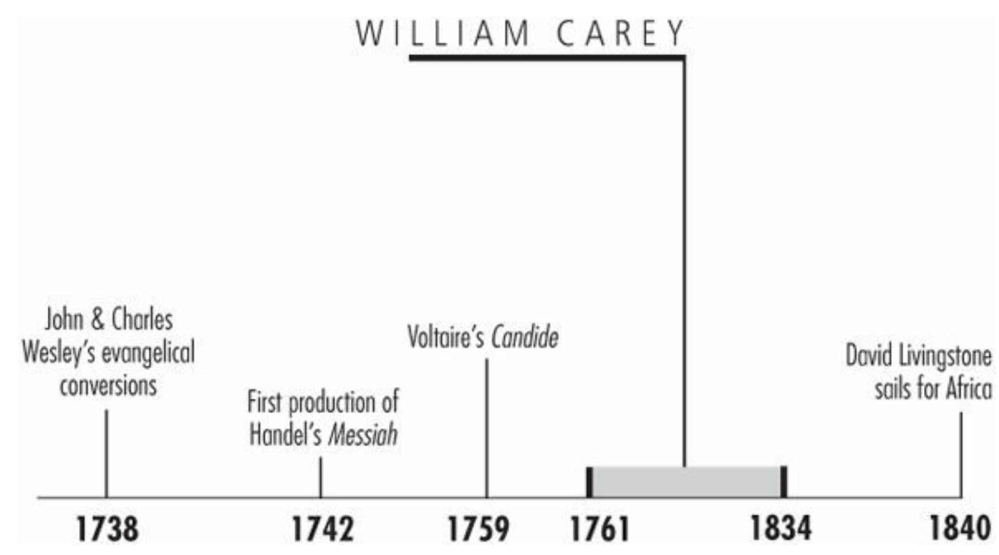
Timeline
Galli, Mark. 131 Christians Everyone Should Know

Slide 16
“Expect great things; attempt great things.”
At a meeting of Baptist leaders in the late 1700s, a newly ordained minister stood to argue for value of overseas missions.
He was abruptly interrupted by an older minister who said, “Young man, sit down! You are an enthusiast. When God pleases to convert the heathen, he'll do it without consulting you or me.”
That such an attitude is inconceivable today is largely due to the subsequent efforts of that young man, William Carey.
Galli, Mark. 131 Christians Everyone Should Know

Slide 17
Plodder
Carey was raised in the obscure, rural village of Paulerpury, in the middle of England.
He apprenticed in a local cobbler's shop, where the nominal Anglican was converted.
He enthusiastically took up the faith, and though little educated, the young convert borrowed a Greek grammar and proceeded to teach himself New Testament Greek.
When his master died, he took up shoemaking in nearby Hackleton, where he met and married Dorothy Plackett, who soon gave birth to a daughter.
Galli, Mark. 131 Christians Everyone Should Know

Slide 18
Plodder
But the apprentice cobbler's life was hard—the child died at age 2—and his pay was insufficient. Carey's family sunk into poverty and stayed there even after he took over the business. “I can plod,” he wrote later, “I can persevere to any definite pursuit.”
All the while, he continued his language studies, adding Hebrew and Latin, and became a preacher with the Particular Baptists.
He also continued pursuing his lifelong interest in international affairs, especially the religious life of other cultures.
Galli, Mark. 131 Christians Everyone Should Know

Slide 19
Plodder
Carey was impressed with early Moravian missionaries and was increasingly dismayed at his fellow Protestants' lack of missions interest.
In response, he penned An Enquiry into the Obligations of Christians to Use Means for the Conversion of the Heathens.
He argued that Jesus' Great Commission applied to all Christians of all times, and he castigated fellow believers of his day for ignoring it: “Multitudes sit at ease and give themselves no concern about the far greater part of their fellow sinners, who to this day, are lost in ignorance and idolatry.”
Galli, Mark. 131 Christians Everyone Should Know

Slide 20
Plodder
Carey didn't stop there: in 1792 he organized a missionary society, and at its inaugural meeting preached a sermon with the call, “Expect great things from God; attempt great things for God!”
Within a year, Carey, John Thomas (a former surgeon), and Carey's family (which now included three boys, and another child on the way) were on a ship headed for India.
Galli, Mark. 131 Christians Everyone Should Know

Slide 21
Stranger in a Strange Land
Thomas and Carey had grossly underestimated what it would cost to live in India, and Carey's early years there were miserable.
Thomas eventually deserted the enterprise, and Carey was forced to move his family repeatedly as he sought employment that could sustain them.
Illness racked the family, and loneliness and regret set in: “I am in a strange land,” he wrote, “no Christian friend, a large family, and nothing to supply their wants.”
And yet he never lost hope: “Well, I have God, and his word is sure.”
He learned Bengali with the help of a pundit, and in a few weeks began translating the Bible into Bengali and preaching to small gatherings.
Galli, Mark. 131 Christians Everyone Should Know

Slide 22
Stranger in a Strange Land
When Carey himself contracted malaria, and then his 5-year-old Peter died of dysentery, it became too much for his wife, Dorothy, whose mental health deteriorated rapidly.
She suffered delusions, accusing Carey of adultery and threatening him with a knife.
She eventually had to be confined to a room and physically restrained. “This is indeed the valley of the shadow of death to me,” Carey wrote, though characteristically added, “But I rejoice that I am here notwithstanding; and God is here.”
Galli, Mark. 131 Christians Everyone Should Know

Slide 23
Eventual Success
In October 1799, things finally turned. He was invited to locate in a Danish settlement in Serampore, near Calcutta.
He was now under the protection of the Danes, who permitted him to preach legally (in the British-controlled areas of India, all of Carey's missionary work had been illegal).
Carey was joined by William Ward, a printer, and Joshua and Hanna Marshman, teachers.
Mission finances increased considerably as Ward began securing government printing contracts, the Marshmans opened schools for children, and Carey began teaching at Fort William College in Calcutta.
Galli, Mark. 131 Christians Everyone Should Know

Slide 24
Eventual Success
In December 1800, after seven years of missionary labor, Carey baptized his first convert, Krishna Pal, and two months later, he published his first Bengali New Testament.
With this and subsequent editions, Carey and his colleagues laid the foundation for the study of modern Bengali, which up to this time had been an “unsettled dialect.”
Carey continued to expect great things; over the next 28 years, he and his pundits translated the entire Bible into India's major languages: Bengali, Oriya, Marathi, Hindi, Assamese, and Sanskrit and parts of 209 other languages and dialects.
He also sought social reform in India, including the abolition of infanticide, widow burning (sati), and assisted suicide.
Galli, Mark. 131 Christians Everyone Should Know

Slide 25
Eventual Success
Carey and the Marshmans founded Serampore College in 1818, a divinity school for Indians, which today offers theological and liberal arts education for some 2,500 students.
By the time Carey died, he had spent 41 years in India without a furlough. His mission could count only some 700 converts in a nation of millions, but he had laid an impressive foundation of Bible translations, education, and social reform.
His greatest legacy was in the worldwide missionary movement of the nineteenth century that he inspired.
Missionaries like Adoniram Judson, Hudson Taylor, and David Livingstone, among thousands of others, were impressed not only by Carey's example, but by his words “Expect great things; attempt great things.”
The history of nineteenth-century Protestant missions is in many ways an extended commentary on the phrase.
Galli, Mark. 131 Christians Everyone Should Know

Slide 26
Adoniram and Ann Judson
America’s First Foreign Missionaries
https://www.frontlinemissionsa.org/missions/adoniram-and-ann-judson-missionaries-to-burma-gcm-2106

Slide 27
Class Discussion Time
https://www.weareteachers.com/moving-beyond-classroom-discussions/

Slide 28
*Class Discussion Time
Fanny Crosby had many reasons (humanly speaking) to become bitter and cynical: And yet Fanny retained a thankful and upbeat attitude and lived a productive life. Contrast Fanny’s attitude in the face of difficulty with how most of us tend to respond when faced with difficulty.
William Carey argued that Jesus' Great Commission applied to all Christians of all times, and he castigated fellow believers of his day for ignoring it: “Multitudes sit at ease and give themselves no concern about the far greater part of their fellow sinners, who to this day, are lost in ignorance and idolatry.” Do you believe Jesus' Great Commission applies to all Christians of all times? If so, what should that look like?
And Jesus came and said to them, "All authority in heaven and on earth has been given to me. ¹⁹ Go therefore and make disciples of all nations, baptizing them in the name of the Father and of the Son and of the Holy Spirit, ²⁰ teaching them to observe all that I have commanded you. And behold, I am with you always, to the end of the age." (Mat 28:18-20)
William Carey endured great difficulty for many years before he saw any success in ministry. Yet he never gave up or lost hope that God would do great things. Contrast this with how most of us tend to respond to a lack of success after years of ministry effort.

