Slide 2
Adoniram and Ann Judson
America’s First Foreign Missionaries
https://www.frontlinemissionsa.org/missions/adoniram-and-ann-judson-missionaries-to-burma-gcm-2106

Slide 3
​Early Life
Judson was born on August 9, 1788, in Malden, Massachusetts to Adoniram Judson, Sr., a Congregational minister, and his wife Abigail.¹
He was a brilliant boy. His mother taught him to read in one week when he was three to surprise his father when he came home from a trip. ²
Judson entered the College of Rhode Island & Providence Plantations (now Brown University) when he was sixteen, and graduated as valedictorian of his class at the age of nineteen. ¹
While studying at college, he met a young man named Jacob Eames, a devout deist and skeptic.
Judson and Eames developed a strong friendship, leading to Judson's abandonment of his childhood faith and parents' religious instruction. ¹
¹ https://www.wikiwand.com/en/Adoniram_Judson
² https://www.desiringgod.org/messages/how-few-there-are-who-die-so-hard

Slide 4
​Conversion
After graduation he wrote for the stage in New York for a while, but then chose to head West for the frontier.
En route, at an Inn, he listened all night to a man dying in the next room.
In the morning he was shocked to learn that the deceased man was his unbelieving college companion, Jacob Eames .
Adoniram knew that Jacob Eames was lost, but he also recognized that the same was true of himself.
The West lost its allure, he turned his horse around and enrolled at a Theological Seminary.
He was converted to Christ there, in 1808.
https://www.frontlinemissionsa.org/missions/adoniram-and-ann-judson-missionaries-to-burma-gcm-2106

Slide 5
Interest in Foreign Missions
It wasn't long before Judson began to become interested in overseas mission work, but as yet no American had ever considered missionary work except within the continent itself, and so no mission society existed to support him.
It was during his study of mission work in the East that he came upon a copy of a book by a British army officer entitled An Account of an Embassy to the Kingdom of Ava (the Kingdom of Ava was a dominant kingdom in the country of Burma).
This book had a profound effect upon him and from that time on his goal was to (eventually) preach the Gospel in Burma (which today is called Myanmar).
https://theologicalstudies.org.uk/article_judson.html

Slide 6
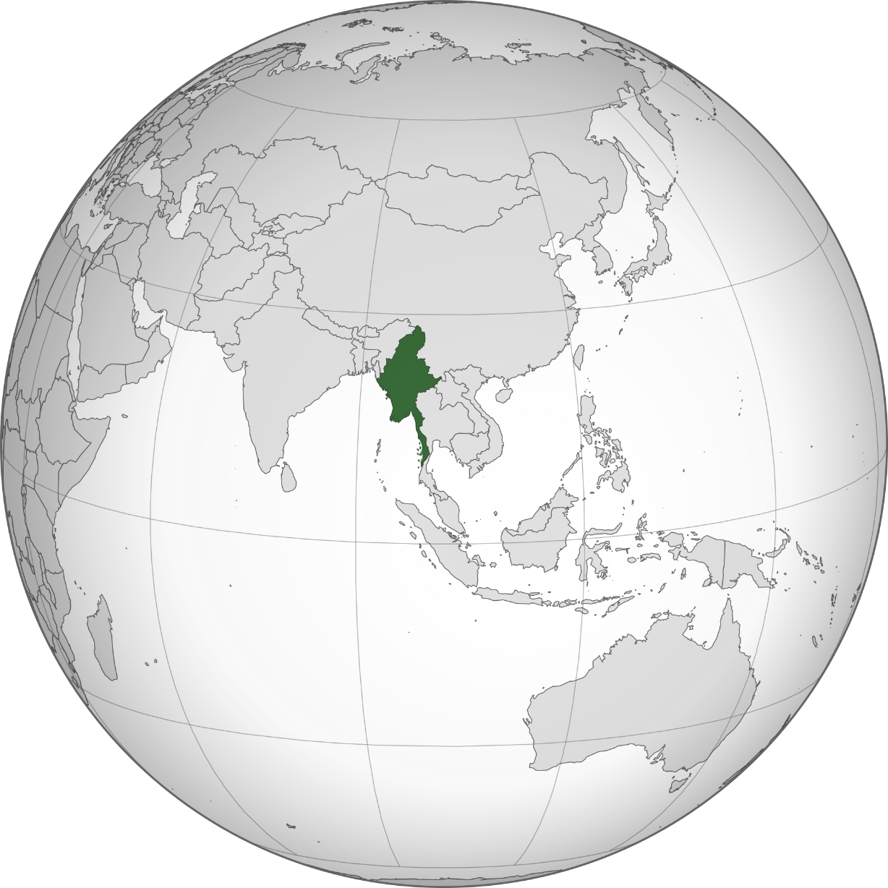
Myanmar (Burma)
https://www.wikiwand.com/en/Myanmar

Slide 7
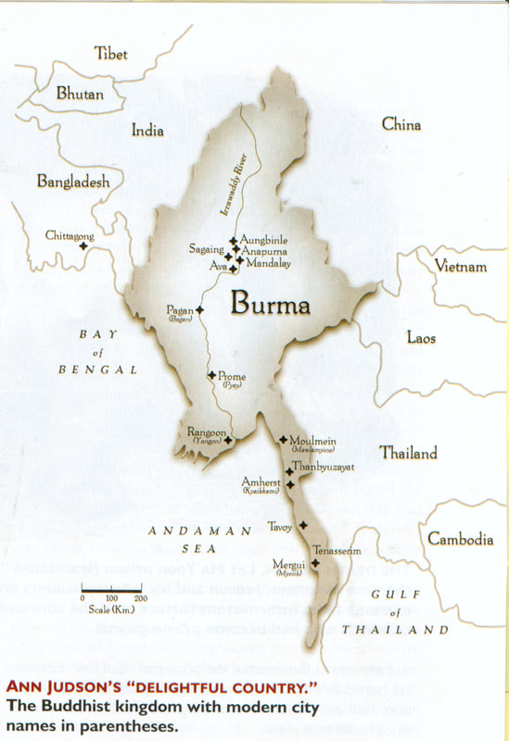
Burma
https://www.frontlinemissionsa.org/missions/adoniram-and-ann-judson-missionaries-to-burma-gcm-2106

Slide 8
Interest in Foreign Missions
Judson believed that in order to go to Burma he would need the support of a mission society, so together with group of like-minded students from the Seminary he established an American mission organization that came to be known as The American Board.
This organization supported Congregational foreign missions for over a century after its formation.
Finances were still a problem, so Adoniram was dispatched to the London Missionary Society (LMS) to raise support there.
On the way his ship was captured by a French privateer, so he was forced to travel to London via a French prison, from which he had to escape!
But then upon his return to the States, it was decided that the new mission would be funded exclusively by Americans, rather than jointly with the LMS.
https://theologicalstudies.org.uk/article_judson.html

Slide 9
Marriage
Adoniram courted Ann Hasseltine who was generally accepted as “the most beautiful girl in Bradford, Massachusetts.”
His letter to her father is a classic:
“I have now to ask whether you can consent to part with your daughter, whether you can consent to her departure to a heathen land, and her subjection to the hardships and suffering of a missionary life? Whether you can consent to her exposure to the dangers of ocean, to the fatal influence of the southern climate of India, to every kind of want and distress, to degradation, insult, persecution, and perhaps a violent death?”
John Hasseltine consented and Adoniram married Ann Hasseltine.
https://www.frontlinemissionsa.org/missions/adoniram-and-ann-judson-missionaries-to-burma-gcm-2106

Slide 10
A Brief Visit with William Carey
On February 19, 1812, only days after getting married, they set sail for Calcutta to join the Baptist Missionary William Carey of England, who was already in India.
They studied the doctrine of Baptism in the original Greek in Scripture on their 4-month journey to India, in an effort to be able to work together with Carey on their doctrinal differences, being of "Covenant Theology" themselves.
The Judsons became convinced that "Believer's Baptism" was scriptural, and were Baptized by immersion in India, changing their denominational affiliation.
They are counted among the group of the first Baptist Foreign Missionaries.
https://dozierdon.blogspot.com/2010/06/future-is-as-bright-as-promises-of-god.html

Slide 11
A Brief Visit with William Carey
A fellow missionary of Judson's, Luther Rice, had reached the same conclusion concerning baptism.
He returned to the United States to encourage the Baptist churches of this land to form a Baptist foreign missions society.
His suggestion was accepted, and in 1814 the Baptist Foreign Missionary Society was organized and became the supporting organization for the Judson mission.
https://www.wholesomewords.org/missions/bjudson24.html

Slide 12
A Brief Visit with William Carey
The Judsons were eventually forced to leave India by the British East India Company, and decided they would go to Burma.
William Carey warned the Judsons of the hostility and savagery of Burma, and advised them not to go there, but they decided to go in spite of the dangers that they knew they might face.
https://dozierdon.blogspot.com/2010/06/future-is-as-bright-as-promises-of-god.html

Slide 13
Tragedy
En-route by ship to Rangoon, their first child was stillborn during the voyage.
In July 1813, the Judsons reached Rangoon. Their hearts sank at the sights and the smells of the place.
Burma was a resistant Buddhist nation, under a cruel and despotic king, who viciously opposed their work.
After their arrival they had another son who died at the age of seven months.
https://www.frontlinemissionsa.org/missions/adoniram-and-ann-judson-missionaries-to-burma-gcm-2106

Slide 14
Perseverance
Judson, who already knew Latin, Greek, and Hebrew, immediately began studying the Burmese grammar but took over three years learning to speak it.
This was due, in part, to the radical difference in structure between Burmese and that of Western languages.
He found a tutor and spent twelve hours per day studying the language. He and his wife firmly dedicated themselves to understanding it.
During this time they were almost entirely isolated from contact with any European or American.
This was the case for their first three years in Burma.
Four years passed before Judson dared even to hold a semi-public service.
https://www.wikiwand.com/en/Adoniram_Judson

Slide 15
Perseverance
At first, Judson tried adapting to Burmese customs by wearing a yellow robe to mark himself as a teacher of religion, but he soon changed to white to show he was not a Buddhist.
Then, he gave up the whole attempt as artificial and decided that, regardless of his dress, no Burmese would identify him as anything but a foreigner.
He accommodated to some Burmese customs and built a zayat, the customary bamboo and thatch reception shelter, on the street near his home as a reception room and meeting place for Burmese men.
Judson began public evangelism in 1818 sitting in his zayat by the roadside calling out “Ho! Everyone that thirsteth for knowledge…”
Two months later, after seven years of labor, he baptized his first Burmese convert, Maung Naw, a 35-year-old timber worker from the hill tribes.
https://www.wikiwand.com/en/Adoniram_Judson

Slide 16
Resistance
In 1820, Judson attempted to petition the Emperor of Burma in the hope that he would grant freedom for the missionaries to preach and teach throughout the country, as well as remove the sentence of death that was given for those Burmese who changed religion.
The Emperor disregarded their appeal and threw one of their Gospel tracts to the ground after reading a few lines.
The progress of Christianity would continue to be slow with much risk of endangerment and death in the Burmese Empire.
It took Judson 12 years to make 18 converts. Nevertheless, there was much to encourage him.
He had written a grammar of the language that is still in use today and had begun to translate the Bible.
https://www.wikiwand.com/en/Adoniram_Judson

Slide 17
Resistance
One of the early disciples who was attracted to the new faith was U Shwe Ngong, a teacher and leader of a group of intellectuals who were dissatisfied with Buddhism.
He was a Deist skeptic to whose mind the preaching of Judson, once a college skeptic himself, was singularly challenging.
After consideration, he assured Judson that he was ready to believe in God, Jesus Christ, and the atonement.
Judson, instead of welcoming him to the faith, pressed him further asking if he believed what he had read in the gospel of Matthew that Jesus the son of God died on the cross.
U Shwe Ngong shook his head and said, “Ah, you have caught me now. I believe that he suffered death, but I cannot believe he suffered the shameful death on the cross.”
Not long after, he came back to tell Judson, “I have been trusting in my own reason, not the word of God…. I now believe the crucifixion of Christ because it is contained in scripture.”
https://www.wikiwand.com/en/Adoniram_Judson

Slide 18
Imprisonment and Torture
In 1824, war broke out between Great Britain and Burma.
Although Judson was an American, he was accused of being an English spy and incarcerated in “Death Prison” for 18 months.
Adoniram was mistreated and tortured by the Burmese, confined with 50 others in the most atrocious conditions, filth and squalor.
At night his feet were tied to a bamboo pole, which was raised above his head so that he was forced to sleep, if at all, with only his head and shoulders on the ground.
https://www.frontlinemissionsa.org/missions/adoniram-and-ann-judson-missionaries-to-burma-gcm-2106

Slide 19
Imprisonment and Torture
On the first occasion that Ann was allowed to visit her husband, eight months after his arrest, she carried their new born daughter, Maria.
Ann was shocked that her normally fastidious, neat and presentable husband was in such a degrading state, having to crawl towards her in a condition that she was not even able to describe.
https://www.frontlinemissionsa.org/missions/adoniram-and-ann-judson-missionaries-to-burma-gcm-2106

Slide 20
Imprisonment and Torture
When the British were able to free Adoniram, he was hit with another devastating blow, his beloved wife Ann had died.
Six months later, their 2-year-old daughter, Maria, was buried alongside her mother.
Adoniram sunk into extreme depression, and for a time, the work of the Gospel in Burma came to a halt.
https://www.frontlinemissionsa.org/missions/adoniram-and-ann-judson-missionaries-to-burma-gcm-2106

Slide 21
Success
But in 1831 things began to change. Judson wrote:
The spirit of inquiry . . . is spreading everywhere, through the whole length and breadth of the land.” [We have distributed] nearly 10,000 tracts, giving to none but those who ask. I presume there have been 6000 applications at the house. Some come two or three months’ journey, from the borders of Siam and China — ‘Sir, we hear that there is an eternal hell. We are afraid of it. Do give us a writing that will tell us how to escape it.’ Others, from the frontiers of Kathay, 100 miles north of Ava — ‘Sir, we have seen a writing that tells about an eternal God. Are you the man that gives away such writings? If so, pray give us one, for we want to know the truth before we die.’ Others, from the interior of the country, where the name of Jesus Christ is a little known - ‘Are you Jesus Christ’s man? Give us a writing that tells us about Jesus Christ.
https://www.desiringgod.org/messages/how-few-there-are-who-die-so-hard

Slide 22
Success
Inspired by the steadfastness of the Judsons, new Missionaries from America began arriving.
More and more Burmese were converted to Christ.
In one year, 200 converts were baptized.
In 1832, Judson’s translation of the New Testament was completed, followed in 1834 by the Old Testament.
https://www.frontlinemissionsa.org/missions/adoniram-and-ann-judson-missionaries-to-burma-gcm-2106

Slide 23
Progress
Adoniram then married Sarah Boardman, the widow of a missionary colleague.
He worked at revising his translation of The Bible, alongside instructing native preachers and Evangelists.
When his work on The Bible was finally done, he turned his attention to a Burmese dictionary.
https://www.frontlinemissionsa.org/missions/adoniram-and-ann-judson-missionaries-to-burma-gcm-2106

Slide 24
Disaster
As Sarah’s health deteriorated, Adoniram accompanied her by sea back to America for recuperation, but she died en-route and was buried on the Island of St. Helena in August 1845.
Then the news reached him that their 1½-year-old son, Charles, had died a month before his mother.
https://www.frontlinemissionsa.org/missions/adoniram-and-ann-judson-missionaries-to-burma-gcm-2106

Slide 25
America
Although by now, he could barely whisper, large crowds gathered to hear him speak in America.
When he returned to Burma, he took his third wife, Emily Chubbuck, with him.
Emily generated some controversy as she was half his age and a writer of popular stories.
Nevertheless, there was no doubt that she was a dedicated Christian and devoted to the Mission.
https://www.frontlinemissionsa.org/missions/adoniram-and-ann-judson-missionaries-to-burma-gcm-2106

Slide 26
Karen for Christ
By 1849, the English-Burmese Dictionary had been completed. By the time Adoniram died in 1850, he had established 63 Churches amongst the Karen tribe.
Over 100,000 Karen people had been baptized.
Before he died, Adoniram declared: “When Christ calls me home, I shall go with the gladness of a boy, bounding away from his school.”
All Judson’s 5 surviving children grew up to distinguish themselves in Christian service.
The Karen people in Burma have remained steadfast in their Christian Faith despite severe persecution, an island of Christianity in a sea of Buddhism.
https://www.frontlinemissionsa.org/missions/adoniram-and-ann-judson-missionaries-to-burma-gcm-2106

Slide 27
Legacy
At least 36 Baptist churches in the United States are named after Judson, as well as the town of Judsonia, Arkansas.
Judson is honored with a feast day on the liturgical calendar of the Episcopal Church (USA) on April 12.
Judson Harmon, a former Governor of Ohio, was named after him.
In World War II, the United States liberty ship SS Adoniram Judson was named in his honor.
https://www.wikiwand.com/en/Adoniram_Judson

Slide 28
John G. Paton
Working Among
the Cannibals
https://principlesforlife.org/2014/02/17/angels-gods-secret-agents/

Slide 29
Class Discussion Time
https://www.weareteachers.com/moving-beyond-classroom-discussions/

Slide 30
*Class Discussion Time
Judson was raised in a Christian home, and yet, when going to college was led astray by a fellow student who was a skeptic. This is unfortunately a sad story that is often repeated in Christian families. Do you think there is anything Christian parents can do to keep this kind of thing from happening?
Note that all five of Adoniram Judson’s surviving children grew up to distinguish themselves in Christian service. Is that just the sovereignty of God at work and unrelated to anything that the parents did in raising those kids? Or do you think the effort that parents make in reaching their children for Christ really matters?
Adoniram Judson made huge sacrifices to do the mission work that he did. Do you think it was worth it? If we’re honest, most of us are unwilling to make these kinds of sacrifices – should we be?
Judson when to great lengths to make sure that he had a mission organization supporting him. Do you think that is really necessary? Why or why not?

