Slide 2
John G. Paton
Working Among
the Cannibals
https://principlesforlife.org/2014/02/17/angels-gods-secret-agents/

Slide 3
Early Life
John Gibson Paton was born to James and Janet Paton on May 24, 1824, near Dumfries in South Scotland.
His parents owned very little but were blessed with eleven children—five sons and six daughters—of whom John was the eldest.
John attended a parish school until the age of twelve when he started learning the trade of his father, who was a manufacturer of stockings.
For fourteen hours a day, John operated one of the six stocking frames in his father’s workshop, while taking the two hours assigned for mealtimes to devote himself to serious study.
John grew to have a profound reverence for the Word of God from his father, who shut himself in his “prayer closet” three times a day after every meal and twice a day led his family in devotions.
https://bethanygu.edu/blog/stories/john-g-paton-working-among-the-cannibals/

Slide 4
Early Life
His father’s prayers had an immense impact on John that carried throughout his whole life. John writes in his autobiography:
“Though everything else in religion were by some unthinkable catastrophe to be swept out of memory, were blotted from my understanding, my soul would wander back to those early scenes, and shut itself up once again in that Sanctuary Closet, and, hearing still the echoes of those cries to God, would hurl back all doubt with the victorious appeal, “He walked with God, why may not I?” (p. 11-12)
John learned early on that prayer was to be involved in every aspect of life.
Before John was ever punished for an act of disobedience, his father first got on his knees and prayed. This taught John and his siblings the importance of inviting God into every area of life.
https://bethanygu.edu/blog/stories/john-g-paton-working-among-the-cannibals/

Slide 5
Early Life
John Paton was also greatly influenced by the faith of his mother when she prayed.
In one particular year, there was a severe crop failure and the family had run out of food.
Amidst all their struggles in rearing a family of eleven, this was the hardest time they had ever had.
Seeing that there was no food, John’s mother encouraged all the children to rest, telling them that she had told God everything and that He would send them food in the morning.
https://bethanygu.edu/blog/stories/john-g-paton-working-among-the-cannibals/

Slide 6
Early Life
The next day, being moved by God and not knowing anything about the family’s circumstances, John’s grandfather sent a present to his daughter.
He sent her a bag of new potatoes, ground meal, and some homemade cheese–plenty of food for the large family to survive.
John’s mother, seeing the children’s surprise for how God answered her prayers, had them kneel with her on the ground to thank God for his goodness, and said:
“O my children, love your heavenly Father, tell Him in faith and prayer all your needs, and He will supply your wants so far as it shall be for your good and His glory.”
This phrase, “so far as it shall be for your good and His glory,” would stick with John until his dying breath.
https://bethanygu.edu/blog/stories/john-g-paton-working-among-the-cannibals/

Slide 7
The Call to Missions
In his early twenties, having a great mind for study and believing that he was called to be a minister of the gospel, John prepared himself for the mission field.
He applied for a paid position in Glasgow, where he would be a district visitor and tract distributor, while also receiving one year’s training at the local seminary, that he might be qualified in teaching and work towards ministry.
He was surprised when he was accepted and prepared to leave his family two days after receiving the letter.
https://bethanygu.edu/blog/stories/john-g-paton-working-among-the-cannibals/

Slide 8
The Call to Missions
Upon leaving home, John tied up all of his earthly possessions, including his Bible, in his pocket-handkerchief.
He did not count himself to be in poverty for the Lord was with him.
He would be walking forty miles on foot to Kilmarnock, where he would then take a train to Glasgow.
His father walked with him for the first six miles of the way.
https://bethanygu.edu/blog/stories/john-g-paton-working-among-the-cannibals/

Slide 9
The Call to Missions
This account could not be more beautifully written than by John G. Paton himself nearly forty years later after this event took place:
“My dear father walked with me the first six miles of the way. His counsels and tears and heavenly conversation on that parting journey are fresh in my heart as if it had been but yesterday; and tears are on my cheeks as freely now as then, whenever memory steals me away to the scene. For the last half mile or so we walked on together in almost unbroken silence,– His lips kept moving in silent prayers for me; and his tears fell fast when our eyes met each other in looks for which all speech was vain! We halted on reaching the appointed parting place; he grasped my hand firmly for a minute in silence, and then solemnly and affectionately said: “God bless you, my son! Your father’s God prosper you, and keep you from all evil!”
https://bethanygu.edu/blog/stories/john-g-paton-working-among-the-cannibals/

Slide 10
The Call to Missions
“Unable to say more, his lips kept moving in silent prayer; in tears we embraced, and parted. I ran off as fast as I could; and, when about to turn a corner in the road where he would lose sight of me, I looked back and saw him still standing with head uncovered where I had left him–gazing after me…I watched through blinding tears, till his form faded from my gaze; and then, hastening on my way, vowed deeply and oft, by the help of God, to live and act so as never to grieve or dishonor such a father and mother as he had given me…it is deep gratitude, which makes me here testify that the memory of that scene not only helped to keep me pure from the prevailing sins, but also stimulated me in all my studies, that I might not fall short of his hopes, and in all my Christian duties, that I might faithfully follow his shining example.”
https://bethanygu.edu/blog/stories/john-g-paton-working-among-the-cannibals/

Slide 11
The Call to Missions
Upon arriving in Glasgow, John busied himself by attending seminary classes.
However, before the first year was complete, his health broke down due to the grueling work, and he had to journey home to recover.
Shortly upon returning to Glasgow, he enrolled in college. Before the semester was over, he ran out of money and could not pay his tuition.
He was nearly torn with grief to give up his career and seek outside work, and almost sold his books so that he could stay, but he could not make himself give up so easily.
Through a series of events, knowing that it was only the Lord who could have guided his steps, he found an advertisement for a position as a teacher at Maryhill Free Church School and immediately secured the job.
https://bethanygu.edu/blog/stories/john-g-paton-working-among-the-cannibals/

Slide 12
The Call to Missions
After teaching for a season, John launched his career as a city missionary in the lower end of Glasgow, which was unoccupied by any minister.
He also carried on his theological studies at the University of Glasgow and the Reformed Presbyterian Divinity Hall and began taking medical classes at Andersonian College.
John G. Paton realized that going overseas would not automatically turn him into a missionary, and that to be a missionary means to win lost souls for Christ.
Thus, for the next ten years, John faithfully sought to win the lost souls of those around him and continued studying the Word of God.
In those years, many came to Christ, and John Paton had a fruitful ministry that would prepare him for the years to come.
https://bethanygu.edu/blog/stories/john-g-paton-working-among-the-cannibals/

Slide 13
The Call to Missions
While pursuing his missionary career in Scotland, John felt a deep burden for the perishing heathen in the South Seas.
For the past two years, the church he had been attending and was a member of had been advertising for a missionary to go to the New Hebrides to join a Rev. John Inglis in his work among the natives, yet no missionary was to be found.
At the age of thirty-two, John Paton decided to become a missionary to the people living in the South Seas because he saw that few were caring for them and he knew that many in Glasgow would be ready to take up his mission work in the district after he left.
https://bethanygu.edu/blog/stories/john-g-paton-working-among-the-cannibals/

Slide 14
The Call to Missions
While it seemed that everyone was against him, John’s parents remained supportive the entire time.
This encouraged him to remain committed to his decision to become a missionary to the people living in the South Seas, especially after receiving a letter that was written to him by his parents.
From that point on, John had a sense of duty and calling that produced in him undaunted courage that would never look back again.
https://bethanygu.edu/blog/stories/john-g-paton-working-among-the-cannibals/

Slide 15
Setting Sail for the New Hebrides
John Paton was ordained by the Reformed Presbyterian Church on March 23, 1858.
On April 2, 1858, John G. Paton married Mary Ann Robson.
Fourteen days later, they set sail together to the mission station on Aneityum (also known as Anatom) , an island in the New Hebrides (known today as Vanuatu), which they reached on August 30.
The pair were soon sent on to establish a new station on the island of Tanna, the natives of which were then entirely untouched by Western civilization, except by sandalwood traders.
https://bethanygu.edu/blog/stories/john-g-paton-working-among-the-cannibals/

Slide 16
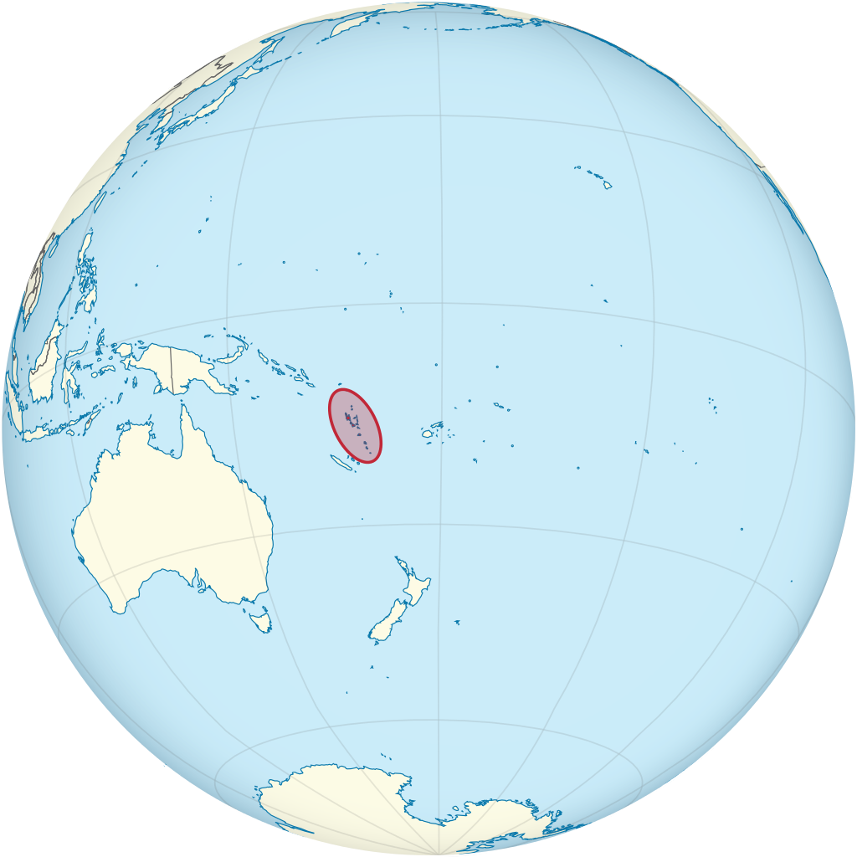
New Hebrides (Known Today as Vanuatu)
https://www.wikiwand.com/en/Vanuatu

Slide 17
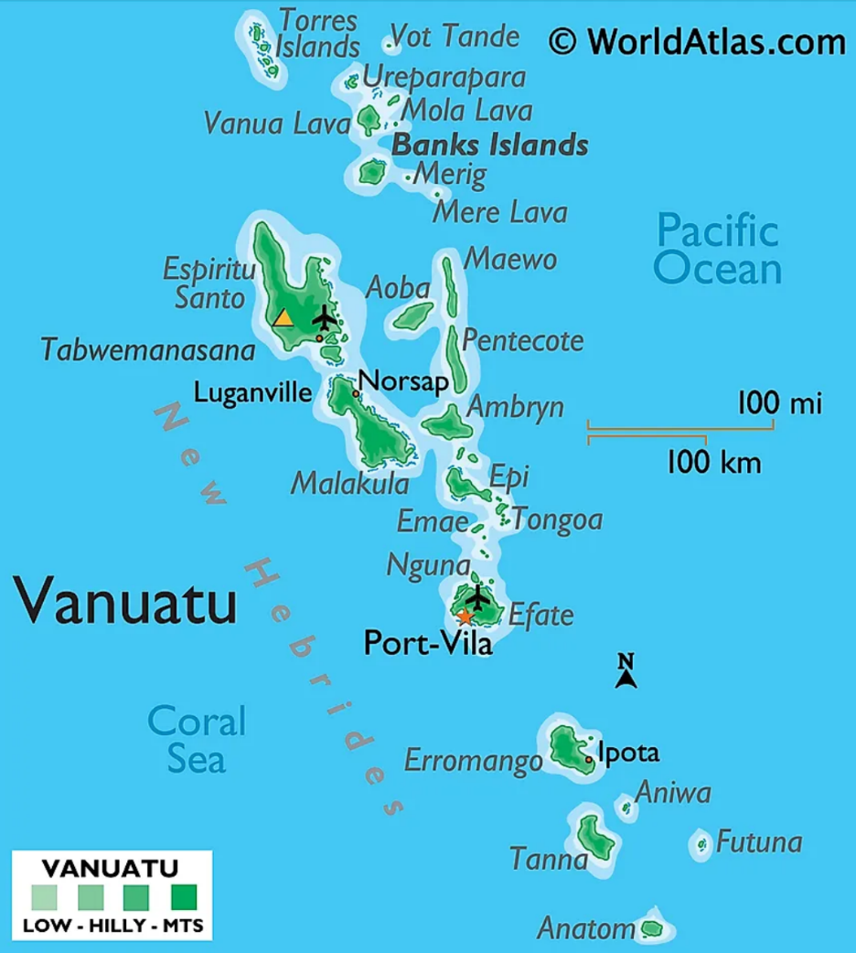
New Hebrides
https://www.worldatlas.com/maps/vanuatu

Slide 18
Working Among the Cannibals
Thus, the young Scotchman and his wife were the first white residents on an island full of naked and painted wildmen–cannibals–who had no idea of right or wrong, worshipping and fearing numerous gods, living in continual dread of evil spirits, constantly fighting among themselves, and always eating the bodies of the slain.
They had little regard for the value of even their own lives and lacked any sense of mutual kindness and obligation towards others.
Such was the task set in front of Paton and his wife who hoped to bring the knowledge of the gospel to these people.
https://bethanygu.edu/blog/stories/john-g-paton-working-among-the-cannibals/

Slide 19
Working Among the Cannibals
One of the most terrifying experiences took place early on, shortly after their ship deposited them on the beach all by themselves.
Paton and his wife had quickly built a cabin in which to live.
But the natives made it clear that they did not want the missionaries on their island.
So one night they surrounded their home intending to burn it to the ground with them inside.
With no one to turn to but the Lord Himself, the two missionaries fell to their knees and spent the entire night praying for God’s protection.
https://principlesforlife.org/2014/02/17/angels-gods-secret-agents/

Slide 20
Working Among the Cannibals
When daylight dawned, they peeked out the window and were amazed. Not a single cannibal was in sight! They had all returned to their village.
One year later, by God’s grace, Paton led the chief of the tribe to commit his life to Jesus Christ.
Still curious about that night, Paton took the opportunity to ask him. “What kept you from burning our cabin to the ground?”
“It was the men with you!” the chief explained.
“What men?” Paton asked. “We didn’t have anyone with us.”
“Oh, yes, you did!” the chief argued. “We saw hundreds of big men in shining garments with swords standing guard in front of your home. That is why we didn’t attack. We were afraid for our lives!”
I wonder. Who were those big men in shining garments standing guard around Paton and his wife? (cf. 2Kings 6:8ff)
https://principlesforlife.org/2014/02/17/angels-gods-secret-agents/

Slide 21
Working Among the Cannibals
During this time, John G. Paton wrote:
“On beholding these natives in their paint and nakedness and misery, my heart was as full of horror as of pity. Had I given up my much-beloved work and my dear people in Glasgow, with so many delightful associates, to consecrate my life to these degraded creatures? Was it possible to teach them right and wrong, to Christianize or even to civilize them? But that was only a passing feeling. I soon got as deeply interested in them, and all that tended to advance them, and to lead them to the knowledge of Jesus, as ever I had been in my work in Glasgow.”
On February 12, 1859, John and Mary had a son, whom they named Peter Robert Robson.
However, on March 3, Mary Paton died of a sudden attack of pneumonia and was later followed by their baby boy on March 20th.
https://bethanygu.edu/blog/stories/john-g-paton-working-among-the-cannibals/

Slide 22
Working Among the Cannibals
Over the next four years on Tanna, John encountered some hair-raising episodes. He himself was attacked fourteen times with severe fever and malaria, leaving him weak.
He had to be constantly on guard, usually sleeping with his clothes on, never knowing when his house would be surrounded or ambushed next.
John Paton knew that Jesus had promised suffering and martyrdom to some of his servants (Luke 11:49; 21:12–18).
Thus, John’s courage came through prayer in claiming the promises of God, having peace in even the most terrifying circumstances, such as when he ran in the middle of contending parties in order to prevent war or was surrounded by armed natives.
https://bethanygu.edu/blog/stories/john-g-paton-working-among-the-cannibals/

Slide 23
Working Among the Cannibals
But after four years on Tanna, John was forced to leave the island because the natives had redoubled their attacks.
In the end, through a series of breathtaking events, John and the other missionaries were rescued by a mission ship in 1862.
John lost all of his property except his Bible and some translation work that he had done in the island language.
https://bethanygu.edu/blog/stories/john-g-paton-working-among-the-cannibals/

Slide 24
Visit to Australia and Scotland
Paton went first to Australia, then to Scotland, seeking to arouse greater interest in the work of the New Hebrides, to recruit new missionaries, and especially to raise a large sum of money for the building and upkeep of a sailing ship to assist the missionaries in the work of evangelizing the Islands.¹
In 1864, two years after his missionary career on Tanna, John Paton married Margaret Whitecross, a woman of great piety and strong character, who assisted her husband up to her death on May 16, 1905.²
Despite all that he had gone through on Tanna, John G. Paton still felt called to reach the people of the South Sea Islands. ²
¹ https://www.wikiwand.com/en/John_Gibson_Paton
² https://bethanygu.edu/blog/stories/john-g-paton-working-among-the-cannibals/

Slide 25
Return to the New Hebrides
So in August 1866, John returned to the New Hebrides with his new wife Maggie and established a new Mission station on Aniwa Island, the nearest island to Tanna.
There they lived in a small native hut while they built a house for themselves and two houses for orphan children. Later, a church, a printing house, and other buildings were erected.
In Aniwa they found the natives to be very similar to those on Tanna – "The same superstitions, the same cannibalistic cruelties and depravities, the same barbaric mentality, the same lack of altruistic or humanitarian impulses were in evidence."
Nevertheless, they continued in their missionary work and it was there in Aniwa that 6 of their 10 children were born, 4 of whom died in early childhood or in infancy.
https://www.wikiwand.com/en/John_Gibson_Paton

Slide 26
Return to the New Hebrides
Their fourth son, Frank Hume Lyall Paton, who followed them as a missionary in the New Hebrides, was one of those born on Aniwa Island.
John learned the language and reduced it to writing.
Maggie taught a class of about fifty women and girls who became experts at sewing, singing and plaiting hats, and reading.
They trained the teachers, translated and printed and expounded the Scriptures, ministered to the sick and dying, dispensed medicines every day, taught them the use of tools, held worship services every Lord's Day and sent native teachers to all the villages to preach the gospel.
https://www.wikiwand.com/en/John_Gibson_Paton

Slide 27
Christianity on Aniwa
In the next fifteen years, John and Margaret Paton saw the entire island of Aniwa turn to Christ. Years later he wrote,
“I claimed Aniwa for Jesus, and by the grace of God Aniwa now worships at the Savior’s feet.”
Paton admitted that at times his heart wavered as he wondered whether these people could be brought to the feet of Jesus and realize their need for Him their lives.
But, he took heart from the power of the gospel and from the fact that thousands on Aneityum had come to Christ in the years prior to his arrival.
https://bethanygu.edu/blog/stories/john-g-paton-working-among-the-cannibals/

Slide 28
Final Years
When John was seventy-three years old, he continued to travel around the world for the cause of missions in the South Seas.¹
In 1899 Paton saw his Aniwa New Testament printed and the establishment of missionaries on twenty-five of the thirty islands of the New Hebrides. ²
To the day of his death, he was translating hymns and catechisms and creating a dictionary for his people even when he couldn’t be with them anymore. ¹
¹ https://bethanygu.edu/blog/stories/john-g-paton-working-among-the-cannibals/
² https://www.wikiwand.com/en/John_Gibson_Paton

Slide 29
Final Years
Near the end of his life, John wrote about the joy that carried him through his ministry and about his hope that his own children would undertake the same mission and find the same joy:
“Let me record my immovable conviction that this is the noblest service in which any human being, can spend or be spent; and that, if God gave me back my life to be lived over again, I would without one quiver of hesitation lay it on the altar to Christ, that He might use it as before in similar ministries of love, especially amongst those who have never yet heard the Name of Jesus. Nothing that has been endured, and nothing that can now befall me, makes me tremble — on the contrary, I deeply rejoice — when I breathe the prayer that it may please the blessed Lord to turn the hearts of all my children to the Mission Field and that He may open up their way and make it their pride and joy to live and die in carrying Jesus and His Gospel into the heart of the Heathen World!”
https://bethanygu.edu/blog/stories/john-g-paton-working-among-the-cannibals/

Slide 30
Hudson Taylor
Missionary to China
https://principlesforlife.org/2014/02/17/angels-gods-secret-agents/

Slide 31
Class Discussion Time
https://www.weareteachers.com/moving-beyond-classroom-discussions/

Slide 32
*Class Discussion Time
We admire John G. Paton as a faithful missionary and servant of Christ, but it is clear that one of the most profound positive spiritual influences in his life was the influence of his parents. Although we live in a different era, do you see any timeless principles in the way John’s parents raised him that might be applicable to parents raising children today?
While we live in a very different era than Paton did and we recognize that God calls each of us to a different kinds of ministry – what kinds of timeless principles of Christian commitment and faithfulness do you see at work in the life of John Paton that could serve as an example to you as you live out your life in service to the same God that he served?
Near the end of his life, Paton wrote: if God gave me back my life to be lived over again, I would without one quiver of hesitation lay it on the altar to Christ, that He might use it as before in similar ministries of love. If you knew that you were about to die, would you be able to say this about your Christian life? Why or why not?

