Slide 2
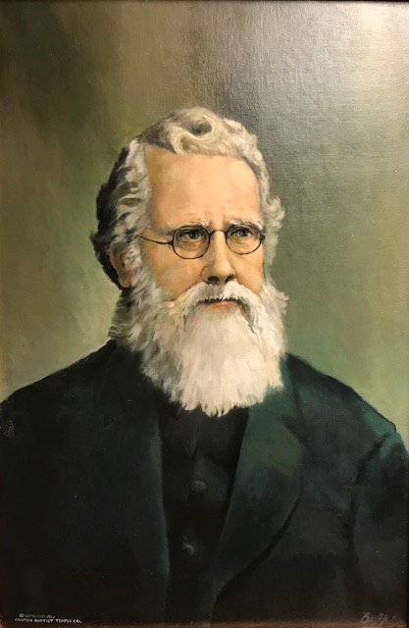
Hudson Taylor
Missionary to China
https://christianhof.org/taylor/

Slide 3
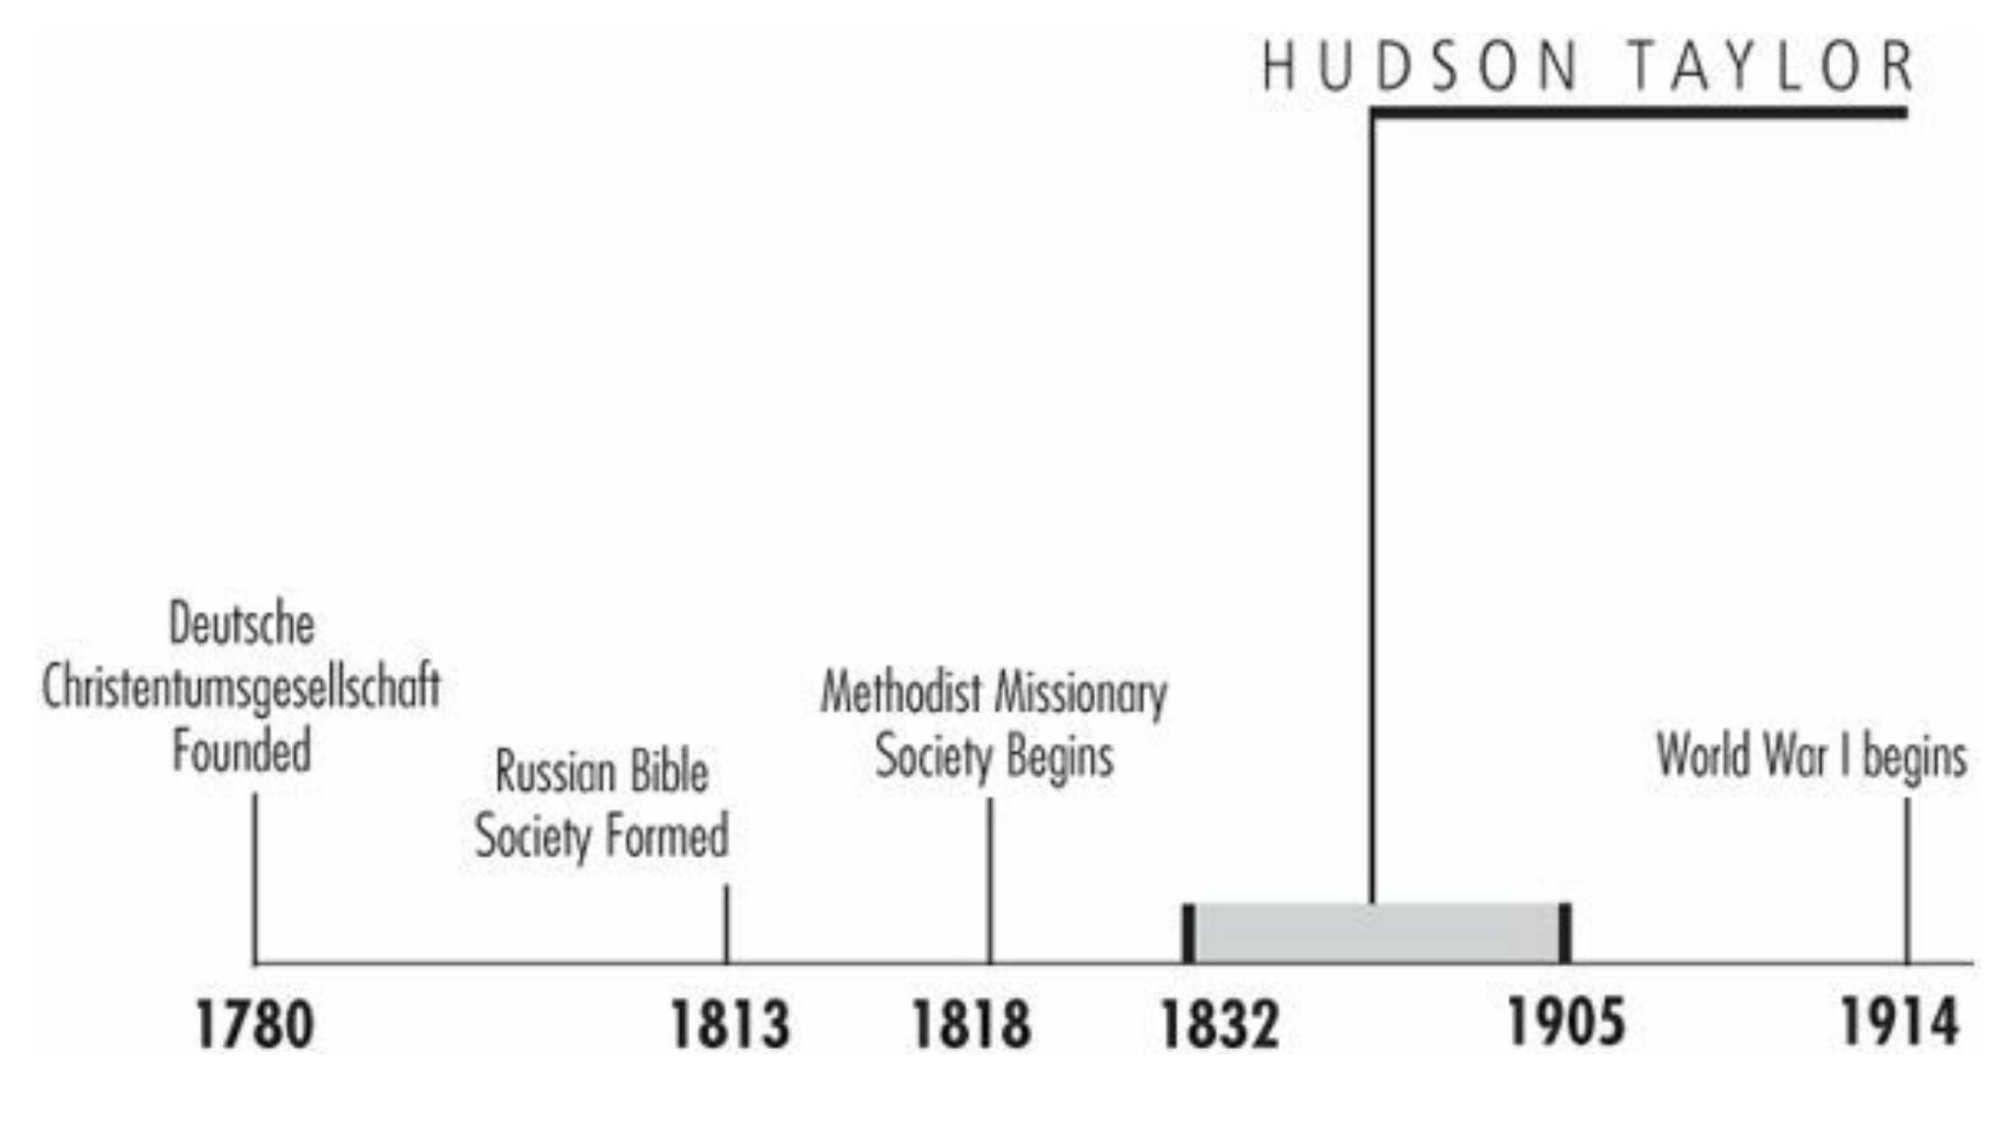
Timeline
Galli, Mark. 131 Christians Everyone Should Know

Slide 4
“China is not to be won for Christ by quiet, ease-loving men and women…. The stamp of men and women we need is such as will put Jesus, China, [and] souls first and foremost in everything and at every time—even life itself must be secondary.”
In September 1853, a little three-masted clipper slipped quietly out of Liverpool harbor with Hudson Taylor, a gaunt and wild-eyed 21-year-old missionary, aboard.
He was headed for a country that was just coming into the Christian West's consciousness; only a few dozen missionaries were stationed there at the time.
By the time Taylor died a half-century later, however, China was viewed as the most fertile and challenging of mission fields as thousands volunteered annually to serve there.
Galli, Mark. 131 Christians Everyone Should Know

Slide 5
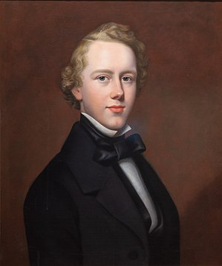
Hudson Taylor at the age of 21
https://www.wikiwand.com/en/Hudson_Taylor

Slide 6
Radical Missionary
Taylor was born to James and Amelia Taylor, a Methodist couple fascinated with the Far East who had prayed for their newborn, “Grant that he may work for you in China.” ¹
As a young man Taylor ran away from the Christian beliefs of his parents. At 15, after reading an evangelistic tract, he professed faith in Christ, and several years later, he committed himself to going to China as a missionary.²
He spent the next years in frantic preparation, learning the rudiments of medicine, studying Mandarin, and immersing himself ever deeper into the Bible and prayer. ¹
His ship arrived in Shanghai in March 1854 – one of five “treaty ports” China had opened to foreigners (in 1842) following its first Opium War with England. ¹
¹ Galli, Mark. 131 Christians Everyone Should Know
² https://www.wholesomewords.org/missions/biotaylor6.pdf

Slide 7
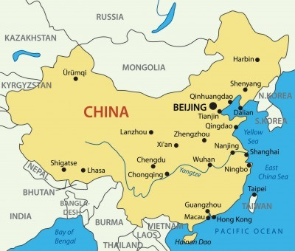
China in Hudson Taylor’s Day
https://vukcdn.whatchristianswanttoknow.com/wp-content/uploads/2013/08/Top-24-Hudson-Taylor-Quotes.jpg

Slide 8
Radical Missionary
Almost immediately Taylor made a radical decision (as least for Protestant missionaries of the day): he decided to dress in Chinese clothes and grow a pigtail (as Chinese men did).
His fellow Protestants were either incredulous or critical.
Taylor, for his part, was not happy with most missionaries he saw: he believed they were “worldly” and spent too much time with English businessmen and diplomats who needed their services as translators.
Instead, Taylor wanted the Christian faith taken to the interior of China. So within months of arriving, and the native language still a challenge, Taylor, along with Joseph Edkins, set sail down the Huangpu River (a 70 mile long man-made river flowing through Shanghai) distributing Chinese Bibles and tracts.
Galli, Mark. 131 Christians Everyone Should Know

Slide 9
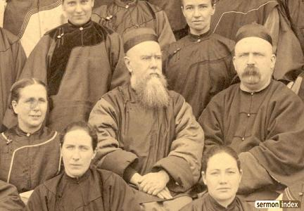
Hudson Taylor in Chinese Garb
https://gregstier.org/blog-youth-ministry-what-a-dead-missionary-can-teach-us-about-radical-youth-ministry/

Slide 10
Radical Missionary
When the Chinese Evangelization Society, which had sponsored Taylor, proved incapable of paying its missionaries in 1857, Taylor resigned and became an independent missionary; trusting God to meet his needs.
The same year, he married Maria Dyer, daughter of missionaries stationed in China.
He continued to pour himself into his work, and his small church in Ningpo (across the bay from Shanghai to the south) grew to 21 members.
But by 1861, he became seriously ill (probably with hepatitis) and was forced to return to England to recover.
Galli, Mark. 131 Christians Everyone Should Know

Slide 11
Radical Missionary
In England, the restless Taylor continued translating the Bible into Chinese (a work he'd begun in China), studied to become a midwife, and recruited more missionaries.
Troubled that people in England seemed to have little interest in China, he wrote China: Its Spiritual Need and Claims.
Taylor became convinced that a special organization was needed to evangelize the interior of China.
He made plans to recruit 24 missionaries: two for each of the 11 unreached inland provinces and two for Mongolia.
It was a visionary plan that would have left veteran recruiters breathless: it would increase the number of China missionaries by 25 percent.
Galli, Mark. 131 Christians Everyone Should Know

Slide 12
Radical Missionary
Taylor himself was wracked with doubt: he worried about sending men and women unprotected into the interior; at the same time, he despaired for the millions of Chinese who were dying without the hope of the gospel.
In 1865 he wrote in his diary, “For two or three months, intense conflict…. Thought I should lose my mind.”
A friend invited him to the south coast of England, to Brighton, for a break. And it was there, while walking along the beach, that Taylor's gloom lifted: “There the Lord conquered my unbelief, and I surrendered myself to God for this service. I told him that all responsibility as to the issues and consequences must rest with him; that as his servant it was mine to obey and to follow Him.”
Galli, Mark. 131 Christians Everyone Should Know

Slide 13
Radical Missionary
His new mission, which he called the China Inland Mission (CIM), had a number of distinctive features such as:
Its missionaries would have no guaranteed salaries nor could they appeal for funds. They would simply trust God to supply their needs
Furthermore, its missionaries would adopt Chinese dress and then press the gospel into the China.
Within a year of his breakthrough, Taylor, his wife and four children, and 16 young missionaries sailed from London to join five others already in China working under Taylor's direction.
Galli, Mark. 131 Christians Everyone Should Know

Slide 14
Strains in the Organization
Taylor continued to make enormous demands upon himself (he saw more than 200 patients daily when he first returned) and on CIM missionaries, some of whom balked.
Lewis Nicol, who accused Taylor of tyranny, had to be dismissed.
Some CIM missionaries, in the wake of this and other controversies, left to join other missions, but in 1876, with 52 missionaries, CIM constituted one-fifth of the missionary force in China.
Because there continued to be so many Chinese to reach, Taylor instituted another radical policy: he sent unmarried women into the interior, a move criticized by many veterans.
Galli, Mark. 131 Christians Everyone Should Know

Slide 15
Strains in the Organization
But Taylor's boldness knew no bounds. In 1881, he asked God for another 70 missionaries by the close of 1884: he got 76.
In late 1886, Taylor prayed for another 100 within a year: by November 1887, he announced 102 candidates had been accepted for service.
His leadership style and high ideals created enormous strains between the London and China councils of the CIM.
London thought Taylor autocratic; Taylor said he was only doing what he thought was best for the work, and then demanded more commitment from others: “China is not to be won for Christ by quiet, ease-loving men and women,” he wrote. “The stamp of men and women we need is such as will put Jesus, China, [and] souls first and foremost in everything and at every time—even life itself must be secondary.”
Galli, Mark. 131 Christians Everyone Should Know

Slide 16
Strains in the Organization
Taylor's grueling work pace, both in China and abroad (to England, the United States, and Canada on speaking engagements and to recruit), was carried on despite Taylor's poor health and bouts with depression.
In 1900 it became too much, and he had complete physical and mental breakdown.
The personal cost of Taylor's vision was high on his family as well: his wife Maria died at age 33, and four of eight of their children died before they reached the age of 10. (Taylor eventually married Jennie Faulding, a CIM missionary.)
Galli, Mark. 131 Christians Everyone Should Know

Slide 17
Strains in the Organization
Between his work ethic and his absolute trust in God (despite never soliciting funds, his CIM grew and prospered), he inspired thousands to forsake the comforts of the West to bring the Christian message to the vast and unknown interior of China.
Though mission work in China was interrupted by the communist takeover in 1949, the CIM continues to this day under the name Overseas Missionary Fellowship (International).
Galli, Mark. 131 Christians Everyone Should Know

Slide 18
Supporters of Hudson Taylor
Taylor became friends with Charles Haddon Spurgeon, who pastored the Metropolitan Tabernacle and became a lifelong supporter of Taylor.
He befriended C.I. Scofield and later filled the pulpit of D.L. Moody as a guest in Chicago. Moody and Scofield thereafter actively supported the work of the China Inland Mission of North America.
Galli, Mark. 131 Christians Everyone Should Know

Slide 19
Hudson Taylor Quotes
“Perhaps if there were more of that intense distress for souls that leads to tears, we should more frequently see the results we desire. Sometimes it may be that while we are complaining of the hardness of the hearts of those we are seeking to benefit, the hardness of our own hearts and our feeble apprehension of the solemn reality of eternal things may be the true cause of our want of success.”
“It will not do to say that you have no special call to go to China. With these facts before you, and with the command of the Lord Jesus to go and preach the gospel to every creature, you need rather to ascertain whether you have a special call to stay at home.”
“The use of means ought not to lessen our faith in God, and our faith in God ought not to hinder our using whatever means He has given us for the accomplishment of His own purposes.”
https://www.whatchristianswanttoknow.com/top-24-hudson-taylor-quotes/

Slide 20
Hudson Taylor Quotes
“I have seen many men work without praying, though I have never seen any good come out of it; but I have never seen a man pray without working.”
“As our Father makes many a flower to bloom unseen in the lonely desert, [let us] do all that we can do, as under God’s eye, though no other eye ever take note of it.”
“I have found that there are three stages in every great work of God: first, it is impossible, then it is difficult, then it is done.”
“Christ is either Lord of all, or He is not Lord at all”
https://www.whatchristianswanttoknow.com/top-24-hudson-taylor-quotes/

Slide 21
Legacy
The beginning of “faith missions” (the sending of missionaries with no promises of temporal support, but instead a reliance “through prayer to move Men by God”) has had a wide impact among evangelical churches to this day. After Taylor’s death, China Inland Mission gained the notable distinction of being the largest Protestant mission agency in the world.
The biographies of Hudson Taylor inspired generations of Christians to follow his example of service and sacrifice. Notable examples are:
Olympic Gold Medalist Eric Liddell,
Twentieth-century missionary and martyr Jim Elliot,
International evangelists Billy Graham and Luis Palau.
“Hudson Taylor was, ...one of the greatest missionaries of all time, and... one of the four or five most influential foreigners who came to China in the nineteenth century for any purpose...” —Kenneth Scott Latourette
https://www.wikiwand.com/en/Hudson_Taylor

Slide 22
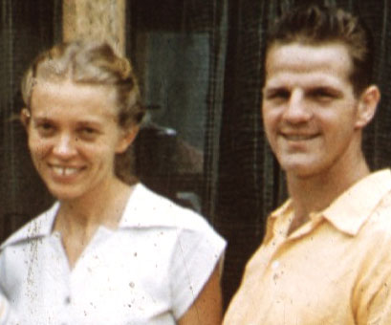
Jim Elliott
https://servantsofgrace.org/suffering-sacrifice-and-the-death-of-jim-elliot/

Slide 23
Class Discussion Time
https://www.weareteachers.com/moving-beyond-classroom-discussions/

Slide 24
*Class Discussion Time
What do you think of Taylor’s policy of forbidding missionaries in his organization from soliciting financial support – that they needed to trust in God instead?
Hudson Taylor says: “Perhaps if there were more of that intense distress for souls that leads to tears, we should more frequently see the results we desire. Sometimes it may be that while we are complaining of the hardness of the hearts of those we are seeking to benefit, the hardness of our own hearts and our feeble apprehension of the solemn reality of eternal things may be the true cause of our want of success.” Do the people you try to reach tend to be hard hearted and, if so, might this statement be applicable to you?
What do you think of Taylor’s claim that: “It will not do to say that you have no special call to go to China. With these facts before you, and with the command of the Lord Jesus to go and preach the gospel to every creature, you need rather to ascertain whether you have a special call to stay at home.”?

