Slide 2
Pentecostalism and the Charismatic Movement
https://www.learnreligions.com/what-is-universalism-700701

Slide 3
Pentecostal/Charismatic Movement
The Pentecostal/Charismatic Movements center on the emotional, mystical, and supernatural: miracles, signs, wonders, and “the gifts of the Spirit” (charismata), especially “speaking in tongues” (glossolalia), faith healing, and “casting out demons” (exorcism).
In these movements, supreme importance is attached to the subjective religious experience of being filled with or possessed by the Holy Spirit.
https://www.encyclopedia.com/environment/encyclopedias-almanacs-transcripts-and-maps/pentecostal-and-charismatic-christianity

Slide 4
Pentecostal/Charismatic Movement
The name Pentecostal derives from the account of the day of Pentecost as described in chapters 1 and 2 of the Acts of the Apostles, when the Holy Spirit descended upon the first Christians: “All of them were filled with the Holy Spirit, and they began to speak in other languages as the Spirit enabled them.” (Act 2:4 NET)
Charismatic derives from the Greek charism, meaning supernatural gifts of the Spirit, which are most often considered those listed in 1 Corinthians 12–14.
https://www.encyclopedia.com/environment/encyclopedias-almanacs-transcripts-and-maps/pentecostal-and-charismatic-christianity

Slide 5
Biblical and Historical Basis Given
Pentecostals trace the beginnings of their movement to the day of Pentecost described in Acts.
They believe that the experience of Spirit Baptism and the practice of the gifts of the Spirit that occurred on that day were meant to be normative in the life of the church and of each believer.
https://www.encyclopedia.com/environment/encyclopedias-almanacs-transcripts-and-maps/pentecostal-and-charismatic-christianity

Slide 6
Biblical and Historical Basis Given
They maintain that although the charismata ceased in the main body of the church soon after the apostolic age, one can trace an intermittent history of charismatic practices among sectarians like the Montanists, Anabaptists, Camisards, Shakers, Irvingites, Mormons, and various nineteenth-century Holiness groups.
The twentieth-century Pentecostal and charismatic movements, therefore, claim to be the restoration of the charismata to the church.
https://www.encyclopedia.com/environment/encyclopedias-almanacs-transcripts-and-maps/pentecostal-and-charismatic-christianity

Slide 7
Rapid Growth
In the explosive growth and geographical extension of Pentecostal and charismatic groups, we are witnessing one of the most if not the most stunning episodes of Christian expansion ever.
In the not-too-distant future Pentecostals will likely make up the majority of Christians worldwide!
So, where in the world did all these Pentecostals and charismatics come from?
https://www.thegospelcoalition.org/article/where-did-all-these-pentecostals-and-charismatics-come-from/

Slide 8
History
The modern Pentecostal/Charismatic movement began at the beginning of the 20th century by a series of revivals on four continents – Asia, Europe, Northern America and Latin America – almost simultaneously.
Today, Pentecostals/Charismatics are found in nearly every country of the world and span all Christian traditions and most denominations.
As such, they are considered a “movement” within World Christianity.
https://www.gordonconwell.edu/blog/pentecostal-charismatic-christianity/

Slide 9
The Start: Topeka
In October 1900, 29-year-old Agnes Ozmen enrolled at the freshly founded Bethel Bible College in Topeka, Kansas.
Former Methodist, now Holiness pastor Charles Fox Parham directed students to read the book of Acts with heightened alertness to every mention of the Spirit.
Consensus emerged on two points:
Outward manifestations always accompany the Spirit’s activity, and
Speaking in tongues is the outward sign, the proof of baptism in the Holy Spirit.
https://www.thegospelcoalition.org/article/where-did-all-these-pentecostals-and-charismatics-come-from/

Slide 10
The Start: Topeka
A watch night service was announced for New Year’s Eve.
Sometime in the wee hours of January 1, 1901, Parham placed his hands on Miss Ozmen at her request, praying that she would receive baptism by the Holy Spirit.
Witnesses claim that Miss Ozmen, for the next three days, spoke and wrote only in Chinese.
Parallel with the event reported in Acts 2 at the feast of Pentecost, the miraculous “tongue” reportedly spoken at Topeka was believed to be a known, extant human language foreign to the speaker.
https://www.thegospelcoalition.org/article/where-did-all-these-pentecostals-and-charismatics-come-from/

Slide 11
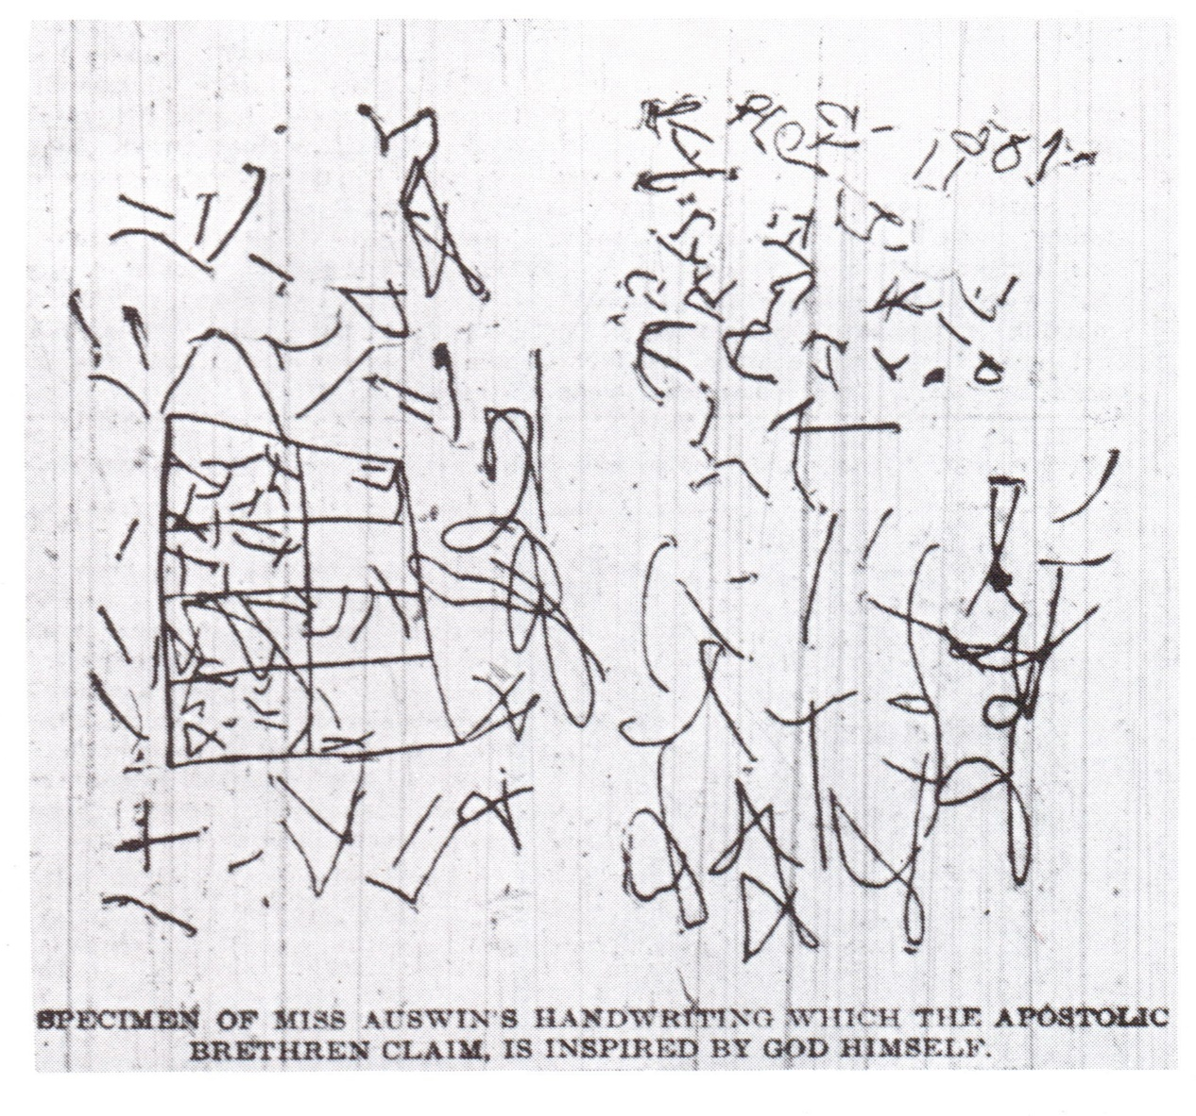
Agnus Ozman’s “Chinese” Handwriting
https://theunexpectedcosmology.com/counterfeit-pentecost-tongue-speak-is-a-hoax/

Slide 12
The Start: Topeka
Only rarely amid the subsequent spread of the movement did reports of such technically “Pentecostal” tongues arise.
Famously, in the summer of 1960, Rabbi Jacob Rabinowitz discovered Irishman John Gruver speaking (unbeknownst to Gruver) Hebrew during an Assemblies of God worship service in Pasadena.
But the vast bulk of Pentecostal tongues have been, ironically, not Pentecostal, but unknown tongues, which have been assumed to be “heavenly languages” – a concept for which there is little or no scriptural support.
https://www.thegospelcoalition.org/article/where-did-all-these-pentecostals-and-charismatics-come-from/

Slide 13
Azusa Street
The second pivotal event occurred when African American Holiness-turned-Pentecostal pastor William J. Seymour made his way to Azusa Street in Los Angeles to preach.
Seymour, a former student of Parham and son of a slave, witnessed the outbreak of a revival that would not abate for three years.
This multi-racial, multi-class eruption of miraculous gifts (charismata) pumped out Pentecostal evangelists, missionaries, and ministers.
The spiritual lineage of almost all early leaders among Pentecostals who soon dispersed throughout North America and beyond trace back to this extraordinary time in greater Los Angeles.
Thus Azusa Street became the launching pad of the movement that began at Topeka.
https://www.thegospelcoalition.org/article/where-did-all-these-pentecostals-and-charismatics-come-from/

Slide 14
Azusa Street
The movement advanced so rapidly that by 1914, Pentecostals could be found in most towns and in more than 50 countries around the world.
In addition to sending out countless missionaries, Seymour also spread Pentecostalism around the world through the publication of 405,000 copies of his Apostolic Faith newspaper.
The newspaper promoted Seymour’s vision and version of Pentecostalism by publishing his sermons, doctrinal teachings, teachings by other early leaders, and countless testimonies of spiritual renewal, evangelism, missions, divine healing and the spiritual gifts.
https://www.thearda.com/timeline/movements/movement_42.asp

Slide 15
Azusa Street
Seymour’s Azusa Street Mission was sort of like a "Mecca" for Pentecostal travelers the world over who liked to kneel where the fire of the Holy Spirit fell.
Although Seymour and the Azusa Street Revival were the single most important catalysts in the origins of classical Pentecostalism in places like the United States, England, Norway, Sweden, Liberia, South Africa, India, China, and Japan, there were other leaders and centers in these countries and others who also helped originate and spread the movement around the world.
https://www.thearda.com/timeline/movements/movement_42.asp

Slide 16
Rapid Growth
By 1970 the movement had grown to 58 million.
By 2020 it reached 635 million.
The Global South is home to 86% of all Pentecostals/ Charismatics in the world.
It is useful to divide the movement into three kinds or types:
Pentecostals
Charismatics
Independent Charismatics
https://www.gordonconwell.edu/blog/pentecostal-charismatic-christianity/

Slide 17
Pentecostals
Pentecostals are members of the explicitly Pentecostal denominations.
Pentecostal denominations that are part of Protestantism include the:
Assemblies of God
International Church of the Foursquare Gospel
Church of God of Prophecy.
https://www.gordonconwell.edu/blog/pentecostal-charismatic-christianity/

Slide 18
Charismatics
Charismatics’ roots go back to early Pentecostalism, but rapid expansion since 1960 (later called the ‘Charismatic renewal’) has made this type larger than Classical Pentecostalism.
Charismatics remained within, and also formed organized renewal groups within, their historical non-Pentecostal denominations (Catholic, Orthodox or Protestant), instead of leaving to join Pentecostal denominations.
https://www.gordonconwell.edu/blog/pentecostal-charismatic-christianity/

Slide 19
Charismatics
The largest Charismatic movement today is the Catholic Charismatic renewal, found in significant numbers mainly across Latin America.
The largest Catholic Charismatic populations are in:
Brazil (61 million)
the Philippines (26 million)
the United States (18 million)
The highest concentrations of Catholic charismatics are in
Guatemala (34% of the country),
Puerto Rico (31%)
Brazil (29%).
https://www.gordonconwell.edu/blog/pentecostal-charismatic-christianity/

Slide 20
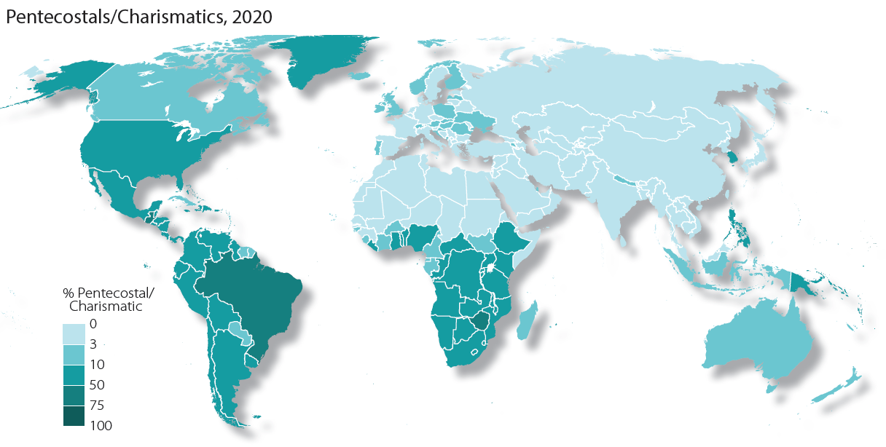
Pentecostals/Charismatics 2020
https://www.gordonconwell.edu/blog/pentecostal-charismatic-christianity/

Slide 21
Independent Charismatics
Thousands of other churches and movements resemble Pentecostals and Charismatics but do not fit their definitions.
These constitute a third Pentecostal/Charismatic type, called “Independent Charismatics”, that are largely found in the Independent Christian tradition – that is, outside of historic Catholic, Orthodox and Protestant churches.
Independent Charismatics are present mainly in the Global South, in denominations and church networks that originate from outside of Western Christianity.
https://www.gordonconwell.edu/blog/pentecostal-charismatic-christianity/

Slide 22
Independent Charismatics
While found in many of the same countries as Pentecostals and Charismatics, Independent Charismatics are largest in:
The United States (33 million)
Nigeria (27 million)
China (24 million)
Over one third of the populations of Eswatini, South Africa and Zimbabwe are Independent Charismatics.
The Pentecostal/Charismatic movement represents some of the fastest-growing Christianity in the world in the 21st century.
https://www.gordonconwell.edu/blog/pentecostal-charismatic-christianity/

Slide 23
Oneness Pentecostals
Debate began in 1913 regarding whether baptism should be “in the name of the Father, the Son, and the Holy Ghost” (as in the ‘Great Commission’ of Matthew 28), or simply “in the name of Jesus” (as in Acts, e.g. 2:38).
The formula for baptism in the book of Acts was given a theological rationale by some Pentecostals which stressed the oneness of God (hence the designation ‘Oneness Pentecostalism’), with Father, Son, and Spirit being seen as three “manifestations” of God.
Trinitarian Pentecostals have rightly rejected such teaching as heretical.
All the same, as many as a quarter of classical Pentecostals may belong to this strand, whose most important groupings include the United Pentecostal Church (USA) and the True Jesus Church (China).
Tim Grass. SCM Core Text: Modern Church History

Slide 24
Pentecostals and Prosperity
The prosperity gospel (also known as the “health and wealth gospel” or by its most popular brand, the “Word of Faith” movement) is a perversion of the gospel of Jesus that claims that God rewards increases in faith with increases in health and/or wealth.
The prosperity gospel teaches that “health and wealth” are the automatic divine right of all Bible-believing Christians and may be procreated by faith as part of the package of salvation, since the Atonement of Christ includes not just the removal of sin, but also the removal of sickness and poverty.
https://www.thegospelcoalition.org/article/what-you-should-know-about-the-prosperity-gospel/

Slide 25
Pentecostals and Prosperity
The prosperity gospel originated as an offshoot of Pentecostalism in post-World War II America.
While it started in local congregations and in tent revivals, the movement gained a larger following through the use of radio and television, and became firmly entrenched in the 1980s with the rise of “televangelism.”
The movement is largely connected to revivalist and charismatic churches.
This has made it easier for the movement to gain traction in Africa, South America, and other areas of the world where Pentecostalism is rapidly expanding.
https://www.thegospelcoalition.org/article/what-you-should-know-about-the-prosperity-gospel/

Slide 26
Pentecostals and Prosperity
The man who could be considered the father of modern prosperity gospel teaching is Oral Roberts.
The faith-healing evangelist became so influential that he started his own school, Oral Roberts University (ORU).
Kenneth Copeland, a student at ORU who served as a pilot and chauffeur for Oral Roberts, also became one of the most notorious (and wealthiest) of prosperity preachers.
These men paved the way for the televangelists who became famous in the 1980s, including Jim and Tammy Faye Bakker, Benny Hinn, Pat Robertson, and Robert Tilton.
Today, some of the best-known prosperity teachers are T. D. Jakes, Joel Osteen, and Paula White.
https://www.thegospelcoalition.org/article/what-you-should-know-about-the-prosperity-gospel/

Slide 27
The ‘Third Wave’
The Third Wave Movement is a Pentecostal or Charismatic movement that began in the 1980s.
The name “Third Wave” was coined by C. Peter Wagner, a professor at Fuller Theological Seminary.
He referred to the movement as the “Third Wave” because this was the third of three distinct Pentecostal/Charismatic movements in modern Christianity.
The first wave was the original Pentecostal Movement that began in the early 1900s with the teachings of Charles Parham followed by the Azusa Street Revival.
The second wave then came in the 1960s with the Charismatic movement. In the Charismatic movement, Pentecostal doctrines, teachings, and practices began to spread to non-Pentecostal churches and denominations.
This wave brought increased popularity to the “Word of Faith” or “Name It and Claim It” false teachings that are still popular today.
https://www.gotquestions.org/Third-Wave-movement.html

Slide 28
The ‘Third Wave’
Then, in the 1980s, another “movement of the Holy Spirit,” supposedly characterized by “signs and wonders,” began in the Vineyard Church with the teachings of John Wimber, Mike Bickle, C. Peter Wagner, Jack Deere, and others.
Professor Wagner characterized this Third Wave as being “a new moving of the Holy Spirit among evangelicals who, for one reason or another, have chosen not to identify with either the Pentecostals or Charismatics.”
Also known as the Neo-Charismatic Movement, this Third Wave of Pentecostal doctrine and excess became very popular and led to many aberrant teachings such as the Toronto Blessing and “laughing in the Spirit”.
https://www.gotquestions.org/Third-Wave-movement.html

Slide 29
The Social Gospel
Walter Rauschenbusch
https://www.wikiwand.com/en/Walter_Rauschenbusch

Slide 30
Class Discussion Time
https://www.weareteachers.com/moving-beyond-classroom-discussions/

Slide 31
*Class Discussion Time
Do you think that it is problematic for the case of someone who wants to claim that the charismatic gifts were meant by God to be “normative in the life of the church and of each believer” – when throughout most of church history (with only occasional rare exceptions) the charismatic gifts were virtually non-existent?
Do you think it is problematic that the “gift of tongues” in the NT consists of men miraculously speaking human languages that they had never been taught and yet almost all tongues speaking in the charismatic movement is non-existent language (perhaps mere babbling)?
Do you believe that Oneness Pentecostals’ denial of the trinity makes them heretical?
What do you think of the health and wellness, “name it and claim it” theology of some charismatics?
What do you think of “third wave” charismatic practices such as “laughing in the spirit” or “being slain in the spirit”?

