Slide 2
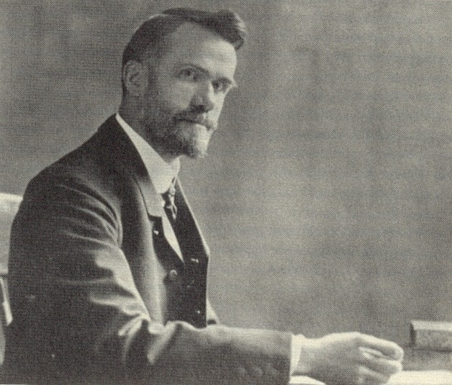
The Social Gospel
Walter Rauschenbusch
https://www.wikiwand.com/en/Walter_Rauschenbusch

Slide 3
The Social Gospel
A major movement for social justice in the United States was called the Social Gospel, a movement that was pushed primarily by liberal Protestant pastors and theological professors.
They formed no outstanding organization but chose to work through established denominations and political agencies.
The crux of the Social Gospel was the belief that God’s saving work included corporate structures as well as personal lives.
Before the Civil War, revivals and reforms went hand in hand.
Charles Finney, for example, encouraged his converts to move from the personal regeneration experience to the social mission of the antislavery crusade.
Shelley, Dr. Bruce L.. Church History in Plain Language: Fourth Edition

Slide 4
The Social Gospel
The father of the Social Gospel was Washington Gladden (1836 – 1918), who published the first of his many books on the Social gospel in 1876.
A transplanted New Englander, he spent his most influential years at the First Congregational Church of Columbus, Ohio.
In his congregation were both employers and employees, so during times of industrial strife Gladden witnessed with alarm “the widening of the breach between these classes.”
In a number of evening addresses he focused on the labor problem and expressed his conviction that the teachings of Jesus contained the principles for the right ordering of society.
Gladden was no socialist. He held to private property and private enterprise.
Yet he believed many industries could be run better cooperatively and that railroads, mines, and public service industries of the cities should be operated by the government.
Shelley, Dr. Bruce L.. Church History in Plain Language: Fourth Edition

Slide 5
The Social Gospel
In terms of lasting influence, the outstanding prophet of the Social Gospel was Walter Rauschenbusch (1861– 1918).
As a young German Baptist pastor in a tenement section of New York City called Hell’s Kitchen, he struggled with the Christian response to urban problems.
His three major works that made him nationally prominent during his years as professor of church history at Rochester Theological Seminary were:
Christianity and the Social Crisis (1907)
Christianizing the Social Order (1912)
A Theology for the Social Gospel (1917)
Shelley, Dr. Bruce L.. Church History in Plain Language: Fourth Edition

Slide 6
The Social Gospel
Avoiding the comforting doctrine of human progress, Rauschenbusch anchored his appeal to social responsibility in the concept of the “kingdom of God”.
“The social gospel,” he wrote, “is the old message of salvation, but enlarged and intensified. The individualistic gospel has taught us to see the sinfulness of every human heart and has inspired us with faith in the willingness and power of God to save every soul that comes to him. But it has not given us an adequate understanding of the sinfulness of the social order and its share in the sins of all individuals within it . . . . The social gospel seeks to bring men under repentance for their collective sins and to create a more sensitive and more modern conscience.”
Shelley, Dr. Bruce L.. Church History in Plain Language: Fourth Edition

Slide 7
The Social Gospel
The prime example of sin in society, according to the preachers of the Social Gospel, was the capitalist system.
Man’s salvation, they said, was impossible as long as that system remained unchanged.
Social Gospelers differed among themselves over how much change was necessary for the regeneration of the American system, but they agreed the kingdom of God could not come without it.
How far did the Social Gospel penetrate the denominations?
Many theological seminaries reshaped their curricula to address social concerns.
Shelley, Dr. Bruce L.. Church History in Plain Language: Fourth Edition

Slide 8
The Social Gospel
The primary sign of change, however, came in 1908 with the formation of the Federal Council of Churches.
Almost the first act of the Council was the adoption of a “Social Creed of the Churches.”
It called for many benefits later American workers considered basics: occupational safety, old age security, minimum wage, and the rights of arbitration.
Throughout its history the church had tried to improve man’s life on earth even as it prepared him for the world to come.
While it is possible to concentrate on the next life so much that Christians can appear insensitive to the pain of this present world, a big danger that Christian movements for social concerns face is reducing the gospel to mere social activism.
Shelley, Dr. Bruce L.. Church History in Plain Language: Fourth Edition

Slide 9
Three Fallacies of the Social Gospel
Similar to the way Marxism twisted Scripture, the Social Gospel Movement was guilty of three major theological fallacies:
Man is not so bad, and God is not so mad.
Cultural restoration is the Gospel.
Social salvation is superior to individual salvation.
https://tifwe.org/three-fallacies-of-the-social-gospel/

Slide 10
Man is not so Bad, and God is not so Mad
In his book, The Kingdom of God in America, Richard Niebuhr described the message of the liberal Social Gospel as:
A God without wrath brought men without sin into a kingdom without judgment through the ministrations of a Christ without a cross.
Rauschenbusch and his followers tended to blame sin on societal structures rather than human nature.
They believed individuals could not leave a life of sin until they were freed from the social and economic situation that drove them into sin in the first place.
This view plainly contradicts the Biblical concept of original sin and individual responsibility.
https://tifwe.org/three-fallacies-of-the-social-gospel/

Slide 11
Cultural Restoration is the Gospel
Social Gospel adherents believed the Gospel was centered on cultural involvement: if people transformed culture, only then would Christ be revealed.
But this understanding of the Gospel is too narrow.
Christians are absolutely called to engage culture—that is the heart of the Cultural Mandate—but the Gospel is larger than that.
It is the story of God’s creation, fall, redemption, and the final restoration.
Social Gospel adherents tended to over-emphasize cultural restoration and minimize Christ as the agent of cultural transformation.
https://tifwe.org/three-fallacies-of-the-social-gospel/

Slide 12
Social Salvation is Superior to Individual Salvation
The Bible teaches that redemption is a matter strictly between each individual and God, but progressives in the Social Gospel Movement believed that redemption could only be achieved collectively, by means of unified, social and political activism.
Though Rauschenbusch saw individual salvation as important, he always considered it secondary to social reform.
In reality, it is individual salvation that needs to be kept central.
Though the Social Gospel movement has since fizzled, similar theology has appeared in Emerging Church circles today.
Pastor Rick Warren has rightly referred to the Social Gospel supported by many of the mainline churches in our day as “Marxism in Christian clothing.”
https://tifwe.org/three-fallacies-of-the-social-gospel/

Slide 13
So What Does It All Mean?
As you work towards developing a biblical perspective on work, it’s important to keep in mind these fallacies of the Social Gospel movement.
As we labor on behalf of the Kingdom, it’s easy for Social Gospel ideas to shape how we think about certain aspects of faith and vocation:
Like the Social Gospel, it’s easy to start treating cultural transformation as an end in and of itself.
If cultural restoration becomes our gospel, we begin to think that the Kingdom is built by us.
https://tifwe.org/three-fallacies-of-the-social-gospel/

Slide 14
So What Does It All Mean?
The Social Gospel rightly recognizes that cultural transformation is important. However, it’s not the end goal.
Everything we do, all the transformation we work towards, should point to the glory of God.
Our cultural involvements are the reflection of the deeper reality of our relationship with God.
This more nuanced view of cultural transformation strikes a balance between outward work and inner salvation.
https://tifwe.org/three-fallacies-of-the-social-gospel/

Slide 15
So What Does It All Mean?
Another common yet subtle idea implied from Social Gospel teachings is that God’s Kingdom is built by us, but it’s not!
Every part of the Kingdom, from its establishment to its construction and eventual consummation is carried out by Christ.
He uses us as his tools in this endeavor. It’s a subtle distinction. We aren’t building the Kingdom. God is building it and using us.
https://tifwe.org/three-fallacies-of-the-social-gospel/

Slide 16
So What Does It All Mean?
Through the person and work of Jesus Christ, God fully accomplishes salvation for us, rescuing us from judgment for sin into fellowship with him, and then restores the creation in which we can enjoy our new life together with him forever.
In order for us to have a correct, biblical perspective on work, we need to understand that Christ drives the process, on both the individual and societal levels. He “accomplishes our salvation,” and uses us to restore His creation.
https://tifwe.org/three-fallacies-of-the-social-gospel/

Slide 17
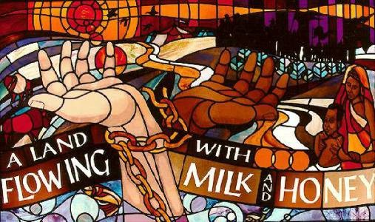
Liberation Theology
http://www.anarresproject.org/we-need-a-theology-of-liberation-in-the-united-states/

Slide 18
Liberation Theology
Liberation theology is a so-called Christian theological approach emphasizing the “liberation of the oppressed”.
In certain contexts, it emphasizes socio-economic analyses, with “social concern for the poor and political liberation for oppressed peoples.”
In other contexts, it addresses other forms of inequality, such as race or caste.
Liberation theology is best known in the Latin American context, especially within Catholicism in the 1960s after the Second Vatican Council.
Theologies of liberation have also developed in other parts of the world such as black theology in the United States and South Africa, Palestinian liberation theology, etc.
https://www.wikiwand.com/en/Liberation_theology

Slide 19
Liberation Theology
A liberal theologian writing for the New York Times once described Liberation Theology as “the Sunday school Jesus who healed the sick or took care of the poor people.” She says:
Liberation Theology is what your Sunday school teacher taught you if you grew up in a church. It isn’t something people should be afraid of, unless they’re invested in poor people not getting fed or sick people not getting healed.
But this is a very oversimplified and inaccurate description of Liberation Theology that is intended to instill guilt in anyone who dares to oppose the view.
https://tifwe.org/faith-economics-liberation-theology/

Slide 20
Liberation Theology
Liberation theology interprets the teachings of Jesus Christ in terms of liberation from unjust economic, political, and social structures in anticipation of ultimate salvation.
It can be described as a radical, Marxist attempt to promote the Social Gospel.
Liberation theology emerged as a reaction against poverty and social injustice.
Though on the surface it appears to be rooted in a deep concern for the poor, Liberation Theology is far from biblical. As G.K. Chesterton said, “Heresy is truth gone mad.”
https://tifwe.org/faith-economics-liberation-theology/

Slide 21
Liberation Theology Loses the Person of Christ.
Liberation theology is like putting a Marxist face on the person of Christ’s head and saying, “this is who Christ really is.”
Church leaders who advocate Liberation Theology will speak of Jesus as though he is “an armed political leader that would fight and take up the arms, to defend the oppressed.”
This does not fit with the biblical image of a Jesus that came to lay down his life for us.
https://tifwe.org/faith-economics-liberation-theology/

Slide 22
Liberation Theology Loses the Person of Christ.
Jesus was not a revolutionary dressed in guerrilla fatigues carrying a rifle.
This picture of Christ is entirely incorrect and reflects the Church’s emphasis on “doing” more than “learning” biblical principles.
While we must recognize that action is important and that “Faith without works is dead” (James 2:17), our actions must be informed by a faith rooted in a proper biblical worldview.
https://tifwe.org/faith-economics-liberation-theology/

Slide 23
Rooted in a Very Materialistic Worldview
The founder of liberation theology, theologian and priest Gustavo Gutiérrez, coined the phrase “preferential option for the poor.”
This expression says that God gives preference to the well-being of the poor in the Bible.
But when this concept is mixed with Marxist ideology in terms of wealth redistribution, it becomes a form of heresy.
https://tifwe.org/faith-economics-liberation-theology/

Slide 24
Rooted in a Very Materialistic Worldview
Christ cares about the poor, but the poor for the Christian is more than just the materially poor. It’s the morally poor, the spiritually poor.
Blessed are the poor in spirit, for theirs is the kingdom of heaven (Mat 5:3 )
the blind receive their sight and the lame walk, lepers are cleansed and the deaf hear, and the dead are raised up, and the poor have good news preached to them. (Mat 11:5)
The Spirit of the Lord is upon me, because he has anointed me to proclaim good news to the poor. (Luke 4:18)
For you always have the poor with you, but you will not always have me. (Mat 26:11 )
https://tifwe.org/faith-economics-liberation-theology/

Slide 25
Rooted in a Very Materialistic Worldview
When approaching the problem of poverty, we need to remember we are all spiritually poor and in need of salvation.
We also need to remember that we are not responsible for bringing about the Kingdom alone, that’s God’s job. He is merely using us as instruments through our work.
https://tifwe.org/faith-economics-liberation-theology/

Slide 26
Re-emerging in the Evangelical World Today
Unfortunately today we see some evangelical protestants falling for various forms of liberation theology.
There are three reasons why this is happening:
Protestant churches are seeking cultural relevance.
Some evangelical churches lack the doctrinal fortitude to condemn Liberation Theology and root it out.
Protestants are not learning from past mistakes made by the Catholic Church decades ago in Latin America.
Evangelicals should instead play a significant role in standing for biblical doctrine and sound economic principles.
https://tifwe.org/faith-economics-liberation-theology/

Slide 27
Re-emerging in the Evangelical World Today
Three major factors extinguished Liberation Theology in Latin America in the late 1980’s:
Theological opposition of the Catholic Church hierarchy.
Defeat of Latin American Marxists leaders.
The Latin American free market economic boom that proved to be a more efficient means of fighting poverty than armed struggle.
Let’s not stumble over the same stone twice.
The lessons of the Liberation Theology movement that swept Latin American teach us that true liberation will not be found in a social movement or economic structure, but in the liberation from spiritual poverty that comes from Christ alone.
https://tifwe.org/faith-economics-liberation-theology/

Slide 28
Feminism
https://www.britannica.com/story/feminism-from-ancient-rome-to-the-womens-march

Slide 29
Class Discussion Time
https://www.weareteachers.com/moving-beyond-classroom-discussions/

Slide 30
*Class Discussion Time
Washington Gladden, the father of the Social Gospel was alarmed by a “widening breach” (economically) between employers and employees in his congregation. Is a disparity in wages and/or standard of living between church members or members of society something that should cause us to be alarmed?
According to the preachers of the Social Gospel, capitalism is the prime example of sin in society. Do you agree? Why or why not?
The Social Gospel called for many benefits that we assume to be required rights in our day: occupational safety, old age security, minimum wage, and the rights of arbitration. In a perfect world, should these things be required by the government?
Advocates of the Social Gospel believed that individuals could not leave a life of sin until they were freed from the social and economic situation that drove them into sin in the first place. Is this a biblical outlook?
Do you see any philosophical connections between Liberation Theology and modern day Critical Theory? If so what are they?

