Slide 2
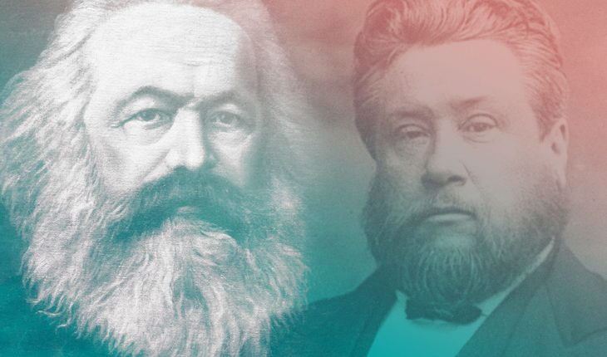
Two Men, Same City, Different Outcomes
https://shepherdsadvantageinc.com/?p=4014

Slide 3
Two Men, Same City, Different Outcomes
We begin today’s lesson on Communism by drawing a contrast between two famous men, whose notable graves can both be seen today in the city of London:
Karl Marx whose body lies in North London at Highgate Cemetery. Though Prussian, Marx lived in London the last thirty-four years of his life. There he refined his radical secular ideology and produced Das Kapital, setting loose upon the world ideas that have wrecked half of it and now threaten to wreck the other half.
Charles Spurgeon whose body lies in South London at West Norwood Cemetery. Known as the “Prince of Preachers,” Spurgeon pastored what was allegedly the largest church congregation in the world and often preached openly against many of Marx’s ideas.
https://larryalextaunton.com/2020/07/karl-marx-vs-charles-spurgeon-an-epic-struggle-for-the-souls-of-men-in-19th-century-london/

Slide 4
Two Men, Same City, Different Outcomes
It is extraordinary to think that both Karl Marx (1818-1883) and Charles Spurgeon (1834-1892) lived and worked in the same city at the same time.
Both were, in a sense, evangelists contending for the souls of men with their competing visions of humanity.
Moreover, each was at the height of his powers at the same time as the other.
While Marx was preaching “salvation” through bloody revolution, Spurgeon, on the other side of the city, was preaching salvation through the blood and grace of Jesus Christ.
https://larryalextaunton.com/2020/07/karl-marx-vs-charles-spurgeon-an-epic-struggle-for-the-souls-of-men-in-19th-century-london/

Slide 5
Two Men, Same City, Different Outcomes
The London of Marx and Spurgeon was the center of world governance and epoch-defining ideas.
With Queen Victoria’s missionaries to civilize it and her ministers, armies, and navy to rule it, the British Empire was at its zenith so that the sun literally never set upon it.
Whether it was David Livingstone searching for the source of the Nile or Charles Darwin penning On The Origin of Species by Means of Natural Selection, Britain was at the forefront of all that was considered progress.
An air of revolution lingered over the Britain of this era like some ominous storm gathering on the horizon, threatening to engulf this peaceful kingdom as it had intermittently done on the continent since the French Revolution in 1789.
https://larryalextaunton.com/2020/07/karl-marx-vs-charles-spurgeon-an-epic-struggle-for-the-souls-of-men-in-19th-century-london/

Slide 6
Two Men, Same City, Different Outcomes
England was in the throes of the Industrial Revolution.
The urban poor crowded the slums and populated the novels of Charles Dickens.
Child labor laws were in their infancy. Black factory smoke choked the air and coal dust filled lungs.
It was into this combustible atmosphere that Karl Marx stepped. The man with a beard so wild that it might have landed him on a Kansas album cover were he born a century later, had revolution on his mind when he moved from Paris to London in 1849.
Of course, revolution had always been on his mind. Marx had sought the overthrow of governments throughout Europe, and in the ensuing turmoil of 1848, he was forced to flee the continent.
https://larryalextaunton.com/2020/07/karl-marx-vs-charles-spurgeon-an-epic-struggle-for-the-souls-of-men-in-19th-century-london/

Slide 7
Two Men, Same City, Different Outcomes
Spurgeon combated Marx and his ideas just as the Apostle John had once opposed Cerinthus and Augustine had used his formidable intellect to confront Pelagius.
In a sermon on Psalm 118 in June 1878, Spurgeon made a tentative prediction to his congregation:
German rationalism which has ripened into Socialism may yet pollute the mass of mankind and lead them to overturn the foundations of society. I say not that it will be so, but I should not wonder if it came to pass, for deadly principles are abroad and certain ministers are spreading them.
It is very likely that the preaching of Spurgeon, and others like him, prevented the violent Revolution in Britain that Marx sought.
https://larryalextaunton.com/2020/07/karl-marx-vs-charles-spurgeon-an-epic-struggle-for-the-souls-of-men-in-19th-century-london/

Slide 8
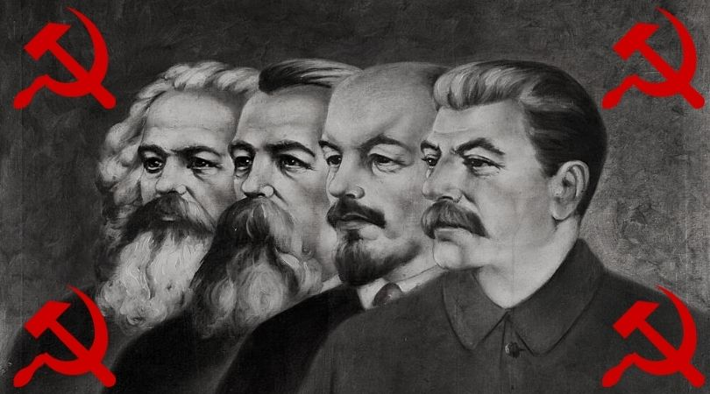
A Brief History of Communism
https://www.churchmilitant.com/news/article/marxism-and-the-catholic-church

Slide 9
A Brief History of Communism
Since its start a century ago, Communism, a political and economic ideology that calls for a classless, government-controlled society in which everything is shared equally, has seen a series of surges—and declines.
What started in 1917 Russia, became a global revolution, taking root in countries as far flung as China and Korea to Kenya and Sudan to Cuba and Nicaragua.
Communism launched from Lenin’s October Revolution and spread to China with Mao Zedong’s rise to power and to Cuba, with Fidel Castro’s takeover.
It was the ideology behind one side of the Cold War and saw a symbolic decline with the fall of the Berlin Wall.
Today just a handful of countries remain under communist rule. Following is a timeline of notable events that shaped Communism’s arc in history.
https://www.history.com/topics/russia/communism-timeline?li_source=LI&li_medium=m2m-rcw-history

Slide 10
Soviet Union Emerges From October Revolution
February 21, 1848: German economist and philosopher Karl Marx and Friedrich Engels published The Communist Manifesto, calling for a working-class revolt against capitalism. Its motto, “Workers of the world, unite!” quickly became a rallying cry.
November 7, 1917: With Vladimir Lenin at the helm, the Bolsheviks, who were Marxists, seized power during Russia’s October Revolution and became the first communist government. Later that month, the leftist Socialist Revolutionaries defeated the Bolsheviks in an election, but, despite his promises of “bread, land and peace,” Lenin used military force to stay in power. It was during this period that the Red Terror (executions of the Czar’s officials), prisoner-of-war labor camps and other police state tactics were established.
https://www.history.com/topics/russia/communism-timeline?li_source=LI&li_medium=m2m-rcw-history

Slide 11
Communism Takes Hold in China and Beyond
July 1, 1921: Inspired by the Russian Revolution, the Communist Party of China was formed.
January 21, 1924: Lenin died at age 54 of a stroke, and Joseph Stalin, who had served as Lenin’s general secretary, eventually took over official rule of the Soviet Union until his death in 1953 from a brain hemorrhage. He industrialized the country through a state-controlled economy, but it led to famine. Under his regime, detractors were deported or imprisoned in labor camps, and, as part of the Great Purge, a million people were executed under Stalin’s orders.
https://www.history.com/topics/russia/communism-timeline?li_source=LI&li_medium=m2m-rcw-history

Slide 12
Communism Takes Hold in China and Beyond
1940 to 1979: Communism was established by force or otherwise in Estonia, Latvia, Lithuania, Yugoslavia, Poland, North Korea, Albania, Bulgaria, Romania, Czechoslovakia, East Germany, Hungary, China, Tibet, North Vietnam, Guinea, Cuba, Yemen, Kenya, Sudan, Congo, Burma, Angola, Benin, Cape Verde, Laos, Kampuchea, Madagascar, Mozambique, South Vietnam, Somalia, Seychelles, Afghanistan, Grenada, Nicaragua and others.
https://www.history.com/topics/russia/communism-timeline?li_source=LI&li_medium=m2m-rcw-history

Slide 13
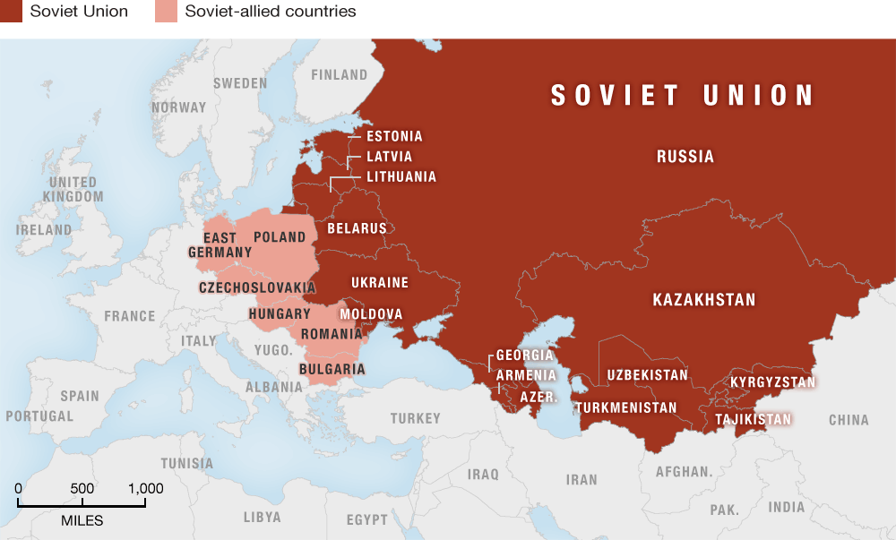
The Soviet Union
https://forgottennations.files.wordpress.com/2015/05/map-soviet-warsaw-624.png

Slide 14
Cold War Begins
May 9, 1945: The U.S.S.R. declared victory over Nazi Germany in World War II. With Japan’s defeat, Korea became divided into the communist North (which the Soviets occupied) and the South (which had been occupied by the United States).
March 5, 1946: Great Britain Prime Minister Winston Churchill made his famous “Iron Curtain” speech in Missouri, alerting Americans to the division between the Soviet Union and the Western allies.
March 12, 1947: President Harry S. Truman addressed Congress in what would come to be known as the Truman Doctrine, calling for the containment of communism, and later, leading to U.S. entry into wars in Korea and Vietnam to provide defense from communist takeovers. The doctrine became the basis for America’s Cold War policy.
https://www.history.com/topics/russia/communism-timeline?li_source=LI&li_medium=m2m-rcw-history

Slide 15
Cold War Begins
October 1, 1949: Following a civil war, China’s Communist Party leader, Mao Zedong declared his creation of the People’s Republic of China, leading the United States to end diplomatic ties with the PRC for decades.
July 5, 1950: Leading United Nations forces, the first U.S. troops engaged in the Korean War, after communist North Korea invaded South Korea with the intent of creating a unified communist state. The war lasted until July 27, 1953, with North Korea, China and the United Nations signing an armistice agreement.
https://www.history.com/topics/russia/communism-timeline?li_source=LI&li_medium=m2m-rcw-history

Slide 16
Communists Win in Cuba, Vietnam
April 25, 1976: Following the fall of Saigon at the end of the Vietnam War, South Vietnam’s capital was seized by communist forces. A few months later, in July, the nation was reunified as the Socialist Republic of Vietnam under communist rule.
October 25, 1983: The United States invaded Grenada under orders of President Ronald Reagan to secure the safety of American nationals under the country’s communist regime, led by Prime Minister Maurice Bishop. The pro-Marxist government was overthrown in about a week.
https://www.history.com/topics/russia/communism-timeline?li_source=LI&li_medium=m2m-rcw-history

Slide 17
Communists Win in Cuba, Vietnam
June 4, 1989: After weeks of protests, the Communist Chinese government sent in its military to fire on demonstrators calling for democracy in Beijing’s Tiananmen Square. The bloody violence ended in hundreds to thousands of deaths (no official death toll was ever released).
https://www.history.com/topics/russia/communism-timeline?li_source=LI&li_medium=m2m-rcw-history

Slide 18
Berlin Wall Falls, Soviet Union Dissolves
November 9, 1989: The Berlin Wall—that separated communist East Berlin from democratic West Berlin for nearly 30 years—fell. The years 1989-90 saw the collapse of communist regimes in Czechoslovakia, Hungary, Bulgaria, Poland, Romania, Benin, Mozambique, Nicaragua and Yemen.
December 25, 1991: With the resignation of Mikhail Gorbachev, the Soviet Union was dissolved. New Russian President Boris Yeltsin banned the Communist Party. Communism soon ended in Afghanistan, Albania, Angola, Congo, Kenya, Yugoslavia and other nations. China, Cuba, Laos, Vietnam remained under communist rule. North Korea remained nominally communist, although the North Korean government doesn't call itself communist.
https://www.history.com/topics/russia/communism-timeline?li_source=LI&li_medium=m2m-rcw-history

Slide 19
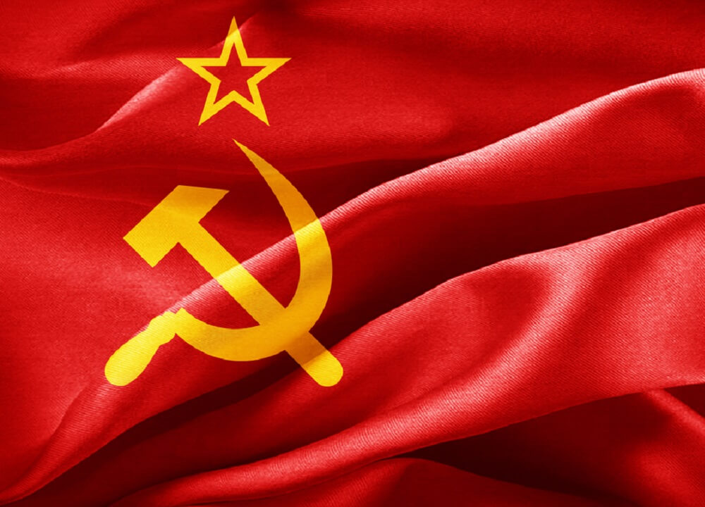
Is Communism a Good Idea?
https://www.churchmilitant.com/news/article/marxism-and-the-catholic-church

Slide 20
Is Communism a Good Idea?
Ideas have consequences. Sometimes good. Sometimes bad. And sometimes catastrophic – like the ideas of Karl Marx.
It was on Marx’s ideas that Lenin and Stalin built the Soviet Union, Mao built communist China, and innumerable other tyrants, from the Kims in North Korea to the Castros in Cuba, built their communist regimes.
Ultimately, those regimes and movements calling themselves “Marxist” have murdered about 100 million people and enslaved more than a billion.
https://www.prageru.com/video/who-is-karl-marx

Slide 21
Is Communism a Good Idea?
Marx believed that workers, specifically those who did manual labor, were exploited by capitalists – the people who owned, as Marx put it, “the means of production” (specifically, factories) – but who did very little physical labor themselves.
Only a workers’ revolution, Marx wrote in Das Kapital, could correct this injustice.
What would that revolution look like?
Marx and his collaborator, Friedrich Engels, spelled it out point-by-point in The Communist Manifesto.
It included the “abolition of property and inheritance” and the “centralization of credit, communication, and transport in the hands of the state.” And a lot more along the same lines.
In other words, the state owns and controls pretty much everything.
https://www.prageru.com/video/who-is-karl-marx

Slide 22
Is Communism a Good Idea?
This notion of total state ownership was widely discussed and debated in European intellectual circles during Marx’s lifetime, but nothing much came of it until Vladimir Lenin took power in Russia in 1917.
This changed everything. Despite its repeated economic failures, Lenin’s Russia, which became known as the Soviet Union, became the model for dictators around the world.
Wherever Marx’s ideas were practiced, life got worse – not by a little; but by a lot.
There is not a single exception to this rule. Not the Soviet Union, not Eastern Europe, not China, not North Korea, not Vietnam, not Cuba, not Venezuela, not Bolivia, not Zimbabwe.
Wherever Marxism goes, economic collapse, terror and famine follow.
https://www.prageru.com/video/who-is-karl-marx

Slide 23
Is Communism a Good Idea?
So, if cataclysmic failure – meaning terrible human suffering – is the inevitable legacy of Marxism, why do so many people – and now, especially, young people – defend it?
The most common answer Marxism’s advocates offer is that “they” – whoever “they” are: Lenin, Stalin, Chavez – never really practiced Marxism. They all somehow got it wrong.
Marxism, we are told, is, at its essence, about sharing what we have: “From each according to his ability, to each according to his needs,” as Marx put it.
Maybe that sounds good to you. But what does it mean? Who determines ability? Who determines need?
The answer is The State. The ruling elite. Under Marxism, that’s who has all of the power.
https://www.prageru.com/video/who-is-karl-marx

Slide 24
Is Communism a Good Idea?
That’s why the truth is this: Marxist dictators like Lenin, Mao and Pol Pot really did get Marxism right.
They wanted absolute power, and Marxism gave them the way to get it.
Karl Marx never had to face the consequences of his theories.
He lived most of his adult life breathing the free air of London, England, living off the generosity of his collaborator and patron Engels, who, as it happens, inherited his money from his wealthy merchant father.
Marx spent his days in the Reading Room of the British Museum, researching and writing.
Although he was obsessed with the term “scientific,” he was never able to marshal data to prove his theories. There’s a good reason for this: There was no data to prove his theories.
https://www.prageru.com/video/who-is-karl-marx

Slide 25
Is Communism a Good Idea?
For all of his time in the library, Marx couldn’t find any evidence to suggest that capitalism – the free exchange of goods and services through privately-owned business – was a passing phase.
Throughout the industrial age, working conditions constantly improved and wealth expanded.
Marx had to rely on outdated reports to make his case. And even then, he had to manipulate the data to get it to conform to his predetermined theories.
https://www.prageru.com/video/who-is-karl-marx

Slide 26
Is Communism a Good Idea?
But Marx really had no interest in proving his theories. He knew that they could be put into practice only by brute force.
He said so himself. “Of course, in the beginning, [communism] cannot be effected except by means of despotic inroads,” he wrote. His ends could “be attained only by the forcible overthrow of all existing social conditions.”
All existing social conditions. That’s religion, family, personal possessions, freedom, and democracy. They all had to go in order to achieve Marx’s vision of an earthly “paradise.”
https://www.prageru.com/video/who-is-karl-marx

Slide 27
Is Communism a Good Idea?
But since few people give up their liberties and property voluntarily, creating a Marxist state has always required guns, prisons, and summary executions.
Marx’s many disciples, from Lenin on, never considered this a problem. Some, like revolutionary poster-boy Che Guevara, considered it a bonus.
“I don’t need proof to execute a man,” Che is said to have boasted. “I only need proof that it’s necessary to execute him!”
If you’re still a fan of Marxism after all the death, suffering, and destruction it’s caused, that’s your right.
But own up to it. Don’t hide behind the “it’s never really been tried” line.
It has.
https://www.prageru.com/video/who-is-karl-marx

Slide 28
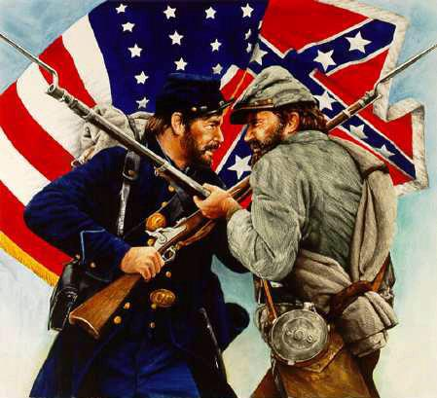
The Civil War
https://www.facebook.com/americancivilwarhistoryhomepage/

Slide 29
Class Discussion Time
https://www.weareteachers.com/moving-beyond-classroom-discussions/

Slide 30
*Class Discussion Time
There are many today who say that a pastor should never talk about political ideas from the pulpit. Spurgeon, the “Prince of Preachers” apparently had no qualms about doing so. What do you think? Is it ever appropriate for a pastor to mention, critique or endorse political ideas from the pulpit? Why or why not?
I have tried to show that communism is a horrible form of government to be avoided at all costs. Do you agree or disagree? Why or why not?
Why do you think so many young people today view communism positively in spite of its abysmal track record?

