Slide 2
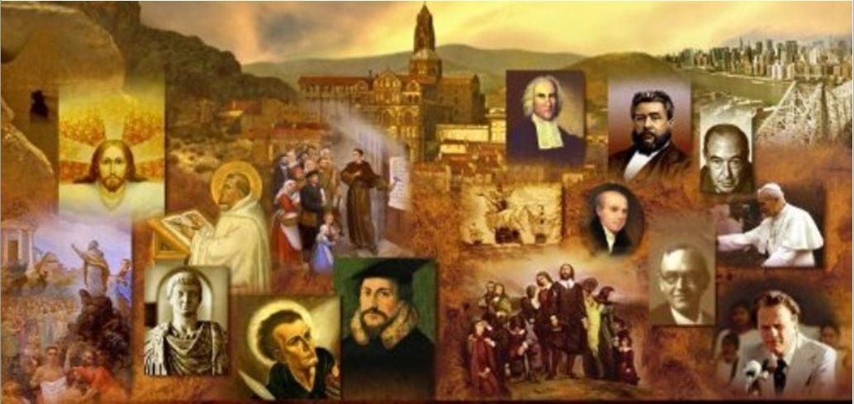
Review
We have been looking at the Apostolic Fathers – early Christian writers who wrote in the period just after the death of the apostles (AD 95-140).
Name the two writings of Apostolic Fathers that we have looked at so far.
1 Clement (AD 95)
The Didache (AD 100)
The Didache gave a number if instructions concerning Baptism. How many can you name?
It should preferably be done in “running water” (like a river).
If running water is not available then baptize in “other water”.
If neither is available, then pour water on the head three times.
It should be done in the name of the Father, Son and Holy Spirit.
Baptize in cold water unless unavailable, then in warm.
The one being baptized as well as others were to fast prior to the baptism.

Slide 3
Review
How often did the Didache say to fast and on what days?
Twice a week, on Wednesday and Friday
What prayer did the Didache instruct its readers to pray and how often were they to pray the prayer?
The “Our Father” (sometimes called “the Lord’s prayer”) was to be prayed three times per day
Does the Bible require us to pray rote prayers?
No
Does the Bible forbid us from praying rote prayers?
Assuming it is done with the right attitude, no.
When the Didache talks about the “Eucharist”, to what is it referring?
The Christian celebration of the Lord’s Supper
Where does the word Eucharist come from?
The Greek word eucharisteo, which means to “to give thanks”

Slide 4
Review
What passage of scripture did the Didache reference to support the idea that unbelievers should not partake of the Eucharist?
Jesus’ teaching to not give dogs what is holy, and do not throw your pearls before pigs (Mat 7:6)
What did the Didache say about a traveling preacher who stayed more than three days or who asked for money?
He is a false prophet
The Didache described an elder in the local church as a “true prophet desiring to settle among you”.
What did the Didache say the congregation’s obligation was to their elders?
To provide them with financial support (from their “first-fruits”)

Slide 5
Review
What two offices did the Didache say were to be appointed within the local church?
Bishops and deacons
On what day did the Didache say that the church was to gather together “to break bread and give thanks”?
The “Lord’s own day”
What did the Didache say concerning church discipline?
“Reprove one another, not in anger but in peace, as you find in the Gospel”;
“And let no one speak to any who have done wrong towards his neighbor, neither let him hear a word from you, until he repent.”

Slide 6
Review
The Didache said a number of things concerning the last days. What are some of the things it said?
Be ready, “for you know not the hour in which our Lord comes”
It talked about the appearance of a “world-deceiver” who would “work signs and wonders” and would “do unholy things, which have never been since the world began.”
It said the heavens would be opened, a trumpet would sound, and the dead in Christ would be raised.
Then the world will see the Lord (all His saints with Him) coming upon the clouds of heaven.

Slide 7
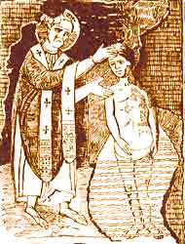
The Letter to Diognetus
https://www.christianity.com/church/church-history/timeline/1-300/epistle-of-diognetus-quote-11629595.html

Slide 8
*The Letter to Diognetus
Sometimes called the Letter of Mathetes [= Greek word for “disciple”] to Diognetus, this letter is thought to have been written between AD 100 and 150.
No one knows who wrote this letter, or who Diognetus was.
The letter set out to show the falsehood of Paganism and Judaism, and the superior teaching of Christianity.
Many readers have found it to be the most noble and beautiful of all Christian writings from this earliest period.
* Needham, Nick. 2,000 Years of Christ's Power Vol. 1: The Age of the Early Church Fathers

Slide 9
*The Letter to Diognetus
CHAPTER I -- OCCASION OF THE EPISTLE.
1:1 Since I see, most excellent Diognetus, that you are exceedingly anxious to understand the religion of the Christians, and that your enquiries respecting them are distinctly and carefully made, as to what God they trust and how they worship Him, that they all disregard the world and despise death, and take no account of those who are regarded as gods by the Greeks, neither observe the superstition of the Jews, … I gladly welcome this zeal in you, and I ask of God, Who supplies both the speaking and the hearing to us, that it may be granted to myself to speak in such a way that you may be made better by the hearing, and to you that you may so listen that I the speaker may not be disappointed.
* Lightfoot & Harmer, 1891 translation – with old English words updated to modern English

Slide 10
*The Letter to Diognetus
CHAPTER II -- THE VANITY OF IDOLS.
2:1 Come then, clear yourself of all the prepossessions which occupy your mind, and throw off the habit which leads you astray, and become a new man, as it were, from the beginning, as one who would listen to a new story, even as you yourself did confess. See not only with your eyes, but with your intellect also, of what substance or of what form they chance to be whom you call and regard as gods.
2:2 Is not one of them stone, like that which we tread under foot, and another bronze, no better than the vessels which are forged for our use, and another wood, which has already become rotten, and another silver, which needs a man to guard it lest it be stolen, and another iron, which is corroded with rust, and another earthenware, not a whit more comely than that which is supplied for the most dishonorable service?
* Lightfoot & Harmer, 1891 translation – with old English words updated to modern English

Slide 11
*The Letter to Diognetus
2:3 Are not all these of perishable matter? Are they not forged by iron and fire? Did not the sculptor make one, and the brass-founder another, and the silversmith another, and the potter another? …
2:4 Could not these things which are now worshipped by you, by human hands again be made vessels like the rest? Are not they all deaf and blind, are they not soul-less, senseless, motionless? Do they not all rot and decay?
2:5 These things you call gods, to these you are slaves, these you worship; and you end by becoming altogether like them.
2:6 Therefore you hate the Christians, because they do not consider these to be gods.
* Lightfoot & Harmer, 1891 translation – with old English words updated to modern English

Slide 12
*The Letter to Diognetus
CHAPTER III -- SUPERSTITIONS OF THE JEWS.
3:1 In the next place, I suspect that you are anxious to hear about [Christians] not practicing their religion in the same way as the Jews.
3:2 The Jews then, so far as they abstain from the mode of worship described above, do well in claiming to reverence one God of the universe and to regard Him as Master; but so far as they offer Him this worship in methods similar to those already mentioned, they are altogether at fault.
3:3 For whereas the Greeks, by offering these things to senseless and deaf images, make an exhibition of stupidity, the Jews considering that they are presenting them to God, as if He were in need of them, ought in all reason to count it folly and not religious worship.
* Lightfoot & Harmer, 1891 translation – with old English words updated to modern English

Slide 13
*The Letter to Diognetus
3:4 For He that made the heaven and the earth and all things that are therein, and furnished us all with what we need, cannot Himself need any of these things which He Himself supplied to them that imagine they are giving them to Him.
3:5 But those who think to perform sacrifices to Him with blood and fat and whole burnt offerings, and to honor Him with such honors, seem to me in no way different from those who show the same respect towards deaf images…
* Lightfoot & Harmer, 1891 translation – with old English words updated to modern English

Slide 14
*The Letter to Diognetus
4:1 But again their scruples concerning meats, and their superstition relating to the Sabbath and the vanity of their circumcision and the pretense of their fasting and new moons, I do [not] suppose you need to learn from me, are ridiculous and unworthy of any consideration.
4:2 For of the things created by God for man’s use – to receive some as created well, but to decline others as useless and superfluous – is not this impious?
4:3 And again to lie against God, as if He forbad us to do any good thing on the Sabbath day, is not this profane?
* Lightfoot & Harmer, 1891 translation – with old English words updated to modern English

Slide 15
*The Letter to Diognetus
4:4 Again, to vaunt the mutilation of the flesh as a token of election as though for this reason they were particularly beloved by God, is not this ridiculous?
4:5 And to watch the stars and the moon and to keep the observance of months and of days, and to distinguish the arrangements of God and the changes of the seasons according to their own impulses, making some into festivals and others into times of mourning, who would regard this as an exhibition of godliness and not much more of folly?
4:6 That the Christians are right therefore in holding aloof from the common silliness and error of the Jews and from their excessive fussiness and pride, I consider that you have been sufficiently instructed; but as regards the mystery of their own religion, do not expect that you can be instructed by man.
* Lightfoot & Harmer, 1891 translation – with old English words updated to modern English

Slide 16
*The Letter to Diognetus
CHAPTER V -- THE MANNERS OF THE CHRISTIANS.
5:1 For Christians are not distinguished from the rest of mankind either in locality or in speech or in customs.
5:2 For they dwell not somewhere in cities of their own, neither do they use some different language, nor practice an extraordinary kind of life.
5:3 Nor again do they possess any invention discovered by any intelligence or study of ingenious men, nor are they masters of any human dogma as some are.
* Lightfoot & Harmer, 1891 translation – with old English words updated to modern English

Slide 17
*The Letter to Diognetus
5:4 But while they dwell in cities of Greeks and barbarians as the lot of each is cast, and follow the native customs in dress and food and the other arrangements of life, yet the constitution of their own citizenship, which they set forth, is marvelous, and confessedly contradicts expectation.
5:5 They dwell in their own countries, but only as sojourners; they bear their share in all things as citizens, and they endure all hardships as strangers. Every foreign country is a fatherland to them, and every fatherland is foreign.
* Lightfoot & Harmer, 1891 translation – with old English words updated to modern English

Slide 18
*The Letter to Diognetus
5:6 They marry like all other men and they beget children; but they do not cast away their offspring.
5:7 They have their meals in common, but not their wives.
5:8 They find themselves in the flesh, and yet they live not after the flesh.
5:9 Their existence is on earth, but their citizenship is in heaven.
5:10 They obey the established laws, and they surpass the laws in their own lives.
5:11 They love all men, and they are persecuted by all.
5:12 They are ignored, and yet they are condemned. They are put to death, and yet they are endued with life.
* Lightfoot & Harmer, 1891 translation – with old English words updated to modern English

Slide 19
*The Letter to Diognetus
5:13 They are in beggary, and yet they make many rich. They are in want of all things, and yet they abound in all things.
5:14 They are dishonored, and yet they are glorified in their dishonor. They are evil spoken of, and yet they are vindicated.
5:15 They are reviled, and they bless; they are insulted, and they respect.
5:16 Doing good they are punished as evil-doers; being punished they rejoice, as if they were thereby quickened by life.
5:17 War is waged against them as aliens by the Jews, and persecution is carried on against them by the Greeks, and yet those that hate them cannot tell the reason of their hostility.
* Lightfoot & Harmer, 1891 translation – with old English words updated to modern English

Slide 20
*The Letter to Diognetus
CHAPTER VIII -- THE MISERABLE STATE OF MEN BEFORE THE COMING OF THE WORD.
8:1 For what man at all had any knowledge what God was, before He came?
8:2 Or do you accept the empty and nonsensical statements of those pretentious philosophers: of whom some said that God was fire (they call that God, where they themselves shall go), and others water, and others some other of the elements which were created by God?
* Lightfoot & Harmer, 1891 translation – with old English words updated to modern English

Slide 21
*The Letter to Diognetus
8:3 And yet if any of these statements is worthy of acceptance, any one other created thing might just as well be made out to be God.
8:4 Nay, all this is the quackery and deceit of the magicians;
8:5 and no man has either seen or recognized Him, but He revealed Himself.
8:6 And He revealed (Himself) by faith, whereby alone it is given to see God.
* Lightfoot & Harmer, 1891 translation – with old English words updated to modern English

Slide 22
*The Letter to Diognetus
8:7 For God, the Master and Creator of the Universe, Who made all things and arranged them in order, was found to be not only friendly to men, but also long-suffering.
8:8 And such indeed He was always, and is, and will be, kindly and good and dispassionate and true, and He alone is good.
8:9 And having conceived a great and unutterable scheme He communicated it to His Son alone.
* Lightfoot & Harmer, 1891 translation – with old English words updated to modern English

Slide 23
*The Letter to Diognetus
8:10 For so long as He kept and guarded His wise design as a mystery, He seemed to neglect us and to be careless about us.
8:11 But when He revealed it through His beloved Son, and manifested the purpose which He had prepared from the beginning, He gave us all these gifts at once, participation in His benefits, and sight and understanding of (mysteries) which none of us ever would have expected.
* Lightfoot & Harmer, 1891 translation – with old English words updated to modern English

Slide 24
*The Letter to Diognetus
9:1 Having thus planned everything already in His mind with His Son, He permitted us during the former time to be borne along by disorderly impulses as we desired, led astray by pleasures and lusts, not at all because He took delight in our sins, but because He bore with us, not because He approved of the past season of iniquity, but because He was creating the present season of righteousness, that, being convicted in the past time by our own deeds as unworthy of life, we might now be made deserving by the goodness of God, and having made clear our inability to enter into the kingdom of God of ourselves, might be enabled by the ability of God.
* Lightfoot & Harmer, 1891 translation – with old English words updated to modern English

Slide 25
*The Letter to Diognetus
9:2 And when our iniquity had been fully accomplished, and it had been made perfectly manifest that punishment and death were expected as its recompense, and the season came which God had ordained, when henceforth He should manifest His goodness and power (O the exceeding great kindness and love of God), He hated us not, neither rejected us, nor bore us malice, but was long-suffering and patient, and in pity for us took upon Himself our sins, and Himself parted with His own Son as a ransom for us, the holy for the lawless, the guileless for the evil, the just for the unjust, the incorruptible for the corruptible, the immortal for the mortal.
* Lightfoot & Harmer, 1891 translation – with old English words updated to modern English

Slide 26
*The Letter to Diognetus
9:3 For what else but His righteousness would have covered our sins?
9:4 In whom was it possible for us lawless and ungodly men to have been justified, save only in the Son of God?
9:5 O the sweet exchange, O the inscrutable creation, O the unexpected benefits; that the iniquity of many should be concealed in One Righteous Man, and the righteousness of One should justify many that are iniquitous!
9:6 Having then in the former time demonstrated the inability of our nature to obtain life, and having now revealed a Savior able to save even creatures which have no ability, He willed that for both reasons we should believe in His goodness and should regard Him as nurse, father, teacher, counsellor, physician, mind, light, honor, glory, strength and life.
* Lightfoot & Harmer, 1891 translation – with old English words updated to modern English

Slide 27
*The Letter to Diognetus
I find it encouraging, that someone (we don’t know who) in the early second century had a very clear grasp of the many principles of God’s sovereignty in salvation that you and I believe today:
God’s purposes
God’s Sovereign Decrees
The sinfulness of man
The inability of man
Imputation
Substitution
Justification
Perhaps even Limited Atonement (Particular Redemption)
* Needham, Nick. 2,000 Years of Christ's Power Vol. 1: The Age of the Early Church Fathers

Slide 28
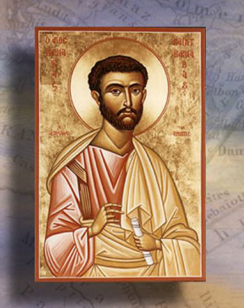
The Epistle of Barnabas
http://www.forerunner.com/churchfathers/X0026_06._EPISTLE_OF_BARNA.html

