Slide 2
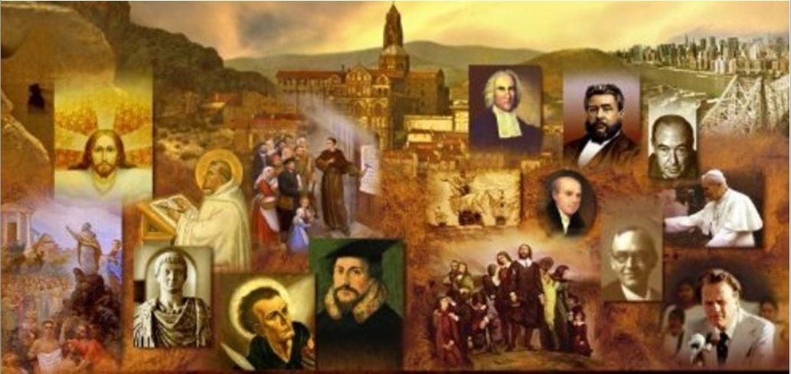
Review
What was the overall purpose of the Letter to Diognetus?
The letter set out to show the falsehood of Paganism and Judaism, and the superior teaching of Christianity.
In the opening of this letter, what does the writer “ask of God, Who supplies both the speaking and the hearing to us”?
That he, as the writer, would speak in such a way that his reader would be made better by the hearing
That the reader would so listen that the writer would not be disappointed

Slide 3
Review
How would you summarize the argument that the writer makes against the pagan reader’s worship of false gods?
The “gods” that the reader worships are mere statues made by human craftsman from ordinary materials – therefore to worship them is absurd.
How would you summarize the argument that the writer makes against Judaism?
That God has no need of the things the Jews offer to Him in their sacrifices, therefore it’s senseless for them to offer such sacrifices.
There is a sense in which his criticism of the Jews is valid and there is a sense in which it is not. Explain.
It is true God has no need of any offering someone might make, but in the OT, God had commanded that such offerings be made.
It is the coming of Christ that makes the sacrifices unnecessary, not the fact that God has no need of them.

Slide 4
Review
The writer points out that in many ways Christians are very ordinary people:
They dwell in their own countries; they share in their civic responsibilities along with their unbelieving fellow citizens.
They follow the native customs in dress and food and the other arrangements of life.

Slide 5
Review
But then the writer draws a number of contrasts between the way Christians live and the way those in pagan society live. Name some of the distinctions that he pointed out.
They marry and have children; but they don’t kill their “unwanted” offspring.
They have their meals in common, but not their wives.
They find themselves in the flesh, and yet they live not after the flesh.
Their existence is on earth, but their citizenship is in heaven.
They obey the established laws, but they surpass the laws in their own lives.
For the most part they are poor, but they make others rich.
They are reviled, yet they bless those who revile them.

Slide 6
Review
The writer shows a very clear grasp of the many principles of God’s sovereignty in salvation that you and I believe today. Name some of those sovereign grace, gospel principles that this writer affirms in this letter.
God’s purposes
God’s Sovereign Decrees
The sinfulness of man
The inability of man
Imputation
Substitution
Justification
Perhaps even Limited Atonement (Particular Redemption)

Slide 7
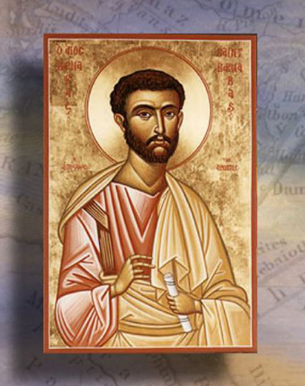
The Epistle of Barnabas
http://www.forerunner.com/churchfathers/X0026_06._EPISTLE_OF_BARNA.html

Slide 8
*The Letter of Barnabas
The Letter of Barnabas is thought by historians to have been written in Alexandria in around AD 120.
The Letter of Barnabas is not to be confused with the Gospel of Barnabas:
The Gospel of Barnabas is a very late (13th century) forgery full of wild-eyed anachronisms. In the Middle Ages, throughout their lives, people rarely traveled more than few miles from where they were born. Consequently, they tended to believe that the whole world had always looked the way things looked in their world, which is why paintings from that time show things that way.
Because of this, it was hard for people in that day to recognize anachronisms and it was easy for them to be fooled by forgeries.
The only people who take the Gospel of Barnabas seriously are Muslims. It was written by someone who had been a Christian and then had become a Muslim of sorts. It is a book of wild-eyed fiction. Even serious Muslim scholars don’t take it seriously.
*Based on notes taken from James White’s 2016 Church History Series; Lesson 9 – The Epistle of Barnabas

Slide 9
*The Letter of Barnabas
While some of the later church fathers (such as Clement of Alexandria – AD 150-215) claimed this letter was written by Paul’s companion, Barnabas, this is almost certainly not the case:
Barnabas was most likely martyred in AD 61 – a number of years prior to when this letter was written.
And it is highly doubtful that the Apostle Paul’s Jewish, NT companion would have espoused the kind of strong anti- Jewish sentiment expressed in this letter.
There is nothing in the letter to identify who wrote it, and therefore we don’t know who actually wrote it.
*Based on notes taken from James White’s 2016 Church History Series; Lesson 9 – The Epistle of Barnabas

Slide 10
*The Letter of Barnabas
If you just look at an outline of the Letter of Barnabas, it seems to be rather straight-forward and orthodox:
Part 1 – External Ritual is Worthless (Chapters 1-4)
Part 2 – The True Religious Life:
The Work of Christ which is prefigured in prophesies and ritual observances (Chapters 5-8)
The religious ordinances of the OT (circumcision and food laws) were only types, while those of the NT (baptism and the cross) were prefigured by the prophets. (Chapters 9-12)
These NT ordinances mark Christians as true heirs of salvation as was understood by the patriarchs, Moses, and the prophets (Chapters 13-14)
Christians posses the true Sabbath and the true temple (Chapters 15-16)
Conclusion and Appendix (Chapters 17-21)
The Way of Light
The Way of Darkness
*William Cunningham; A Dissertation on the Epistle of Barnabas; 1877; p. 13-14
https://play.google.com/books/reader?id=Uf1EAAAAYAAJ&hl=en&pg=GBS.PR13

Slide 11
*The Letter of Barnabas
And there are a number of things about the Letter of Barnabas that I find to be very encouraging.
For example, there is a strong emphasis on the deity of Christ. The Letter of Barnabas tells us that:
Christ is “Lord of the world” and God [the Father] is said to have consulted Him concerning the creation of man (5:5)
“The Son of God, being Lord is coming to judge the living and the dead.” (7:2)
“When the Son shall come, [he will] put an end to the evil days, and judge the wicked, and change the sun and the moon and the stars…” (15:5)
The letter is equally distinct in its teaching of the full humanity of Christ, thus avoiding the error of Gnosticism, which was already beginning to take root at the time this letter was written:
How could sinful men bear to look upon Him and be saved if He had not come in the flesh?” (5:10)
* William Cunningham; A Dissertation on the Epistle of Barnabas; 1877; p. 105ff

Slide 12
*The Letter of Barnabas
The letter shows a good understanding of the gospel and Christ’s substitutionary sacrifice on the cross:
5:1 For this end the Lord suffered to give His flesh to corruption, that we might be sanctified by the remission of our sins, through the sprinkling of His blood.
7:2 If therefore the Son of God, who is Lord, and will judge the quick and the dead, suffered in order that His stripes might make us live ; we ought to believe that the Son of God was not able to suffer except on our account.
12:7 He, though dead, is able to make alive.
He views baptism (by immersion!) as an important declaration of a believer’s faith and hope in Christ:
11:8 Blessed are they that set their hope on the cross, and go down into the water.
11:11 We go down into the water laden with sins and filth, and rise up from it bearing fruit in the heart, resting our fear and hope on Jesus in the spirit.
* William Cunningham; A Dissertation on the Epistle of Barnabas; 1877; p. 105ff

Slide 13
*The Letter of Barnabas
He mentions the “eighth day” (i.e. Sunday) as a day on which Christians celebrate Christ’s resurrection:
15:9 We celebrate the eighth day with gladness, for on it Jesus arose from the dead, and appeared, and ascended in heaven.
We don’t know for sure to which scriptures the writer of this letter had access.
Within the letter he quotes extensively from the OT, but only directly cites the NT two times – both references from the Synoptic Gospels:
4:14 Many are called but few are chosen (cf. Mat. 22:14)
5:9 He came not to call the righteous but sinners (cf. Mat. 9:13; Mark 2:17; Luke 5:32)
* William Cunningham; A Dissertation on the Epistle of Barnabas; 1877; p. 105ff

Slide 14
The Letter of Barnabas
Although there is much in this letter that is encouraging, there are a number of glaring weaknesses in the theology of this letter, all of which seem to stem from an antagonism on the part of the writer towards the Jews and Judaism.
This antagonism towards the Jews is something that we have already begun to see in other writers of this time (e.g. The Letter to Diognetus) and it becomes even stronger as church history progresses – even to the time of the Reformation and beyond!
For most Christians, “the Jews” now simply meant those who had crucified Christ and continued to reject Him – a lost, blind people. This attitude produced among many Christians a mindless hostility to Jews.*
This antagonism of the Christian church towards the Jews was harmful and very problematic.
* Needham, Nick. 2,000 Years of Christ's Power Vol. 1: The Age of the Early Church Fathers

Slide 15
The Letter of Barnabas
First and foremost, Christian hatred and antagonism towards the Jews and Judaism is a violation of Paul’s clear teaching in Romans 9-11.
The Apostle Paul, a Jew himself, loved his fellow Jews and was deeply grieved by those Jews who rejected the gospel:
I am telling the truth in Christ (I am not lying!), for my conscience assures me in the Holy Spirit– I have great sorrow and unceasing anguish in my heart. For I could wish that I myself were accursed– cut off from Christ– for the sake of my people, my fellow countrymen, who are Israelites. (Rom 9:1-4 NET)
Brothers and sisters, my heart's desire and prayer to God on behalf of my fellow Israelites is for their salvation. (Rom 10:1 NET)

Slide 16
The Letter of Barnabas
Furthermore, the Apostle Paul views our Christian heritage as being founded on historic Judaism:
To [the Jews] belong the adoption as sons, the glory, the covenants, the giving of the law, the temple worship, and the promises. To them belong the patriarchs, and from them, by human descent, came the Christ, who is God over all, blessed forever! Amen. (Rom 9:4-5 NET)
Paul goes on warn against the very attitudes that later developed in the Christian church:
Now I am speaking to you Gentiles … if some of the branches were broken off, and you, a wild olive shoot, were grafted in among them and participated in the richness of the olive root, do not boast over the branches. But if you boast, remember that you do not support the root, but the root supports you. Then you will say, "The branches were broken off so that I could be grafted in." Granted! They were broken off because of their unbelief, but you stand by faith. Do not be arrogant, but fear! For if God did not spare the natural branches, perhaps he will not spare you. (Rom 11:13, 17-21 NET)

Slide 17
The Letter of Barnabas
A number of other negative consequences resulted from the many centuries of Christian antagonism towards the Jews:
For a number of centuries most Christian scholars had little to no knowledge of Hebrew.
As a result, their understanding of the OT was weak.
It become very popular among Christians to ignore the literal teachings of the OT and to begin interpreting OT passages “spiritually” or allegorically.
The Letter of Barnabas is a classic example of a Christian writer allegorizing or spiritualizing the OT almost to the point of being absurd.

Slide 18
The Letter of Barnabas
For example, the Letter of Barnabas spiritualizes the OT commands to offer animal sacrifices. According to this letter:
God never intended for the Jews to offer literal animal sacrifices.
The OT commands to offer animal were really meant by God to read be “spiritually” to mean that they should live sacrificial lives of obedience to God.
To prove his case the writer cites passages like Isaiah 1:11-13 where Gods says things like: What to me is the multitude of your sacrifices? says the LORD; I have had enough of burnt offerings of rams and the fat of well-fed beasts; I do not delight in the blood of bulls, or of lambs, or of goats. When you come to appear before me, who has required of you this trampling of my courts? Bring no more vain offerings; incense is an abomination to me.

Slide 19
*The Letter of Barnabas
The Letter of Barnabas spiritualizes the OT dietary laws. According to this letter:
God, when he spoke through Moses, never intended the Jewish dietary laws to mean they should literally avoid certain foods, but instead Moses intended these commands to be understood spiritually .
10:1 And when Moses said to not eat the pig, or the eagle, or the hawk, or the crow, or any fish without scales, he received three firm teachings in his understanding.
10:2 Moreover, he said to them in the book of Deuteronomy: I will establish a covenant with this people in my righteous demands. So, then, the commandment of God is not a matter of avoiding food; but Moses spoke in the Spirit.
10:9 And so, Moses received the three firm teachings about food and spoke in the Spirit. But they received his words according to the desires of their own flesh, as if he were actually speaking about food.
* Ehrman, The Apostolic Fathers: Epistle of Barnabas, Papias and Quadratus, Epistle to Diognetus, The Shepherd of Hermas (Cambridge, Mass.: Harvard University Press, 2003), 17

Slide 20
The Letter of Barnabas
According to the Letter of Barnabas some spiritual applications of the OT dietary laws are:
The prohibition against eating pork is intended to forbid the people to live like swine, who grunt when hungry but are silent when full: likewise, the people are not to pray to God when they are in need but ignore Him when they are satisfied. (10:3)
The prohibition against eating a vulture or buzzard means that people should work for their own food rather than stealing other people’s food like the vulture or buzzard. (10:4)
The prohibition against eating rabbit means that the people are not to behave in a promiscuous manner in the way that rabbits do. (10:6)

Slide 21
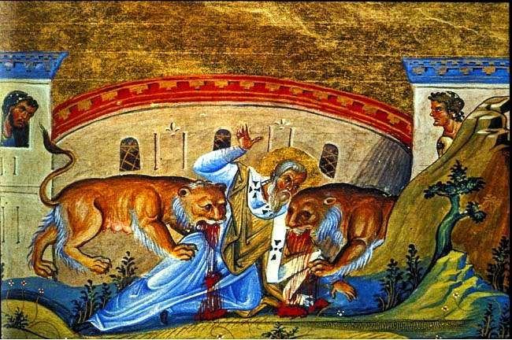
Ignatius of Antioch
http://www.forerunner.com/churchfathers/X0026_06._EPISTLE_OF_BARNA.html

