Slide 2
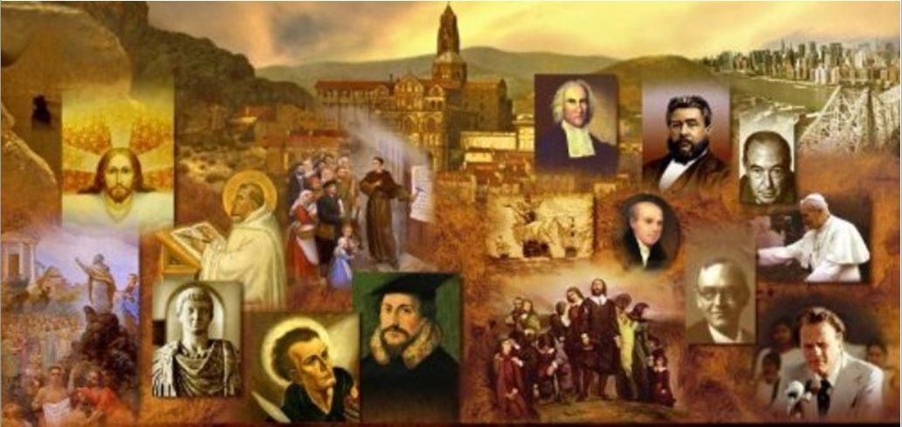
Review
Last time, when we studied the Letter of Barnabas, I pointed out that it is important to distinguish between the Letter of Barnabas which was written in about AD 120 and the Gospel of Barnabas.
When was the Gospel of Barnabas written, and what is the major problem with it?
The Gospel of Barnabas is a very late (13th century) forgery full of wild-eyed anachronisms.
What is an anachronism and how do anachronisms sometimes help scholars and historians identify forgeries?
An anachronism is the act of attributing a custom, event, or object to a period of time to which it does not belong.
When a work claiming to be written at a very early date describes things that did not exist until many years later, we know that it can’t have been written at the time that it claims to have been written.

Slide 3
Review
What are the two reasons I gave why it is unlikely that the Letter of Barnabas would have been written by the Apostle Paul’s NT companion named Barnabas?
Barnabas was most likely martyred in AD 61 – a number of years prior to when this letter was written.
And it is highly doubtful that the Apostle Paul’s Jewish, NT companion would have espoused the kind of strong anti- Jewish sentiment expressed in this letter.
What NT scriptures can we know for sure that the author of this letter had access to, and how do we know that?
We know he at least had access to the Synoptic Gospels since he gives two citations from them in the letter. We don’t know whether he had access to any other NT scriptures beyond that.

Slide 4
Review
Last time I listed several things about the letter of Barnabas that I found to be encouraging. How many of those things can you name?
There is a strong emphasis on the deity of Christ
The letter is equally distinct in its teaching of the full humanity of Christ, thus avoiding the error of Gnosticism, which was already beginning to take root at the time this letter was written.
The letter shows a good understanding of the gospel and Christ’s substitutionary sacrifice on the cross.
The author of the letter views baptism (by immersion!) as an important declaration of a believer’s faith and hope in Christ.
The author mentions the “eighth day” (i.e. Sunday) as a day on which Christians celebrate Christ’s resurrection

Slide 5
Review
What did I say was the glaring theological weakness that we find in this letter and what does it seem to stem from?
The letter allegorizes the OT teachings to the point of absurdity – claiming that God never intended for the Jews to offer real animal sacrifices, refrain from eating certain foods, etc.
It seems to stem from a growing antagonism towards Judaism and tendency to spiritualize the OT that we see in the early church.
Where in the NT do we find strong warnings against the kind of Gentile anti-Jewish sentiment that we see so much of in the early church?
Romans 9-11

Slide 6
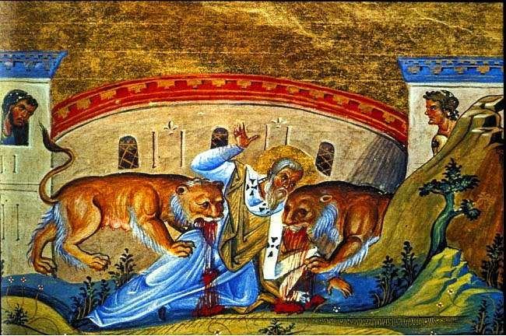
Ignatius of Antioch
https://www.tektonministries.org/student-reflection-on-st-ignatius-of-antioch-tomorrows-reading-reflection/

Slide 7
*Ignatius of Antioch
Ignatius (AD 35 – 107) was the bishop of the church in Antioch at the beginning of the 2nd century.
Arrested for being a Christian, he was taken to Rome by a military escort, where he was executed under the emperor Trajan.
As Ignatius journeyed to Rome, he wrote seven letters –
Five to churches in Asia Minor:
Ephesus
Magnesia
Tralles
Philadelphia
Smyrna
One to the church of Rome
One a personal letter to Polycarp, bishop of the church in Smyrna.
Ignatius’s letters reveal a deep spiritual devotion to Christ and an enthusiastic longing to sacrifice his life for Christ’s sake.
* Needham, Nick. 2,000 Years of Christ's Power Vol. 1: The Age of the Early Church Fathers

Slide 8
*Ignatius of Antioch
In addition to the seven genuine letters written by Ignatius, there are a number of pseudo-Ignatian Epistles. You can often identify them by all the anachronisms they contain.
The Jehovah’s Witnesses once wrote a series of articles on the early church fathers where they tried to make it sound like the early church fathers all held to the same beliefs as modern Jehovah’s Witnesses.
Their entire article on Ignatius was based on the pseudo-Ignatian Epistles. (https://faithleaks.org/wiki/documents/8/8d/W_E_19920201.pdf , p.21)
In the genuine letters written by Ignatius he refers to Jesus as God a number of times. Therefore the JWs didn’t use those letters.
*Based on notes taken from James White’s 2016 Church History Series; Lessons 10-11 – Ignatius

Slide 9
*Ignatius of Antioch
Contrary to the claim made by the JWs, Ignatius makes a number of very strong statements concerning the deity of Christ:
Ignatius, who is also called Theopharus [= “God bearer”], to the Church which is at Ephesus, in Asia, deservedly most happy, being blessed in the greatness and fullness of God the Father, and predestinated before the beginning of time, that it should be always for an enduring and unchangeable glory, being united and elected through the true passion by the will of the Father, and Jesus Christ, our God... (Ephesians Intro)
*https://www.iclnet.org/pub/resources/text/apl/jw/ignatius.txt

Slide 10
*Ignatius of Antioch
Contrary to the claim made by the JWs, Ignatius makes a number of very strong statements concerning the deity of Christ:
For our God, Jesus Christ, was, according to the appointment of God, conceived in the womb by Mary, of the seed of David, but by the Holy Ghost… (Ephesians 18)
Now the virginity of Mary was hidden from the prince of this world, as was also her offspring… God Himself being manifested in human form for the renewal of eternal life. (Ephesians 19)
*https://www.iclnet.org/pub/resources/text/apl/jw/ignatius.txt

Slide 11
*Ignatius of Antioch
Contrary to the claim made by the JWs, Ignatius makes a number of very strong statements concerning the deity of Christ:
Ignatius, who is also called Theophorus, to the Church which has obtained mercy, through the majesty of the Most High Father, and Jesus Christ, His only-begotten Son; the Church which is beloved and enlightened by the will of Him that wills all things which are according to the love of Jesus Christ our God (Romans Intro)
I glorify God, even Jesus Christ, who has given you such wisdom. (Smyrneans 1)
*https://www.iclnet.org/pub/resources/text/apl/jw/ignatius.txt

Slide 12
*Ignatius of Antioch
Aside from directly calling Jesus Christ “God”, Ignatius gives us a number of other indications of his strong belief in the deity of Christ:
Now, He suffered all these things for our sakes, that we might be saved. And He suffered truly, even as also He truly raised up Himself, not, as certain unbelievers maintain, that He only seemed to suffer, as they themselves only seem to be [Christians]. (Smyrneans 2)
The NT teaches that all three members of the Trinity were involved in raising Jesus from the dead:
The Father (Romans 4:24)
Jesus (John 2:19-21)
The Holy Spirit (Rom. 1:4)
Here Ignatius attacks the gnostic teachers of his day, and in the process makes reference to the Lord Jesus raising Himself from the dead. In his letter to the Trallians (chapter 9) Ignatius confesses his belief that the Father raised Christ from the dead as well.
*https://www.iclnet.org/pub/resources/text/apl/jw/ignatius.txt

Slide 13
*Ignatius of Antioch
Aside from directly calling Jesus Christ "God," Ignatius gives us a number of other indications of his strong belief in the deity of Christ:
Look for Him who is above all time, eternal and invisible, yet who became visible for our sakes; impalpable [=unable to be touched] and impassible [=not subject to suffering], yet who became passible [=subject to suffering] on our account; and who in every kind of way suffered for our sakes. (Polycarp 3)
Here Ignatius describes the Son as eternal, invisible, impalpable and impassible. One is reminded of Paul's words to Timothy (1:17), Now to the eternal king, immortal, invisible, the only God, be honor and glory forever and ever! Amen. (NET).
*https://www.iclnet.org/pub/resources/text/apl/jw/ignatius.txt

Slide 14
*Ignatius of Antioch
One of the highest Christological statements to be found in the early patristic literature is found in Ignatius’ letter to the Ephesians :
There is one Physician who is possessed both of flesh and spirit; both made and not made; God existing in flesh; true life in death; both of Mary and of God; first passible and then impassible, even Jesus Christ our Lord. (Ephesians 7)
Such a confession of faith shows a keen insight into the person of Jesus Christ, for it shows that Ignatius was fully aware of the dual nature of Christ — “God existing in flesh” is the way he put it. Fully man and fully God — such teaching is in contrast to the heretical Gnostic teaching that was already beginning to take root in Ignatius’ day.
*https://www.iclnet.org/pub/resources/text/apl/jw/ignatius.txt

Slide 15
*Ignatius of Antioch
Finally, with reference to the three Persons of the Trinity, we note the following passage that comes close on the heals of the previous citation:
[You] being stones of the temple of the Father, prepared for the building of God the Father, and drawn up on high by the instrument of Jesus Christ, which is the cross, making use of the Holy Spirit as a rope… (Ephesians 9)
Compare this with Paul’s statement to the Ephesian believers: [You are] built on the foundation of the apostles and prophets, Christ Jesus himself being the cornerstone, in whom the whole structure, being joined together, grows into a holy temple in the Lord. In him you also are being built together into a dwelling place for God by the Spirit. (Eph. 2:20-22)
*https://www.iclnet.org/pub/resources/text/apl/jw/ignatius.txt

Slide 16
*Ignatius of Antioch
So to summarize Ignatius' view concerning who Christ is:
Seven times Ignatius directly calls Jesus Christ “God.”
Four of these times he uses the phrase “our God” or its equivalent.
He expresses his belief that Jesus Christ raised Himself from the dead, and in describing Him, uses such terms as “eternal,” “invisible,” “impalpable,” and “impassible.”
He speaks of Christ as “God existing in flesh,” “true life in death,” and as “both of Mary and of God.”
To any serious investigator, Ignatius' belief in the deity of Christ could not be more clear.
*https://www.iclnet.org/pub/resources/text/apl/jw/ignatius.txt

Slide 17
*Ignatius of Antioch
Unfortunately, while Ignatius had a strong orthodoxy concerning the deity and humanity of Christ, his ecclesiology is not as encouraging.
In Ignatius’ letters we see the beginnings of what theologians call a “monarchical episcopate” – a form of church government where there is a single bishop within each church who presides over a board of elders.
As we have seen, such a practice was not universal at this time: When Ignatius writes to the Ephesian and Roman churches, for example, he does not speak of a single bishop, because those churches did not have a single bishop at that time.
But unfortunately, this unbiblical development in church government become more and more common in the early church, so that by AD 150 it was becoming the norm.
*Based on notes taken from James White’s 2016 Church History Series; Lesson 11 – Ignatius

Slide 18
*Ignatius of Antioch
An example of Ignatius’ view of a single bishop within each church can be seen in his letter to the Smyrneans:
See that you all follow the bishop, even as Jesus Christ does the Father, and the presbytery as ye would the apostles; and reverence the deacons, as being the institution of God. Let no man do anything connected with the Church without the bishop. Let that be deemed a proper Eucharist, which is[administered] either by the bishop, or by one to whom he has entrusted it. Wherever the bishop shall appear, there let the multitude[of the people] also be; even as, wherever Jesus Christ is, there is the Catholic Church. It is not lawful without the bishop either to baptize or to celebrate a love-feast; but whatsoever he shall approve of, that is also pleasing to God, so that everything that is done may be secure and valid. (Smyrneans 8)
*Based on notes taken from James White’s 2016 Church History Series; Lesson 11 – Ignatius

Slide 19
*Ignatius of Antioch
Ignatius is thought to be the first known Christian writer to argue in favor of replacing the observance of the Jewish Sabbath with the Lord's Day:
Be not deceived with strange doctrines, nor with old fables, which are unprofitable. For if we still live according to the Jewish law, we acknowledge that we have not received grace… (Magnesians 8)
If, therefore, those who were brought up in the ancient order of things have come to the possession of a new hope, no longer observing the Sabbath, but living in the observance of the Lord's Day, on which also our life has sprung up again by Him and by His death… (Magnesians 9)
* https://en.wikipedia.org/wiki/Ignatius_of_Antioch

Slide 20
*Ignatius of Antioch
A passage in Ignatius that is sometimes misunderstood by those who believe in transubstantiation (a view held by Roman Catholics which states that the during the celebration of the Lord’s supper, the bread and wine literally turn into the physical body and blood of Christ):
But consider those who are of a different opinion with respect to the grace of Christ which has come unto us, how opposed they are to the will of God. They have no regard for love; no care for the widow, or the orphan, or the oppressed; of the bond, or of the free; of the hungry, or of the thirsty. They abstain from the Eucharist and from prayer, because they confess not the Eucharist to be the flesh of our Savior Jesus Christ, which suffered for our sins, and which the Father, of His goodness, raised up again. (Smyrneans 6-7)
This is most likely a reference to the Gnostic belief that Jesus Christ did not come in the flesh, since the idea of transubstantiation did not come along till much later in church history.
*Based on notes taken from James White’s 2016 Church History Series; Lesson 10 – Ignatius

Slide 21
Ignatius of Antioch
The last, and perhaps most admirable thing we should see in Ignatius’ letters is the courage and determination that he had in facing a martyr’s death:
I write to all the Churches, and impress on them all, that I shall willingly die for God, unless you hinder me. I beseech of you not to show an unseasonable goodwill towards me. Suffer me to become food for the wild beasts, through whose instrumentality it will be granted me to attain to God. I am the wheat of God, and am ground by the teeth of the wild beasts, that I may be found the pure bread of God. Rather entice the wild beasts, that they may become my tomb, and may leave nothing of my body; so that when I have fallen asleep [in death], I may not be found troublesome to any one. (Romans 4)

Slide 22
Ignatius of Antioch
May I enjoy the wild beasts that are prepared for me; and I pray that they may be found eager to rush upon me, which also I will entice to devour me speedily, and not deal with me as with some, whom, out of fear, they have not touched. But if they be unwilling to assail me, I will compel them to do so. Pardon me [in this] I know what is for my benefit. Now I begin to be a disciple. And let no one, of things visible or invisible, envy me that I should attain to Jesus Christ. Let fire and the cross; let the crowds of wild beasts; let tearings, breakings, and dislocations of bones; let cutting off of members; let shatterings of the whole body; and let all the dreadful torments of the devil come upon me: only let me attain to Jesus Christ. (Romans 5)

Slide 23
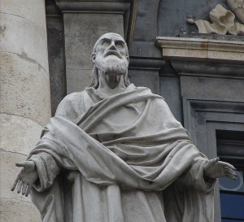
Polycarp
http://www.returntoorder.org/2016/01/courage-play-the-man/

